Slide 1
Evaluation of Loss Functions for Segmentation of Mammography Images
Christopher Collum
Ayesh Meepaganithage

Slide 2
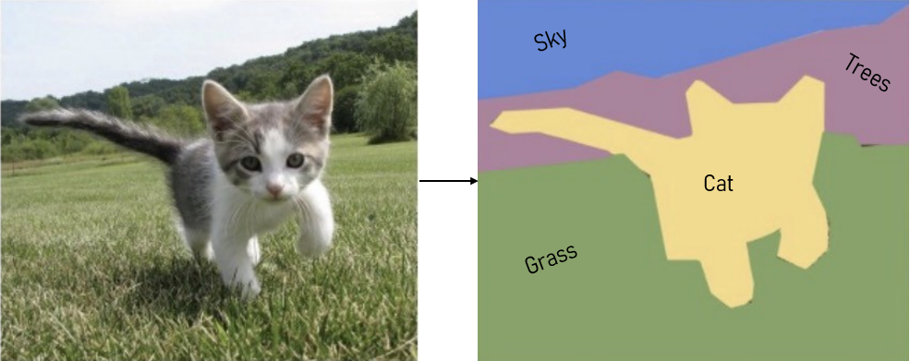
Image Segmentation
The process of partitioning an image into multiple (meaningful) regions.
Mass segmentation segments mammographies image to masses and background.

Slide 3
Introduction
The performance of mass segmentation have improved substantially due to the advancement of deep learning.
Loss function is one of the key components contributing to the performance of a deep learning based method.
There is a surge in loss functions targeting different challenges in mass segmentation.
There are reviews of strengths and weaknesses of different losses generally.
However, there is no comprehensive review and evaluation of loss functions on mammograms.

Slide 4
Related Work
A comprehensive review of loss functions used in medical image segmentation.
Categorized loss functions into four groups:
distribution-based loss functions
region-based loss functions
boundary-based loss functions
compounded loss functions
Discuss the advantages and disadvantages of each loss functions and provides recommendations on how to select the suitable loss function.
Highlighted relationships among existing loss functions.
Suggests that compound loss functions are better suited for medical image segmentation tasks.
J. Ma, Segmentation loss odyssey. [Online]. Available: http: //arxiv.org/abs/2005.13449- 2020.
Notes:
Liver, Liver Tumor, Pancreas, and Multi-organ

Slide 5
Related Work
Jadon has explored various loss functions used in semantic segmentation
Categorized loss functions into four groups:
distribution-based loss functions
region-based loss functions
boundary-based loss functions
compounded loss functions
Discusses the advantages, disadvantages, and use of each loss function
Suggests that it’s impossible to have a universal loss function, and the best loss function mostly depends on the dataset.
S. Jadon. A survey of loss functions for semantic segmentation. [Online]. Available: https://arxiv.org/abs/2006.14822v4-2020.

Slide 6
Proposed Method
Categorize loss functions based challenges they target and compare the performances.
Review and compare more that 25 loss functions on mammogram segmentation.
Evaluate loss functions on mammography datasets including:
INbreast
CBIS-DDSM
Mini-MIAS
Official implementations of losses will be used.
Will implement losses without implementations.
Might need adaptations for some losses like boundary loss.
Analyze the performance of different losses on mammogram datasets.
Evaluate the loss functions on different architectures for each dataset.

Slide 7
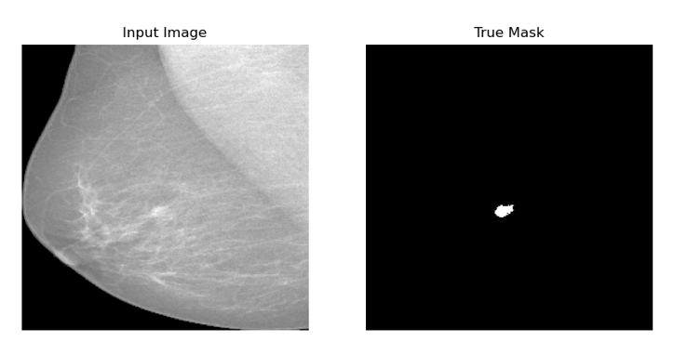
Challenges :Class Imbalance
In mass segmentation tasks, the number of pixels belonging to the foreground class (e.g., mass) is often much smaller than the number of pixels belonging to the background class.
This class imbalance can make it difficult for the model to learn to distinguish between foreground and background pixels.
.Masses may take less than one percent of the image.

Slide 8
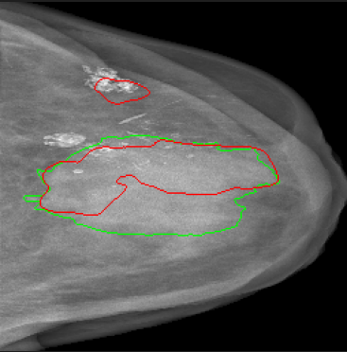
Challenges :False Positive and Negative
The amount of false positive and false negative is another challenge that loss functions could be useful in eliminating them.
Specifically when the results will be used for treatments.
False positive and false negative are important factors.

Slide 9
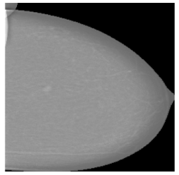
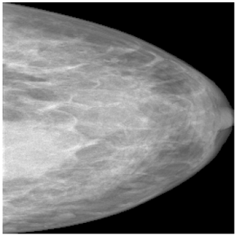
Challenges :Breast Density Categories
Based on ACR breast density could be categorised into four groups from fatty to dense based on the presence of glandular and fibrous tissues.
The higher density classes are more challenging to segment.
Samples with low and high density categories.

Slide 10
Dice Loss
Designed to address class imbalance in image segmentation tasks.
Penalizes the model more heavily for misclassifying foreground pixels than background pixels.
It has been shown to be effective in a variety of image segmentation tasks.
It can be more sensitive to noise and outliers than cross-entropy loss.
It can be more difficult to tune the hyperparameters of Dice loss than cross-entropy loss.
Y represents the ground truth or true positive region (the target).
Y` represents the predicted positive region (the model's output).

Slide 11
Focal Loss
A variation of Binary Cross-Entropy.
It down-weights the contribution of easy examples and enables the model to focus more on learning hard examples.
Works well for highly imbalanced class scenarios.
p_{t} is the predicted probability that the example is positive
γ is a hyperparameter that controls the focus on hard examples
If γ is equal to 0, then focal loss is equivalent to cross-entropy loss.
if γ is greater than 0, then focal loss will down-weight the loss for easy examples.

Slide 12
Tversky Loss
Based on the Tversky index, which is a generalization of the Jaccard index and Dice coefficient.
Measures the similarity between two sets, considering both false positives (FP) and false negatives (FN).
Y represents the ground truth or true positive region (the target).
Y` represents the predicted positive region (the model's output).
α is the weight associated with false positives.
β is the weight associated with false negatives.

Slide 13
Timeline
November 8: Review the loss functions for the segmentation task and implement them according to the papers (if the implementation is not publicly available).
November 16: Reprocess the datasets for segmentation of mammography images, including INbreast, CBIS-DDSM, and mini-MIAS.
November 24: Training and testing the losses using commonly used architecture, including U-Net and more (we will select them based on the review of the literature in the future).
December 2: Design the synthesis dataset for different challenges in the datasets.
December 10: Designing and performing the tests of the losses on the synthetic datasets.
December 20: Analyzing the findings and completing the report of the project.

Slide 14
Thank You!

