Slide 1
PROJECT PROPOSAL:
Patch-Based CNN Classification in Mammograms
Brian Székely and Gaurav Srikar

Slide 2
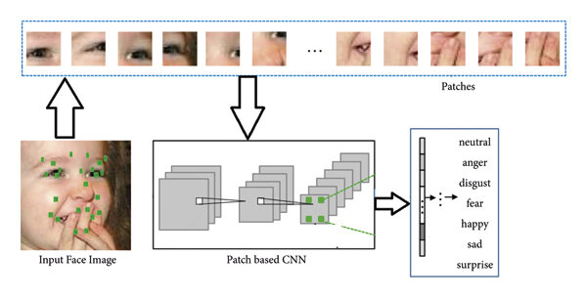
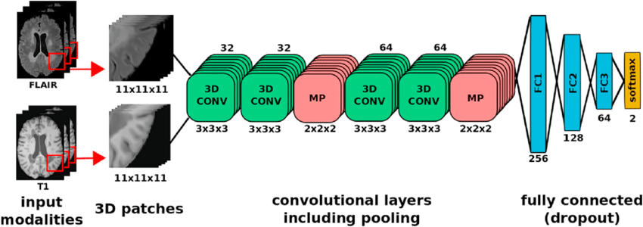
Overview
Project Focus: Employ Patch-based CNNs for high-resolution mammography image classification.
Goal: Develop a Patch-based CNN that learns locally and transfers local weights globally for accurate mass classification.
Hypothesis: Enhance mammogram mass classification accuracy using Patch-based learning and bagging methods.
Objective: Preserve essential details like small malignant masses and calcifications for improved high-resolution image classification.

Slide 3
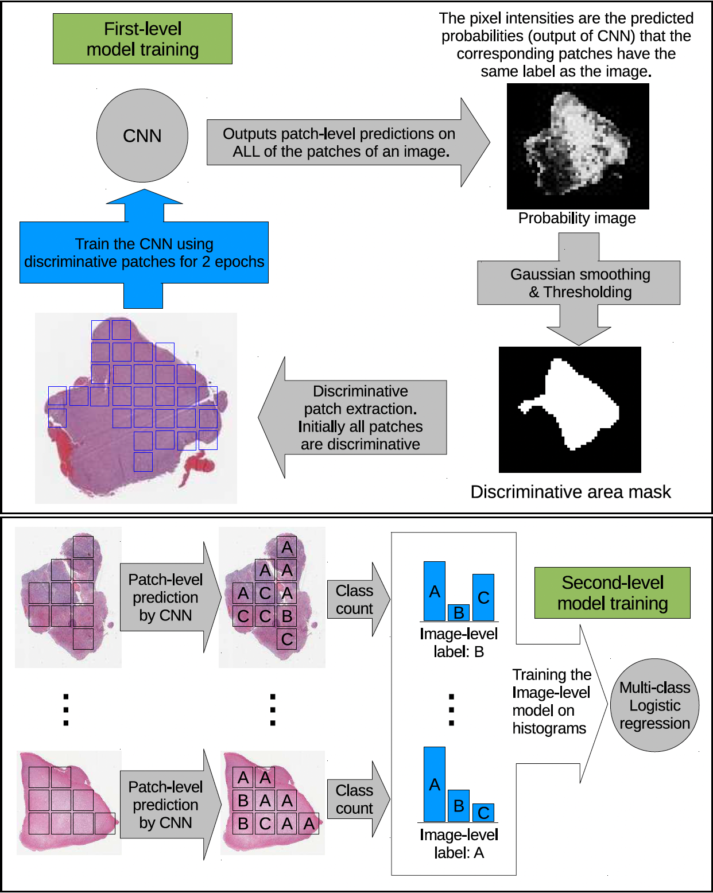
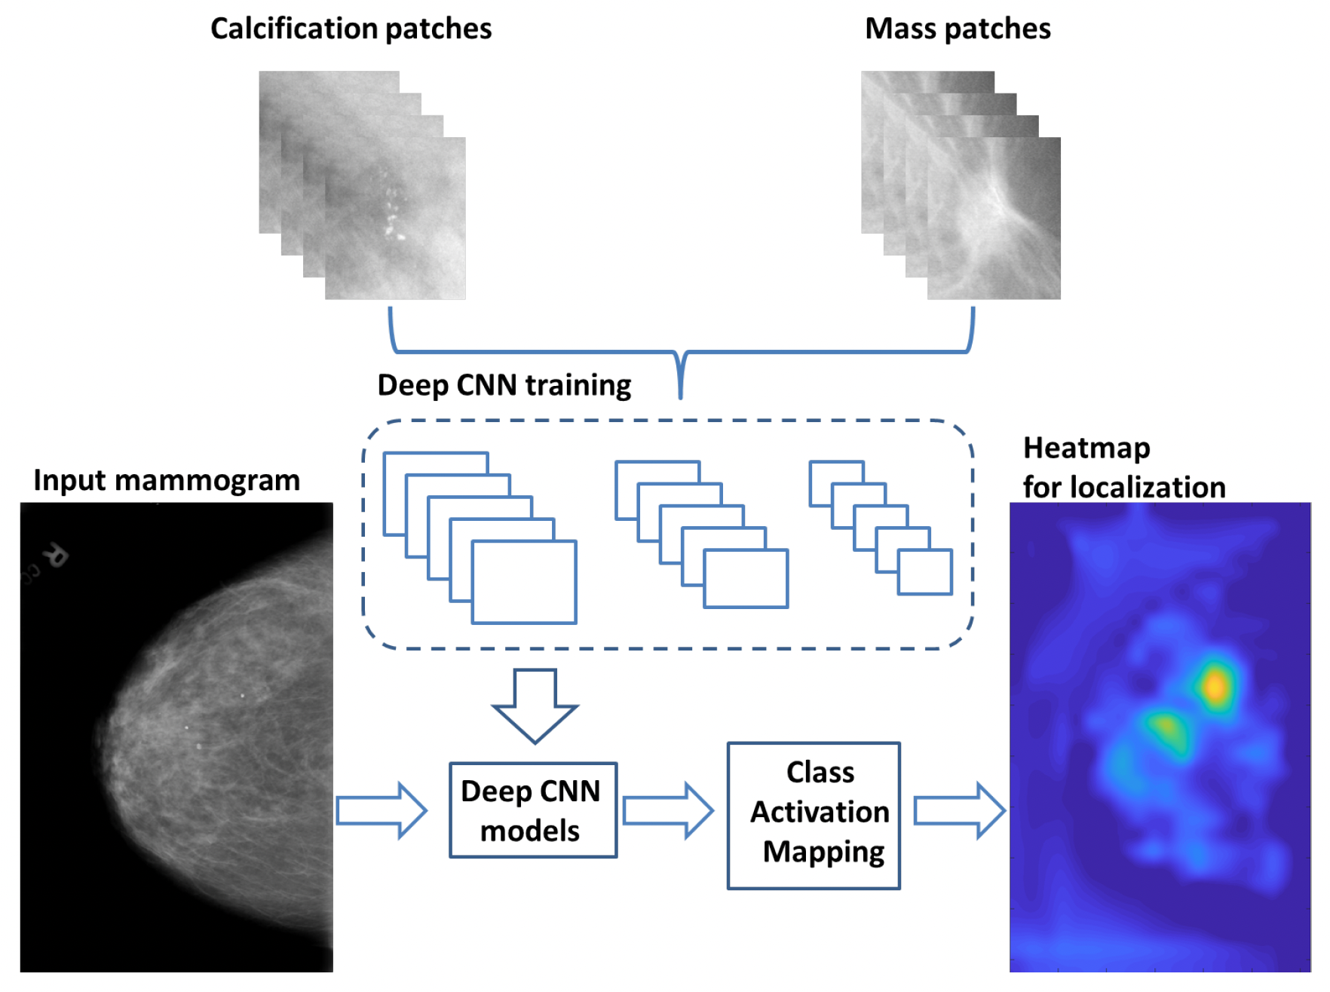
Brief Review
Hou et. al.
Xi et. al. 2018

Slide 4
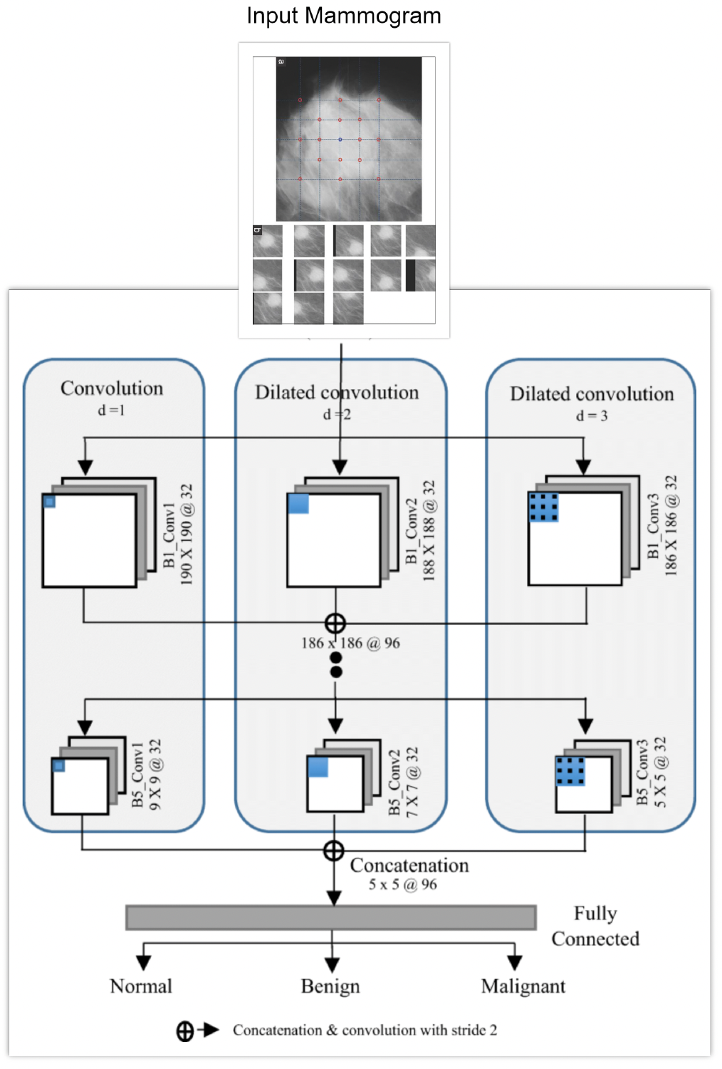
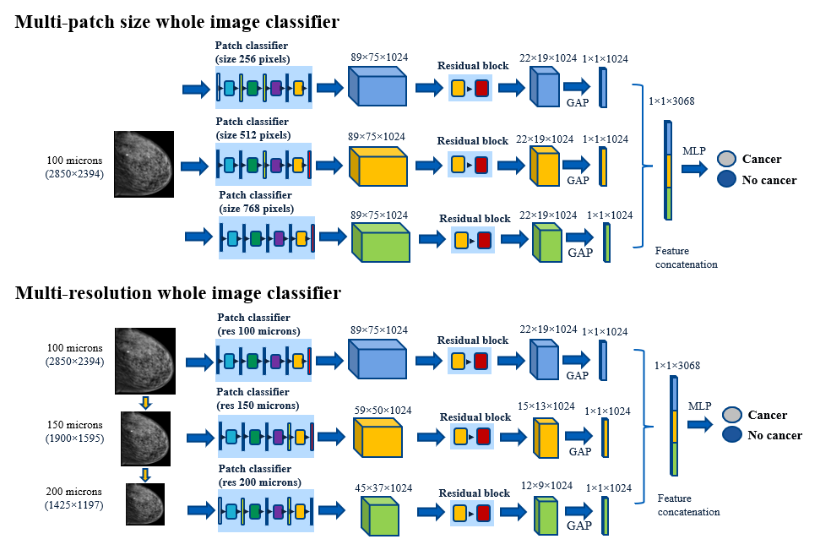
Brief Review
Kaur et. al.
Quintana et. al.

Slide 5
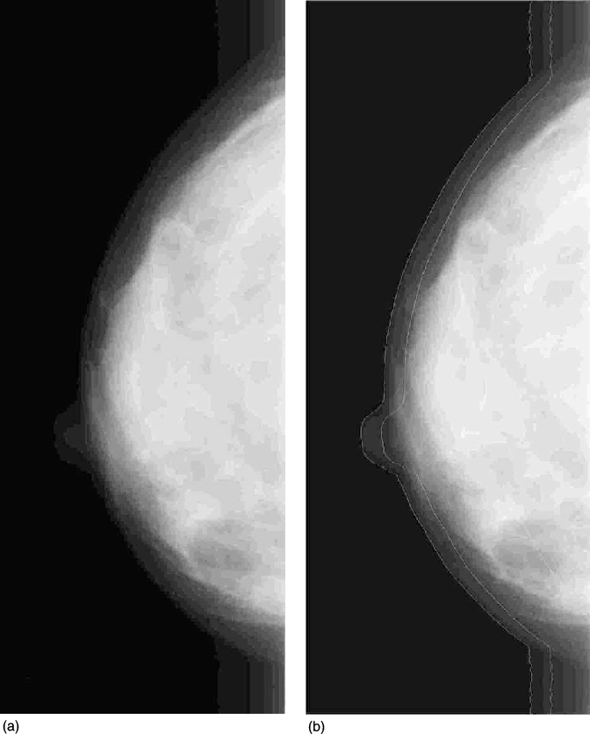
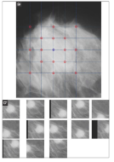
Experimental Design
Datasets
Training and Validation
OPTIMAM Mammography Image Database (OMI-DB)
VNDR-Mammo Dataset
Test
INbreast dataset
Patch-based CNN
VGGNet and ResNet (Xi et al., 2018
Adaptive patch size
Need to know the patch size a-priori
Contrast Limited Adaptive Histogram Equalization
Patch-based methods
Notes:
Contrast Limited Adaptive Histogram Equalization (CLAHE; Kaur et al., 2022). This technique will help eliminate artifacts and reduce background noise in the images.

Slide 6
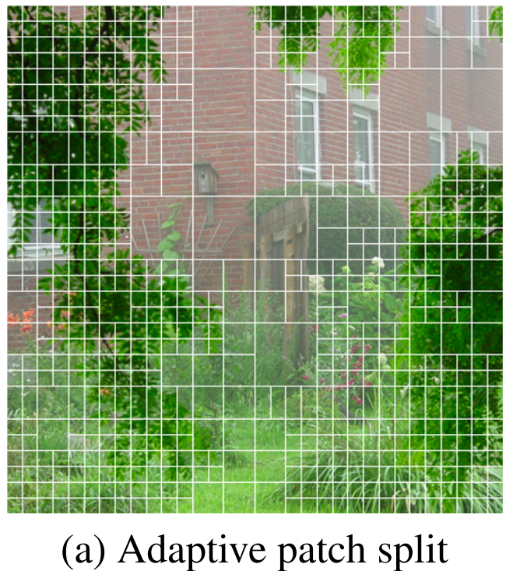
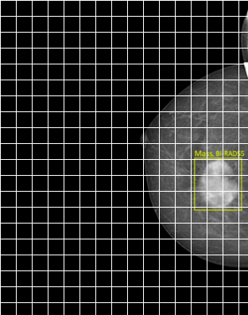
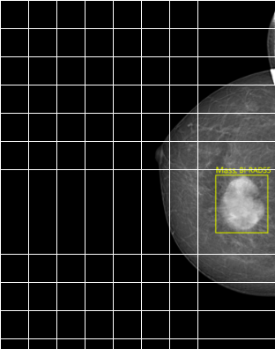
Adaptive Patch Size
Static Patch Size
Custom Adaptive Patch Size
Kim et al., 2018
Notes:
This means that we will dynamically determine the patch size based on the size of the mass being examined.
Smaller masses will require smaller patches, while larger masses can be divided into larger patches.
To achieve this, we will select images from the datasets mentioned earlier that include annotated mass sizes

Slide 7
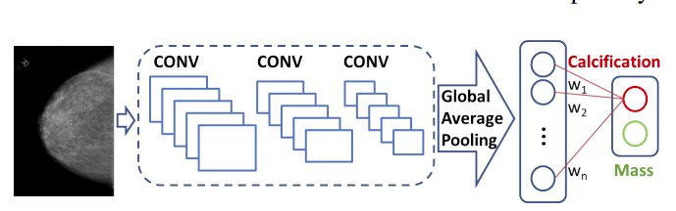
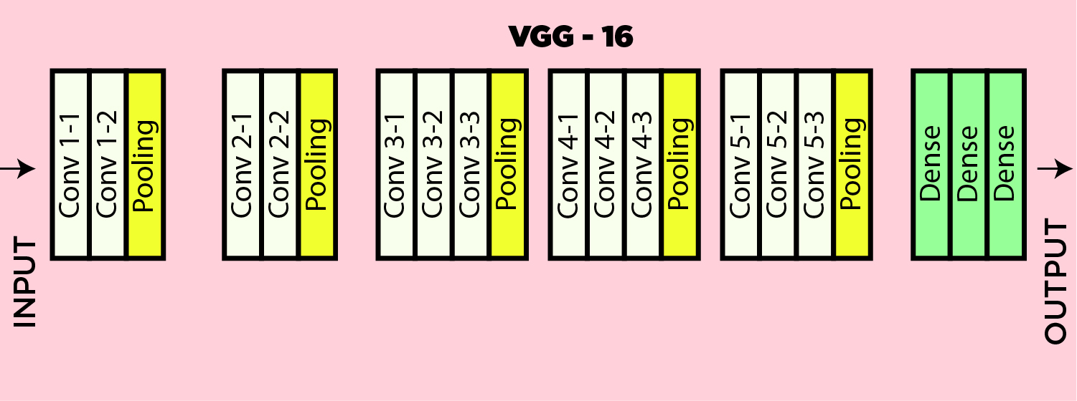
Models
General Architecture
Xi et. al. 2018
Notes:
Two best models ( 90% acc) from Xi et al., 2018
Global Max or Average Pooling, followed by fully connected layer, with a soft max layer
Use standard metrics like accuracy, specificity and sensitivity

Slide 8
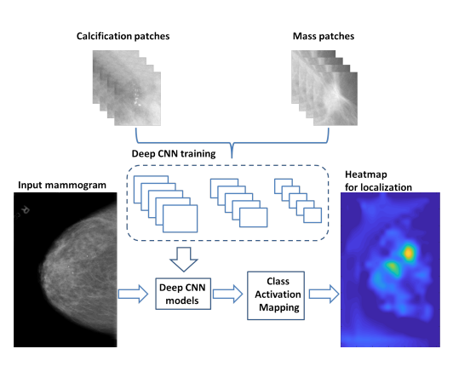
Exploratory Analysis
Class Activation Mapping (CAM) to locate malignant and benign masses in medical images.
Patch-based CNN -> global average pooling, fully con. layer -> CAM for each class.
CAM generates heat maps highlighting ROI for each class.
Aims to identify common patterns and locations for malignant and benign masses in medical images.
Abnormality detection (Xi et al., 2018)
Available code: https://github.com/jacobgil/pytorch-grad-cam.git.
(Selvaraju et al., 2019)
Notes:
1. We will train a Patch-based CNN, such as VGGNet or ResNet.
2. After the convolutional layers, we will introduce a global average pooling layer. This layer computes the spatial average of the feature maps.
3. Following the global average pooling layer, we will add a fully connected layer with a softmax activation function. This step helps us obtain class probabilities.
4. To generate CAM for each class (malignant, benign, or normal), we will focus on the weights of the fully connected layer corresponding to the class of interest.

Slide 9
Projected Timeline
Extract all images that have annotations: 10/17/23 - 10/25/23
Create VGGNet and ResNet models with the average and max pooling layers for local to global prediction: 10/25/23 - 11/1/23
CAM exploratory analysis: 11/2/23 - 11/5/23
Train models: 11/5/23 - 11/6/23
Collate preliminary results: 11/7/23 - 11/8/23
Adjustments to analysis: 11/9/23 - 11/15/23
Retrain: 11/15/23 - 11/16/23
Finalize results: 11/17/23 - 11/30/23
Write report: 12/1/23 - 12/17/23

Slide 10
References
Hou, L., Samaras, D., Kurc, T. M., Gao, Y., Davis, J. E., & Saltz, J. H. (2016). Patch-based Convolutional Neural Network for Whole Slide Tissue Image Classification. Proceedings / CVPR, IEEE Computer Society Conference on Computer Vision and Pattern Recognition. IEEE Computer Society Conference on Computer Vision and Pattern Recognition, 2016, 2424–2433.
Kaur, G., Joseph, A. J., & Pournami. (2022, March 10). Patch-based All convolutional neural network model for classification of benign and malignant mammograms. 2022 IEEE International Conference on Signal Processing, Informatics, Communication and Energy Systems (SPICES). 2022 IEEE International Conference on Signal Processing, Informatics, Communication and Energy Systems (SPICES), THIRUVANANTHAPURAM, India. https://doi.org/10.1109/spices52834.2022.9774096
Quintana, G. I., Li, Z., Vancamberg, L., Mougeot, M., Desolneux, A., & Muller, S. (2023). Exploiting Patch Sizes and Resolutions for Multi-Scale Deep Learning in Mammogram Image Classification. Bioengineering (Basel, Switzerland), 10(5). https://doi.org/10.3390/bioengineering10050534
Xi, P., Shu, C., & Goubran, R. (2018). Abnormality Detection in Mammography using Deep Convolutional Neural Networks. In arXiv [cs.CV]. arXiv. http://arxiv.org/abs/1803.01906

Slide 11
Thank You for Your Attention
Questions?

