Slide 1
Activation Maps for Breast Cancer Classification in Mammogram Images
Aminul Huq and Mst. Tasnim Pervin

Slide 2
Problem Statement
Focus on improving the low performance of breast cancer classification problem.
Incorporate Class Activation Maps (CAM) into the deep neural network model during training of the model and prepare a custom loss function.
Develop a deep learning model with CAM to not only classify but also identify and highlight specific areas of concern or anomalies that contribute to the classification result.

Slide 3
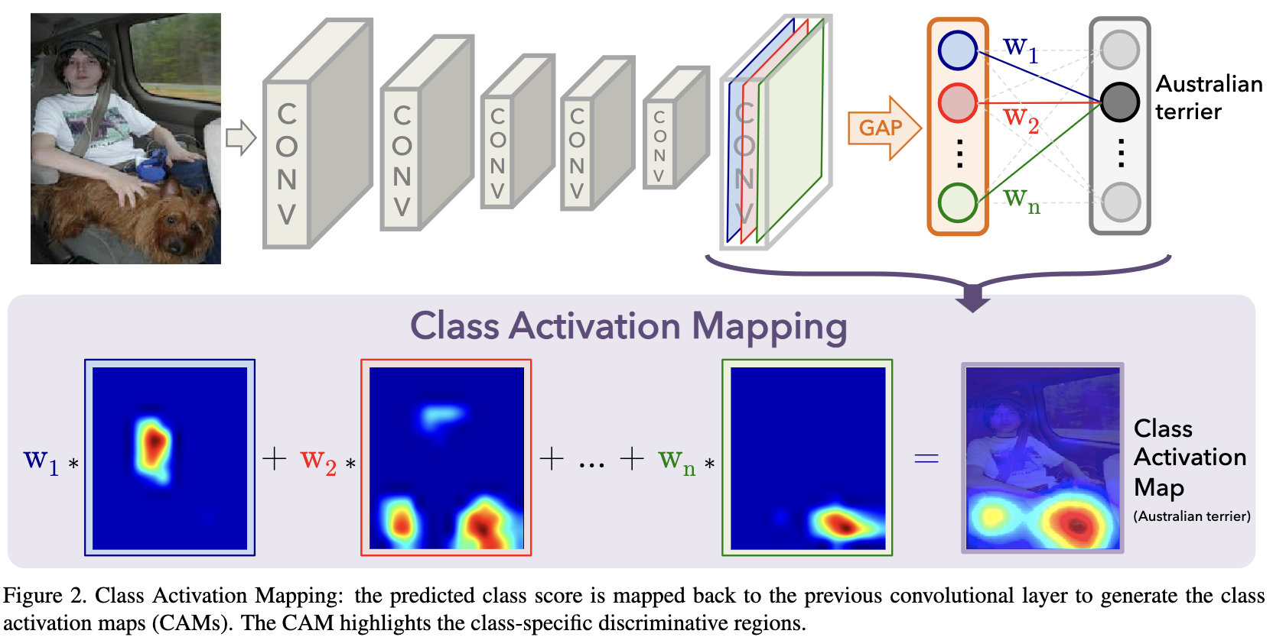
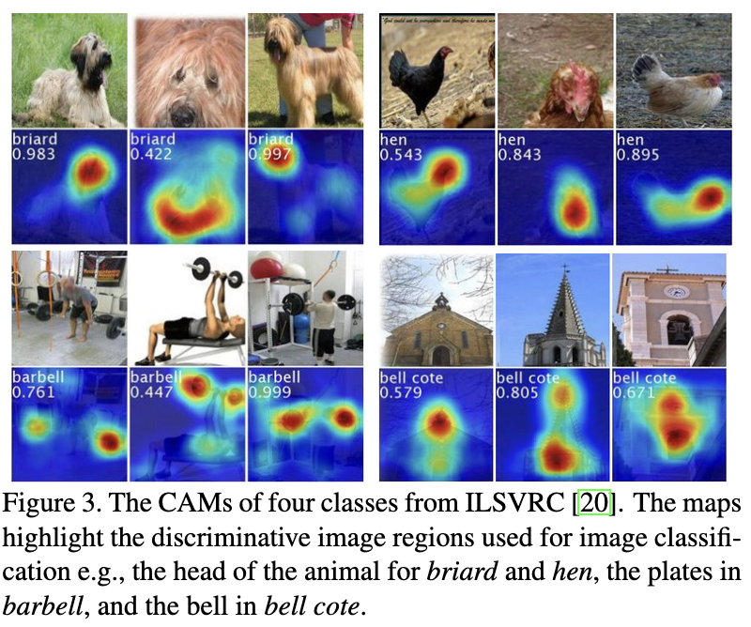
Related Works (CAM)
B. Zhou, A. Khosla, A. Lapedriza, A. Oliva, and A. Torralba, “Learning deep features for discriminative localization,” in Proceedings of the IEEE conference on computer vision and pattern recognition, pp. 2921–2929, 2016.

Slide 4
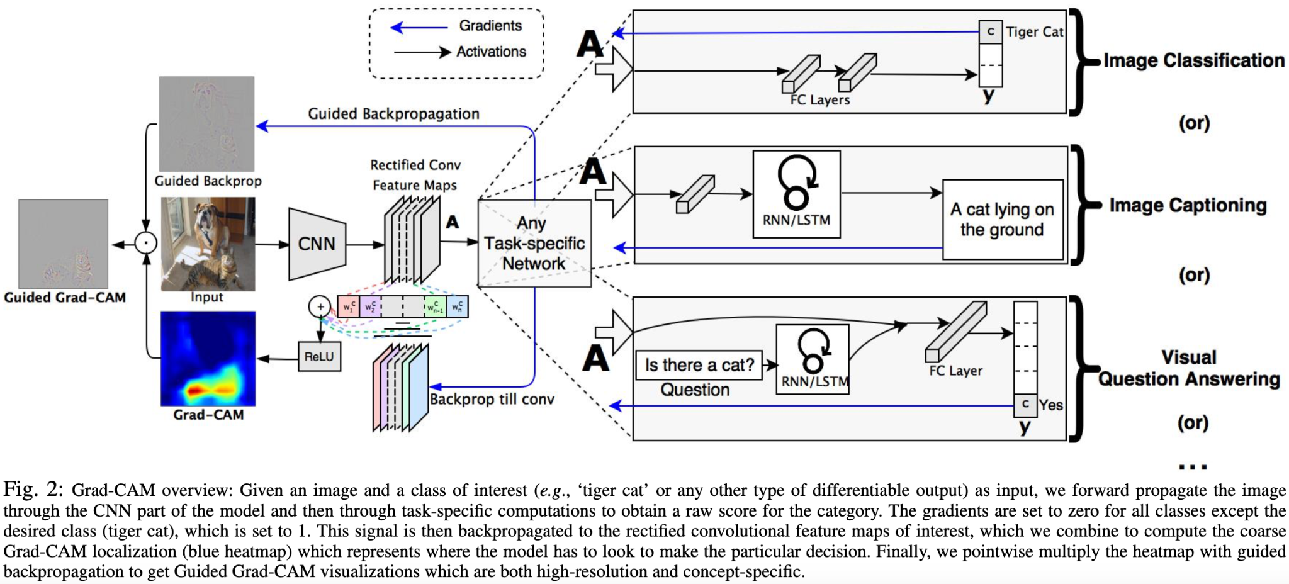
Related Works(GRAD-CAM)
R. R. Selvaraju, M. Cogswell, A. Das, R. Vedantam, D. Parikh, and D. Batra, “Grad-cam: Visual explanations from deep networks via gradient-based localization,” in Proceedings of the IEEE international conference on computer vision, pp. 618–626, 2017.

Slide 5
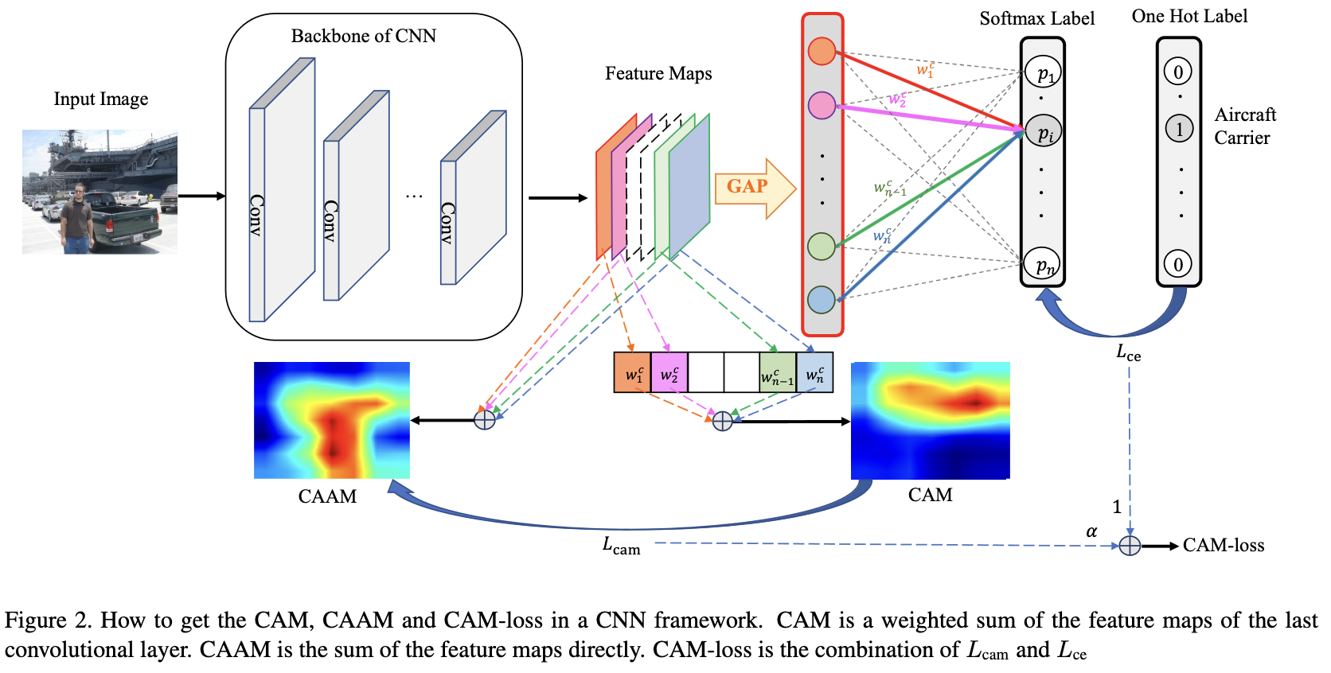
Related Works ( CAM Loss)
C. Wang, J. Xiao, Y. Han, Q. Yang, S. Song, and G. Huang, “Towards learning spatially dis- criminative feature representations,” in Proceedings of the IEEE/CVF International Conference on Computer Vision, pp. 1326–1335, 2021.

Slide 6
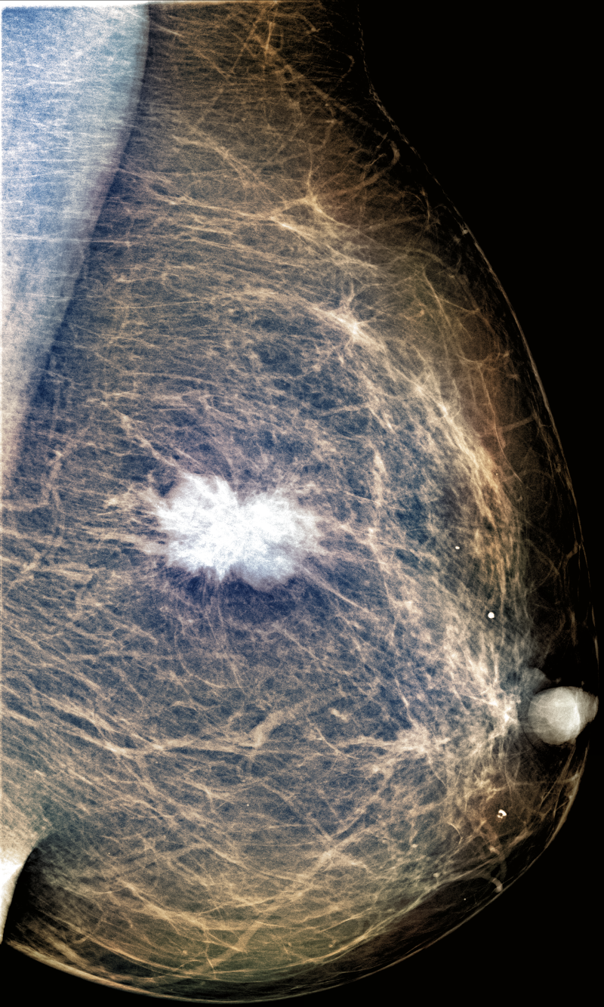
Proposed Methodology
Original Label
Classification Loss
….
Prediction
Activation maps
Ground Truth
Custom Loss
Activation Map Loss

Slide 7
Dataset
CBIS-DDSM: 2907 (MLO & CC), resolution- 3000x4800
INBreast: 410 (MLO & CC), resolution- 3328x4048
Augmentation by data generation:
Contrast Limited Adaptive Histogram Equalization
4 rotations (0º,90º,180º,270º)
Baccouche, Asma, et al. "Breast Lesions Detection and Classification via YOLO-Based Fusion Models." Computers, Materials & Continua 69.1 (2021).
Cao, Haichao, et al. "Breast mass detection in digital mammography based on anchor-free architecture." Computer Methods and Programs in Biomedicine 205 (2021): 106033.

Slide 8
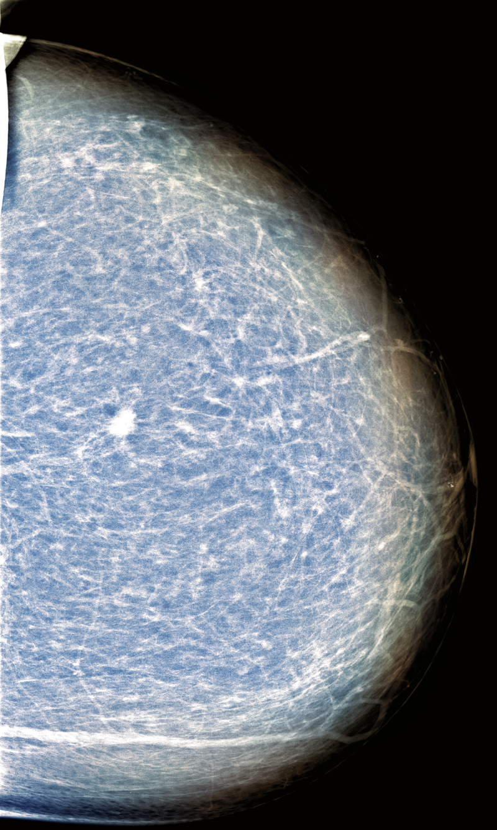
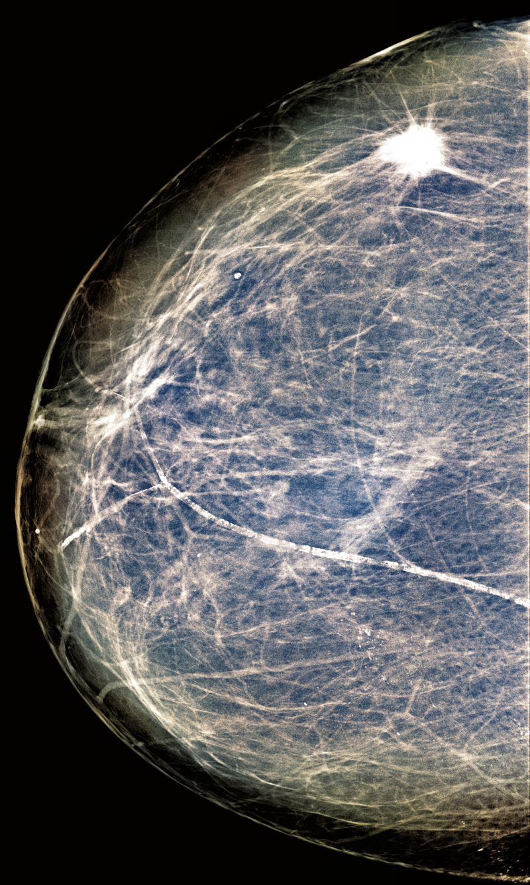
Preprocessing
Image cropping
Truncation normalization
Image enhancement

Slide 9
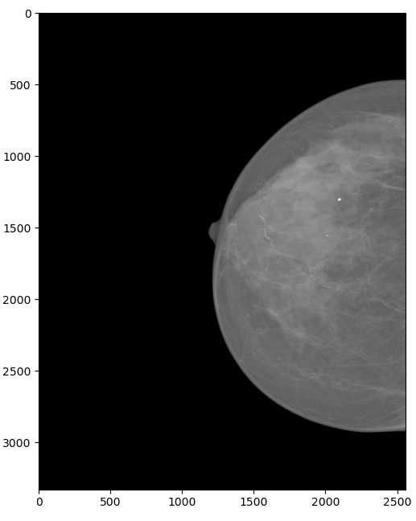
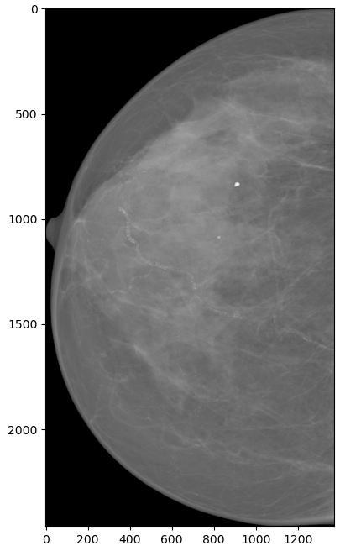
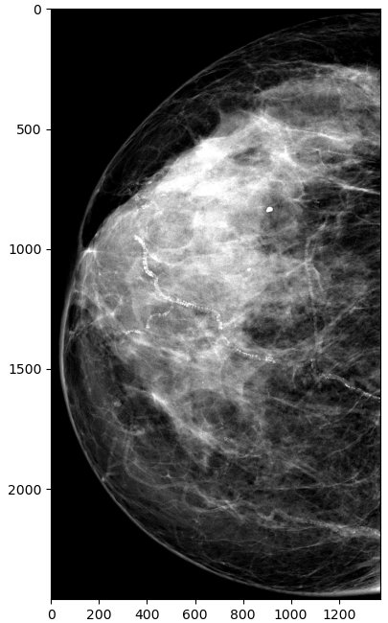
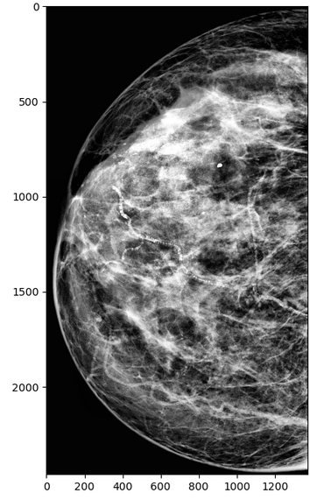
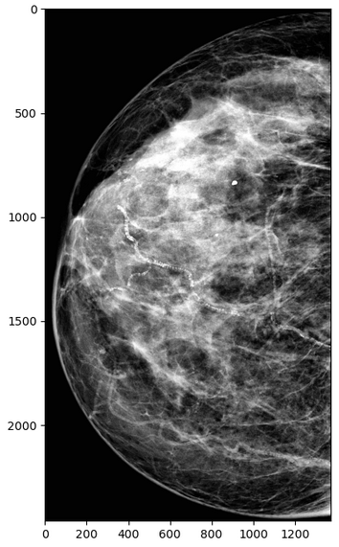
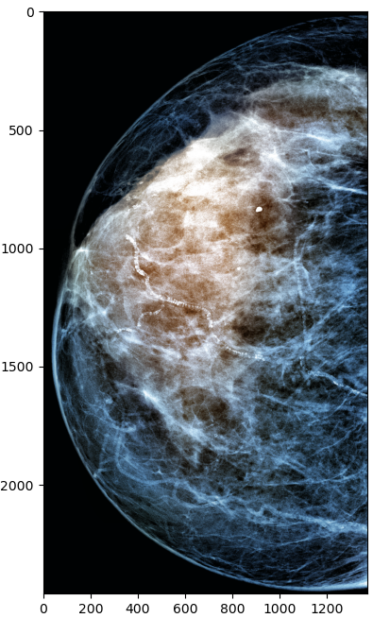
Preprocessing
Image Cropping
Truncation Normalization
Enhancement
Cao, Haichao, et al. "Breast mass detection in digital mammography based on anchor-free architecture." Computer Methods and Programs in Biomedicine 205 (2021): 106033.

Slide 10
Custom Loss Function
Classification Loss | Activation Map Loss | Activation Maps
Cross Entropy | Dice Loss | CAM
Focal Loss+ Label Smoothing | Dice Loss | CAM
Cross Entropy | IoU Loss | CAM
Focal Loss+ Label Smoothing | IoU Loss | CAM
Cross Entropy | Dice Loss | Grad-CAM
Focal Loss + Label Smoothing | Dice Loss | Grad-CAM
Cross Entropy | IoU Loss | Grad-CAM
Focal Loss + Label Smoothing | IoU Loss | Grad-CAM

Slide 11
Experiments
Explore different custom loss functions
Use ResNet-152 and DenseNet-161 for comparison
Train on CBIS-DDSM and test on INBreast and vice versa.

Slide 12
Evaluation Metrics
Accuracy
Precision
Recall
F1 Score
AUC-ROC (TPR vs FPR)

Slide 13
Timeline
Milestones | Time Frame
Dataset preprocessing | 2nd November, 2023
Base model training | 8th November, 2023
Activation map integration and model training | 20th November, 2023
Experimentations | 10th December, 2023
Project Presentation | 20th December, 2023
Report submission | 22nd December, 2023

Slide 14
Thank you
Any Questions !

