Slide 1
Project Proposal
Synthesis of CC view (from MLO view) mammogram using CR-GAN followed by multi-view breast cancer classification using Parameterized hypercomplex neural network.
By
Neha Ujjainkar & Abhishek Khandekar

Slide 2
Outline
Problem Statement
Introduction
Literature Review
Data set
Significance
Experiment Design
Timeline and Milestones
References

Slide 3
Problem Statement
.
Synthesis of CC view (from MLO view) mammogram using CR-GAN followed by multi-view breast cancer classification using Parameterized hypercomplex neural network.

Slide 4
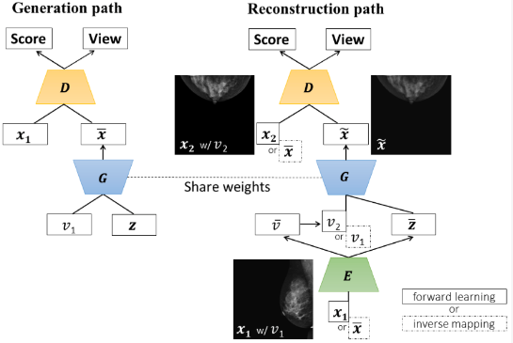
Introduction
.
CR-GAN to generate CC-view mammograms from MLO view data.
CR-GAN uses a two-pathway framework to achieve the complete representation.
Next, classify multi-view breast cancer on the MLO, CC view pair using the Parameterized hypercomplex neural network (PHNN).

Slide 5
Literature review
.
CR-GAN: Learning Complete Representations for Multi-view Generation” by Yu Tian et al.
Two-View Mammogram Synthesis from Single-View Data Using Generative Adversarial Networks by Asumi Yamazaki et al.
Hypercomplex Neural Architectures for Multi-View Breast Cancer Classification by Lopez et al.
High-Resolution Breast Cancer Screening with Multi-View Deep Convolutional Neural Networks by Geras et al.

Slide 6
Dataset
.
1054 pairs from CBIS-DDSM (3000 x 4500 to 4000 x 5700)
188 pairs from INBreast (3328 x 4084 or 2560 x 3328)
330 pairs from MIAS (1024x1024)

Slide 7
Significance
.
This approach may improve the accuracy of breast cancer classification by using PHResNet on both single-view mammographs (MLO views) and the generated CC views. (from MLO views)
CR-GAN will help enable coverage of the whole latent space and learning of complete representations, which was impossible in single pathway GAN.
Higher resolution and superior quality mammogram syntheses will be achieved by using the Progressive growing technique and Feature matching loss.
Parameterized hypercomplex ResNet will leverage information contained in multiple views through parameterized hypercomplex convolutional (PHC) layers in order to obtain a more performant and robust classifier for breast cancer.
Instead of handling the mammographic views independently, which results in losing significant correlations, this model processes them as a unique component, without breaking the original nature of the exam.
PHC-based models possess half the number of free parameters.

Slide 8
Experiment Design
.
  Tech/Tools/Systems
  Pre-processing
  Method
  Training
  Evaluation

Slide 9
  Tech/Tools/Systems
  The coding will be done in Python (Pytorch & Open CV)
  Plan to use Google Colab for Python coding.
  We will choose the hyperparameters and batch size at the time of training

Slide 10
Pre-processing
.
  Data augmentation to the images from CBIS-DDSM and INBreast.
  Zooming (in or out)
  High-frequency enhancements
  Contrast and brightness adjustments
  Image rotations, and image shifts.

Slide 11
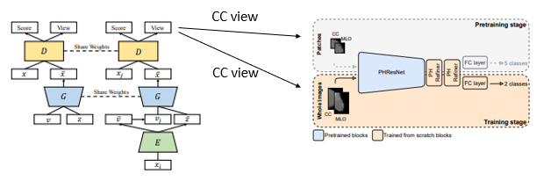
Method
.
  Task 1: CC view generation from the MLO view by using the CR-GAN network.
  Task 2: To employ parameterized hypercomplex ResNets (PHResNets) for multi-view breast cancer classification

Slide 12
Training
  Task 1:
  80% of pairs will be used for training
  20% of pairs will be used for testing.
  Task 2:
  Pre-train the model on patches of mammograms
  Use the pre-trained weights to initialize the network for training on whole images.
  80% of pairs will be used for training
  20% of pairs will be used for testing.

Slide 13
Evaluation
.
  Task 1:
  Peak signal-to-noise ratio (PSNR)
  Structural similarity (SSIM)
  Multi-scale SSIM (MS-SSIM)
  Cosine similarity (Cos_sim)
  Task 2:
  AUC (Area Under the ROC Curve)
  Classification accuracy.

Slide 14
Timeline and Milestones
.
Task 1: Generation of CC views (from MLO views)
Task 2: Multi-view breast cancer classification using Parameterized hypercomplex neural network.
Sr. No. | Milestone | Duration | Completion Date
1 | Defining the problem statement. | 1 week | 10/08/2023
2 | Submit the Project Proposal. | 1 week | 10/16/2023
2 | Data exploration and data analysis for task 1. | 1 week | 10/22/2023
3 | Data augmentation for task 1. | 1 week | 10/29/2023
4 | Splitting the data and training the model for task 1. | 1 week | 11/05/2023
5 | Evaluate the performance of the model for task 1 | 1 week | 11/12/2023
6 | Data Exploration and data analysis for task 2 | 1 week | 11/19/2023
7 | Splitting the data and pretraining the network on patches for task 2 | 1 week | 11/26/2023
8 | Splitting the data and training the model on the whole image for task 2. | 1 week | 12/03/2023
9 | Evaluate the performance of the model for task 2. | 1 week | 12/10/2023
10 | Final testing. | 1 week | 12/17/2023
11 | Project Presentation | 1 week | 12/20/2023
12 | Submit Final Project Report. | 1 week | 12/23/2023

Slide 15
References
1. Yamazaki, A., & Ishida, T. (2022). Two-View Mammogram Synthesis from Single-View Data Using Generative Adversarial Networks. Applied Sciences, 12(23), 12206. https://www.mdpi.com/2076-3417/12/23/12206
2. Tian, Y., Peng, X., Zhao, L., Zhang, S., & Metaxas, D. N. (2018). CR-GAN: learning complete representations for multi-view generation. arXiv preprint arXiv:1806.11191. https://arxiv.org/abs/1806.11191
3. Geras, K. J., Wolfson, S., Shen, Y., Wu, N., Kim, S., Kim, E., ... & Cho, K. (2017). High-resolution breast cancer screening with multi-view deep convolutional neural networks. arXiv preprint arXiv:1703.07047. https://arxiv.org/abs/1703.07047
4. Lopez, E., Grassucci, E., Valleriani, M., & Comminiello, D. (2022). Multi-View Breast Cancer Classification via Hypercomplex Neural Networks. arXiv e-prints, arXiv-2204. https://arxiv.org/pdf/2204.05798.pdf
5.Liu, Y., Zhang, F., Chen, C., Wang, S., Wang, Y., & Yu, Y. (2021). Act like a radiologist: towards reliable multi-view correspondence reasoning for mammogram mass detection. IEEE Transactions on Pattern Analysis and Machine Intelligence, 44(10), 5947-5961. https://ieeexplore.ieee.org/abstract/document/9444895
6.Yang, Z., Cao, Z., Zhang, Y., Tang, Y., Lin, X., Ouyang, R., ... & Ma, J. (2021). MommiNet-v2: Mammographic multi-view mass identification networks. Medical Image Analysis, 73, 102204. https://www.sciencedirect.com/science/article/pii/S1361841521002498

Slide 16
.
Thank You

