Slide 1
Finding Tiny Masses
Kelly Chinander & Ronald Du
October 25th, 2023

Slide 2
Slides
Overview
  Project Introduction
  Finding Tiny Faces
  Adapting “Finding Tiny Faces”
Other Works
  “Ultra-high resolution, multi-scale, context-aware approach for detection of small cancers on mammography”
  “Improving Small Object Detection”
  “Swin-sftnet: spatial feature expansion and aggregation using swin transformer for whole breast micro-mass segmentation”
  “Recognizing Tiny Faces”
Experiment Design
  Project Design
  Datasets
  Experiments
  Code and Tools
Project Plan
  Milestones
    “Finding Tiny Faces”
    Setup
    Image Scaling
    ML Model
    Evaluation
    Refinement
Questions?
References

Slide 3
Overview

Slide 4
Project Introduction
Our project was inspired by the paper “Finding Tiny Faces” by Peiyun Hu and Deva Ramanan. We want to take the techniques used in the paper to find tiny faces in crowded photos and apply it to finding tiny masses in mammograms!

Slide 5
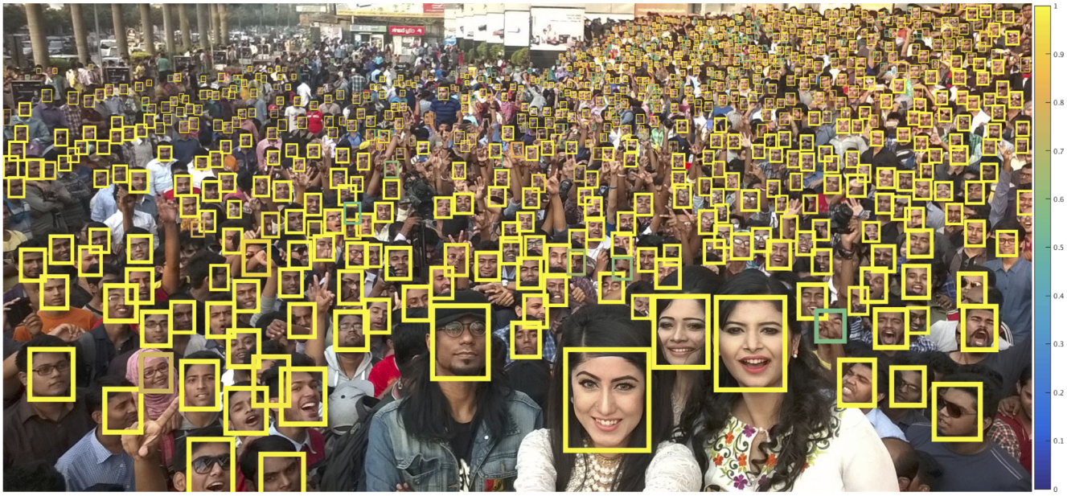
Finding Tiny Faces
Peiyun Hu, Deva Ramanan. “Finding Tiny Faces”, CVPR 2017.

Slide 6
Finding Tiny Faces
The paper “Finding Tiny Faces” by Peiyun Hu and Deva Ramanan details a few key techniques that improve their ability to detect small faces in crowded images. The main idea is creating a scale-invariant face detector accomplished by a scale-specific network to which the inputs are resized rather than trying to detect different sized faces in the input.
Additionally, they use some data augmentation and contextual reasoning techniques to improve detection accuracy, like the contextual reasoning that a small object next to a body is more likely to be a face.
Peiyun Hu, Deva Ramanan. “Finding Tiny Faces”, CVPR 2017.

Slide 7
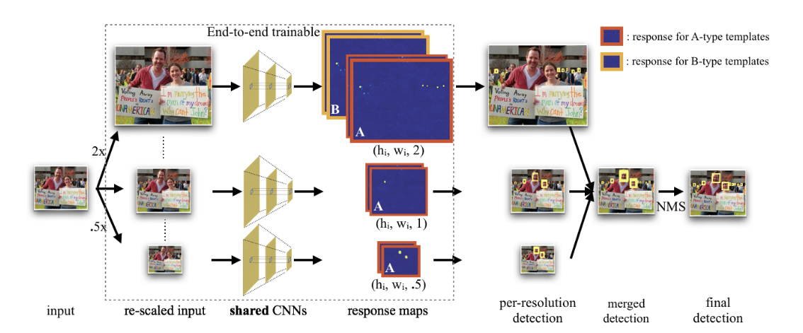
Finding Tiny Faces
Peiyun Hu, Deva Ramanan. “Finding Tiny Faces”, CVPR 2017.

Slide 8
Adapting “Finding Tiny Faces”
We propose applying the techniques described in the paper “Finding Tiny Faces” by Peiyun Hu and Deva Ramanan and applying them to models aimed at mass detection in mammogram imagery.
The goal of this project will be to improve detection of small masses that may be missed by other detection methods.
Improving small mass detection in mammogram imagery would be significant for early detection, which is key to better treatment and long term outcomes.

Slide 9
Other Works

Slide 10
Review - Ultra-high resolution, multi-scale, context-aware approach for detection of small cancers on mammography
Rangarajan, K., Gupta, A., Dasgupta, S. et al. Ultra-high resolution, multi-scale, context-aware approach for detection of small cancers on mammography. Sci Rep 12, 11622 (2022). https://doi.org/10.1038/s41598-022-15259-7
This paper notes that small mass detection of mammograms is difficult as many images for mammograms are downsampled before being fed into a model due to computational limitations.
Many details of the small masses are lost after downsampling, including spiculations and microcalcifications.
This paper explores using full size mammograms for detection of small masses, and obtains better results by doing so.
They used 32 V100 32GB GPUs,

Slide 11
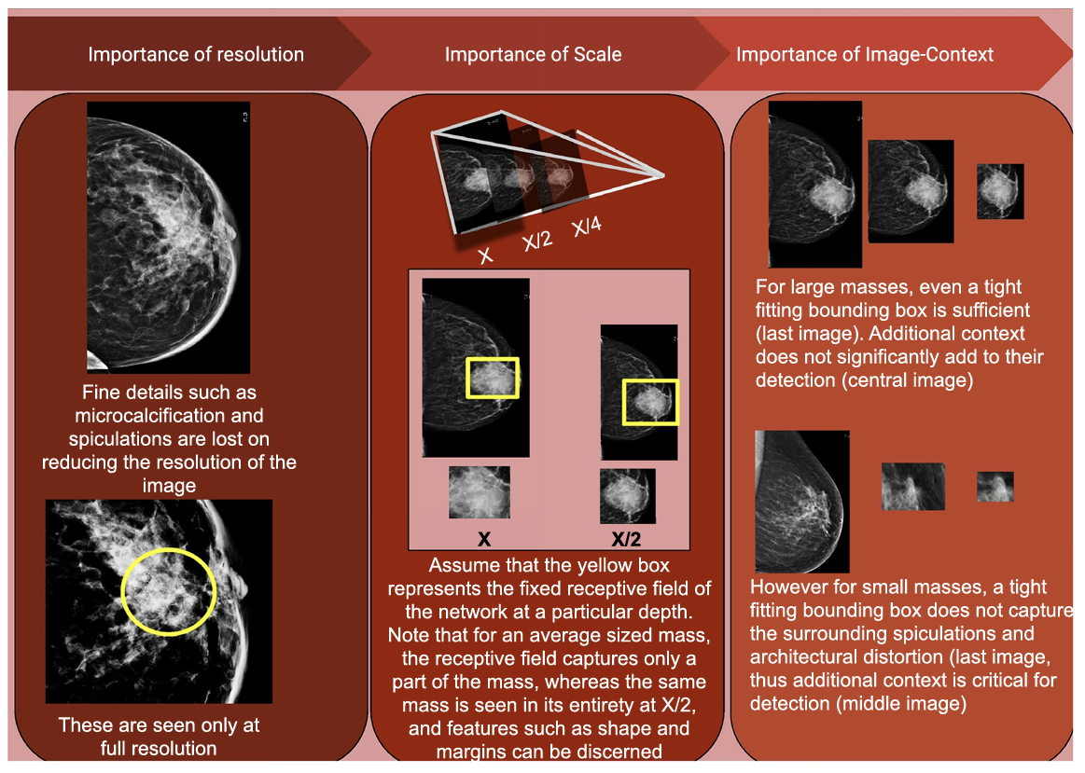
Review - Ultra-high resolution, multi-scale, context-aware approach for detection of small cancers on mammography

Slide 12
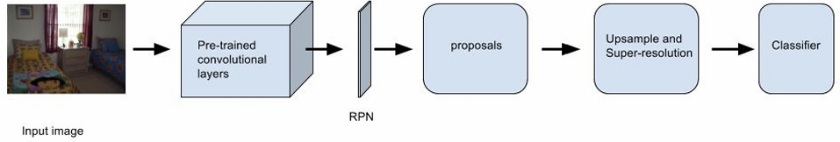
Review - Improving Small Object Detection
H. Krishna and C. V. Jawahar, "Improving Small Object Detection," 2017 4th IAPR Asian Conference on Pattern Recognition (ACPR), Nanjing, China, 2017, pp. 340-345, doi: 10.1109/ACPR.2017.149.
Object detection models work relatively well for medium and large sized objects in images but struggle with smaller objects.
Krishna et al explores adding a super resolution layer in the object detection model effectively upscaling the image.
This improves the results as the original models were trained on higher resolution images.

Slide 13
Review - Swin-sftnet: spatial feature expansion and aggregation using swin transformer for whole breast micro-mass segmentation
Kamran SA, Hossain KF, Tavakkoli A, Bebis G, Baker S (2022) Swin-sftnet: spatial feature expansion and aggregation using swin transformer for whole breast micro-mass segmentation. arXiv preprint arXiv:2211.08717
This paper explores the implementation of a novel model architecture that takes into account that small masses within mammograms have lower resolutions.
A novel architecture, SWIN-SFTNet is proposed with new features such as skip connection features to prevent any further downsampling. The last patch expanding layer also performs upsampling in order to help get more details from a lower resolution patch.
This improved the detection of small masses as this model was better refined for minimizing spatial resolution losses, which affect small mass detection more.

Slide 14
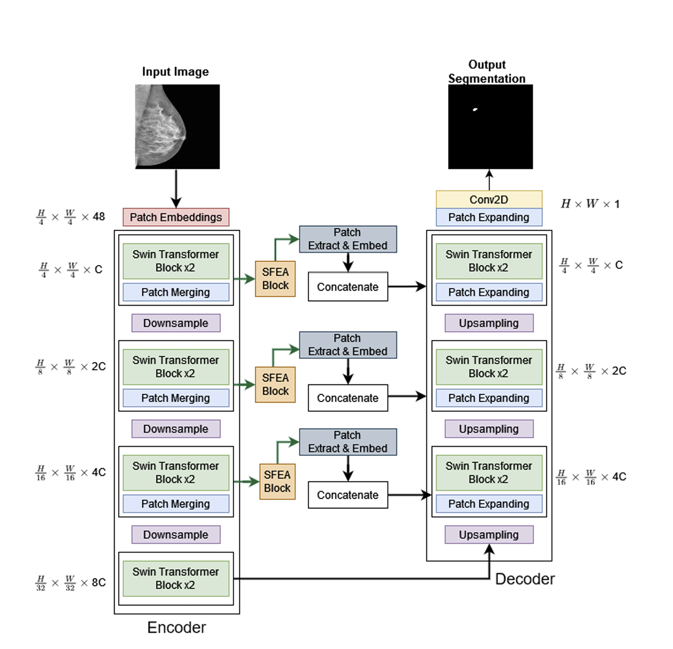
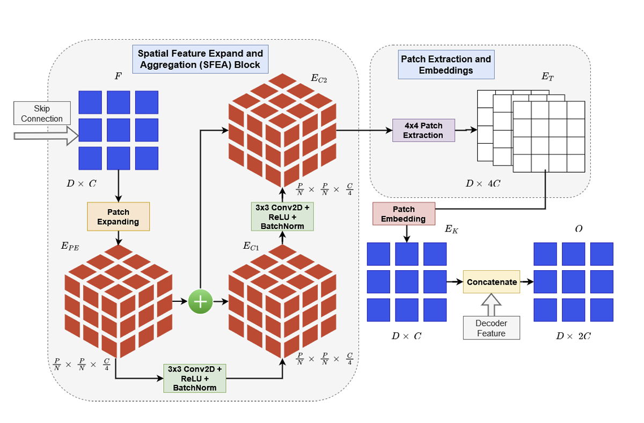
Review - Swin-sftnet: spatial feature expansion and aggregation using swin transformer for whole breast micro-mass segmentation

Slide 15
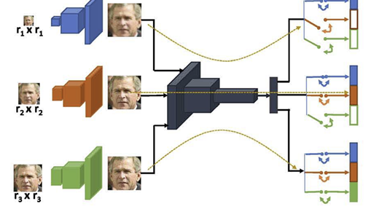
Review - Recognizing Tiny Faces
S. C. Mynepalli, P. Hu and D. Ramanan, "Recognizing Tiny Faces," 2019 IEEE/CVF International Conference on Computer Vision Workshop (ICCVW), Seoul, Korea (South), 2019, pp. 1121-1130, doi: 10.1109/ICCVW.2019.00143.
This paper notes that it is difficult for facial recognition models to detect lower resolution faces.
At higher resolutions, models can rely on features that are present at lower resolutions, but at lower resolutions these features are missing.
A novel model is proposed that turns on and off certain parts of the model depending on the resolution. Could improve small mass detection by applying a similar technique.

Slide 16
Experiment Design

Slide 17
Project Design
We envision designing our experiment to build and train a machine learning model that will process mammogram images using the same techniques described in the “Finding Tiny Faces” paper.
The general concept will be that the machine learning model will be trained on a constant image size, and larger images will be scaled down into smaller resolutions to use as input for the model. In the original paper, this meant that small faces would be more detectable because the model wouldn’t ignore them for the larger faces in the imagery. For our project, this should translate into better small mass detection when the model isn’t trained on the larger features in the imagery.

Slide 18
Datasets
We intend to start with the CBIS-DDSM dataset as our main source for bulk mammogram imagery to use with our project.
Additionally, the Breast Micro-Calcification dataset may be useful for providing small masses to detect.

Slide 19
Experiments
We will conduct experiments to compare the detection rate of masses in the imagery from our code to standard mass detection models available.
Current state of the art models include:
AUNet
ARFNet
SWIN-UNet

Slide 20



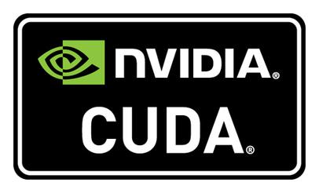
Code and Tools
For “Finding Tiny Masses”, we will use VS Code as our IDE, utilizing Python and PyTorch with CUDA support
Original project codebase, written in Matlab:
https://github.com/peiyunh/tiny
Author’s Github with other projects as well:
https://peiyunh.github.io/
Third party port of original project into Python:
https://github.com/varunagrawal/tiny-faces-pytorch

Slide 21
Project Plan

Slide 22
Milestones
“Finding Tiny Faces” phase
“Finding Tiny Masses” setup
Develop the image scaling logic
Build the machine learning model
Evaluate the effectiveness of the model
Refine the model

Slide 23
Set up and run the “Finding Tiny Faces” project code on our own machines
Download the code
Run it locally
Verify that we can reproduce their results

Slide 24
Create our “Finding Tiny Masses” repository and development environment
Set up a GitHub repository
Set up VS Code with Python
Run test code for PyTorch with CUDA

Slide 25
Develop the image scaling logic
Take in a full size mammogram
Create multiple versions of the image at different scales
Output the scaled images to be used by the model

Slide 26
Build the machine learning model
Take the basic principles of the “Finding Tiny Faces” model
Apply it to input imagery from mammograms

Slide 27
Evaluate the effectiveness of the model
Run the input data through our model
Run the input data through a sample model
Compare the mass detection between models

Slide 28
Refine the model
Possible improvements to the model -
  Experiment with input image sizes?
  Add contextual awareness like “Finding Tiny Faces”?
  Experiment with loss functions?
  Experiment with model depth / layers?

Slide 29
Questions?

Slide 30
References
S. C. Mynepalli, P. Hu and D. Ramanan, "Recognizing Tiny Faces," 2019 IEEE/CVF International Conference on Computer Vision Workshop (ICCVW), Seoul, Korea (South), 2019, pp. 1121-1130, doi: 10.1109/ICCVW.2019.00143.
Kamran SA, Hossain KF, Tavakkoli A, Bebis G, Baker S (2022) Swin-sftnet: spatial feature expansion and aggregation using swin transformer for whole breast micro-mass segmentation. arXiv preprint arXiv:2211.08717
Rangarajan, K., Gupta, A., Dasgupta, S. et al. Ultra-high resolution, multi-scale, context-aware approach for detection of small cancers on mammography. Sci Rep 12, 11622 (2022). https://doi.org/10.1038/s41598-022-15259-7
H. Krishna and C. V. Jawahar, "Improving Small Object Detection," 2017 4th IAPR Asian Conference on Pattern Recognition (ACPR), Nanjing, China, 2017, pp. 340-345, doi: 10.1109/ACPR.2017.149.
Peiyun Hu, Deva Ramanan. “Finding Tiny Faces”, CVPR 2017.

