Slide 1
General Medical Imaging Dataset for Two Stage Transfer Learning
Dan Eassa, Augustine Ofoegbu

Slide 2

Outline
Project Goals
Introduction
Prior Works
Datasets/Code
Experiments
Project Plan

Slide 3
Goals of this project
Provide a general medical imaging dataset that can be used for a variety of tasks in the medical domain.
Use this dataset to evaluate the performance of architectures using a two stage transfer learning approach.

Slide 4
Introduction
Transfer learning in medical imaging involves adapting pre-trained deep learning models for specific medical diagnostic tasks.
This approach accelerates model development, reduces the need for extensive labeled datasets, and improves the accuracy of image analysis.
Challenges include
  limited medical data,
  domain adaptation,
  model interpretability, and
  regulatory approval.

Slide 5
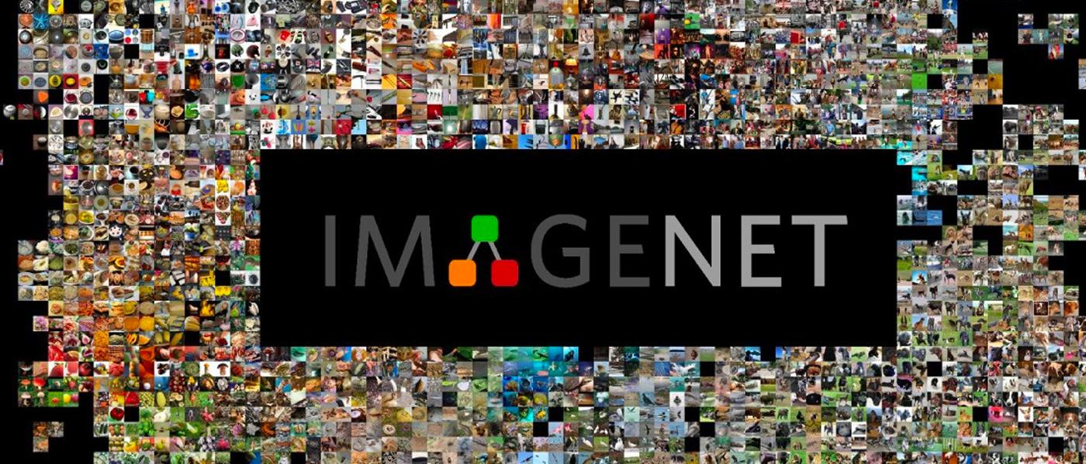
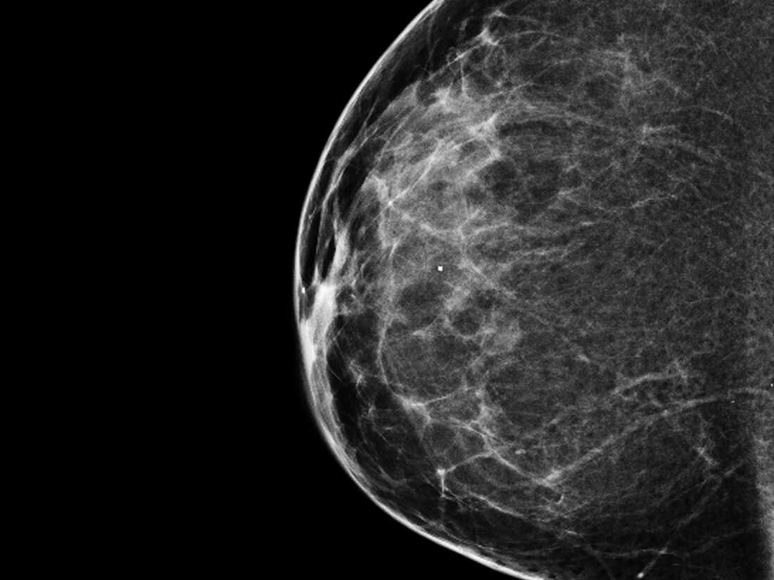
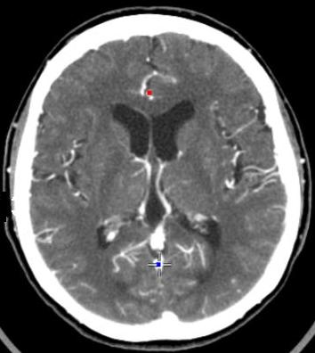
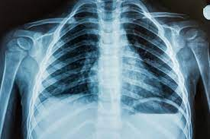
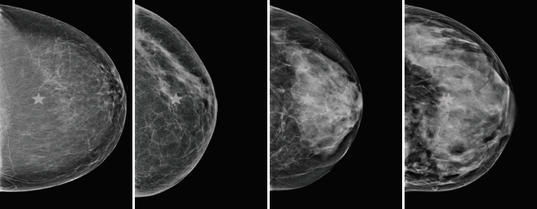
Introduction
Can domain adaptation be improved by incorporating multiple pre-training stages?
General Transfer Learning approach
Stage 1: ImageNet Pretraining
Stage 2: Mammogram Analysis
Train model on ImageNet
Unfreeze layers, train on general medical images
Unfreeze layers, train for task

Slide 6
Prior Works
Prior work has shown that pre-training can improve model performance or improve time to convergence
Similar two stage transfer learning approaches have been done
  Using a similar image domain
    Fine tune on chest images, test on mammogram images
  Using a larger dataset
    Pre-train large mammogram dataset, fine-tune on specific mammogram dataset
  Using different imaging techniques
    Pre-train on microscopic images, fine-tune on mammogram dataset

Slide 7
Datasets
Pretraining Stage 1: ImageNet Dataset
Pretraining Stage 2: Aggregated Medical dataset created by us
Considerations for including datasets in final aggregated dataset
  Diversity of body parts and imaging modalities
  Balance of categories
  Quality of images
Augmentations may be used to improve balance of final dataset

Slide 8
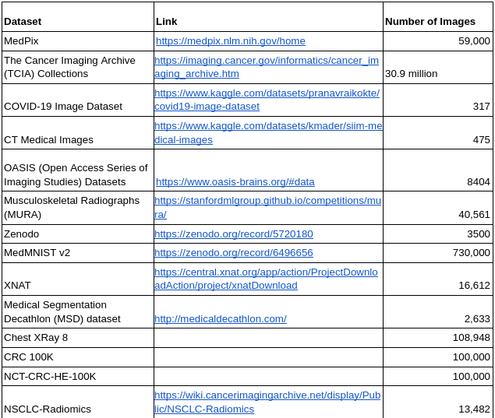
Datasets
Fine tune, train and test - INBreast, CBIS-DDSM (classification), BCSS (segmentation)
Training:

Slide 9
Experiment Architectures
Primary architecture for evaluation is Swin-T
Other architectures to be explored as time permits
  ResNet - Classification
  UNet - Segmentation
  Swin UNETR - Segmentation

Slide 10
Experiment Tools
Preprocessing
  Normalize images to 3 channels
  Normalize image size
  CLAHE
  Masking of artifacts
Data augmentation
  Resizing
  Cropping
  Flipping
  Rotating
  Translating
  Stretching/Squeezing
  Image filtering

Slide 11
Experiment Tools
PyTorch used for experiments
Swin Transformer and ResNet have pre-trained ImageNet1k models in PyTorch
Code available for all architectures considered

Slide 12
Experiment Design
Experiment Number | Pretraining Stage 1 Dataset | Pretraining Stage 2 Dataset | Fine Tuning Task | Fine Tuning Dataset | Test Dataset
1 | ImageNet 1k | Med Images | Classification | INBreast, CBIS-DDSM | INBreast, CBIS-DDSM
2 | ImageNet 1k | Med Images | Segmentation | BCSS | BCSS
3 | ImageNet 1k | None | Classification | INBreast, CBIS-DDSM | INBreast, CBIS-DDSM
4 | ImageNet 1k | None | Segmentation | BCSS | BCSS
5 | None | Med Images | Classification | INBreast, CBIS-DDSM | INBreast, CBIS-DDSM
6 | None | Med Images | Segmentation | BCSS | BCSS
7 | None | None | Classification | INBreast, CBIS-DDSM | INBreast, CBIS-DDSM
8 | None | None | Segmentation | BCSS | BCSS
*Pretraining stage 2 is classification task

Slide 13
Experiment - Other Considerations
Other considerations are which layers to unfreeze for Pre-training Stage 2 and Fine Tuning Stage

Slide 14
Experiment Evaluation
Evaluation of performance will report metrics:
  AUC (TPR vs FPR)
  F1 score
  Accuracy
  Precision
  Recall
  RMSE
  Confusion Matrix (True vs Predicted label)

Slide 15
Project Plan
S/N | Task | ECD
1 | Topic Identification | 10/16
2 | Dataset Collection | 10/23
3 | Data Preprocessing | 10/30
4 | Model Implementation | 10/30
5 | Interim Report | 11/8
6 | Model Training | 11/20
7 | Experiments and Evaluations | 12/4
8 | Final Report | 12/22

Slide 16
References
Convolutional Neural Networks for Medical Image Analysis: Full Training or Fine Tuning?
  https://ieeexplore.ieee.org/document/7426826
Deep Learning Pre-training Strategy for Mammogram Image Classification: an Evaluation Study
  https://www.ncbi.nlm.nih.gov/pmc/articles/PMC7573033/#:~:text=This%20study%20suggests%20that%20pre,malignant%20and%20benign%20screening%20patients
Double-Shot Transfer Learning for Breast Cancer Classification from X-Ray Images
  https://www.mdpi.com/2076-3417/10/11/3999
A Novel Multistage Transfer Learning for Ultrasound Breast Cancer Image Classification
  https://www.researchgate.net/publication/357652385_A_Novel_Multistage_Transfer_Learning_for_Ultrasound_Breast_Cancer_Image_Classification

