Slide 1
Coevolutionary Approaches to Generating Robust Build-Orders for Real-Time Strategy Games
Christopher Ballinger
caballinger@cse.unr.edu
http://www.cse.unr.edu/~caballinger
Notes:
Hello, my name is Chris Ballinger
Today, I’m going to talk about my research to find robust build-orders for real-time strategy games using a covolutionary approach

Slide 2
Outline
Problems
Board Games
RTS Games
Challenges
Build-Orders
Prior Work
Approach
Evolutionary Approaches
Representation
Results
Previous Results
New Results
Case Injection
Expanded Representation
Conclusions
Future Work
Notes:
Before I describe my research, I’ll describe a bit of background information
First, I’ll briefly describe problems that are found in board game and RTS games and why these are interesting problems to work on
I’ll also review prior work and compare prior work to my investigations to find build-orders.
Second, I’ll cover the approaches we use to find build-orders, and describe how we represent a build order.
Third, I’ll review the results I presented for my proposal, followed by my new results to find stronger build-orders.
Finally, I’ll talk about what contributions my research has made, and possible future research.
Before we talk about board games, a basic concepts to understand is what an “Intelligent Agent” is in respect to problems in games.

Slide 3
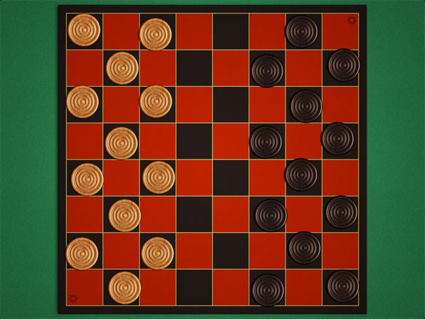
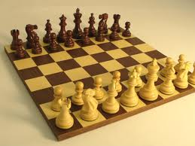
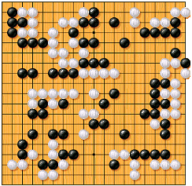
Board Games
Present challenging problems
Complex state space
Adversarial planning
Checkers
Board States - (10²⁰)
Chess
Board States - (10⁵⁰)
Go
Board States - (10¹⁷⁰)
Number of protons in the universe - (10⁸⁰)
A lot of research in the past used board games
Game AIs play competitively against humans
Recently, researchers have been using computer games
RTS games are particularly interesting
Notes:
Board games present game AI with non-trivial problems to solve: large state space and adversarial planning.
Checkers solved – Chinook
Chess Ais up to grand masters
Decent Go players, highest level amateur level or low-level master, ongoing research
Game AI does well for board games, but computer games (specifically RTS games) are even more challenging

Slide 4
Real-Time Strategy
Why RTS games?
Present many challenging problems
Share similarities to real-life problems
Solving problems in RTS games have practical applications
We believe designing a good RTS game player will advance AI research significantly (like chess and checkers did)
What is an RTS game?
Notes:
What is it that makes RTS games interesting?
Different problems which I’ll be covering later
Contain problems similar to real-world problems
Path finding
If an approach solves a problem in a game, it might solve a problem in the real-world
Solving these problems will advance AI research, and have practical applications
How are RTS games played and what problems do they present?

Slide 5
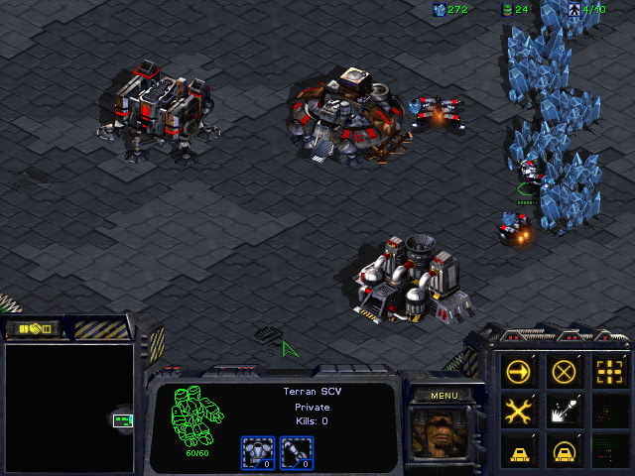
Real-Time Strategy
Example: StarCraft
Manage economy
Build an army
Many types of units
Different strengths and weaknesses
Finding the right mix is critical
Research upgrades
Destroy enemy
More complex than most board games
Notes:
For those of you who aren’t familiar with computer games, RTS games are combat simulators where the player takes on a management role.
One of the most popular commercial RTS games is called StarCraft, shown in this figure
Players must manage an economy and gather resources, such as minerals and gas
Players gather resources with SCVs, the more SCVs dedicated to a resource, the faster the resource is gathered.
Players must decide how many SCVs to dedicate to each resource
Player must build and army buy spending resources to build new units, such as marines or addition SCVs, or construct new buildings
Different units have different costs, strengths and weaknesses, player must create a diverse mix to win
Overall goal is for the player to create and manage an army to destroy their opponents structures and units
These goals create challenges much harder than problems in board games

Slide 6
Real-Time Strategy
Much more complex than board games
Number of board states is orders of magnitude larger
(10⁵⁰)^{36,000} to (10²⁰⁰)^{36,000} for an entire game match
Gameplay different from board games
Two categories of problems
Micromanagement
Macromanagement
RTS Games | Board Games
Simultaneous Moves | Turn-based Moves
Durative Actions | Instant Actions
Partially Observable | Fully Observable
Non-deterministic | Determinist
Notes:
Some problems are created by differences in gameplay between board-games and computer games
Differences create a huge number of game states
Problems in RTS games fall under two categories: micro and macro

Slide 7
Real-Time Strategy
Micromanagement
Short-term control problems
Interacting with units
Managing unit positions during combat
Not focused Micromanagement in this work
StarCraft II
Notes:
Micro involves short term control problems
Interacting with units an managing positions
Shown in video
Has been research into micro, but not the focus of my work

Slide 8
Real-Time Strategy
Macromanagement
Longer-term strategic planning
Resource management
Force composition
Decisions under uncertainty
Temporal reasoning
Specifically, we are interested in planning which units to build, and the order in which to build them
Plans that address this problem are called “Build-Orders”
Notes:
Interested in Macromanagement
Longer term planning problems
Gathering enough resources
Can’t see everything the opponent is doing, how do I decide what I need?
Building units takes time, need to play ahead to make sure they are available when needed
Many possible different mixes of units, which one will defeat the opponent
Specifically, interested in build-orders, affected by these planning problems
Why am I interested in build-orders?

Slide 9
Real-Time Strategy
Why RTS build-orders?
Important for winning
Intransitive relationships between build-orders
Exemplified by rock-paper-scissors
No one optimal build-orders dominates all other build-orders
Robustness and strength of build-orders
Difficult to find winning build-order
Want to find build-orders that will allow a game AI to quickly defeat multiple opponents
How do we test build-orders?
Have a game AI use the build-orders in an RTS game
B₁
B₃
B₂
Notes:
Build-orders are important for winning
We’re interested in build-orders because they’re particularly hard to find, due to intransitive relationships
We want to find build-orders that will allow a game AI to quickly defeat multiple opponents
Note: not finding a complete game AI, just finding build-orders that will allow a given game AI to win
To test how well a build-order works, we need to actually have a game AI use the build-order
Need an RTS environment to test build-orders in

Slide 10
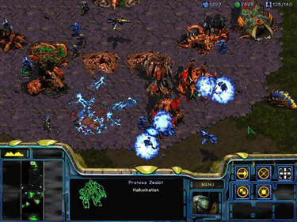
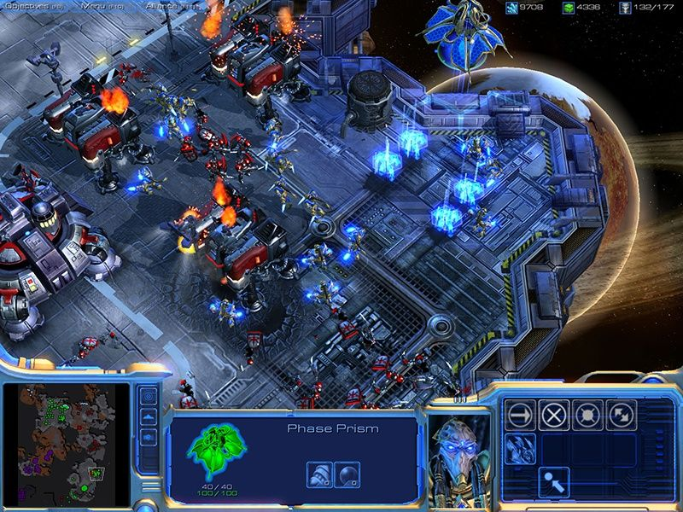
StarCraft
Simulation Environments
StarCraft
3rd-Party tools make AI development possible
Runs (relatively) slow
Hard to run multiple instances in parallel
StarCraft II
No tools to allow AI development
Developed our own
WaterCraft
BOSS
Notes:
There are different commercially available RTS games, but not suitable for research
Don’t provide researchers with a way of allowing a game AI to control a player
No API for StarCraft II
StartCraft 1 cant run fast, w/o graphics, or in parallel
Cant easily test our build-orders
We developed our own environments to test RTS games

Slide 11
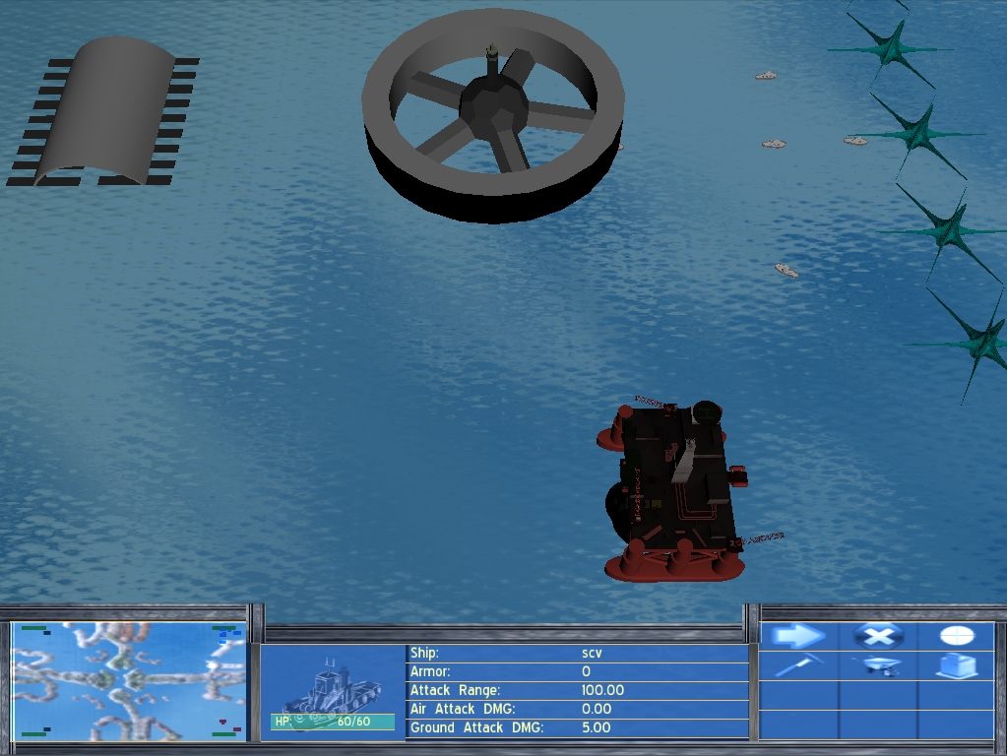
WaterCraft
WaterCraft†
Modeled after StarCraft II
Easy to run in parallel
Runs quicker by disabling graphics
† Source code can be found on Christopher Ballinger’s website
Notes:
Watercraft is an RTS game modeled around StarCraft II
We game AI can play against humans or other game AI
Runs quickly, optional components can be disabled
Humans can play a game in it
A lot of unessicary components still slowing it down, we create another simplified simulation specifically for build-orders

Slide 12
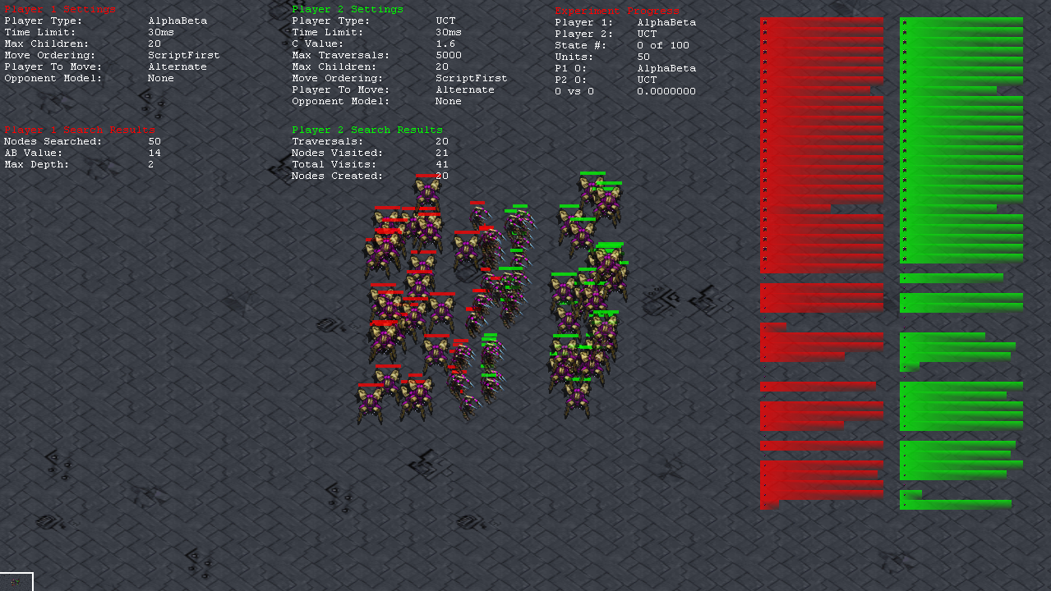
Build-Order Simulator Software
BOSS†
Modeled after StarCraft: Brood War
Estimates build-order completion time
No unnecessary components
Paired with Churchill’s combat simulator “SparCraft”*
A large body of work investigates problems in RTS games
† Source code can be found on Christopher Ballinger’s website
* http://code.google.com/p/sparcraft
Notes:
Modeled around StarCraft: Brood War
Faster than WaterCraft, but not a full RTS game and cannot be played by humans
BOSS only estimates the results of a build-order, reports when each unit is built
Pair with SparCraft, which only estimates the outcome of combat
RTS games are interesting to other researchers as well

Slide 13
Previous Work
Different Approaches
Case-based reasoning¹
GA + CBR²
Reinforcement Learning³
Different Problems
Combat⁴
Economy⁵
Coordination⁶
Build-Orders
Predict and Change⁷
Select from case-base⁸
DFS in real-time⁹
What I’ve done
Focus on build-orders
Robustness
Defeat multiple opponents
Strength
Defeat opponents quickly
Learning from specific build-orders
Case-injection
Two Build-Order Representations
Build-Order List (BOL)
Build-Order Iterative List (BOIL)
Compare two evolutionary methods
Genetic Algorithm (GA)
Coevolutionary Algorithm (CA)
Ontanion, 2006
Miles, 2005
Spronck, 2007
Churchill, 2012
Chan, 2007
Keaveney, 2011
Cho, 2013
Weber and Mateas, 2009
Churchill and Buro, 2011
Notes:
Researchers have investigated different approaches and problems in RTS games
Very little work investigating build-orders
My research finding strong and robust build-orders
I investigate learning from specific build-orders using case-injection, which I’ll discuss later
I use two representations for build-orders, the latest representation include branches and loops
I use two evolutionary approaches to find build-orders: a GA and CA
Because the GA and CA are both evolutionary methods, the steps and terminology are closely related

Slide 14
Evolutionary Methods
Evaluation
Crossover
Mutation
New Population
Selection
Population
Terminology
Chromosome
A possible solution
Population
A set of chromosomes
Typically, initial population contains completely random chromosomes
Fitness
A measure of how well a solution/chromosome solves a problem
Generation
The number of iterations we repeat the process
C0
C0
C1
1
0
0
1
0
C2
Gene
Alleles =
0,1
. . .
Cn
Notes:
Terminology. Describe how GA/CA Works.
Once we have a population of chromosomes, the first step for a GA and CA is to evaluate all the chromosomes

Slide 15
Evolutionary Methods
Identical
Crossover, mutation and selection
Fitness
A Chromosome’s fitness depends on the opponent
Rewards constructing units and destroying opponent
Shared Fitness
A Chromosome’s shared fitness depends on the fitness of all other chromosomes in the population
Rewards defeating opponents other chromosomes cant defeat
Difference
CA
Teachset (8 Opponents)
Hall of Fame (HOF)
History of best chromosomes from previous generations
Shared Sampling
Chromosomes which defeat different opponents
Pose diverse problems
Bootstrapped by CA
GA
Teachset (3 Opponents)
Opponents never change
Must be hand-coded
Notes:
All the same operators
Fitness, Shared Fitness, and Shared sampling in appendix slide, if anyone is interested in how we calculate
Specific differences in the teachsets
CA plays against 8 opponents, from 2 different sources
HOF
Don’t forget to defeat older opponents
Shared sample
Selects opponents with diverse behaviors
Learn to defeat many different behaviors
GA players against 3 baselines opponents
Created baselines by hand

Slide 16
Metric - Baseline Build-Orders
Provide a diverse set of challenges
Fast Build-Order
Quickly build 5 Marines and attacks
Doesn’t need much infrastructure
Medium Build-Order
Build 10 Marines and attack
Slow Build-Order
Build 5 Vultures and attacks
Slow, requires a lot of infrastructure
Encoded as a chromosome
Notes:
Created three build-orders to provide different challenges
The GA, CA, and baselines all use the same representation
Can compare and reuse

Slide 17
Representation - BOL
Bit Sequence | Action | Prereq.
000-001 | Build SCV (Minerals) | None
010 | Build Marine | Barracks
011-100 | Build Firebat | Barracks, Refinery, Academy
101 | Build Vulture | Barracks, Refinery, Factory
110 | Build SCV (Gas) | Refinery
111 | Attack | None
Build-Order List (BOL)
Bitstring
3-bits per action
Decoded sequentially
Inserts required prerequisites
Used by a game AI to play a game
0
1
0
1
0
0
Notes:
Build-order is encoded as a bitstring
Build-order is given to a game AI, which follows the build-order to play an RTS game and try to defeat an opponent

Slide 18
Representation – Game AI
Sequentially executes actions as quickly as possible
Do not skip any actions
“Attack” action
All Marines, Firebats, and Vultures attack opponents Command Center
Attack any other opponent units/buildings along the way
If nearby ally-unit is attacked, assist it by attacking opponent’s unit
If Command Center is attacked, send SCVs to defend
Once all threats have been eliminated, SCVs return to their tasks
Can a GA and CA use this representation to defeat our baselines?
Does the CA and GA find different build-orders?
Notes:
Game AI follow the sequence of actions
Attack - Sends complete units to attack opponents base
Defend Command center with SCVs
Can we find winning build-orders with this representation?

Slide 19
Experiment #1
Can GAs and CAs find winning BOLs?
Compare to Exhaustive Search
5-actions(15-bits) is the most we can search
All 5-action build-orders compete against all three baselines
Provides an absolute measure of BOL quality
Evolved 5-actions(15-bits) BOLs
GA evaluates BOLs against the baselines
CA never evaluates BOLs against the baselines
Ballinger, C.; Louis, S., "Comparing Heuristic Search Methods for Finding Effective Real-Time Strategy Game Plans“,
IEEE Symposium Series on Computational Intelligence (SSCI) 2013
Ballinger, C.; Louis, S., "Comparing Coevolution, Genetic Algorithms, and Hill-Climbers for Finding Real-Time Strategy Game Plans“, ACM SIGEVO Genetic and Evolutionary Computation Conference (GECCO) 2013,
Notes:
To see if we can find winning build-orders, we first need an absolute measure of quality
Exhaustively searching outcomes for all build-orders against our three baselines gives a measure of quality, but 5-actions is the longest is exhaustively search
GA and CA also search for 5-action build-orders, which we can compare to exhaustive search
Ran our GA and CA 10 times, and produced the same result

Slide 20
Results
Exhaustive Search
32,768(2¹⁵) possible BOL
80% of BOLs lose to all three baselines
19.9% of possible BOLs beat only one baseline
0.1% of possible BOLs can defeat two baselines
30 BOLs
Zero BOLs could beat three
Quality of BOLs found by CA and GA?
Ballinger, C.; Louis, S., "Comparing Heuristic Search Methods for Finding Effective Real-Time Strategy Game Plans“,
IEEE Symposium Series on Computational Intelligence (SSCI) 2013
Ballinger, C.; Louis, S., "Comparing Coevolution, Genetic Algorithms, and Hill-Climbers for Finding Real-Time Strategy Game Plans“, ACM SIGEVO Genetic and Evolutionary Computation Conference (GECCO) 2013,
Notes:
Very difficult problem
80% of all possible build-orders lose to all three baselines
20% only defeat one
Only .1% (30) build-orders defeat two
No 5-action build-orders defeat all three
How well did the CA and GA do in finding winning build-order?

Slide 21
Results
Ran GA and CA 10 times
Population size of 50
Runs for 100 generations
Results are averaged over 10 runs
Do we reproduce our results?
GA always found the two BOLs
CA always found one BOL
GA
Always converged to two BOLs that could beat two baselines
CA
Always converged to one BOL
Different from GA BOL
Never defeats any baselines
Still improves score
Beats other 5-action BOLs
Ballinger, C.; Louis, S., "Comparing Heuristic Search Methods for Finding Effective Real-Time Strategy Game Plans“,
IEEE Symposium Series on Computational Intelligence (SSCI) 2013
Ballinger, C.; Louis, S., "Comparing Coevolution, Genetic Algorithms, and Hill-Climbers for Finding Real-Time Strategy Game Plans“, ACM SIGEVO Genetic and Evolutionary Computation Conference (GECCO) 2013,
Notes:
GA always found two of the best build-orders
Defeat two opponents

Slide 22
Discussion #1
GA reliably produces high-quality BOLs
CA improves against baselines
Never used baselines to evaluate BOL fitness
5-actions is very limited
Huge disadvantage against the baselines
Baselines use up to 13-actions
Ballinger, C.; Louis, S., "Comparing Heuristic Search Methods for Finding Effective Real-Time Strategy Game Plans“,
IEEE Symposium Series on Computational Intelligence (SSCI) 2013
Ballinger, C.; Louis, S., "Comparing Coevolution, Genetic Algorithms, and Hill-Climbers for Finding Real-Time Strategy Game Plans“, ACM SIGEVO Genetic and Evolutionary Computation Conference (GECCO) 2013,
Notes:
GA produces high-quality BOLs
CA improves even though it never seems the baselines
Will our results change if the GA/CA build-orders arent at a disadvantage against the baselines?

Slide 23
Experiment #2
Will CA perform better on a level playing field?
Increased bit-string length to 39 (13-actions)
Same length as our longest baseline
Ran GA and CA 10 times
Population size of 50, runs for 50 generations
Results are averaged over all 10 runs
GA converged to one BOL
CA converged to three BOLs
Generated 10 random BOLs
All GA, CA, Random, and Baseline BOLs competed against each other
Ballinger, C.; Louis, S., "Robustness of Coevolved Strategies in a Real-Time Strategy Game“,
IEEE Congress on Evolutionary Computation (CEC) 2013
Notes:
We increased the length of the BOLs to 13-actions, the length of our longest build-order
GA always found one BOL, while the CA found 3 BOLs
Competed Baselines, CA, GA, and 10 random strategies against each other

Slide 24
Results - Score
GA fitness highest against baselines
CA fitness highest against all other BOLs
Set | Baseline(3) | GA(1) | CA(3) | Rand(10)
Baseline(3) | 1733 | 2341 | 1975 | 2935
GA(1) | 4591 | 2875 | 2175 | 3573
CA(3) | 2600 | 3925 | 2830 | 3775
Rand(10) | 1124 | 2017 | 1456 | 1851
Ballinger, C.; Louis, S., "Robustness of Coevolved Strategies in a Real-Time Strategy Game“,
IEEE Congress on Evolutionary Computation (CEC) 2013
Notes:
GA does the best against the baselines
CA more robust and does better against other opponents

Slide 25
Results - Wins
GA always wins against the baselines
CA beats two of the three baselines
CA did not independently find baselines
Set | Baseline(3) | GA(1) | CA(3) | Rand(10)
Baseline(3) | 33% | 33% | 44% | 90%
GA(1) | 100% | 100% | 0% | 80%
CA(3) | 66% | 100% | 44% | 100%
Rand(10) | 10% | 40% | 0% | 45%
Ballinger, C.; Louis, S., "Robustness of Coevolved Strategies in a Real-Time Strategy Game“,
IEEE Congress on Evolutionary Computation (CEC) 2013
Notes:
GA always defeats the baselines
CA defeats other opponents more often
Random solutions don’t win often, still not easy to find good build-orders

Slide 26
Discussion #2
GA produces high-quality BOLs for specific opponents
Highest score against the baselines used for evaluating BOL fitness
CA produces more robust BOLs
Defeats baselines not used for evaluation
How difficult are these BOLs to a human player?
Can we bias a CA to defeat a human?
Ballinger, C.; Louis, S., "Robustness of Coevolved Strategies in a Real-Time Strategy Game“,
IEEE Congress on Evolutionary Computation (CEC) 2013
Notes:
GA produces HQ solutions for known opponents
CA produces robust solutions, defeats the baselines never seen during training
CA build-orders are hard for the game AI to defeat, but what about a human player?
Can the CA/GA also learn to defeat a human?

Slide 27
Experiment #3
Recorded actions of a human player against a coevolved BOL
Coevolved strategy was 39-bits (13 actions)
Human (me) selected which units to build in real-time
Unit actions were controlled by same AI used by the GA and CA
Human build-orders took 75-bits (25 actions) to encode
Very hard to find winning 39-bit BOLs without “peeking”
39-bit BOLs can still defeat 75-bit build-orders
Ballinger, C.; Louis, S., "Finding Robust Strategies to Defeat Specific Opponents Using Case-Injected Coevolution“,
IEEE Conference on Computational Intelligence and Games (CIG) 2013
Notes:
I played against the coevolved strategy
Hard to defeat, took 25 actions to defeat the 13-action CA BOL
Possible to win with 13 or less actions, but requires cheating and knowning what the BOL does
13 action BOL strong enough to defeat 25-action build-orders

Slide 28
Metric – Human Cases
We selected two human build-orders
Easy Human (EH) Build-Order (75-bits, 25 actions)
Quickly build 2 Marines, attack, repeat
Slows down opponent and chips away at the base
Hard Human (HH) Build-Order (75-bits , 25 actions)
Build 9 SCVs, then build Firebats and Vultures in parallel until opponent sends attack force
Defend Command Center and send remaining units to destroy opponents defenseless base
Slow, requires a lot of infrastructure
Ballinger, C.; Louis, S., "Finding Robust Strategies to Defeat Specific Opponents Using Case-Injected Coevolution“,
IEEE Conference on Computational Intelligence and Games (CIG) 2013
Notes:
I found two build-orders that could defeat the CA BOL
Called easy human and hard human, for reasons that will soon become apparent
My actions were encoded into a chromosome

Slide 29
Case-Injection
Injected human replays into CA teachset
2 of the 8 teachset spaces are permanently replaced with the human cases
Not injecting human cases into the population (yet)
GA only evaluates BOLs against the human cases
Ballinger, C.; Louis, S., "Finding Robust Strategies to Defeat Specific Opponents Using Case-Injected Coevolution“,
IEEE Conference on Computational Intelligence and Games (CIG) 2013
Notes:
CA still bootstraps its own opponents, but also plays against my build-orders
GA only trains against my build-orders

Slide 30
Results
Ran GA and CA 10 times
Population size of 50, runs for 50 generations
Results are averaged over all 10 runs
GA always converged to one build-order
CA always converged to a different build-order
Averaged the population’s performance against each human build-order
Ballinger, C.; Louis, S., "Finding Robust Strategies to Defeat Specific Opponents Using Case-Injected Coevolution“,
IEEE Conference on Computational Intelligence and Games (CIG) 2013
Notes:
Ran 10 times, CA and GA each found different build-orders
Measured the performance of the entire population against the human build-orders

Slide 31
Results – Score
GA got the highest scores against the EH
CA got the highest scores against the HH
Ballinger, C.; Louis, S., "Finding Robust Strategies to Defeat Specific Opponents Using Case-Injected Coevolution“,
IEEE Conference on Computational Intelligence and Games (CIG) 2013
Notes:
Results were surprising
While the GA got the highest score against the easy-human strategy, it also go the lowest score against the HH strategy
Our previous results indicated the GA does the best against the training opponent

Slide 32
Results - Wins
Trivial to beat EH
GA never defeat HH
Over specializes against EH
CA quickly learns to defeat HH
Still defeats EH as often as the GA
Score isn’t as high
Ballinger, C.; Louis, S., "Finding Robust Strategies to Defeat Specific Opponents Using Case-Injected Coevolution“,
IEEE Conference on Computational Intelligence and Games (CIG) 2013
Notes:
It turns out, the EH build-order is trivial to beat, and can be defeated by most random chromosomes
On the other hand, the HH build-order is very difficult, and can never be defeated by random chromosomes
As the GA learns to defeat the EH build-order, it improves the score against HH, but not enough to defeat HH.
Leads to overspecialization for EH
CA bootstrapping remains robust, and eventually leads to finding build-order to defeat EH

Slide 33
Discussion #3
GA with fitness sharing can be mislead by large difficulty gap
CA produces high-quality robust BOLs
Can be biased towards specific opponents
Less prone to being mislead
Learned to defeat injected cases
Can we learn to play LIKE injected cases?
Will we lose robustness?
Ballinger, C.; Louis, S., "Finding Robust Strategies to Defeat Specific Opponents Using Case-Injected Coevolution“,
IEEE Conference on Computational Intelligence and Games (CIG) 2013
Notes:
GA can actually be mislead by a large difficultly gap
CA produces robust solutions, can be influenced towards defeating specific opponents
CA learns to defeat build-orders, but can we also use case-injection to play like specific cases? And will it negatively affect the robustness of the build-orders?

Slide 34
Experiment #4
Learning to play like specific BOLs
Training Case-Base
Five 13-action BOLs previously evolved or hand-tuned
Used for population and teachset injection
Testing BOLs
Five BOLs previously evolved or hand-tuned
Different from cases in Training Case-Base
Never used for evaluating a BOLs fitness
Used to test the performance of build-orders
Tested four injection scenarios
No injection
Teachset only injection
Population only injection
Teachset and population injection
Ballinger, C.; Louis, S., "Learning Robust Build-Orders from Previous Opponents with Coevolution“,
IEEE Conference on Computational Intelligence and Games (CIG) 2014
Notes:
Two separate case bases
Cases are previous results from CA/GA/hand-tuning, which were strong and worked well
I tested for injection scenarios
No injection allows our to compare the effects of other injection scenarios
Injection for teachset and population are different

Slide 35
Experiment #4
Teachset Injection
In every generation, replace 2 teachset chromosomes with 2 random chromosomes from the training case-base
Population Injection
Every 5th generation, replace the two lowest fitness chromosomes with two chromosomes from the training case-base
Measure Hamming Distance
Compare the bits in the highest fitness chromosome to the bits in all five injected chromosomes
Count how many bits are different
The lower the hamming distance, the more similar the chromosomes are
Does injecting cases change the Hamming distance?
Test highest fitness chromosomes against all chromosomes in the testing case-base
Does changing the Hamming Distance change robustness?
Ballinger, C.; Louis, S., "Learning Robust Build-Orders from Previous Opponents with Coevolution“,
IEEE Conference on Computational Intelligence and Games (CIG) 2014
Notes:
Hamming distance tells us how much we’ve learned from the injected cases
Comparing against the testing case-base tells us if we’ve change the robustness

Slide 36
Results #4
Injection into population has different results
Depends on the injected case
No effect
Plays like injected case
Plays differently than injected case
No negative effects on robustness
Ballinger, C.; Louis, S., "Learning Robust Build-Orders from Previous Opponents with Coevolution“,
IEEE Conference on Computational Intelligence and Games (CIG) 2014
Notes:
Different cases have different influences on the population
Some cases have no effect, same hamming distance as no injection

Slide 37
Results #4
Injection into population has different results
Depends on the injected case
No effect
Plays like injected case
Plays differently than injected case
No negative effects on robustness
Ballinger, C.; Louis, S., "Learning Robust Build-Orders from Previous Opponents with Coevolution“,
IEEE Conference on Computational Intelligence and Games (CIG) 2014
Notes:
The population became similar to one of the injected cases, as seen in both and pop only injection

Slide 38
Results #4
Injection into population has different results
Depends on the injected case
No effect
Plays like injected case
Plays differently than injected case
No negative effects on robustness
Ballinger, C.; Louis, S., "Learning Robust Build-Orders from Previous Opponents with Coevolution“,
IEEE Conference on Computational Intelligence and Games (CIG) 2014
Notes:
Influencing the population to play like one injected case can also influence the population to play differently than another injected case
As expected, Injecting into the teachset does not cause the population to play like an injected case

Slide 39
Results #4
Injection into population has different results
Depends on the injected case
No effect
Plays like injected case
Plays differently than injected case
No negative effects on robustness
Ballinger, C.; Louis, S., "Learning Robust Build-Orders from Previous Opponents with Coevolution“,
IEEE Conference on Computational Intelligence and Games (CIG) 2014
Notes:
Even though case injection changes the build-orders found by the CA, build-orders are still robust

Slide 40
Discussion #4
CA can learn to be similar to injected cases
Doesn’t lower robustness of BOLs
CA works well for producing robust BOLs
BOLs are limited
Limited length
Single, unchanging sequence
Can a CA and GA utilize branches and loops to find stronger build-orders?
Requires a lot of testing, we need a faster environment
Ballinger, C.; Louis, S., "Learning Robust Build-Orders from Previous Opponents with Coevolution“,
IEEE Conference on Computational Intelligence and Games (CIG) 2014
Notes:
Case injection can also be used to learn to play like injected cases, without losing robustness
CA can find winning BOLs, but BOLs are limited
Limited length and unchanging sequence
Can a CA and GA take advantage of a representation with branches and loops and produce stronger build-orders?
First, Need a faster testing environment

Slide 41
Experiment #5
Changed from WaterCraft to BOSS
Different Games
A build-order will produce different results in each game
Ran exhaustive search against the baselines again
Ballinger, C.; Louis, S.; Liu, S.“Coevolving Robust Build-Order Iterative Lists for Real-Time Strategy Games”
IEEE Transactions on Computational Intelligence and AI in Games 2015, (Submitted for consideration)
Notes:
WaterCraft and BOSS are different games with different rules
Units have different strengths, combat results are different
A build-order will have different performance in each game
Did first experiment again in BOSS, with exhaustive search

Slide 42
Experiment #5: BOSS
Qualitatively the same results
Easier to win in BOSS
SCV have a better advantage
Extend BOL representation
Ballinger, C.; Louis, S.; Liu, S.“Coevolving Robust Build-Order Iterative Lists for Real-Time Strategy Games”
IEEE Transactions on Computational Intelligence and AI in Games 2015, (Submitted for consideration)
Notes:
Baseline fast is still the strongest, medium the weakest
Much easier to win in BOSS, SCVs are stronger

Slide 43
Experiment #5
Extend BOL to Build-Order Iterative List (BOIL)
Encodes branches and loops
Branches and loops can contain one of two different conditions
Less than seven units built
Seven or more units built
After a loop or branch is encoded:
Next three encoded actions belong to the loop or branch
The build-actions will only occur if the condition is true
Still encoded as a bitstring
Ballinger, C.; Louis, S.; Liu, S.“Coevolving Robust Build-Order Iterative Lists for Real-Time Strategy Games”
IEEE Transactions on Computational Intelligence and AI in Games 2015, (Submitted for consideration)
Notes:
Branches and loops enable a build-order to represent different sequences, depending on the situation
Loops allow for a more compact representation
Actions under a loop or branch only occur if the loop/branch condition is true

Slide 44
Representation - BOIL
Two Conditions | Action | Prerequisites
0000 | IF(Condition1) | N/A
0001 | WHILE(Condition1) | N/A
0010 | IF(Condition2) | N/A
0011-0100 | WHILE(Condition2) | N/A
0101 | Build SCV (Gather Minerals) | None
0110 | Build SCV (Gather Gas) | None
0111 | Build Marine | Barracks
1000 | Build Firebat | Barracks, Refinery, Academy
1001 | Build Vulture | Barracks, Refinery, Factory
1010 | Build Barracks | None
1011-1100 | Build Factory | Barracks
1101 | Build Refinery | None
1110 | Build Academy | Barracks
1111 | Attack | N/A
BOIL
4-bits per action
Decoded sequentially
Prereqs. MUST be encoded
Makes finding build-orders harder
Two conditions
“Less than seven completed units”
“Seven or more completed units ”
Notes:
Unlike BOL, BOIL does not assume the game AI will fill in prereq
If a prereq is missing, the game AI will stall
E.g. a marine before a barrack
Harder to find working build-orders, let alone a winning one

Slide 45
Representation - BOIL
Build SCV
While (Less Than)
Build SCV
Build Barracks
Build Barracks
Build Marine
0
1
0
1
0
0
0
1
0
1
0
1
1
0
1
0
1
0
1
0
0
1
1
1
Build SCV
While(Less Than)
Build SCV
Build Barracks
Build Barracks
Build Marine
Ballinger, C.; Louis, S.; Liu, S.“Coevolving Robust Build-Order Iterative Lists for Real-Time Strategy Games”
IEEE Transactions on Computational Intelligence and AI in Games 2015, (Submitted for consideration)
Notes:
Example of how BOIL translates into a build-order
This example one contains the less than condition
We try boil with different conditions

Slide 46
Experiment #5
Used 4 different BOIL representations
No Loops/Branches
“Less than seven completed units” condition
“Seven or more completed units ” condition
Both conditions
Used 13-action(52-bit) BOILs in all cases
Ran GA and CA 50 times
Population size of 50, runs for 100 generations
Results are averaged over all 50 runs
Ballinger, C.; Louis, S.; Liu, S.“Coevolving Robust Build-Order Iterative Lists for Real-Time Strategy Games”
IEEE Transactions on Computational Intelligence and AI in Games 2015, (Submitted for consideration)
Notes:
No loops and branches lets us compare the effects of branches and loops with different rules
Used 13-actions to be consistent with previous work and compare to longest baseline

Slide 47
Results #5
Learns winning BOILs faster without branches and loops
Learns slowest with both-condition BOIL
Ballinger, C.; Louis, S.; Liu, S.“Coevolving Robust Build-Order Iterative Lists for Real-Time Strategy Games”
IEEE Transactions on Computational Intelligence and AI in Games 2015, (Submitted for consideration)
Notes:
CA/GA learn winning build-orders faster without branches and loops
Both conditions take longer to optimize
Note that with 5-action BOLs against the baselines, BOLs won 50% of the time
With 13-action BOILs, random chromosomes win about 30% of the time, despite having more actions to use
BOIL is harder to find than BOLs

Slide 48
Results #5
Both-condition BOILs are stronger, and defeat opponents faster
Takes longer to optimize the branches and loops
Ballinger, C.; Louis, S.; Liu, S.“Coevolving Robust Build-Order Iterative Lists for Real-Time Strategy Games”
IEEE Transactions on Computational Intelligence and AI in Games 2015, (Submitted for consideration)
Notes:
However, BOILs produced with both conditions learn to destroy all units during combat faster
Takes the GA and CA longer to optimize different loops
Found build-orders that used both conditions.
Less-than loop to find build SCVs and multiple barracks, allows marines to be produced in parallel
Greater-than loop to build SCVs and marines in parallel

Slide 49
Discussion #5
Build-orders benefit from branches and loops
Enables CAs and GAs to find stronger build-orders
Takes CAs and GAs longer to optimize multiple paths
Ballinger, C.; Louis, S.; Liu, S.“Coevolving Robust Build-Order Iterative Lists for Real-Time Strategy Games”
IEEE Transactions on Computational Intelligence and AI in Games 2015, (Submitted for consideration)

Slide 50
Conclusion
Contributions
Used a coevolutionary approach to generating robust build-orders
Show that coevolved build-orders learn from case-injection while maintaining robustness
Show that coevolved build-orders benefit from branches and loops
Conclusion
CAs are a promising approach for finding RTS build-orders
Produces robust build-orders
Can defeat multiple opponents
Can defeat opponents not seen during training
Learn from case-injection
Effectively utilizes branches and loops
Promising approach for similar problems
Notes:
My research provides three contributions
Use a coevolutionary approach to find robust build-orders
To the best of my knowledge, has not been done before
Show that a CA can learn to defeat specific build-orders and learn to play like specific build-orders, while maintaining robustness
Show that a CA can use branches and loops to produce stronger build-orders
My works shows that CAs are suitable for finding strong, robust build-orders
CA not dependent on RTS games
May be a promising approach to other scheduling problems

Slide 51
Future Work
Future Work
BOIL
Additional Units
Additional Conditions
Coevolve branch/loop scope size
Future-Future Work
Coevolve complete game AI
Micromanagement*
Better opponent modeling
Represent human player build-orders in BOIL
*Liu, S.; Louis, S.; Ballinger, C., “Evolving effective micro behaviors in RTS game”, Computational Intelligence and Games (CIG), 2014 IEEE Conference on
Notes:
Coevolve solutions to other RTS problems, create a complete RTS game AI
Might be more than one way to represent a human players build-order in BOIL

Slide 52
Acknowledgements
This research is supported by ONR grant N000014-12-C-0522.
More information (papers, movies)
caballinger@cse.unr.edu (http://www.cse.unr.edu/~caballinger)
sushil@cse.unr.edu (http://www.cse.unr.edu/~sushil)
Notes:
Movie of WC

Slide 53
Publications
Liu, S.; Ballinger, C.; Louis, S.; "Player Identification from RTS Game Replays", Computers and Their Applications (CATA), 2013 28th International Conference on, 4-6 March 2013
Ballinger, C.; Louis, S., "Comparing Heuristic Search Methods for Finding Effective Real-Time Strategy Game Plans", IEEE Symposium Series on Computational Intelligence (SSCI) 2013, 16-19 April 2013
Ballinger, C.; Louis, S., "Comparing Coevolution, Genetic Algorithms, and Hill-Climbers for Finding Real-Time Strategy Game Plans", Genetic and Evolutionary Computation Conference (GECCO) 2013, 6-10 July 2013
Ballinger, C.; Louis, S., "Robustness of Coevolved Strategies in a Real-Time Strategy Game", IEEE Congress on Evolutionary Computation (CEC) 2013, 20-23 June 2013
Liu, S.; Louis, S.; Ballinger, C., “Evolving effective micro behaviors in RTS game”, Computational Intelligence and Games (CIG), 2014 IEEE Conference on, 1-8
Ballinger, C.; Louis, S., "Finding Robust Strategies to Defeat Specific Opponents Using Case-Injected Coevolution", IEEE Conference on Computational Intelligence and Games (CIG) 2013, 11-13 August 2013
Ballinger, C.; Louis, S., "Learning robust build-orders from previous opponents with coevolution," IEEE Conference on Computational Intelligence and Games (CIG) 2014, vol., no., pp.1,8, 26-29 Aug. 2014
Ballinger, C.; Louis, S.; Liu, S.“Coevolving Robust Build-Order Iterative Lists for Real-Time Strategy Games” IEEE Transactions on Computational Intelligence and AI in Games 2015, (Submitted for consideration)

Slide 54
Appendix

Slide 55
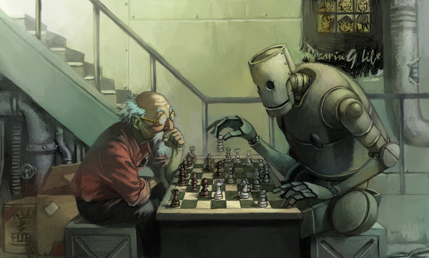
Intelligent Agents
An autonomous entity which observes through sensors, acts upon an environment using actuators, and directs its activity towards achieving goals. (Russell & Norvig)
In games, typically act as a player trying to win
Colloquially called the “Game AI”
Commonly used for board games and computer games
Notes:
“Intelligent Agent” does not have one well-accepted definition, but Russel and Norvig define it as…
In terms of a game, an intelligent agent acts as a player.
If you’ve ever played a game such as chess against a computer, you’ve interacted with an intelligent agent colloquially called the “Game AI”

Slide 56
Evaluation
Assign a fitness to all chromosomes in the population
Population
Evaluate Chromosome
Evaluator
C0
F0
Assign Fitness
C1
F1
C2
F2
. . .
…
Cn
Fn
Notes:
Evaluation assigns a fitness to each chromosome
A chromosome given to an outside, separate Evaluator
The evaluation determines how well the chromosome solves a problem and assigns it a corresponding fitness
Higher fitness -> solves the problem better
Repeated for every chromosome
Once every chromosome has a fitness, we want to select pairs of chromosomes that learn from each other

Slide 57
Selection
A method for selecting which chromosomes we should select for crossover, and how often.
Roulette Wheel Selection
Fn
F0
F2
F1
Notes:
Different possible selection strategies
Fitness proportional selection
Lower fitness selected less often
higher fitness selected more often
focus on more promising chromosomes
Once we’ve selected multiple of pairs of chromosomes, they learn from eachother using crossover

Slide 58
Crossover
A method to exchange information between two chromosomes (parents), attempting to produce more effective chromosomes (children)
Randomly Select Index
1
1
0
0
1
1
0
0
1
1
0
0
1
1
0
0
1
1
0
0
Parent 1
Parent 2
Child 1
Child 2
Notes:
Different crossover methods, this is one-point crossover
Crossover attempts to take the best features in both parents, and put them together to create even better children
Explores new solutions, but limited/focused to what exists in the population

Slide 59
Mutation
A method to make sure certain patterns/capabilities do not permanently go extinct in the entire population
1
0
0
1
1
0
0
1
0
1
0
0
1
0
0
1
1
1
1
0
1
1
0
1
1
0
…
…
…
Notes:
Helps explore a broader range of solutions
Also helps present patterns from being lost

Slide 60
New Population
All Children become the Parents for the start of the next generation
Evaluation
Crossover
Mutation
Selection
New Population
Old Population
(Parents)
New Population
(Children)
C0
F0
C0
C1
F1
C1
C2
F2
C2
. . .
…
. . .
Cn
Fn
Cn
Notes:
The result of these steps is a new population
New population replaces the old population, and steps are repeated
If a GA and CA both follow these steps, then how are they different?

Slide 61
Evolutionary Methods
Differences between our GA and CA?
GA: Population plays against the same hand-tuned baselines every generation
Population
Generation 1
Teachset
(Evaluators)
C0
Build-Order 1
C1
Build-Order 2
Cn
Build-Order 3
Notes:
GA plays against the same build-orders in every generation
All the opponents the GA plays against are in a set called the teachset

Slide 62
Evolutionary Methods
Differences between our GA and CA?
GA: Population plays against the same hand-tuned baselines every generation
Population
Generation 2
Teachset
(Evaluators)
C0
Build-Order 1
C1
Build-Order 2
Cn
Build-Order 3
Notes:
GA plays against
All the opponents the GA plays against are in a set called the teachsetthe same build-orders in every generation

Slide 63
Evolutionary Methods
Differences between our GA and CA?
GA: Population plays against the same hand-tuned baselines every generation
Population
Generation 3
Teachset
(Evaluators)
C0
Build-Order 1
C1
Build-Order 2
Cn
Build-Order 3
Notes:
GA plays against the same build-orders in every generation
All the opponents the GA plays against are in a set called the teachset

Slide 64
Evolutionary Methods
Differences between our GA and CA?
GA: Population plays against the same hand-tuned baselines every generation
CA: Population plays against chromosomes from previous generations
Population
Generation 1
Teachset
(Evaluators)
C0
Parent 1
C1
Parent 2
Cn
Parent 3
Notes:
CA plays against previous solutions
Bootstraps opponents that get harder over time

Slide 65
Evolutionary Methods
Differences between our GA and CA?
GA: Population plays against the same hand-tuned baselines every generation
CA: Population plays against chromosomes from previous generations
Population
Generation 2
Teachset
(Evaluators)
C0
Parent 1
C1
Parent 2
Cn
Parent 3
Notes:
CA plays against previous solutions
Bootstraps opponents that get harder over time

Slide 66
Evolutionary Methods
Differences between our GA and CA?
GA: Population plays against the same hand-tuned baselines every generation
CA: Population plays against chromosomes from previous generations
Population
Generation 3
Teachset
(Evaluators)
C0
Parent 1
C1
Parent 2
Cn
Parent 3
Notes:
CA plays against previous solutions
Bootstraps opponents that get harder over time

Slide 67
Fitness of Chromosomei against Chromosomej
Resource Cost of Destroyed Opponent Units
Resource Cost of Destroyed Opponent Buildings
Resources Spent
=
+
∑
+
∑
F
SR
2
UC
3
BC
ij
i
k
k
k
∈
UD
k
∈
BD
j
j
Number of times opponent j lost to all chromosomes
Shared Fitness of Chromosomei
Opponents Defeated by i
shared
∑
⎡
⎤
f
=
⎛
1
⎞
F
⎢
⎝
j
⎠
ij
⎥
i
⎣
l
⎦
j
∈
D
i
Notes:
Can CA defeat baselines w/o seeing baslines, robustness
GA

Slide 68
Exhaustive Search
Solution 1
Baseline 1
Baselines encoded in 24-39bits
Have advantage against 15-bit BOLs
Shows how frequently the best/worst BOLs occur
Ranks all BOLs by how many baselines they defeat
Shows how hard it will be to find winning BOLs
Baseline 2
Baseline 3
Solution 2
Baseline 1
Baseline 2
Baseline 3
Solution N
Baseline 1
Baseline 2
Baseline 3
Ballinger, C.; Louis, S., "Comparing Heuristic Search Methods for Finding Effective Real-Time Strategy Game Plans“
Ballinger, C.; Louis, S., "Comparing Coevolution, Genetic Algorithms, and Hill-Climbers for Finding Real-Time Strategy Game Plans"
Notes:
Exhaustive search competes all possible build-orders against all three baselines
Note that 5-action build-orders are at a disadvantage
Allows us to rank build-orders
How hard will it be to find good build-orders?

Slide 69
Results
Exhaustive Search
32,768(2¹⁵) possible BOL
80% of BOLs lose to all three baselines
19.9% of possible BOLs beat only one baseline
0.1% of possible BOLs can defeat two baselines
30 BOLs
Zero BOLs could beat three
Quality of BOLs found by CA and GA?
Ballinger, C.; Louis, S., "Comparing Heuristic Search Methods for Finding Effective Real-Time Strategy Game Plans“
Ballinger, C.; Louis, S., "Comparing Coevolution, Genetic Algorithms, and Hill-Climbers for Finding Real-Time Strategy Game Plans"
Notes:
Very difficult problem
80% of all possible build-orders lose to all three baselines
20% only defeat one
Only .1% (30) build-orders defeat two
No 5-action build-orders defeat all three
How well did the CA and GA do in finding winning build-order?

Slide 70
Results
CA
Always found the same BOL
Four Vultures and a Firebat
Never defeats any baselines
Doesn’t plan for BOLs that take more than 5 actions
Still improves score
Beats other 5-action BOLs
Ballinger, C.; Louis, S., "Comparing Heuristic Search Methods for Finding Effective Real-Time Strategy Game Plans“
Ballinger, C.; Louis, S., "Comparing Coevolution, Genetic Algorithms, and Hill-Climbers for Finding Real-Time Strategy Game Plans"
Notes:
CA always found the same solution
Doesn’t defeat any of the baselines
However, improves the score to better than average
Defeats other 5-action BOLs
Did the GA fair any better?

Slide 71
Results
GA
Always found BOLs that could beat two baselines
Build-order 1
Two SCVs, Two Firebats, One Vulture
Quick but weak defense
Build-order 2
Four Firebats, One Vulture
Strong but slow defense
Ballinger, C.; Louis, S., "Comparing Heuristic Search Methods for Finding Effective Real-Time Strategy Game Plans“
Ballinger, C.; Louis, S., "Comparing Coevolution, Genetic Algorithms, and Hill-Climbers for Finding Real-Time Strategy Game Plans"
Notes:
GA always found two of the best build-orders
Defeat two opponents

Slide 72
Results – Command Centers
Percent of C.C. destroyed were very similar
Only two of the three CA build-orders attack
Set | Baseline(3) | GA(1) | CA(3) | Rand(10)
Baseline(3) | 22% | 33% | 44% | 86%
GA(1) | 100% | 0% | 0% | 60%
CA(3) | 44% | 66% | 11% | 66%
Rand(10) | 0% | 0% | 0% | 0%
Ballinger, C.; Louis, S., "Robustness of Coevolved Strategies in a Real-Time Strategy Game"
Notes:
GA always destroys the opponents command center
Only two of the three CA strategies attack, but the attacking strategies defeat the command centers often

Slide 73
Full BOIL Representation
No Conditions | Single Condition | Two Conditions | Action | Prerequisites
N/A | 0000 | 0000 | IF(Condition1) | N/A
N/A | 0001-0010 | 0001 | WHILE(Condition1) | N/A
N/A | N/A | 0010 | IF(Condition2) | N/A
N/A | N/A | 0011-0100 | WHILE(Condition2) | N/A
0000 | 0011 | 0101 | Build SCV (Gather Minerals) | None
0001-0010 | 0100 | 0110 | Build SCV (Gather Gas) | None
0011-0100 | 0101-0110 | 0111 | Build Marine | Barracks
0101 | 0111 | 1000 | Build Firebat | Barracks, Refinery, Academy
0110-0111 | 1000 | 1001 | Build Vulture | Barracks, Refinery, Factory
1000-1001 | 1001-1010 | 1010 | Build Barracks | None
1010 | 1011 | 1011-1100 | Build Factory | Barracks
1011-1100 | 1100 | 1101 | Build Refinery | None
1101-1110 | 1101-1110 | 1110 | Build Academy | Barracks
1111 | 1111 | 1111 | Attack | N/A

Slide 74
Full BOIL Representation
Two Conditions | Action | Prerequisites
0000 | IF(Condition1) | N/A
0001 | WHILE(Condition1) | N/A
0010 | IF(Condition2) | N/A
0011-0100 | WHILE(Condition2) | N/A
0101 | Build SCV (Gather Minerals) | None
0110 | Build SCV (Gather Gas) | None
0111 | Build Marine | Barracks
1000 | Build Firebat | Barracks, Refinery, Academy
1001 | Build Vulture | Barracks, Refinery, Factory
1010 | Build Barracks | None
1011-1100 | Build Factory | Barracks
1101 | Build Refinery | None
1110 | Build Academy | Barracks
1111 | Attack | N/A

