Slide 1

CS 709
Chapter 4: Use Case Modeling
From [Jim Arlow and Ila Neustadt, UML 2 and the Unified Process, Addison-Wesley 2005]
University of Nevada, Reno
Department of Computer Science & Engineering

Slide 2
Outline
Use case modeling
  Overview
  Finding actors and use cases
  Use case specification
  Requirements tracing
2
Use Case Modeling
Notes:
2

Slide 3
Use Case Modeling: Overview
The Use Case Model consists of the following:
  Actors
  Use cases
  Relationships
  System boundary
Steps of use case modeling:
  Find the system boundary
  Find the actors
  Find the use cases
3
Use Case Modeling
Notes:
3

Slide 4
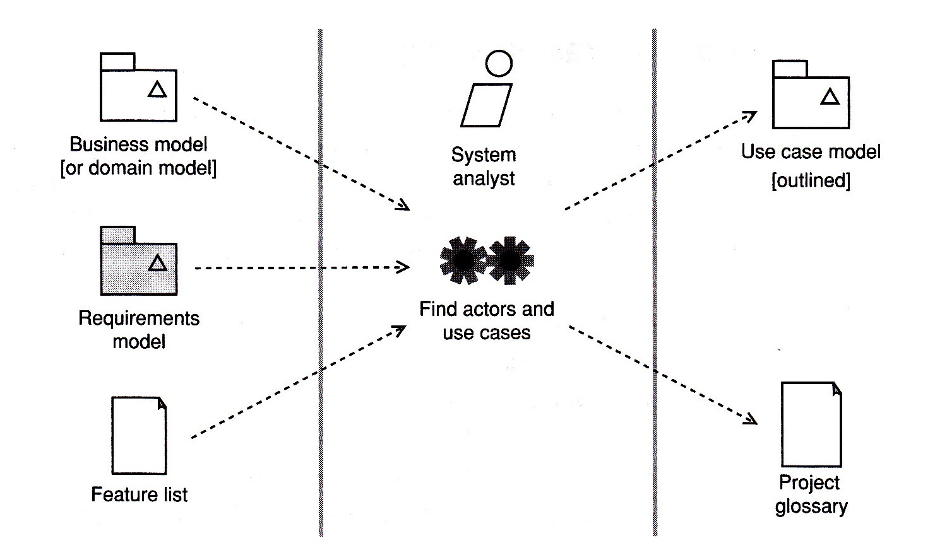


Finding Actors and Use Cases
Fig. 4.2 [Arlow & Neustadt 2005]
4
Notes:
4

Slide 5
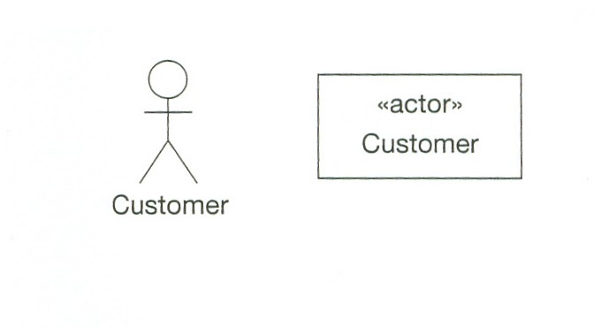
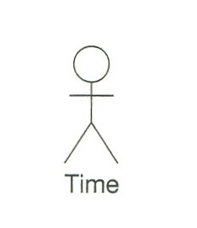
Finding Actors and Use Cases
An actor is a role taken by an external entity when interacting with the system directly
An actor is a stereotype of class with its own icon
5
Use Case Modeling
Notes:
5

Slide 6
Finding Actors and Use Cases
An actor
  Is always external to the system
  Interacts directly with the system
  Represents a role played by people or things, not specific people or things
Use cases
  Are always started by an actor
  Are always written from an actor’s point of view
6
Use Case Modeling
Notes:
6

Slide 7
Finding Actors and Use Cases
According to Rumbaugh, a use case is
a specification of sequences of actions, including variant sequences and error sequences, that a system, subsystem, or class can perform by interacting with outside actors
Use Case Modeling
7
Notes:
7

Slide 8
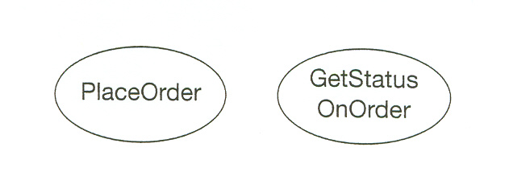
Finding Actors and Use Cases
Examples of use cases:
Names of use cases should be verb phrases
Candidate use cases can be discovered starting from the list of actors (how they interact with the system?)
Finding use cases is an iterative process
8
Use Case Modeling
Notes:
8

Slide 9
Finding Actors and Use Cases
Questions you can ask to identify use cases:
  What functions a specific actor wants from the system?
  Does the system store and retrieve information? If yes, which actors are involved?
  Are any actors notified when the system changes state?
  Are any external events that affect the system? What notifies the system about these events?
9
Use Case Modeling
Notes:
9

Slide 10
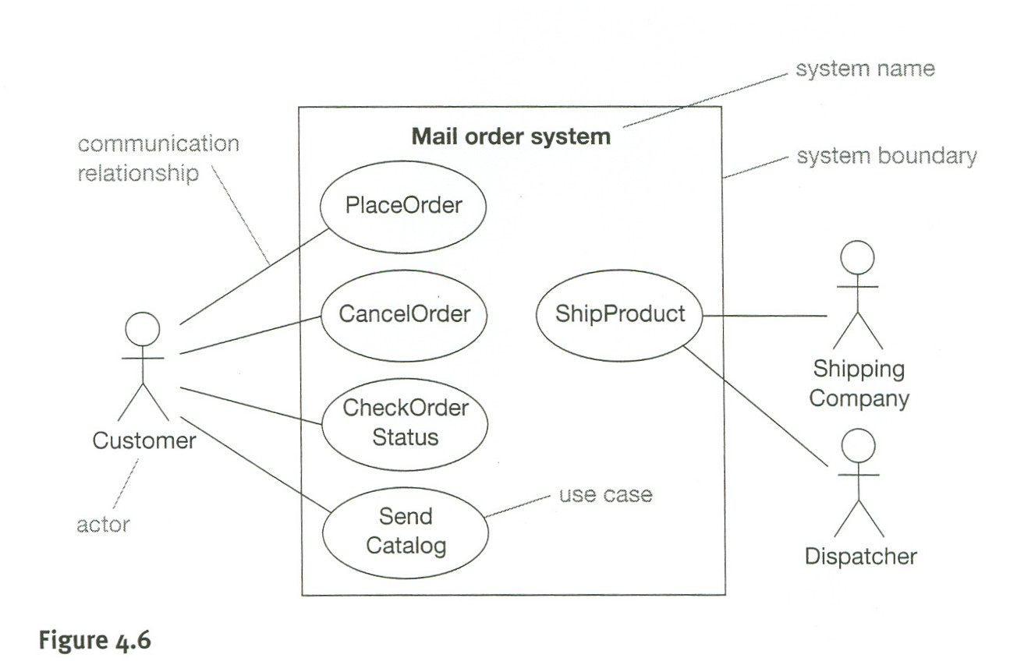
Finding Actors and Use Cases
The use case diagram shows the system boundary, the use cases internal to the system, and the actors external to the system
Use Case Modeling
10
Notes:
10

Slide 11
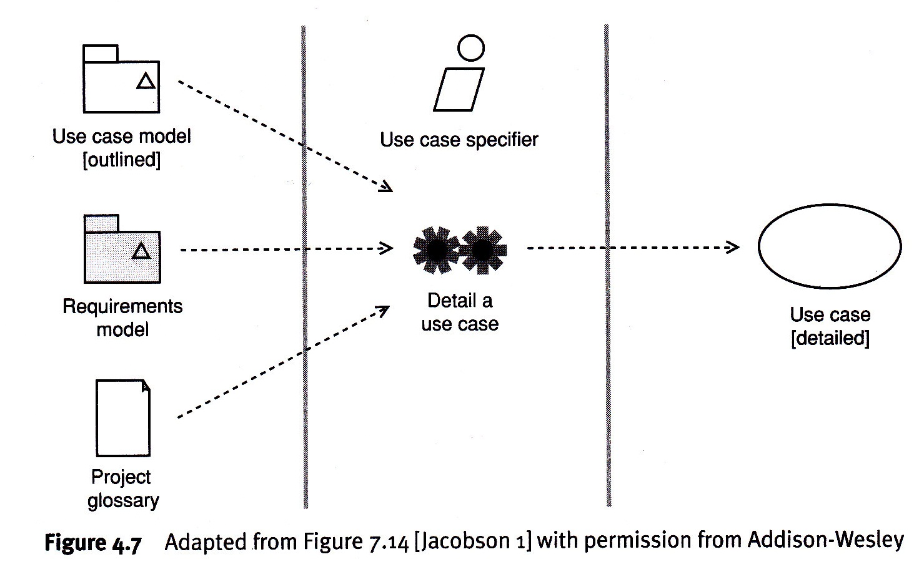
Finding Actors and Use Cases
Fig. 4.7 [Arlow & Neustadt 2005]
11
Notes:
11

Slide 12
Finding Actors and Use Cases
The project glossary
  Important project artifact
  Provides a dictionary of key business terms
  Captures business language and jargon
  Should resolve synonyms and homonyms
  Should be understandable by all stakeholders
  UML does not set a standard for the project glossary
12
Use Case Modeling
Notes:
12

Slide 13
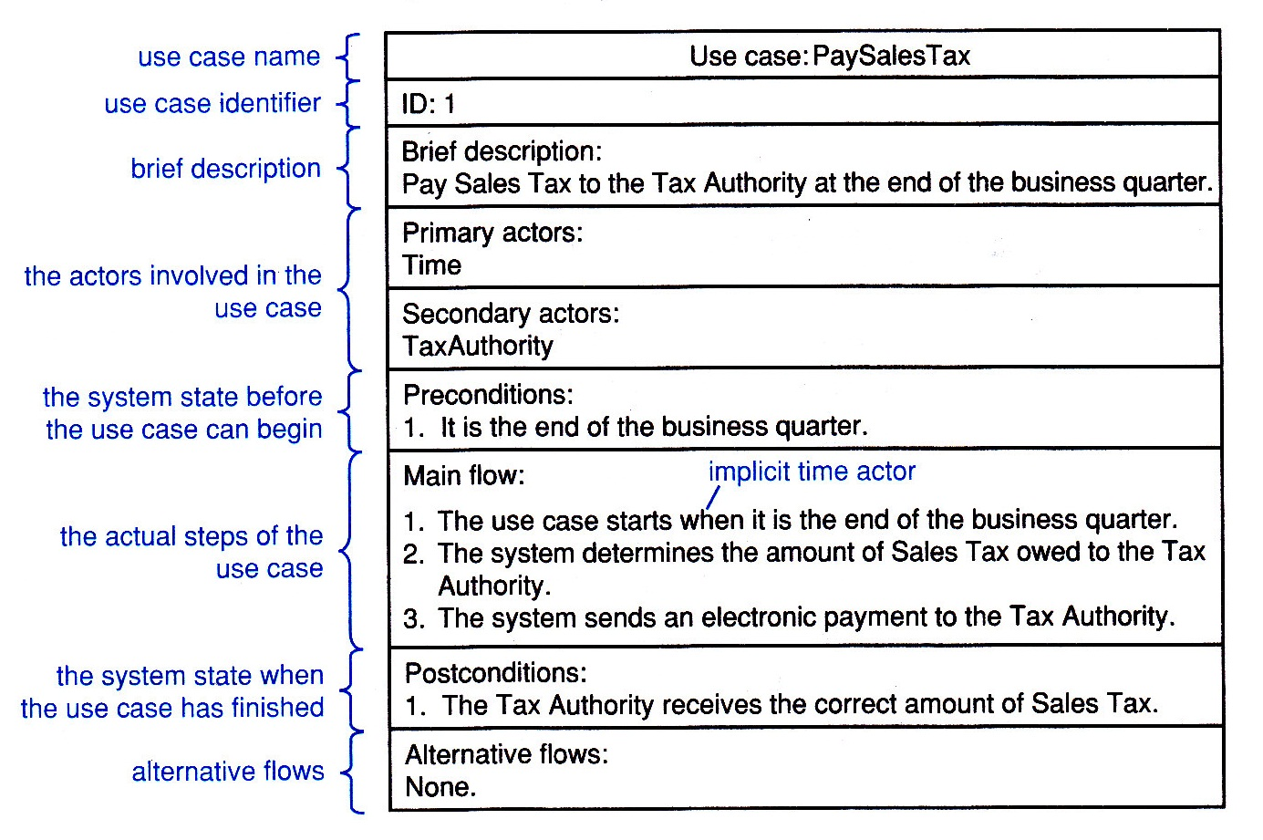
Use Case Specification
The output of this activity is a more detailed use case that consists at least of the use case name and use case specification
Most common template for use case specification
13
Use Case Modeling
Notes:
13

Slide 14
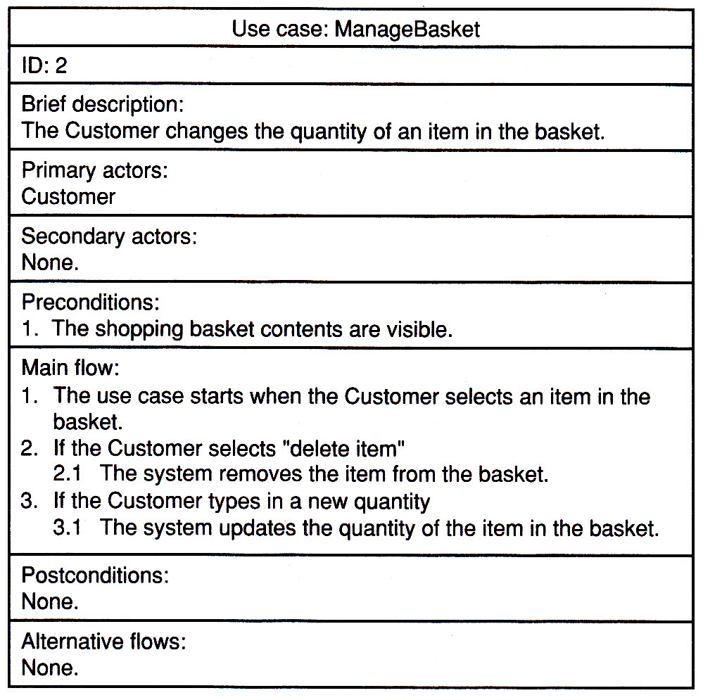
Use Case Specification
Branching, repetition, and alternative flows are possible in a use case
Example of branching using the keyword IF
14
Use Case Modeling
Notes:
14

Slide 15
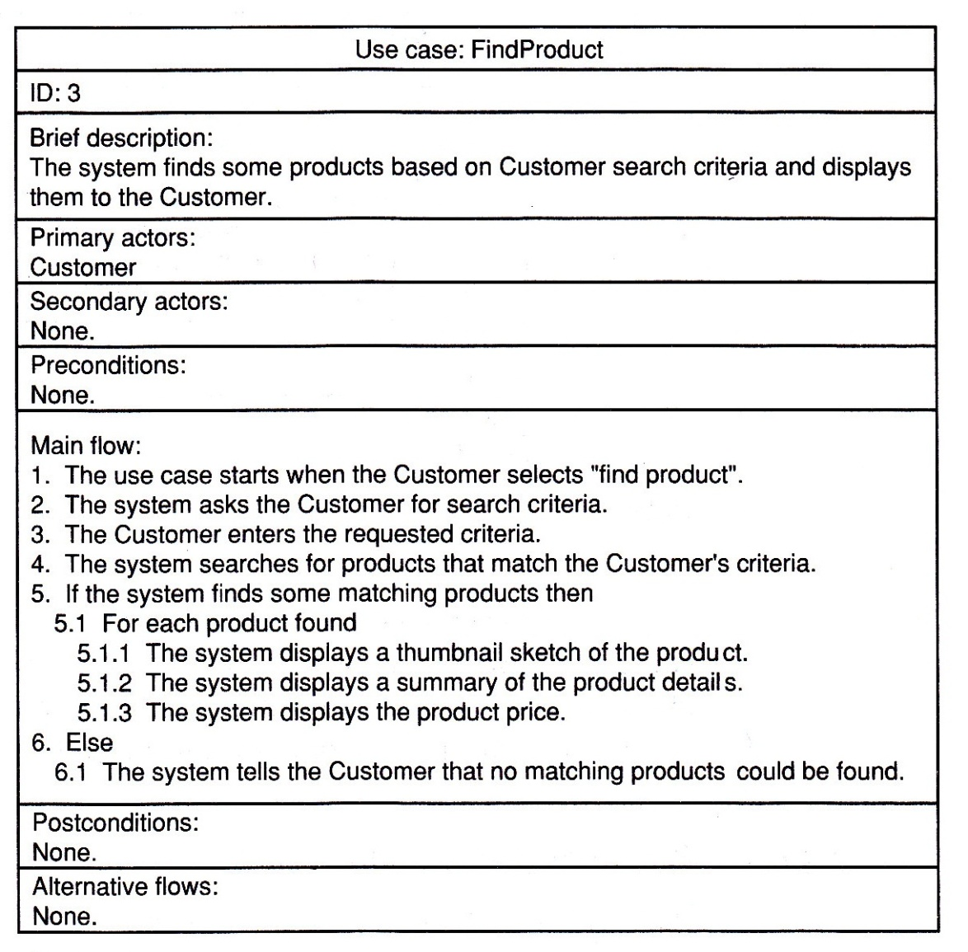
Use Case Specification
Example of repetition within a flow (FOR)
15
Use Case Modeling
Notes:
15

Slide 16
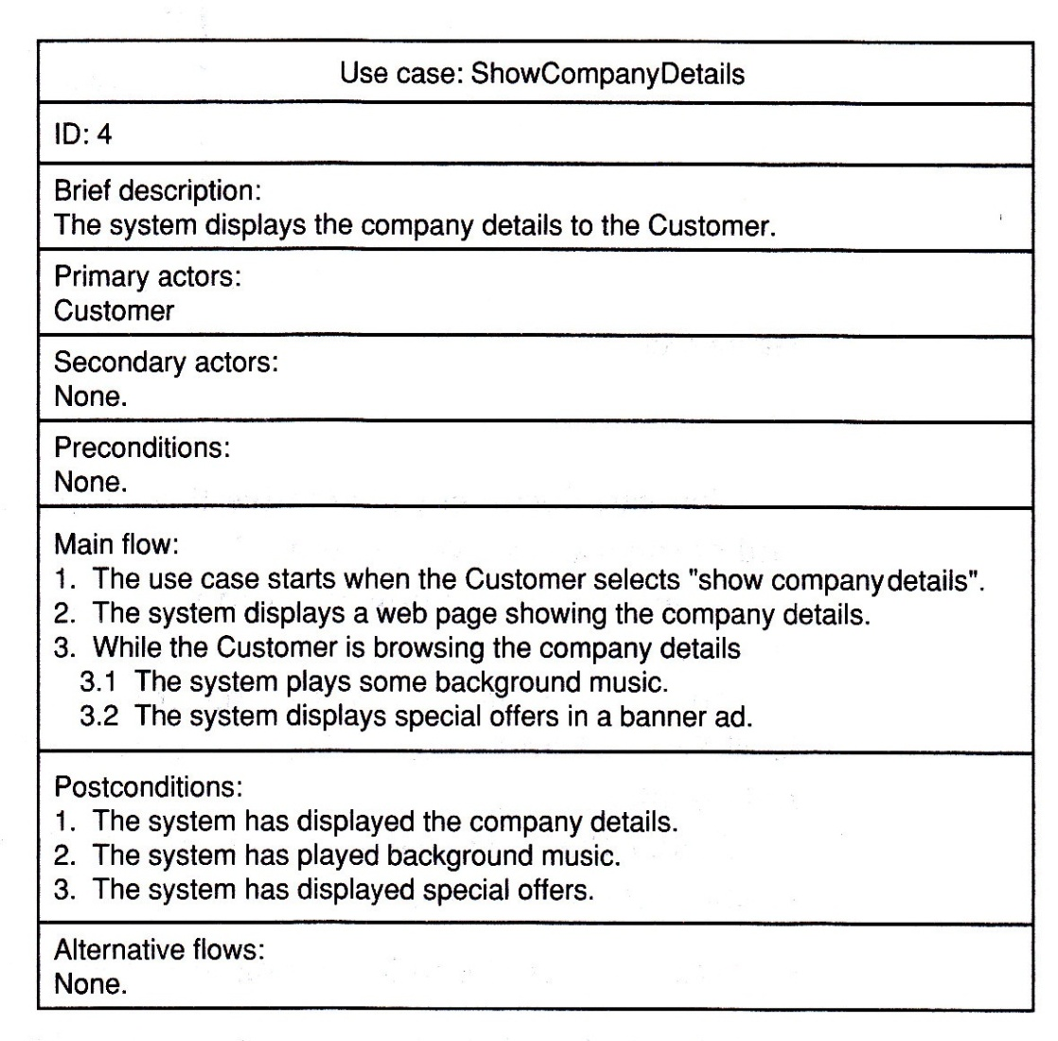
Use Case Specification
Example of repetition within a flow (WHILE)
16
Use Case Modeling
Notes:
16

Slide 17
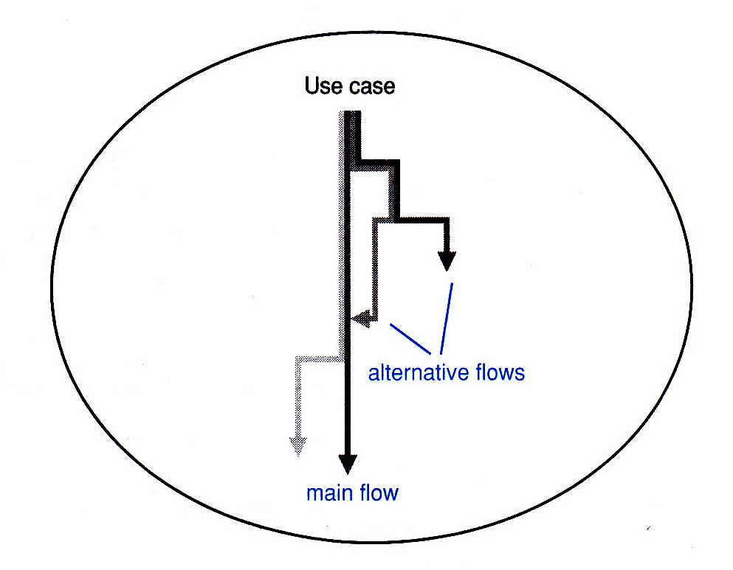
Use Case Specification
Modeling alternative flows
17
Use Case Modeling
Notes:
17

Slide 18
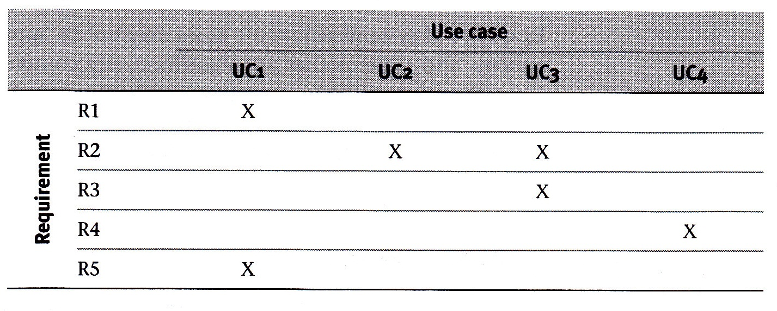
Requirements Tracing
Tracing requirements
18
Use Case Modeling
Notes:
18

Slide 19
CS 709
Chapter 5: Advanced Use Case Modeling
From [Jim Arlow and Ila Neustadt, UML 2 and the Unified Process, Addison-Wesley 2005]
University of Nevada, Reno
Department of Computer Science & Engineering

Slide 20
Outline
Advanced use case modeling
  Actor generalization
  Use case generalization
  Inclusion
  Extension
20
Advanced Use Case Modeling
Notes:
20

Slide 21
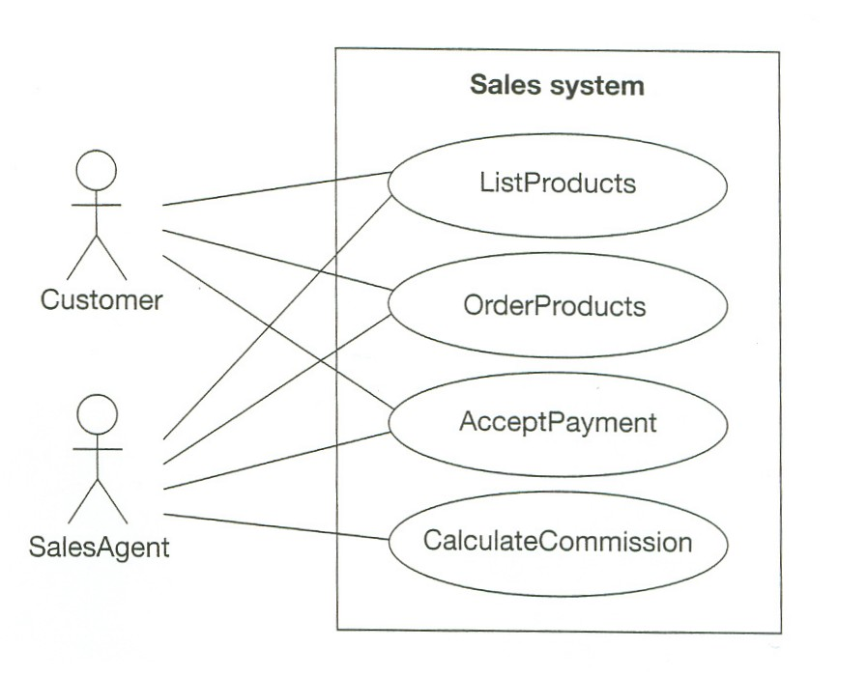
Actor Generalization
Fig. 5.2
21
Advanced Use Case Modeling
Notes:
21

Slide 22
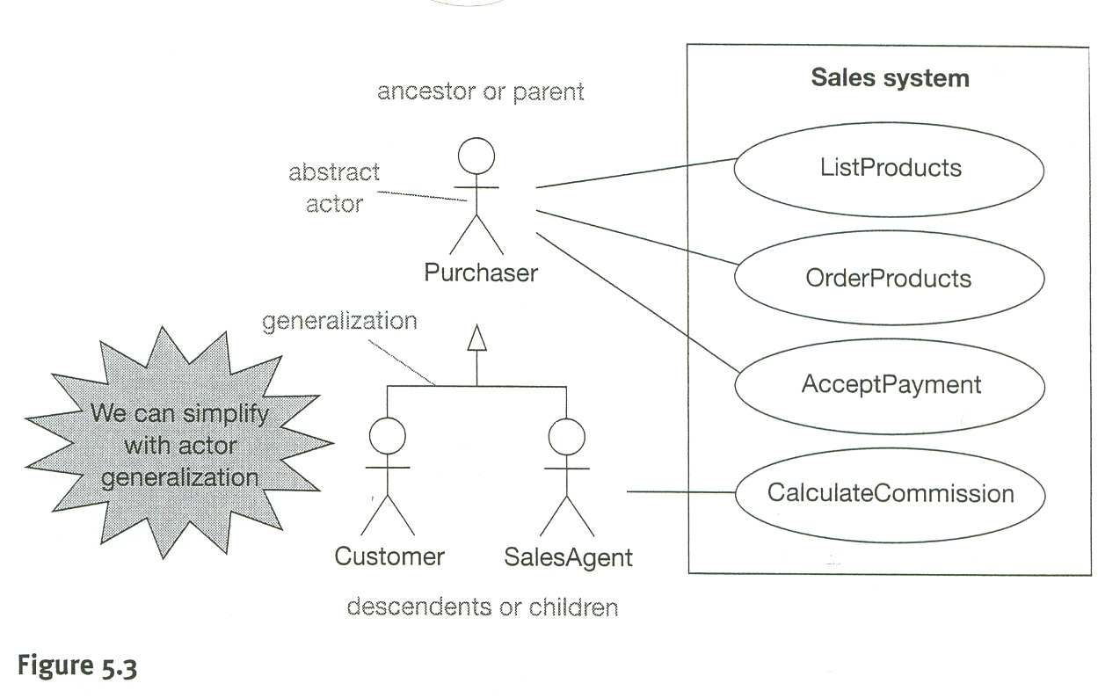
Actor Generalization
Fig. 5.3
22
Advanced Use Case Modeling
Notes:
22

Slide 23
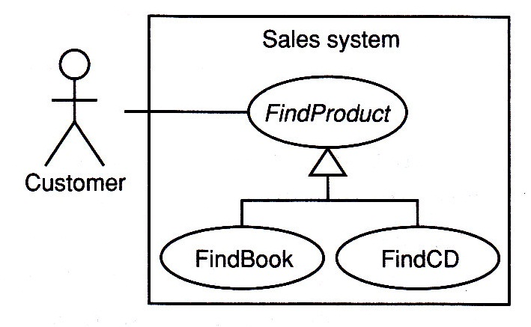
Use Case Generalization
Fig. 5.4
23
Advanced Use Case Modeling
Notes:
23

Slide 24
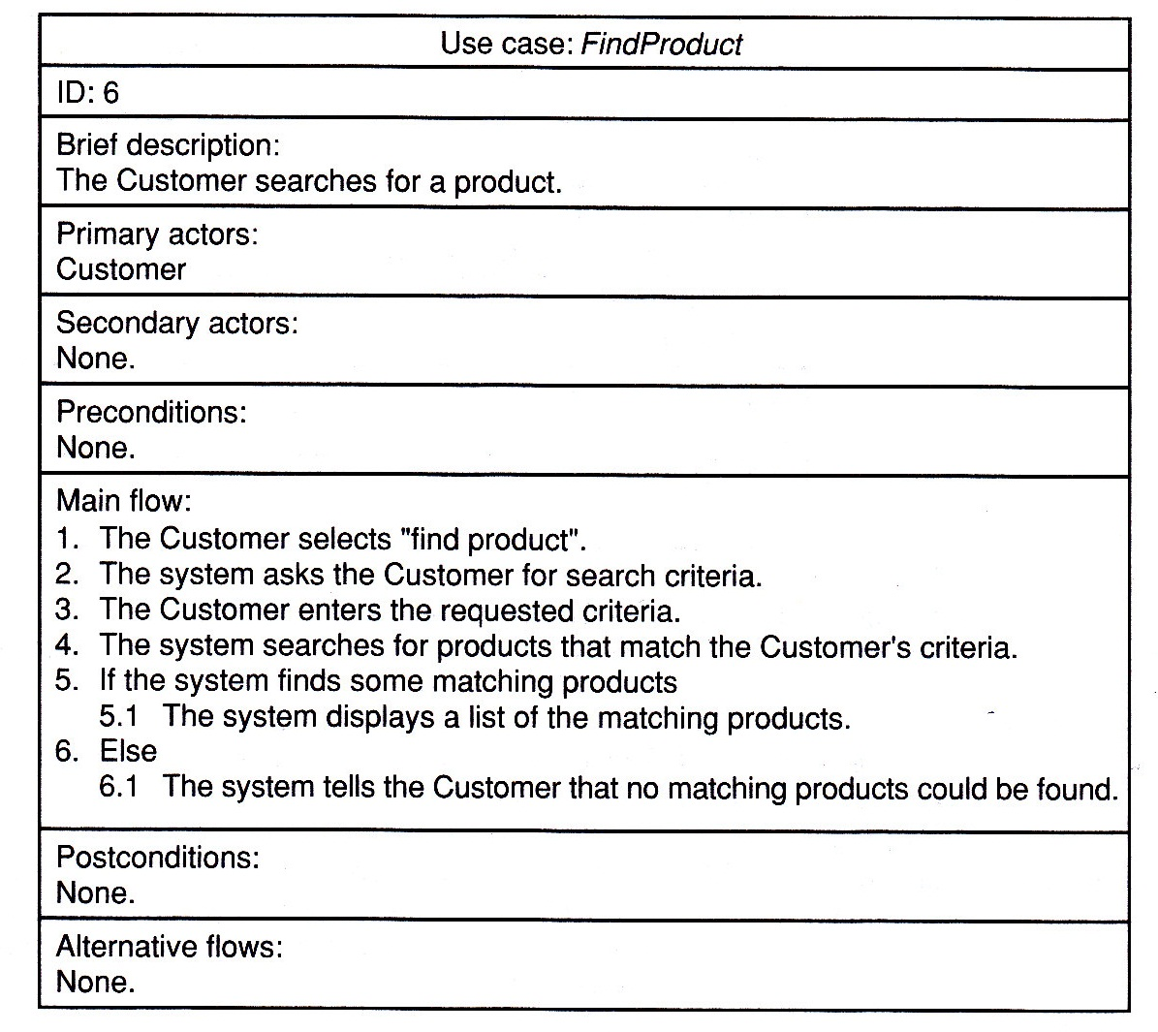
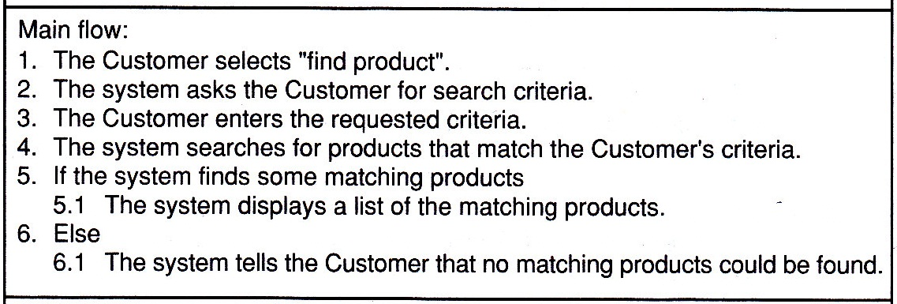
Use Case Generalization
Fig. 5.5
24
Advanced Use Case Modeling
Notes:
24

Slide 25
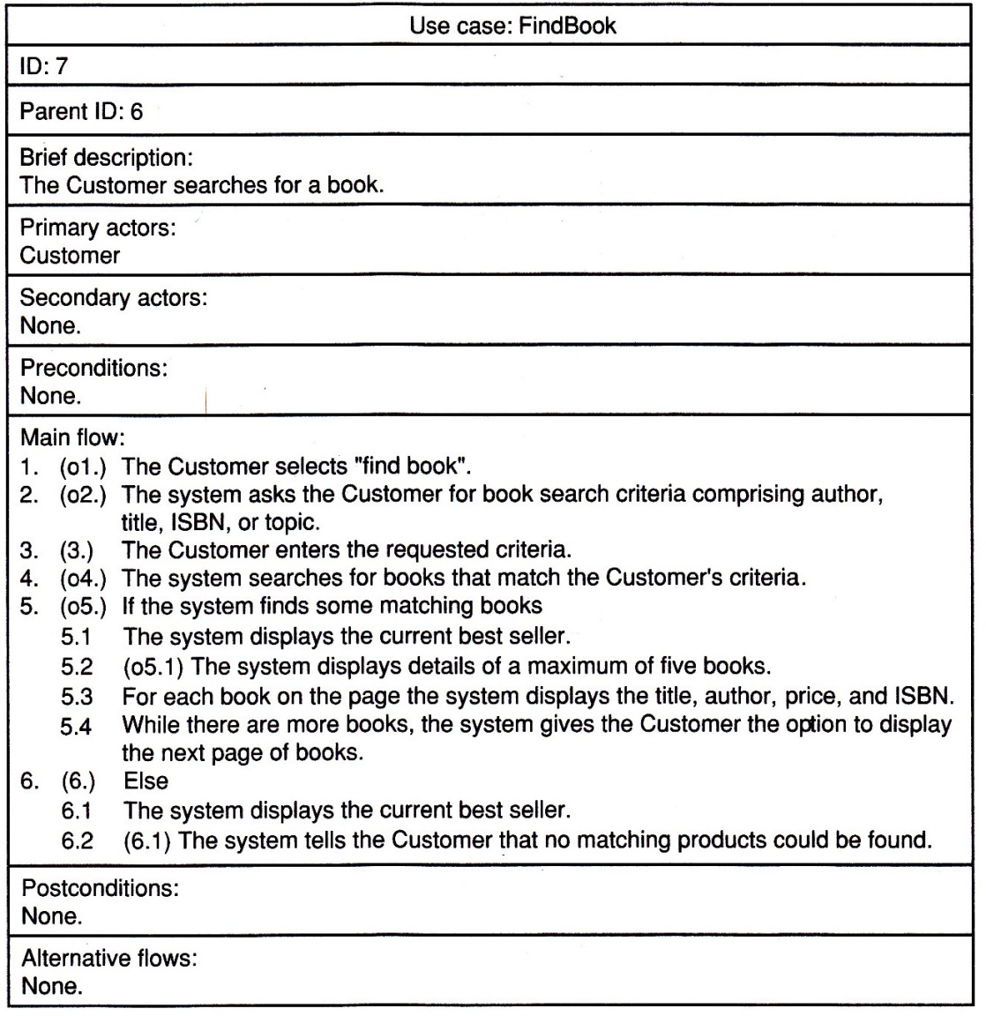
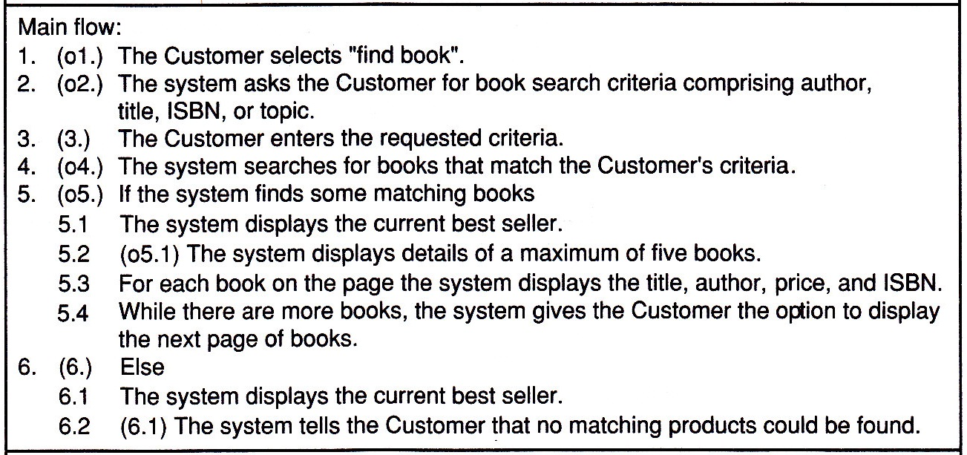
Use Case Generalization
Fig. 5.6
25
Advanced Use Case Modeling
Notes:
25

Slide 26
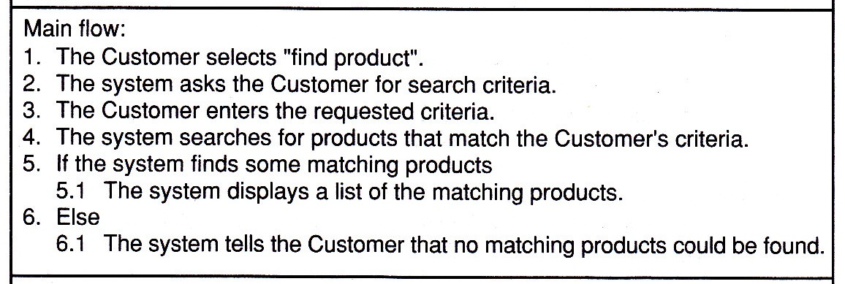
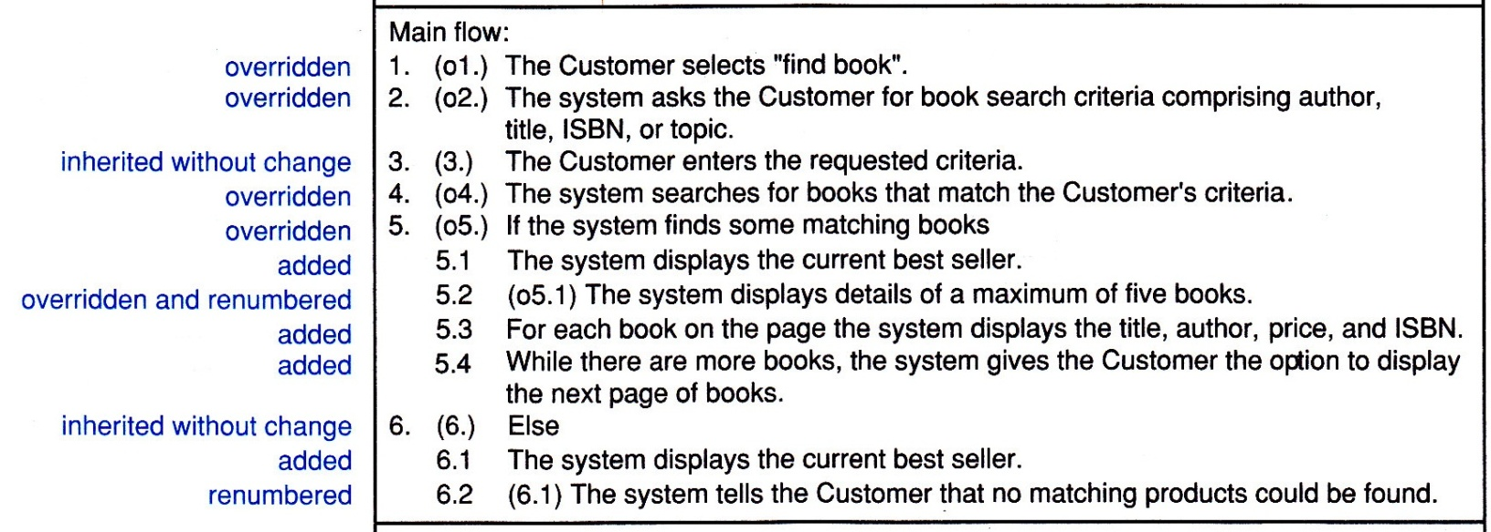
Use Case Generalization
26
Notes:
26

Slide 27
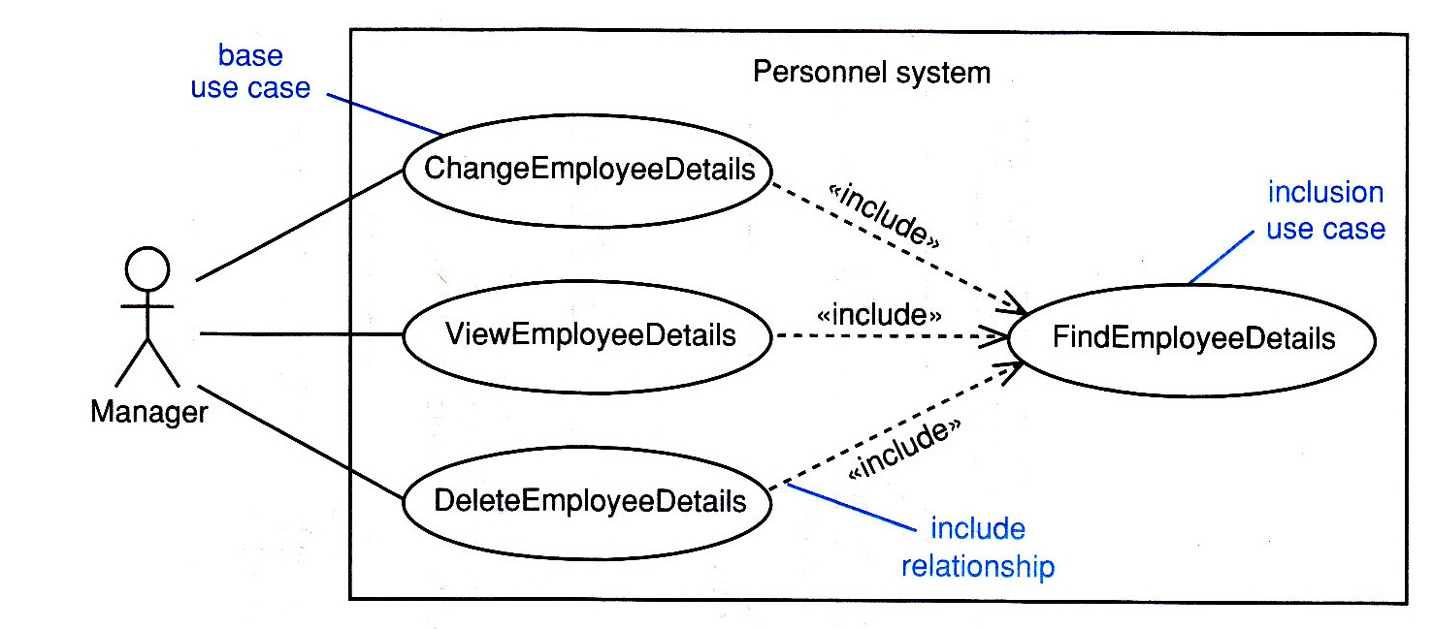
Inclusion
Fig. 5.7
27
Advanced Use Case Modeling
Notes:
27

Slide 28
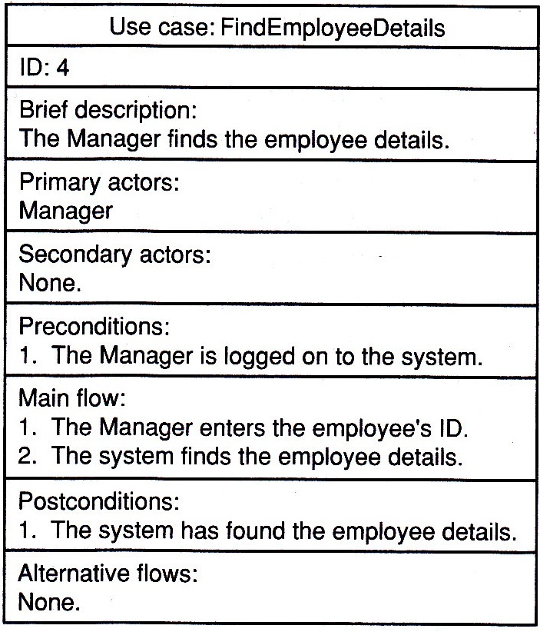
Inclusion
Fig. 5.9
28
Advanced Use Case Modeling
Notes:
28

Slide 29
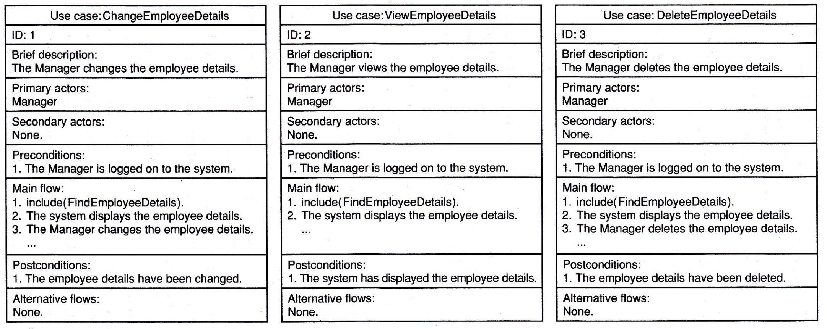
Inclusion
Fig. 5.8
29
Advanced Use Case Modeling
Notes:
29

Slide 30
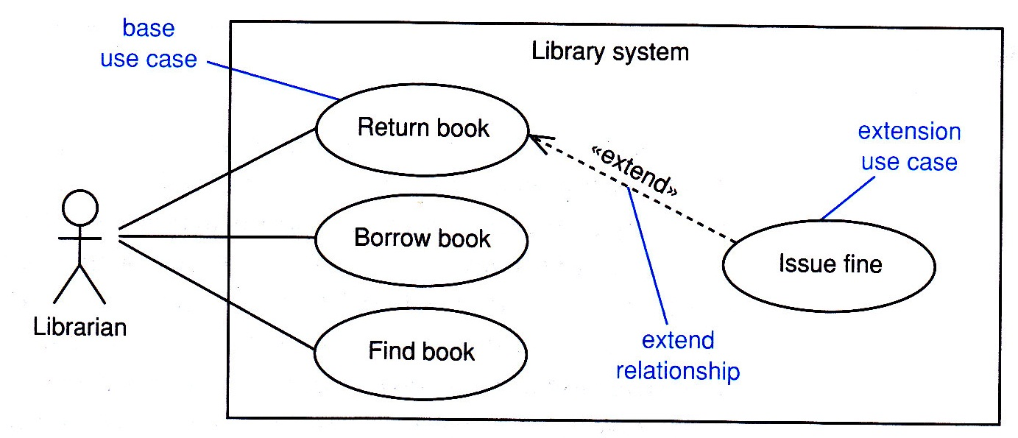
Extension
Fig. 5.10
30
Advanced Use Case Modeling
Notes:
30

Slide 31
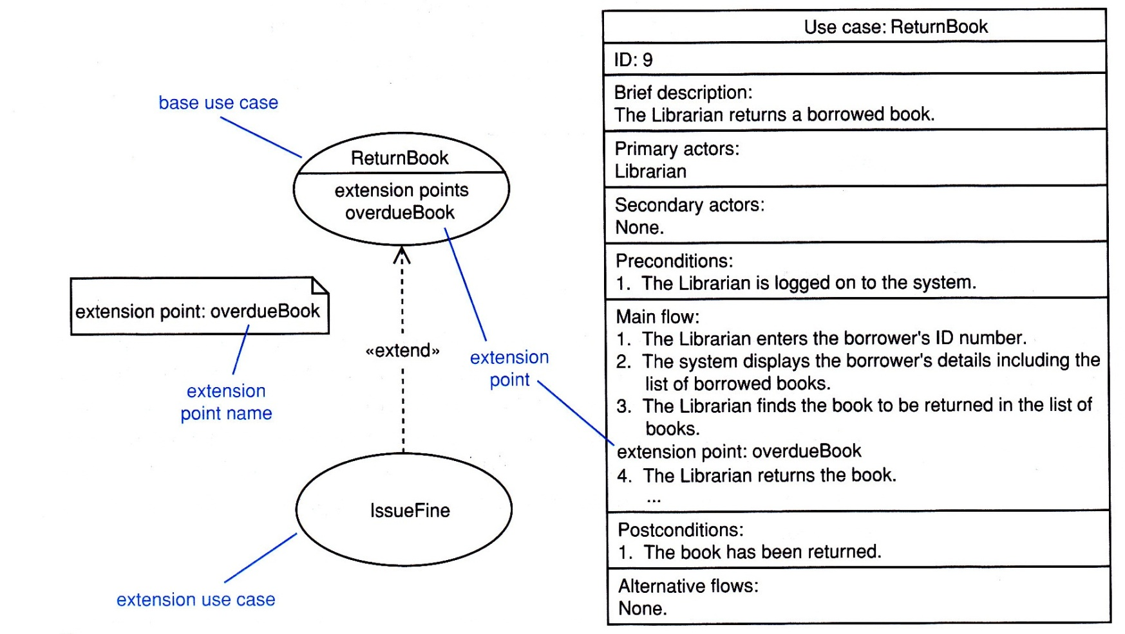
Extension
Fig. 5.11
Advanced Use Case Modeling
31
Notes:
31

Slide 32
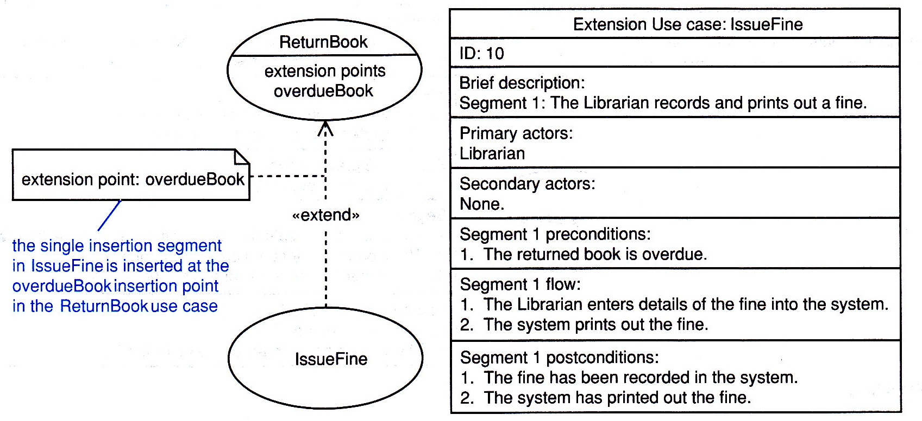
Extension
Fig. 5.12
32
Advanced Use Case Modeling
Notes:
32

Slide 33
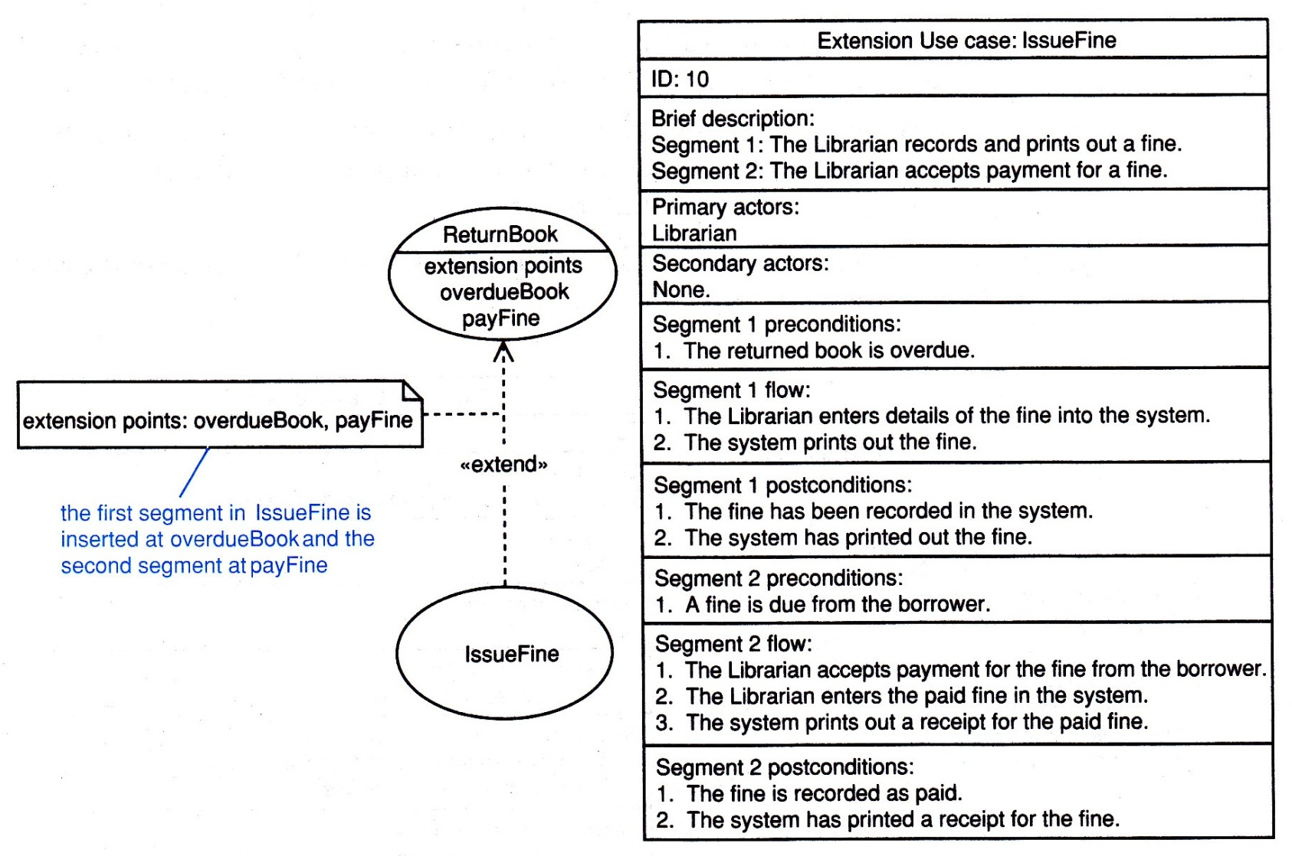
Extension
Fig. 5.13
33
Advanced Use Case Modeling
Notes:
33

Slide 34
When to use advanced features?
Use advanced features when they simplify the model
Heavy use of <<include>> should be avoided
Many stakeholders, including object modelers misunderstand <<extend>>
Avoid use case generalization unless abstract parent use cases are used
34
Advanced Use Case Modeling
Notes:
34

Slide 35
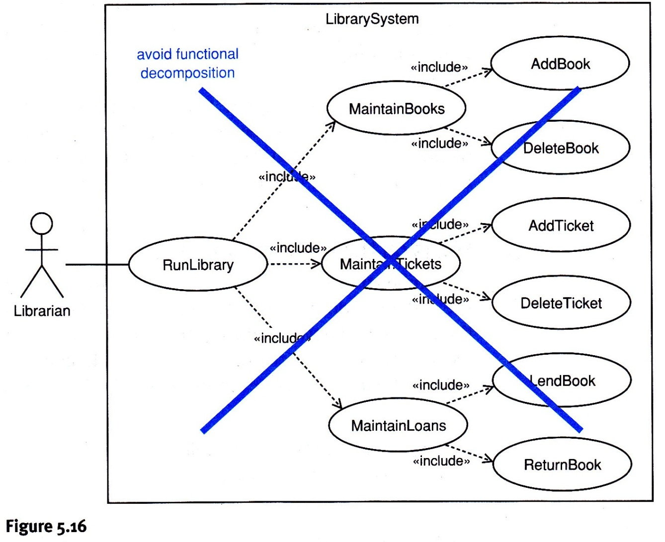
When to use advanced features?
Avoid functional
decomposition!
35
Advanced Use Case Modeling
Notes:
35

