Slide 1
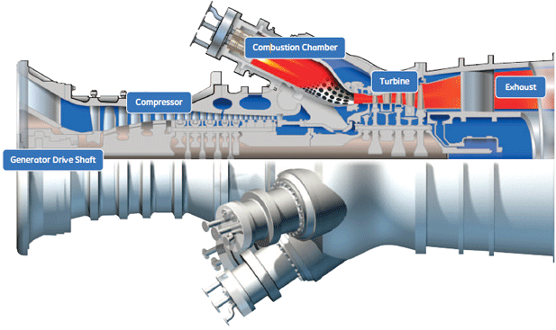
Software Engineering
2010 Project Ideas
General Electric

Slide 2
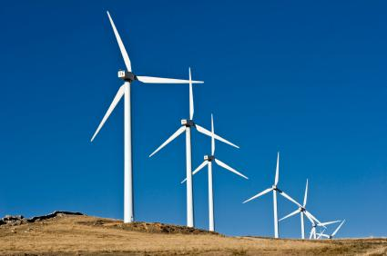
Introduction
What do we do
  Machine Monitoring
  Turbines, Wind Energy, Hydro Electric
How
  Vibration
  Temperature, Pressure, Flow, Power

Slide 3
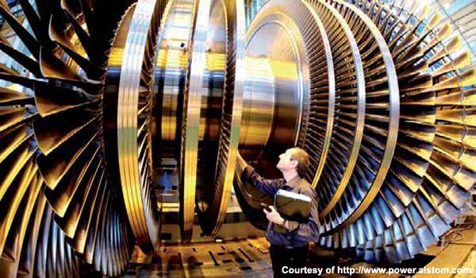
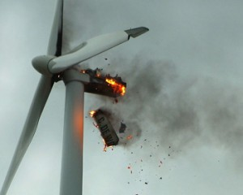
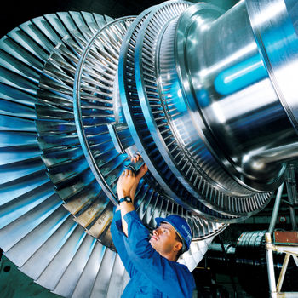
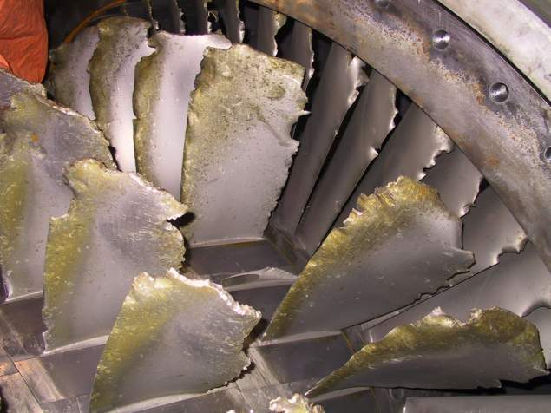
Why…

Slide 4
Project Ideas
Fault Advisor
  Training and Advisory tool for automated diagnostics
Machine Health Card
  Mini-Report tool to show vital information about a machine in a single card
Mobile App
  Mini Application on mobile phone, Droid or iPhone or Windows7 maybe
Statistical Alarming
  Number crunching and statistical processing to provide alarm levels
Dashboard
  Dashboard like display for plant managers to see how their plant is performing at a glance
Report Builder
  Tool to allow users to create their own custom report formats
Sticky Notes
  Virtual whiteboard to share sticky notes across large project teams.

Slide 5
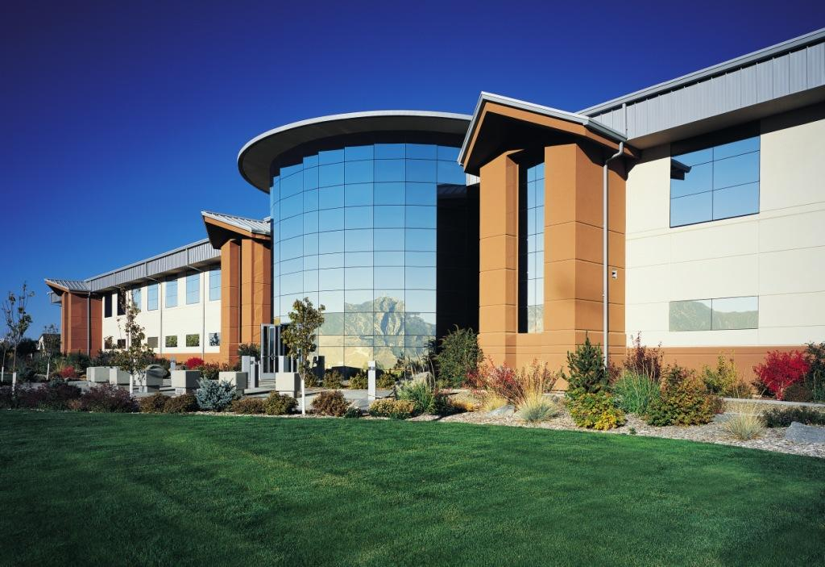
Interested?
Ken Ceglia
Principle Engineer
General Electric
ken.ceglia@ge.com
Office: 775-215-1863
Cell: 775-901-6706
Fun, Explore, Create and Experience, Stipend

