Slide 1
CS 791z
Graduate Topics on Software Engineering
Sarah Beecham, Padraig O’Leary, Sean Baker,
Ita Richardson, and John Noll (2014),
Making Software Engineering Research Relevant,
IEEE Computer 47 (4): 80-83.
University of Nevada, Reno
Department of Computer Science & Engineering

Slide 2
Outline
Introduction
What kind of support are practitioners looking for?
Where do they go for support?
The practice-research paradox
Guidelines for making SE research relevant

Slide 3
A Look at the Practice-Research Divide in SE

Slide 4
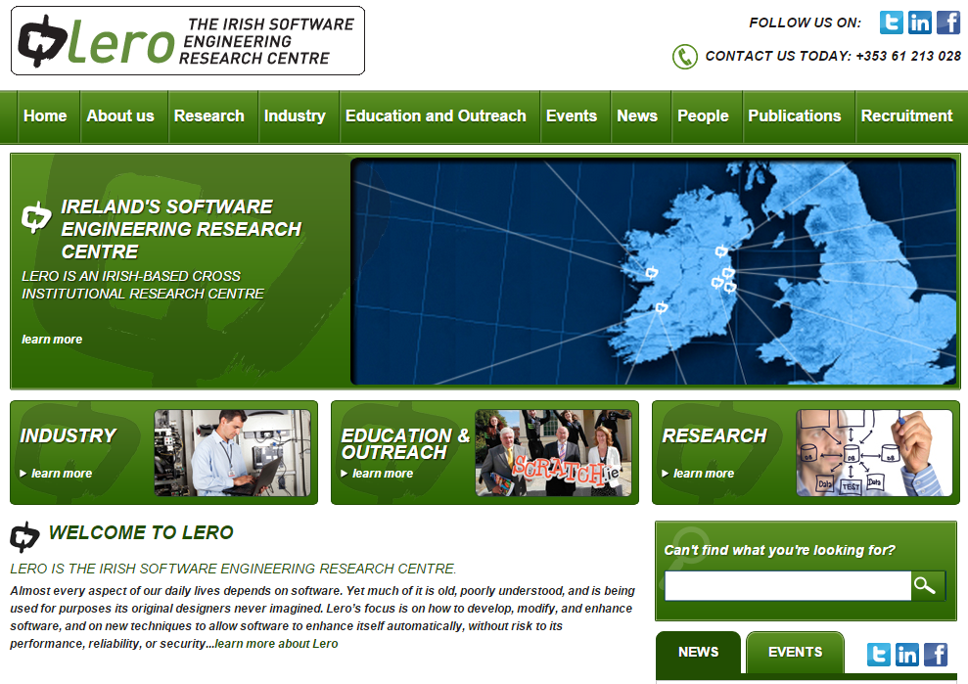
A LERO Perspective
http://www.lero.ie/videos/overviewvideo

Slide 5
Introduction
Software practitioners rarely look to academic literature for new and better ways to develop software
Example taken by the authors of the paper: global software engineering (GSE)
In prior work, the authors had created a Decision Support System (DSS) for Global Team Management

Slide 6
Introduction
The prototype DSS was used to test the market
The initial goal was to explore practitioners’ views on GSE research and gauge their interest in the idea of a GSE-focused DSS
The test group included practitioners form organizations such as Google, Microsoft, Oracle
Senior managers and project managers were interviewed

Slide 7
What Kind of Support Are Practitioners Seeking?
Respondents indicated challenges in GSE such as:
Culture – mismatched work ethics, languages, religions
Communication overhead
Different time zones across sites
Tool mismatch
Vendor selection
Sourcing skills
Task allocation
Relevant and timely conversations
Inability to roll out best practices across sites, etc.
All these have been researched by a decade by LERO authors and many others (see next slide)
Yet, practitioners do not read GSE research!

Slide 8
What Kind of Support Are Practitioners Seeking?

Slide 9
What Kind of Support Are Practitioners Seeking?
Possible causes:
GSE is considered mainstream SE (general project management)
Also, practitioners seem to look for patterns of context-specific help, rather than frameworks
Finally, experience-based advice seems to trump it all
So, where are the practitioners looking for support?
… see next page …

Slide 10
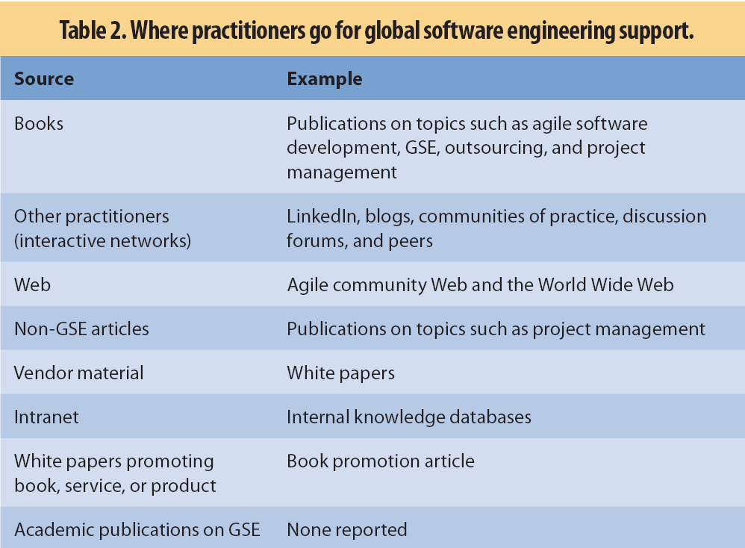
Where Do Practitioners Really Go for Support?
Interfaces and Components

Slide 11
Where Do Practitioners Go for Support?
First, practitioners depend on their own experience
Then, their main source of support comes from peers
Next, they rely on resources such as books, blogs, wikis, and own corporate intranets
Robert Glass signaled the practice-research divide in an 1996 Communications of the ACM article
The idea was that researchers did not have the required experience to make their theories the solution of choice
Indeed, the key problem seems to be: can we really expect practitioners to apply a theory that hasn’t been proven in practice first?

Slide 12
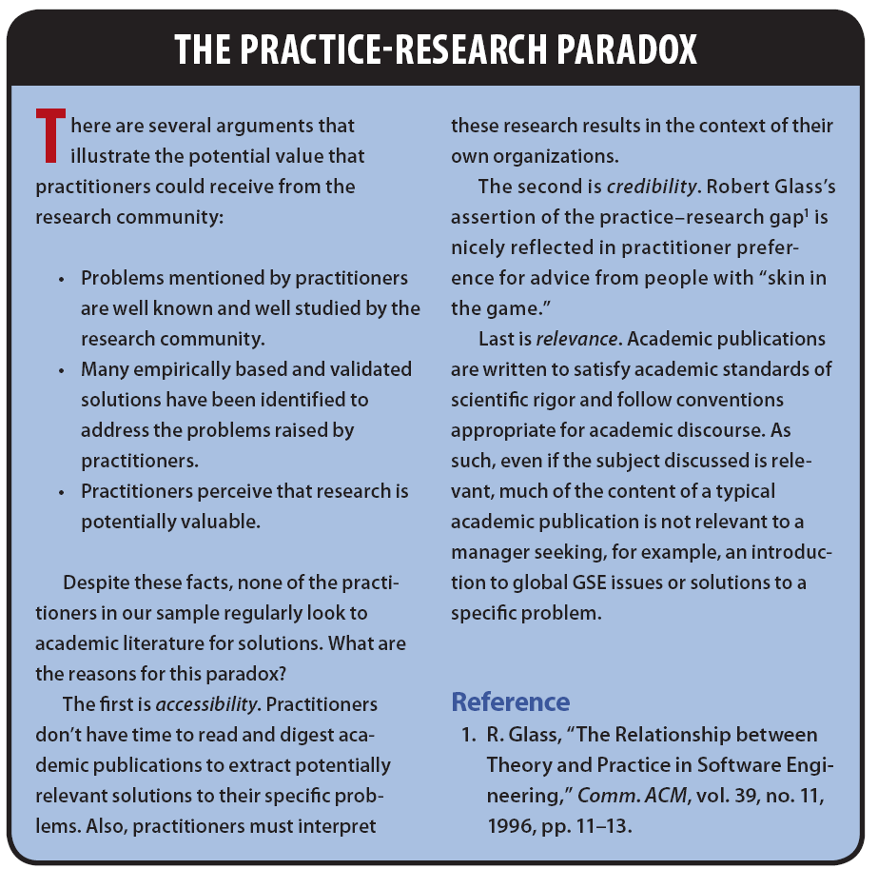

Slide 13
Making Research Accessible
The LERO group concluded that GSE research is not reaching its target audience
This happens because research results are often inaccessible, lack credibility, and are irrelevant
Their study was indeed small and highly selective, but still likely representative for the actual situation in the SE industry
Caveat: none of known practitioners that straddle the research-practice divide were interviewed
So, what can be done?

Slide 14
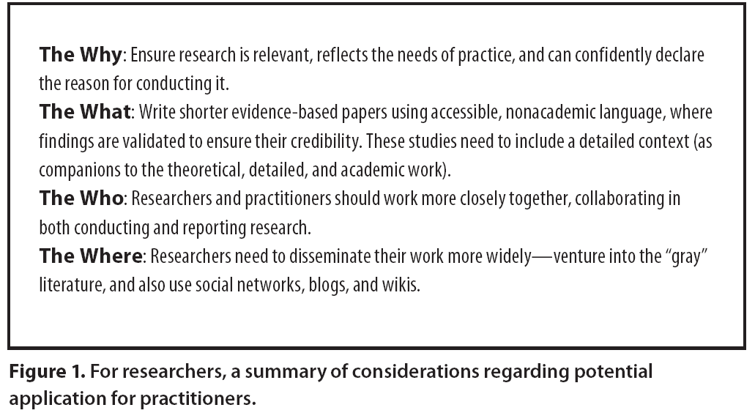
Making Research Accessible: Guidelines

Slide 15
Spin off questions
What is your own experience with the practice-research divide in SE?
How much of this divide (gap, or paradox) exists in other areas of CSE research? (consider robotics, computer vision, etc…). If there are differences from SE, try to explain them.
What other approaches/strategies could help reduce the practice-research divide?

