Slide 1
CS 791Graduate Topics in Computer Science [Software Engineering]
Mary Shaw, What Makes Good Research in Software Engineering?, International Journal Software Tools for Technology Transfer, 2002, 4(1): 1-7.
University of Nevada, Reno
Department of Computer Science & Engineering

Slide 2
Outline
Introduction
Questions, Results, and Validation in Software Engineering
Research Strategies
Summary

Slide 3
Introduction
Physics, biology, and medicine have well-defined explanations of their research process
Software engineering has not yet explicitly explained its research processes or how to recognize excellent research
So, what are generally accepted research strategies in SE?

Slide 4
Introduction
Key questions in scientific and engineering research:
What kind of questions are “interesting”?
What kind of results can answer these questions, and what methods can produce these results?
What kind of evidence can demonstrate the validity of the results, and how can we distinguish good results from bad results?
Interfaces and Components

Slide 5
Introduction: Software Technology Maturation
Redwine and Riddle (1984, 1985) found that it takes 15-20 years for a new technology to evolve from concept to popularization
Typical phases:
Basic research
Concept formulation
Development and extension
Internal enhancement and exploration
External enhancement and exploration
Popularization

Slide 6
Introduction: Prior Reflections on SE Research
Critiques of experimental SE:
Tichy et al [1995, 1998] indicated that “computer scientists publish relatively few papers with experimentally validated results”
They found that 43% of CS modeling and design papers lacked experimental evaluation, and SE samples were worse than CS
Zelkowitz and Wallace [1997, 1998] examined over 600 CS papers over a 10-year period and found that too many have no experimental validation or only informal validation
The implied premise is that SE research should follow a classical experimental paradigm. But, what is high quality SE research?

Slide 7
Introduction: Analyzing Research with Pro Forma Abstracts
Newman [1994] analyzed publications in 5 engineering fields and found that 90% of them were of 3 types:
Enhanced analytical modeling techniques – tell if a design is practicable or make performance predictions
Enhanced solutions – overcome problems, or are easier to analyze with existing modeling techniques
Enhanced tools and methods – used for applying analytical; models or building functional models or prototypes
Part of a pro forma abstract:
Existing <model-type> models are deficient in dealing with <properties> of <solution strategies>. An enhanced <model-type> is described, capable of providing more accurate analyses/predictions …

Slide 8
Introduction: Broad View of Research
Brooks [1988] noticed the tension in HCI research between
Narrow truths proved by statistically sound experiments
Broad truths, generally applicable, supported only by unrepresentative observations
He proposed three classes of results (good for HCI and SE):
Findings – well established truths, judged by rigor
Observations – reports on actual phenomena, judged by interestingness
Rules of thumbs – individual generalizations, judged by usefulness

Slide 9
Questions, Results and Validation in SE
Generally, software engineering researchers seek improved ways to develop and evaluate software
They are motivated by practical problems
Key objectives of research are often quality, cost, and timeliness of the software
Mary Shaw proposes a model for SE research with the following components:
Types of research questions
Types of research results
Types of research validations

Slide 10
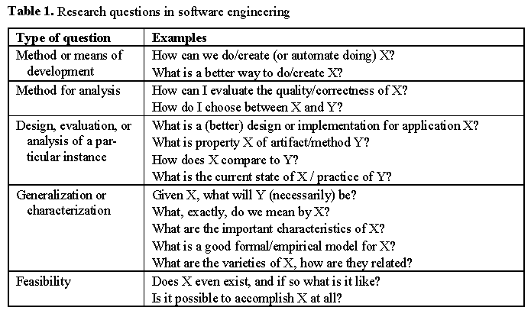
Research Questions in SE

Slide 11
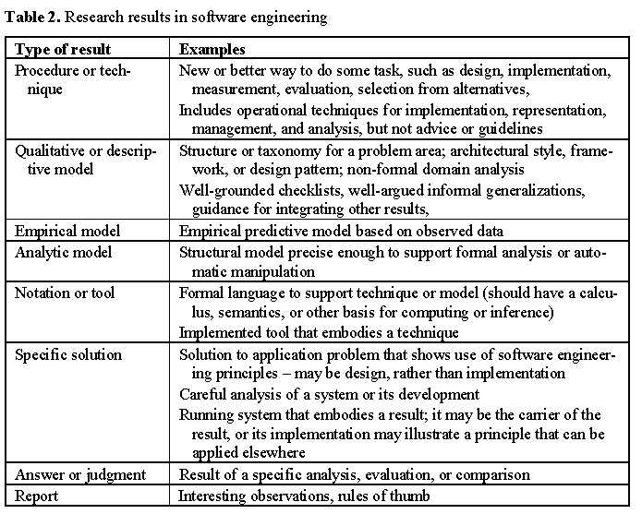
Research Results in SE

Slide 12
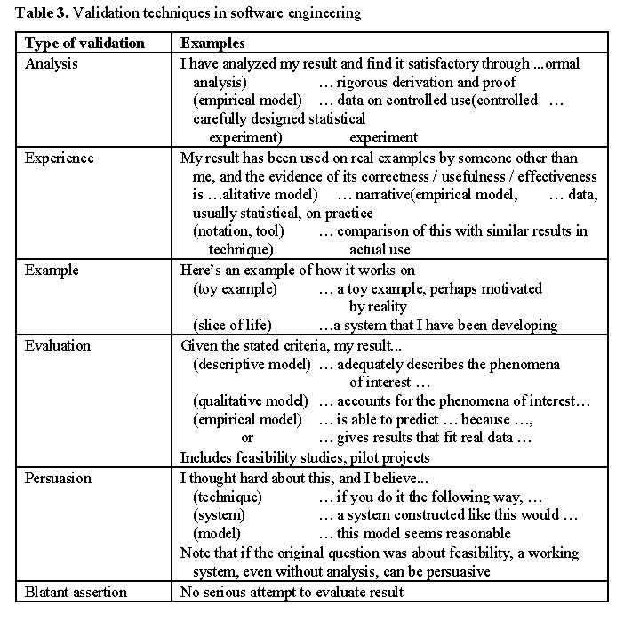
Research Validation in SE

Slide 13
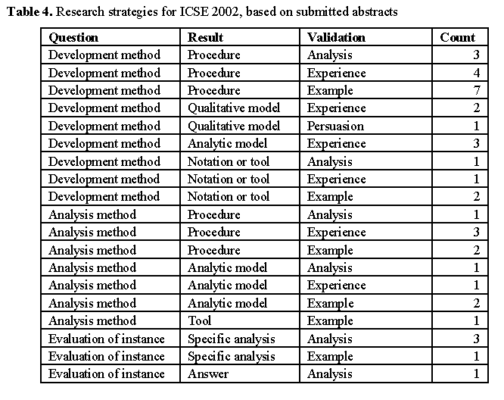
Research Strategies (ICSE-2002)

Slide 14
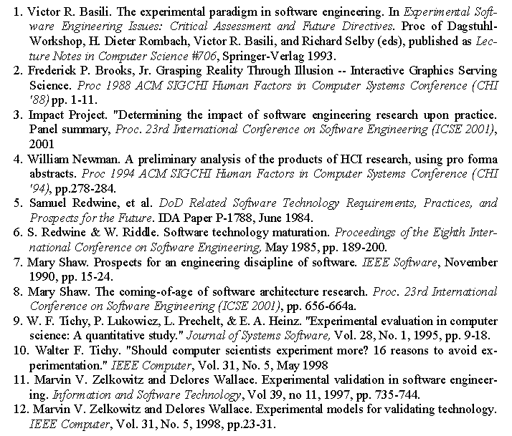
References

