Slide 1
CS 791z
Graduate Topics on Software Engineering
Carlos E. Otero and Adrian Peter (2015),
Research Directions for Engineering
Big Data Analytics Software,
IEEE Intelligent Systems 30 (1): 13-19.
University of Nevada, Reno
Department of Computer Science & Engineering

Slide 2
Outline
Introduction
Actionable Intelligence
Big Data Analytics Software Engineering
The Requirements Problem
The Design Problem
The Construction Problem
The Testing Problem
The Road Ahead

Slide 3
Engineering Big Data Analytics Software

Slide 4
Introduction
What is big data?
What is big data software?
Can this software be engineered?

Slide 5
Introduction
What is big data?
Infrastructure perspective: 3V+U (high volume, velocity, and variety + unpredictability)
Analytics perspective: data so large that it contains significant low probability events otherwise absent from regular data
Business perspective: data that offer opportunities for gaining actionable intelligence
Also (infrastructure): data so large that current typical methods cannot process it

Slide 6
Introduction
Now, what is big data software?
Software that supports the time-constrained processing of continuous information flows to provide actionable intelligence
Characteristics:
Includes both infrastructure software and analytics software (big throughput + big analytics software)
Time-constrained (late response is wrong response)
Continuous information flow (see big data’s 3V and data streams)
Actionable intelligence, which produces information directly usable for strategic, operational, or tactical goals

Slide 7
Actionable Intelligence
Actionable intelligence goes beyond finding and summarizing data; it stresses the discovery of patterns that can be used to predict concepts, events, trends, opinions, etc. to support decision-makers.
Three levels of actionable intelligence (ai):
L1: Supervised ai
L2: Semi-supervised ai
L3: Unsupervised ai

Slide 8
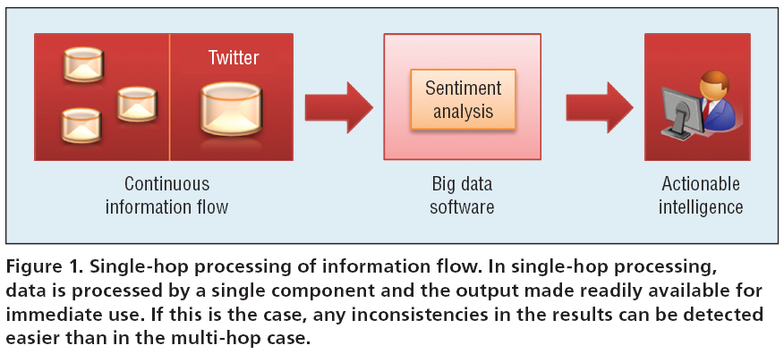
Intelligence production process
Single hop intelligence production process

Slide 9
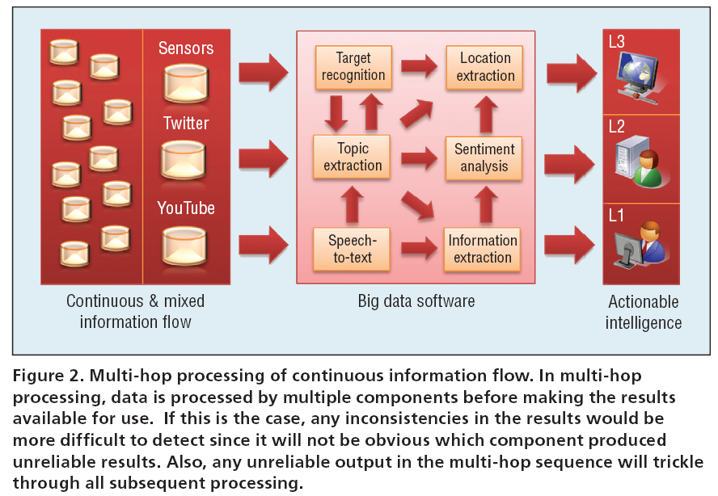
Intelligence production process
Multi hop intelligence production process

Slide 10
Big Data Analytics Software Engineering
Challenges encountered when engineering big data software pertain to:
Requirements specification
Design
Construction
Testing

Slide 11
Big Data Analytics Software Engineering
The Requirements Problem: in essence, consists of dealing with time constraints and concept drifts (changes in statistical properties of the concept to be learned)
Regular software
Real-time software
Big-data software

Slide 12
Big Data Analytics Software Engineering
The addition of p (period of validity) requires a paradigm shift in how software contracts are thought about
Mainstream applications for big data software encompass software for national security, government policy-making, and safety-critical applications

Slide 13
Big Data Analytics Software Engineering
The Design Problem includes:
Usability
Performance
Reliability: the state-of-the-art is insufficient to verify reliability; suggested approaches include adapting old and creating new architecture tactics (e.g., change detection components, detectors of software misbehavior)
Availability
Security: challenges include adversarial machine learning, execution-phase-attacks, training-phase-attacks, denial of service
Interoperability
Scalability
Testability, etc.

Slide 14
Big Data Analytics Software Engineering
The Construction Problem encompasses:
Big data software requires more than just programming skills
Lack of tools and frameworks that support assistive development (e.g., tools such as Excel, Octave, R, WEKA are not big data tools)
The need for multi-processing technologies such as CUDA, GPUs, Map-Reduce, and Hadoop (new solutions are being created, e.g., Mahout, Spark -built on Scala- and Storm)
The need for distributed database technologies underlying analytics computations (e.g., NoSql, SciDB)
The requirement for multimedia processing, which increases complexity

Slide 15
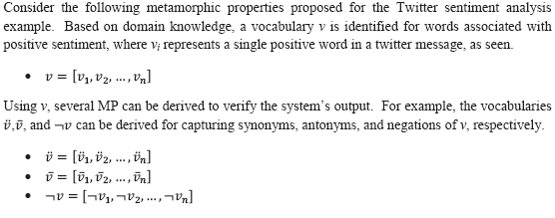
Big Data Analytics Software Engineering
The Testing Problem encompasses:
Big data processing is impractical for humans, and many defects can go unnoticed
Untrustworthy data, bad assumptions, incorrect mathematics
Big data software belong to the class of non-testable software
A possible approach: metamorphic testing

Slide 16
The Road Ahead
SE research needed on
Architectures, tools, frameworks
Visualization and infrastructure software
Usability of adaptive learning systems
Parallel processing
Data architecture and database management

