Slide 1
CS 791 SE
Project P#1 Preparation
1. UML-based Requirements
From Chapter 3 of [Jim Arlow and Ila Neustadt, UML 2 and the Unified Process, Addison-Wesley, 2005]
University of Nevada, Reno
Department of Computer Science & Engineering

Slide 2
Outline
Requirements workflow details
The importance of requirements
Defining requirements

Slide 3
The Requirements Workflow
The purpose of the requirements workflow is to reach an agreement on what the system should do, expressed in a way accessible to the users of the system
Requirements engineering involves various activities: elicitation, negotiation, conflict resolution, prioritization, documentation, and maintenance of requirements
Various stakeholders are involved in establishing the set of requirements for the system
UML uses cases describe functional requirements, but non-functional requirements need different description

Slide 4
Requirements Workflow Detail
Arlow and Neustadt extend slightly the use case modeling
workflow with the addition of new tasks: find functional
requirements, find non-functional requirements, prioritize
requirements, & trace requirements to use cases.

Slide 5
The Importance of Requirements
Requirements engineering is about establishing what the stakeholders need from the system
Poor requirements engineering is the major cause of software project failure
The second major cause of software project failure is lack of user participation

Slide 6
Defining Requirements
Requirement: “a specification of what should be implemented”
There are two types of requirements:
Functional requirements: describe the desired behavior of the system
Non-functional requirements: specify particular properties of or constraints on the system
In theory, the set of requirements should be only about “what” the system should do, but in practice it is not possible to avoid “how” aspects of the system

Slide 7
Defining Requirements
Simple format recommended for well-formed requirements:
<id> The <system> shall <function>
Examples of functional requirements (what the system should do):
1 The ATM shall check the validity of the ATM card inserted
2 The ATM shall validate the PIN number entered by the client
3 The ATM shall allow the user to deposit cash
Examples of non-functional requirements (constraints on or properties of the system):
1 The ATM shall be written in C++
2 The ATM shall validate the PIN in three seconds or less

Slide 8
Defining Requirements
Organizing requirements: when there are many requirements, a more complex taxonomy can be used, e.g.
Functional requirements
Customers
Products
Orders
Sales channels
Payments

Slide 9
Finding Requirements
Requirements come from the context of the system:
Direct users
Other stakeholders (e.g., managers, maintainers, installers)
Other systems that interact with the system
Hardware devices attached to the system
Legal and regulatory constraints
Technical constraints
Business goals

Slide 10
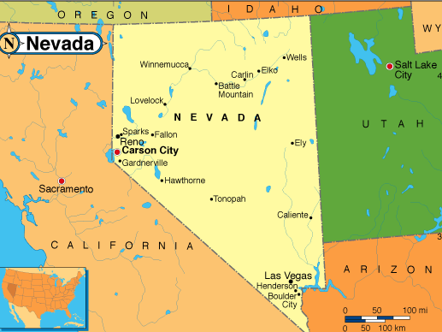
Finding Requirements
The map is not the territory
When modeling, we apply three cognitive filters that simplify our effort [Chomsky, 1975]:
Deletion
Distortion
Generalization

Slide 11
Finding Requirements
In requirements specification we need to identify the application of the above filters and find “challenges” for them to recover information
In particular, universal quantifiers such as
All
Everyone
Always
Never
Nobody
None
should be inspected closely for accuracy

Slide 12
Finding Requirements
Interviews:
Don’t imagine a solution
Ask context-free questions
Listen
Don’t mind read
Have patience

Slide 13
Finding Requirements
Questionnaires
Cannot substitute the interviews
Can supplement the interviews
Good at getting answers to closed questions

Slide 14
Finding Requirements
Requirements workshop
Participants
Facilitator
Requirements engineer
Stakeholders
Domain experts
Procedure
Brainstorm (accept all ideas)
Identify key requirements
Iterate over identified requirements, note additional attributes
After the meeting
Analyze results and turn them into requirements
Circulate results for comments

Slide 15
CS 420/620 HCI
Project P#2 preparation
Use Case Modeling with UML
From Chapters 4 and 5 of [Jim Arlow and Ila Neustadt, UML 2 and the Unified Process, Addison-Wesley, 2005]
University of Nevada, Reno
Department of Computer Science & Engineering

Slide 16
Outline
Use case modeling
Overview
Finding actors and use cases
Use case specification
Requirements tracing
16
Use Case Modeling
Notes:
16

Slide 17
Use Case Modeling: Overview
The Use Case Model consists of the following:
Actors
Use cases
Relationships
System boundary
Steps of use case modeling:
Find the system boundary
Find the actors
Find the use cases
17
Use Case Modeling
Notes:
17

Slide 18
Finding Actors and Use Cases
An actor is a role taken by an external entity when interacting with the system directly
An actor is a stereotype of class with its own icon
18
Use Case Modeling
Notes:
18

Slide 19
Finding Actors and Use Cases
An actor
Is always external to the system
Interacts directly with the system
Represents a role played by people or things, not specific people or things
Use cases
Are always started by an actor
Are always written from an actor’s point of view
19
Use Case Modeling
Notes:
19

Slide 20
Finding Actors and Use Cases
According to Rumbaugh, a use case is
a specification of sequences of actions, including variant sequences and error sequences, that a system, subsystem, or class can perform by interacting with outside actors
Use Case Modeling
20
Notes:
20

Slide 21
Finding Actors and Use Cases
Examples of use cases:
Names of use cases should be verb phrases
Candidate use cases can be discovered starting from the list of actors (how they interact with the system?)
Finding use cases is an iterative process
21
Use Case Modeling
Notes:
21

Slide 22
Finding Actors and Use Cases
Questions you can ask to identify use cases:
What functions a specific actor wants from the system?
Does the system store and retrieve information? If yes, which actors are involved?
Are any actors notified when the system changes state?
Are any external events that affect the system? What notifies the system about these events?
22
Use Case Modeling
Notes:
22

Slide 23
Finding Actors and Use Cases
The use case diagram shows the system boundary, the use cases internal to the system, and the actors external to the system
Use Case Modeling
23
Notes:
23

Slide 24
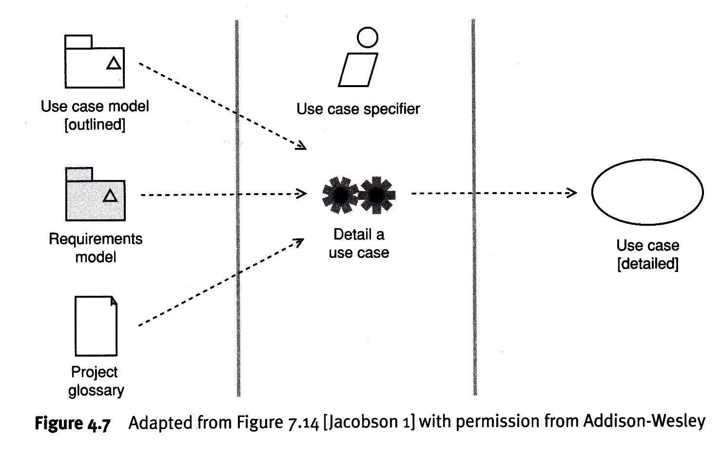
Finding Actors and Use Cases
Fig. 4.7 [Arlow & Neustadt 2005]
24
Notes:
24

Slide 25
Finding Actors and Use Cases
The project glossary
Important project artifact
Provides a dictionary of key business terms
Captures business language and jargon
Should resolve synonyms and homonyms
Should be understandable by all stakeholders
UML does not set a standard for the project glossary
25
Use Case Modeling
Notes:
25

Slide 26
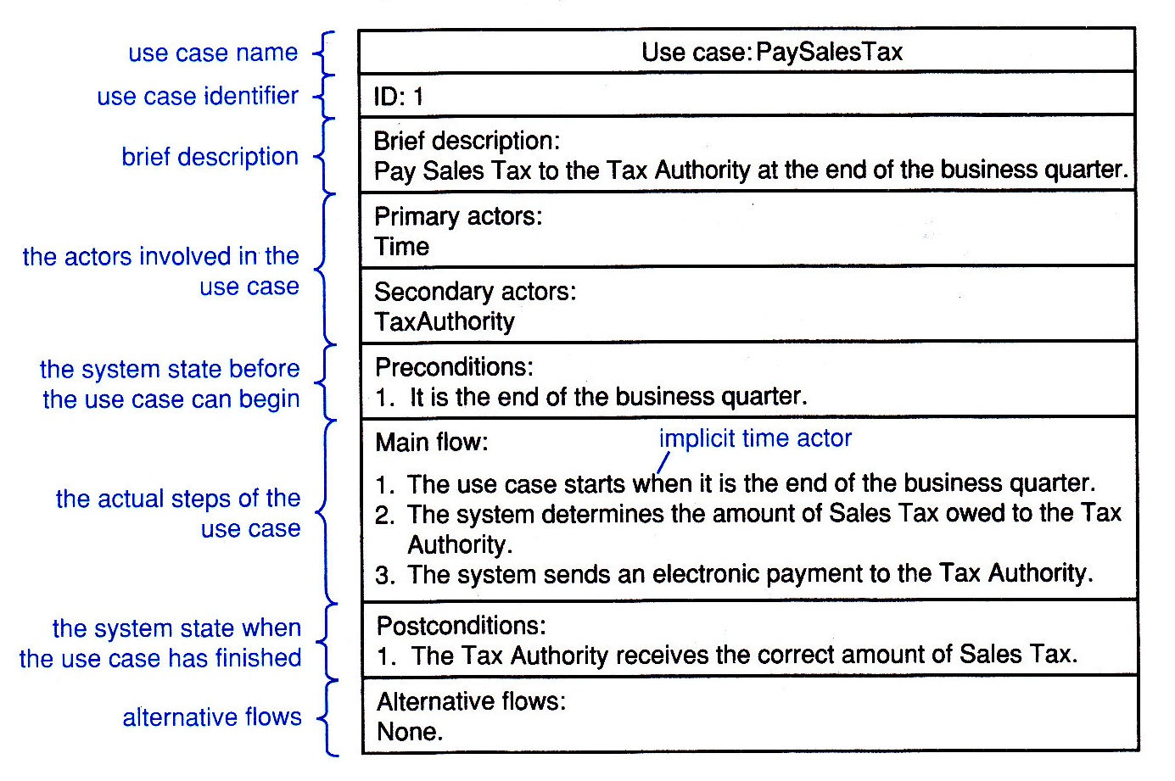
Use Case Specification
The output of this activity is a more detailed use case that consists at least of the use case name and use case specification
Most common template for use case specification
26
Use Case Modeling
Notes:
26

Slide 27
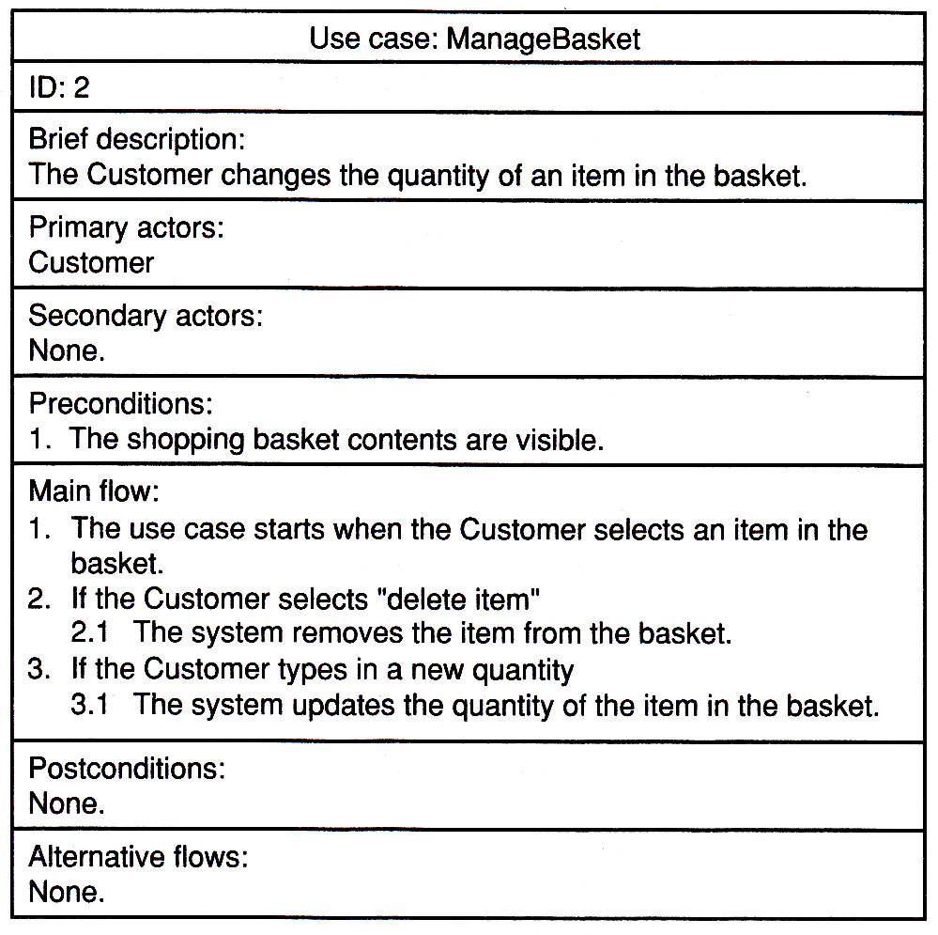
Use Case Specification
Branching, repetition, and alternative flows are possible in a use case
Example of branching using the keyword IF
27
Use Case Modeling
Notes:
27

Slide 28
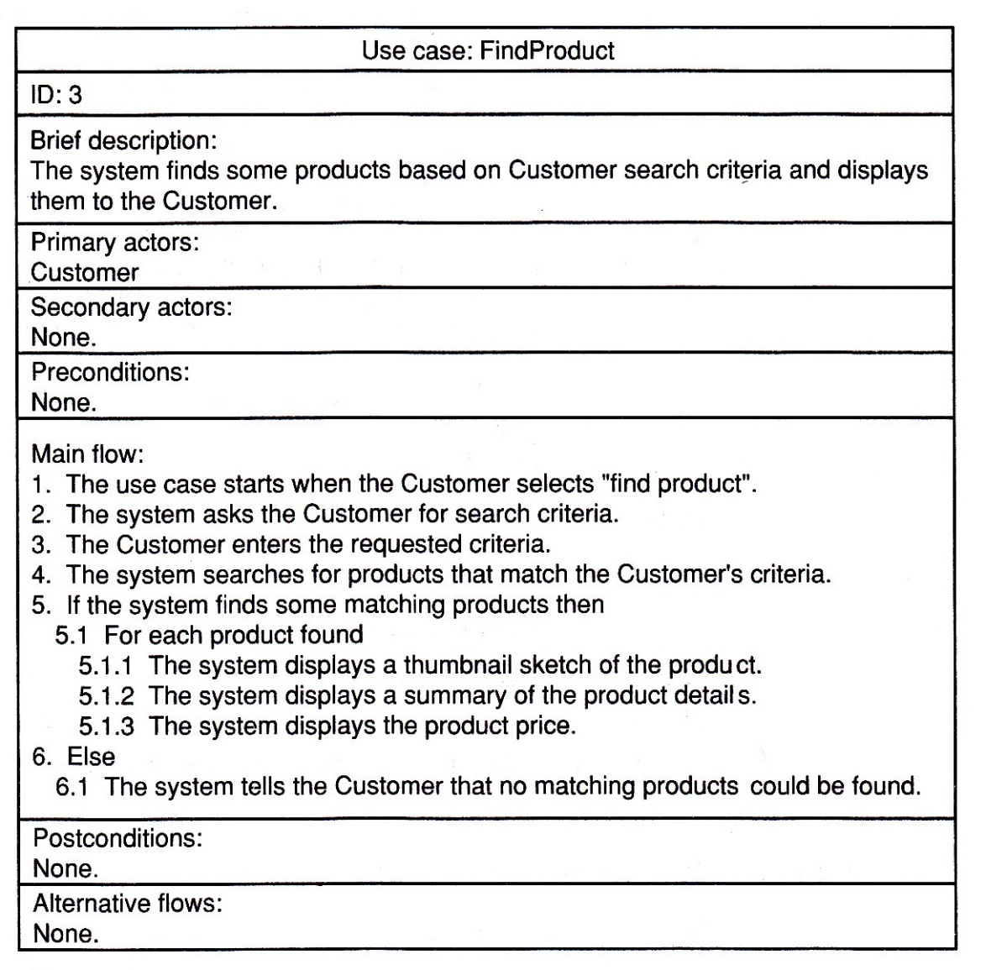
Use Case Specification
Example of repetition within a flow (FOR)
28
Use Case Modeling
Notes:
28

Slide 29
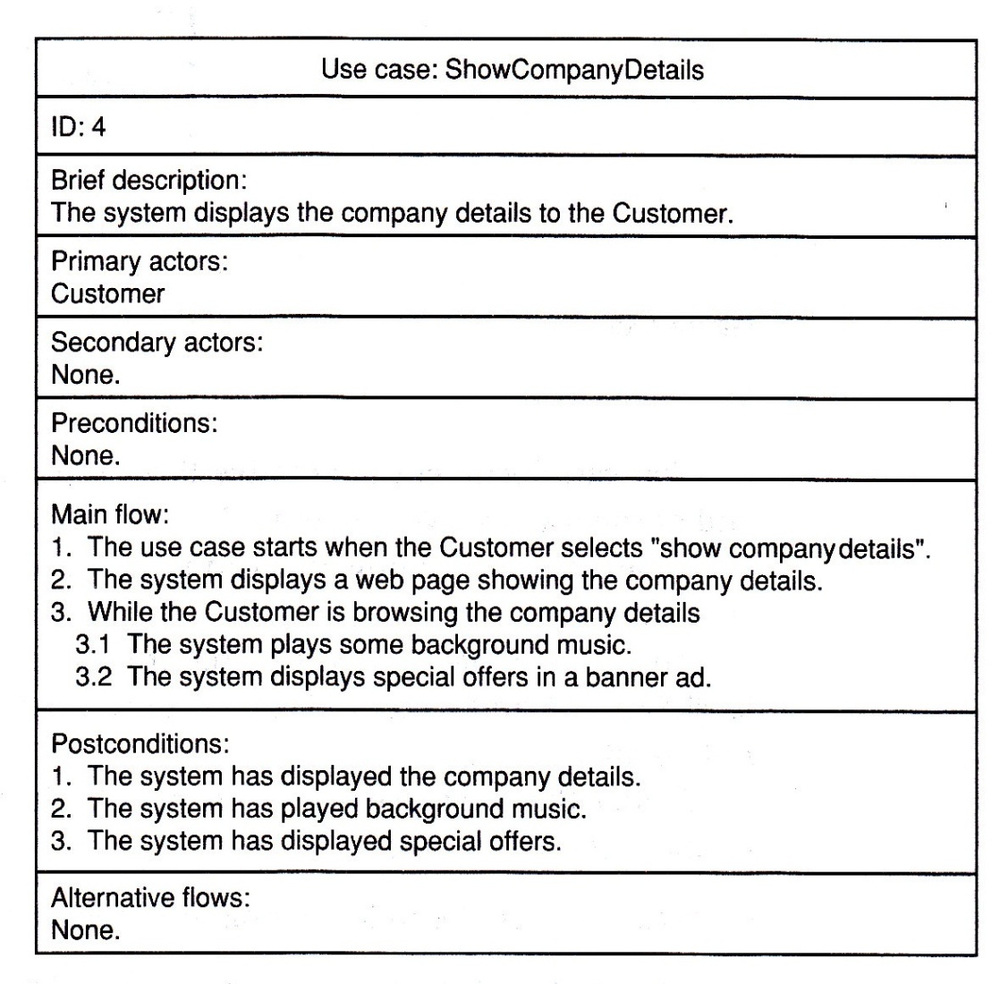
Use Case Specification
Example of repetition within a flow (WHILE)
29
Use Case Modeling
Notes:
29

Slide 30
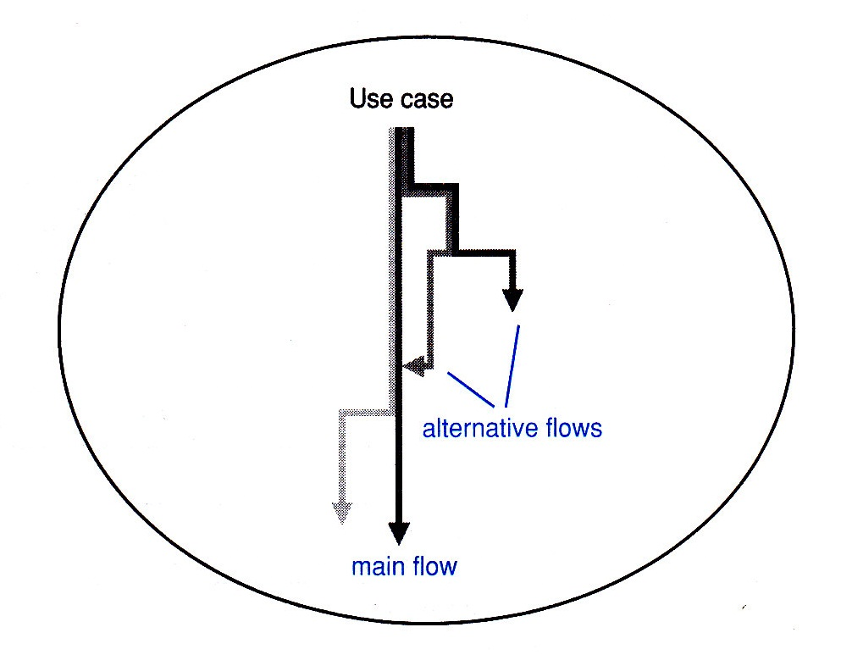
Use Case Specification
Modeling alternative flows
30
Use Case Modeling
Notes:
30

Slide 31
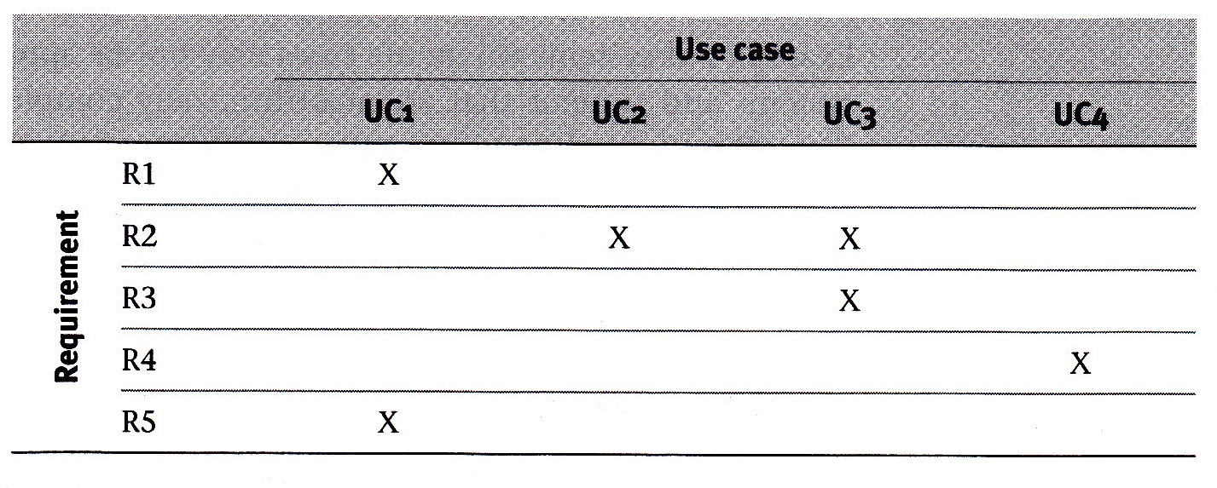
Requirements Tracing
Tracing requirements
31
Use Case Modeling
Notes:
31

