Slide 1
CS 791 [Software Engineering]
Preparation P2 Design
UML Activity Diagrams & State Charts
October 30, 2019
From Chapters 14, 21, and 22 [Jim Arlow and Ila Neustadt, UML 2 and the Unified Process, Addison-Wesley 2005]
University of Nevada, Reno
Department of Computer Science & Engineering

Slide 2
Outline
Part 1 - Activity diagrams
Introduction
Activities
Nodes
Action nodes
Control nodes
Object nodes
Activity parameters

Slide 3
Introduction: What are activity diagrams?
Activity diagrams:
A form of “object-oriented flowcharts”
Attached to modeling elements to describe behavior
Typically attached to use cases, classes, operations, components, and interfaces
Can also be used to model business processes and workflows

Slide 4
Introduction: Where are activity diagrams used?
Commonly used in:
Analysis
To model the flow of a use case
To model the flow between use cases
Design
To model details of an operation
To model details of an algorithm
Business modeling
To model a business process
As always in modeling, it is important to keep them simple and understandable by their intended audience

Slide 5
Activities *****
Activity diagrams are networks of nodes connected by edges
Nodes
Action nodes – atomic units of work within the activity
Control nodes – control the flow through the activity
Object nodes – represent objects used in the activity
Edges
Control flows – depict the flow of control through activity
Object flows – depict the flow of objects through activity

Slide 6
* Activities ****
Activities and actions can have pre- and post-conditions
Tokens (part of semantics but not shown graphically) abstractly flow in the network and can represent:
The flow of control
An object
Some data
A token moves from a source node to a target node across an edge depending on:
Source node post-conditions
Edge guard conditions
Target node preconditions

Slide 7
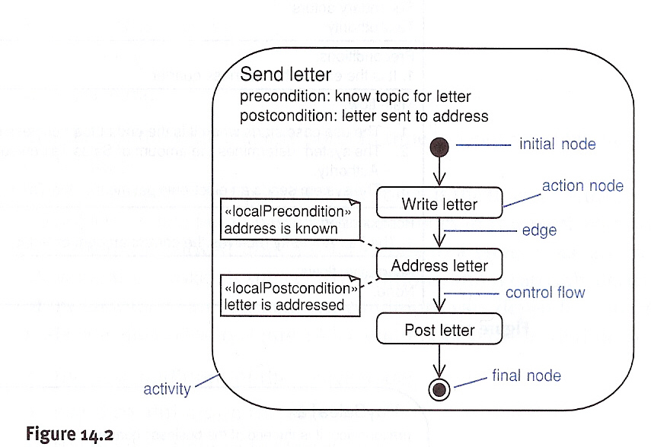
** Activities ***
Example of an activity (“send letter”), Fig. 14.2 [Arlow & Neustadt 2005]

Slide 8
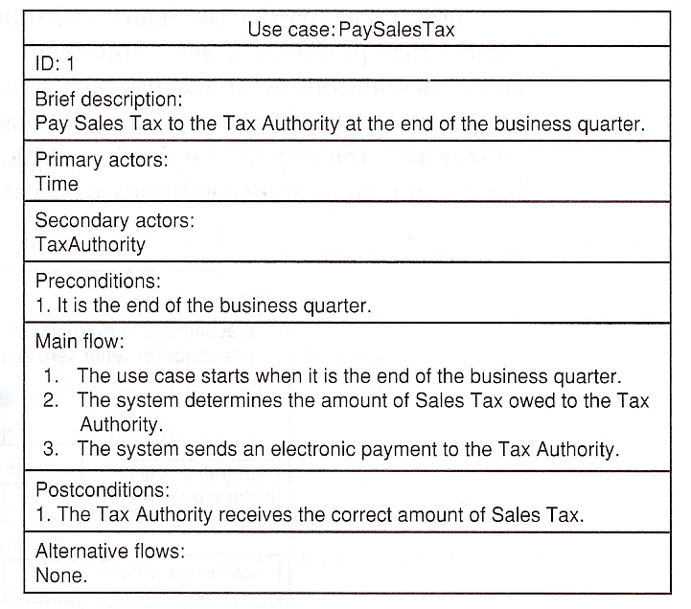
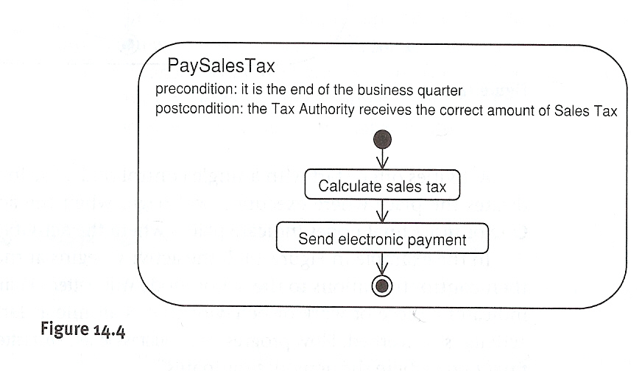
*** Activities **
Activity diagrams can model use cases as a series of actions.

Slide 9
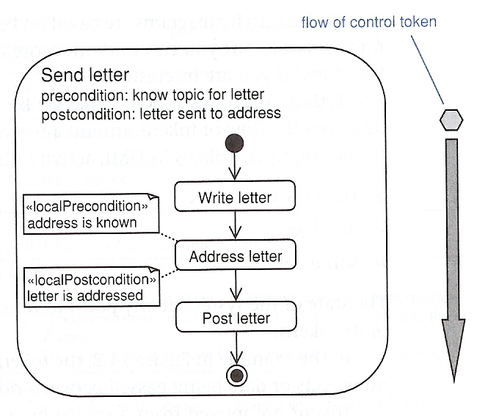
**** Activities *
Activity diagrams have semantics based on Petri Nets
They model behavior using the token game
Tokens move through the network subject to conditions
Object nodes represent objects flowing around the system
Example of flow of control token

Slide 10
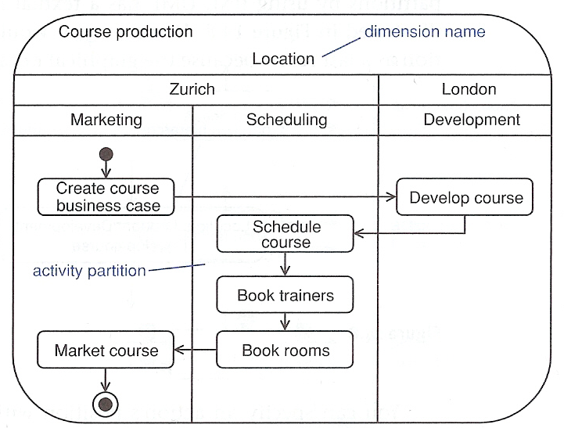
***** Activities
Activity diagrams can be divided in partitions (swimlanes) using vertical, horizontal, or curved lines.

Slide 11
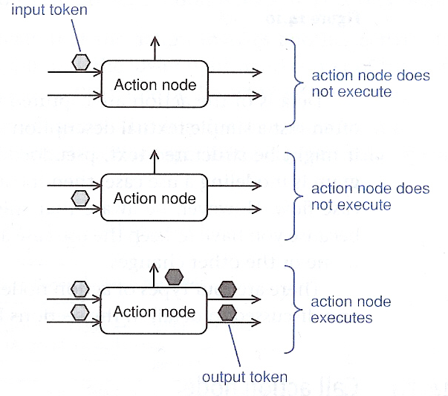
Action nodes ****
Action nodes execute when:
There are tokens present at all their input nodes AND
The input tokens satisfy all action node’s local preconditions

Slide 12
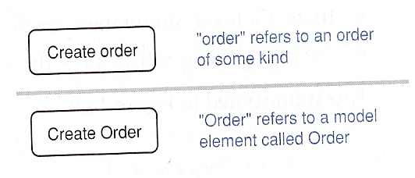
* Action nodes ***
After execution, the local post-conditions are checked; if all are satisfied, the node simultaneously offers tokens to all its output edges (this is an implicit fork that may give rise to many flows)

Slide 13
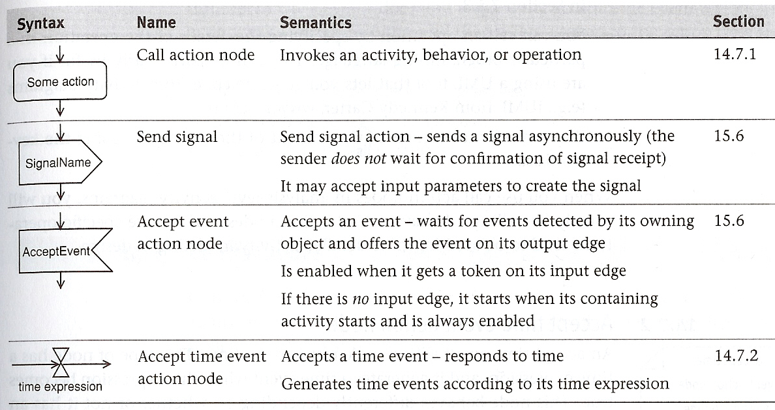
** Action nodes **
Types of action nodes, Table. 14.1 [Arlow & Neustadt 2005]

Slide 14
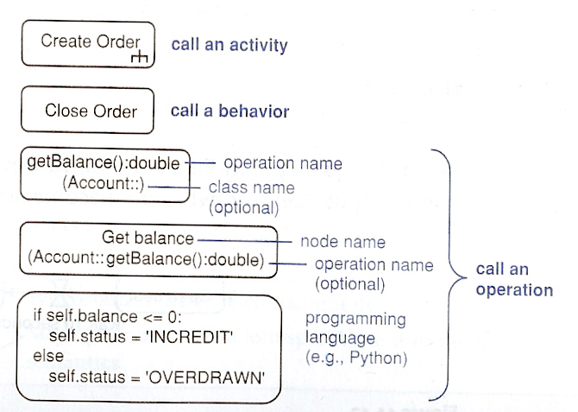
*** Action nodes *
A call action node invokes an activity, behavior, or operation

Slide 15
**** Action nodes
An accept time event action node responds to time

Slide 16
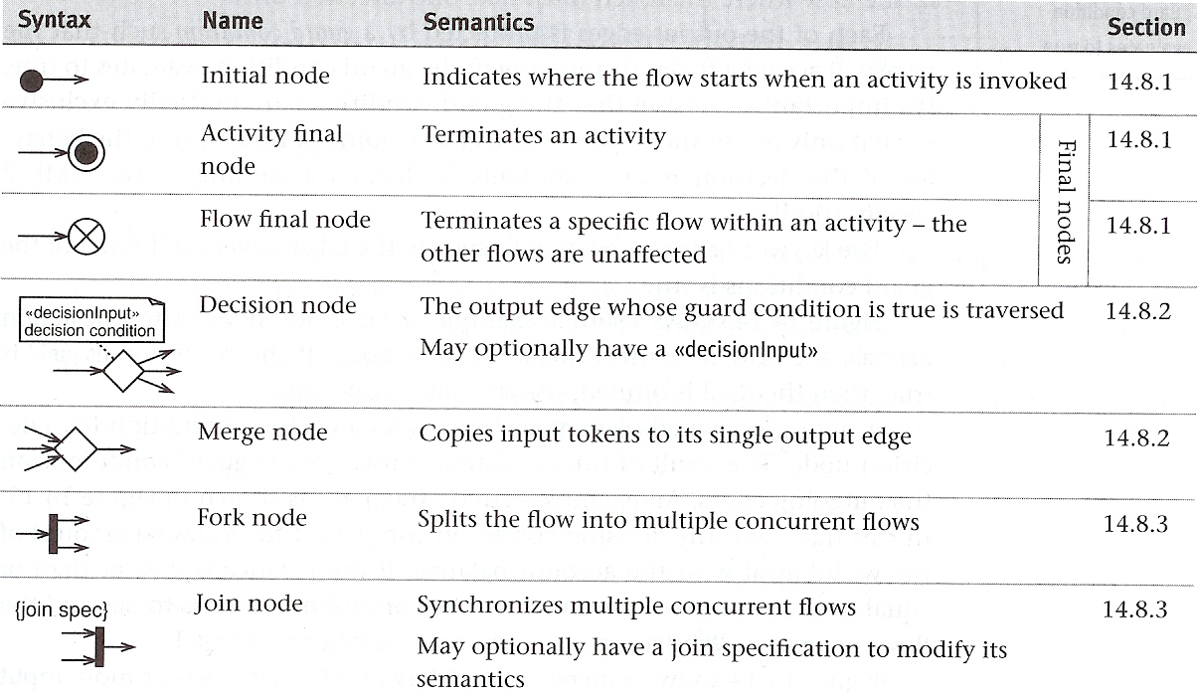
Control nodes **
Control nodes manage the flow of control within an activity
Table 14.2 [Arlow & Neustadt 2005] shows the types of control nodes

Slide 17
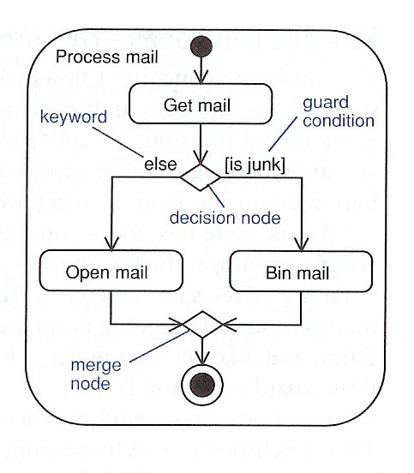
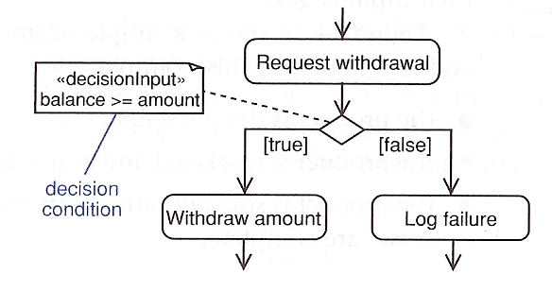
* Control nodes *
Examples of decision and merge nodes

Slide 18
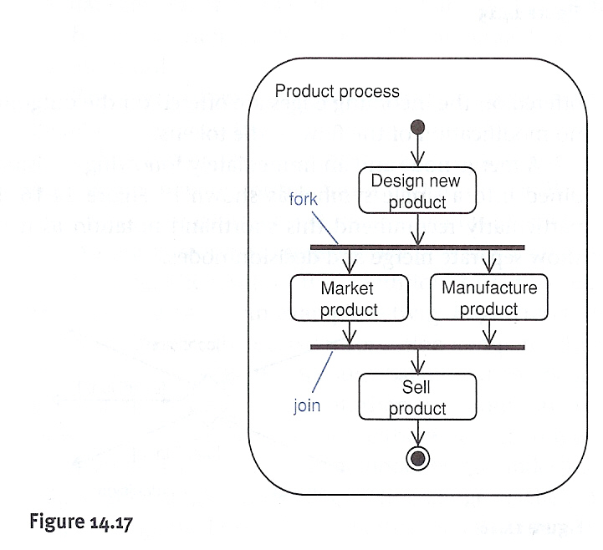
** Control nodes
Examples of join and fork nodes

Slide 19
Object nodes **
Object nodes indicate that instances of a particular classifier are available at a specific point in the activity
They are labeled with the name of the classifier and represent instances of that classifier or its subclasses
The input and output edges are object flows
The objects are created and consumed by action nodes
When an object node receives an object token on one of its input edges, it offers this token to all its output edges, which compete for the token.

Slide 20
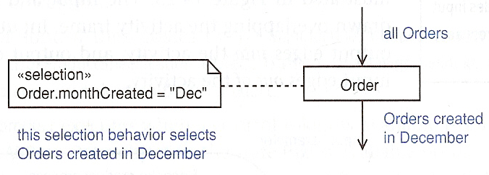
* Object nodes *
Object node notation and their buffer semantics. Object nodes act as buffers – places in the activity diagram where object tokens can reside while waiting to be accepted by other nodes (via edges).

Slide 21
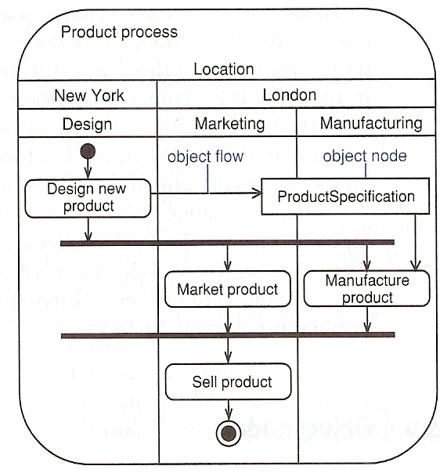
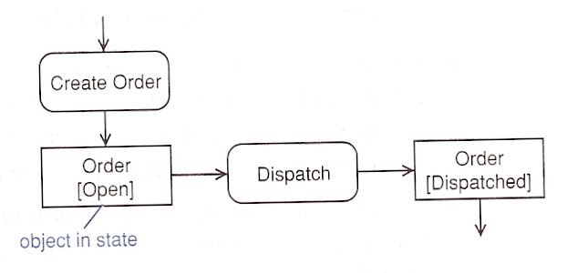
** Object nodes
Examples of using object nodes. Note that object nodes can represent objects in particular states.

Slide 22
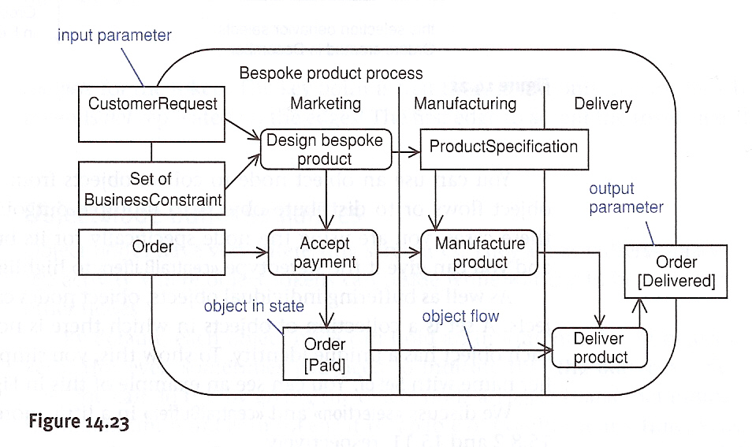
Activity parameters
Activities can have object nodes to provide inputs and outputs

Slide 23
Part 2 – State Charts
From Chapter 21: State Machines &
Chapter 22: Advanced State Machines (partial)
[Arlow and Neustadt 2005]

Slide 24
Outline
State machines
Introduction
State machine diagrams
States
Transitions
Events
Advanced state machines
Composite states
Simple
Orthogonal
History

Slide 25
Introduction
Both activity diagrams and state machine diagrams model system behavior
However, they have different semantics:
Activity diagrams are based on Petri Nets and usually model processes when several objects participate
State machines are based on Harel’s statecharts and typically used to model single reactive objects

Slide 26
Introduction
Reactive objects:
Respond to external events
May generate and respond to internal events
Have a lifecycle modeled as a progression of states, transitions and events
May have current behavior that depends on past behavior
State machines are used to model behavior of items such as classes, use cases, subsystems, systems

Slide 27
Introduction
State machines are most commonly used to model dynamic behavior of classes
In a software process, machines can be used in: requirements, analysis, design
A significant challenge is testing state machines: manual walkthrough, simulation, code generation + test harnesses for state machines

Slide 28
State machine diagrams
There are three main modeling elements in state diagrams: states, transitions, and events.
Example of a simple state machine, Fig. 21.2 [Arlow & Neustadt]

Slide 29
States
Summary of UML state syntax

Slide 30
Transitions
Summary of UML syntax for transitions in behavioral state diagrams, Fig.21.5
Where:
event(s)= internal or external occurrence(s) that trigger the transition
guardCondition = boolean expression, when true the transition is allowed
anAction = some operation that takes place when the transition fires

Slide 31
Transitions
A junction pseudo-state represents a point where transitions
merge or branch

Slide 32
Transitions
A junction pseudo-state may have more than one output transition
(protected by mutually exclusive guard conditions)

Slide 33
Transitions
Choice pseudo-state can also be used:

Slide 34
Events
Events can be of four types:
Call event
Signal event
Change event
Time event

Slide 35
Events
Example of a call event, Fig.21.11 [Arlow & Neustadt 2005]

Slide 36
Events
A signal is a package of
information sent
asynchronously between
objects. Example of signal
Event, Fig. 21.12
Example of sending a
Signal, Fig. 21.13

Slide 37
Events
Change events are positive edge triggered.
Example of a change event, Fig. 21.15 [Arlow & Neustadt 2005]

Slide 38
Events
Time events are indicated by the keywords when and after.
Example of a time event:

Slide 39
Example of a
state machine
[Dascalu 2001]

Slide 40
Composite states
A composite state contains one or more nested state machines (submachines), each existing in its own region, Fig 22.2
The composition icon is shown in Fig. 22.4

Slide 41
Simple composite states
A superstate that contains a single region is called a simple composite state,

Slide 42
Orthogonal composite states
Orthogonal composite states consist of two or more sub-machines that execute in parallel. Composite states below are Initializing and Monitoring

Slide 43
Orthogonal composite states
The composite state Initializing:

Slide 44
Orthogonal composite states
The composite state Monitoring

Slide 45
History
Example of using the shallow history indicator

Slide 46
History
Example of using
the deep history
indicator

