Slide 1
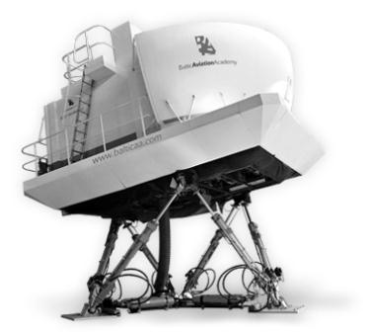
Flight Simulators
Christine Johnson

Slide 2
How the military uses virtual reality
Applications
Training
Flight Simulators
Ground Vehicle Simulators
Submarine Simulators
Therapy
Treating soldiers with PTSD
Developers
Military
Third-party developers

Slide 3
Training with flight simulators
Used to train pilots for situations that are impractical to perform in actual aircraft
Recovery and evacuation from system failures and other emergency situations
Flying in battle (under fire)
Coordinating with ground operations
Cost effective

Slide 4
Flight Simulators
Enclosed cockpit that attempts to replicate a specific aircraft
Videos
Boeing 737 landing
http://www.youtube.com/watch?v=_53xWxj136E
Boeing 737 Simulator landing
http://www.youtube.com/watch?v=RLFbNcqG_ng
http://aviationblog.dallasnews.com/2013/06/Boeing-737-
Max-7-in-Southwest-Airlines-livery.jpg

Slide 5
Flight Simulator Components
Six Degrees of Freedom Motion Platform
Control Loading System
Vibrating Seats
3-D Sound Simulation
Visual System

Slide 6
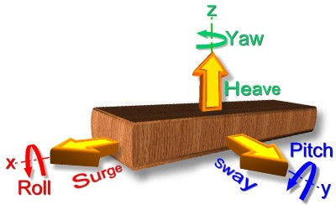
Six DoF Motion Platform
Hexapod of actuators that delivers motion based on calculated Pitch, Surge, Roll, Sway, Heave and Yaw
http://www.worldwideflood.com/ark/basic_hull_design/degrees_of_freedom.jpg

Slide 7
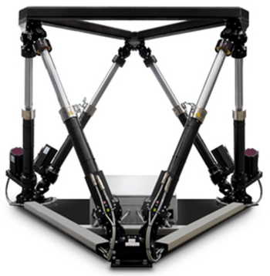
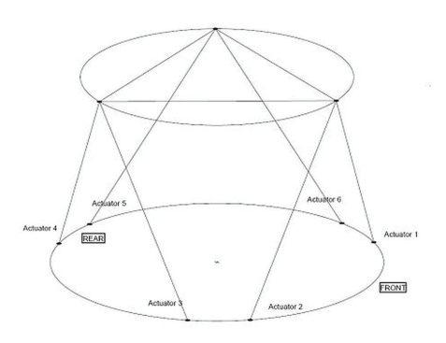
Six DoF Motion Platform
Uses hydraulic (linear) and crank arm (rotational) actuators
http://www.moog.com/images/Products/Motion_Bases/MB-E-6DOF_24_1800KG.jpg http://bffsimulation.com/Manual-6DOF/Operation.php

Slide 8
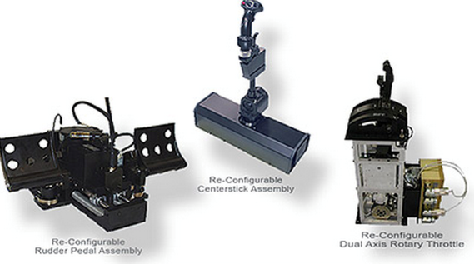
Control Loading System (CLS)
The system that replicates aircraft controls
Components
Side stick
Center stick
Linear throttle
Rotary throttle
Rudder pedals
http://www.ccontrols.com/images/success/Wittenstein1.jpg

Slide 9
3-D Sound Simulation
Pilots heavily depend on auditory cues
Replicated sound sources
Aerodynamic hiss – the sound of wind that changes depending on speed and direction
Engine
Landing gear – gear motor sounds and locking sounds of the gear extending and retracting

Slide 10
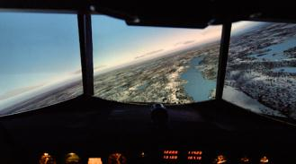
Visual System
Important issues
Resolution
High resolution is expensive http://simulaattori.mik.fi/wp-content/uploads/2009/10/simuvisuaali.jpg
Resolution threshold where improving resolution no longer improves pilot performance
Field of view
Narrow views limit peripheral vision
Wide views distort details because more information is shown on the screens

Slide 11
Further Development
Improve effectiveness of training
Achieved by continuing to make the simulations as real as possible, and creating simulations for as many situations as possible
Development of simulators for new aircraft
Increasing efficiency and reducing cost of simulators

Slide 12
Conclusion
How the military uses virtual reality
Training with flight simulators
Flight simulator components
Further development

Slide 13
Works Cited
"Control Loading Systems – Fixed-wing Systems." Wittenstein Mechatronic Components and Systems for Motion. N.p., 2011. Web. 9 Nov. 2013. <http://www.wittenstein-us.com/Control-Loading-Systems/Fixed-Wing-Systems.html>.
Keller, M. ; Schnell, T. ; Lemos, K. ; Glaab, L. ; Parrish, R. “Pilot performance as a function of display resolution and field of view in a simulated terrain followingflight task using a synthetic vision system.” Digital Avionics Systems Conference, 2003. DASC '03. Publication Year: 2003 , Page(s): 9.E.5 - 91-12 vol.2.
Sheng Xiaowei; Zheng Shutao; Han Junwei; Hao Minghui. “Development of 3D sound simulation system for flight simulator.” Computer Research and Development (ICCRD), 2011 3rd International Conference, Publication Year: 2011, Volume: 4, Page(s): 244 – 248.
Strickland, Jonathon. "How Virtual Reality Military Applications Work." HowStuffWorks. N.p., n.d. Web. 9 Nov. 2013. <http://science.howstuffworks.com/virtual-military1.htm>.
"Virtual Reality Air Force Training." Virtual Reality. N.p., 2009. Web. 9 Nov. 2013. <http://www.vrs.org.uk/virtual-reality-military/air-force-training.html>.
"Virtual Reality Media - Military Aircraft Simulators and Training Systems." Airforce Technology. N.p., n.d. Web. 9 Nov. 2013. <http://www.airforce-technology.com/contractors/training/virtual-reality-media/>.
"6 DOF Motion Software for Hexapod Flight Simulators." 6 DOF Motion Software for Hexapod Flight Simulators. N.p., 2013. Web. 9 Nov. 2013. <http://bffsimulation.com/6DOF-Motion-Software.php>.

