Slide 1
Example of IRB Application and Resulting Research Paper
Presented by
Sonu Jose
https://www.uwec.edu/orsp/faculty-academic-staff/research-using-human-subjects/

Slide 2
Outline
What is IRB?
Types of IRB Review
IRB Application Procedure
IRB Proposal Forms
Research Paper - Goals
Methodology
Results
Conclusion

Slide 3
IRB - Institutional Review Board
Jems.com https://www.ccga.edu/page.cfm?p=742

Slide 4
IRB - Contd..
Protect the rights and welfare of human subjects
Pre-approval from IRB is required for human subjects involved research
IRB approve, disapprove or ask for modifications

Slide 5
Types of IRB Review
Exempt
Expedited
Full Board Review

Slide 6
Exempt Review
Review by one IRB member
Research activity is low risk
Reviews are completed within two weeks
Example: UI usability testing, Computer-based training

Slide 7
Expedited Review
Review by the IRB chair and one or more experienced reviewers
Only minimal risk involved
Does not employ sensitive populations or topics
Appropriate informed consent procedures
Three weeks of review time
Example: a) Collection of physical data through ECG, MRI, ultrasound
b) Interaction with Robots - Identifying the behaviors of the participants, for example, emotions.
-

Slide 8
Full Board Review
Involves more than minimal risk
Involves protected populations such as children, prisoners, or disabled individuals
Research that uses procedures that are personally intrusive, and stressful
Take upto a month or longer

Slide 9
IRB Application Procedure
CITI Certification - Collaborative Institutional Training Initiative - Both Principal Investigator (PI) and Student Investigators need certification
Create an account with IRBNet
Upload the CITI certificate
https://www.irbnet.org/release/index.html https://www.unr.edu/research-integrity/human-research/irbnet

Slide 10
IRB Proposal Forms
1. Responsible official attestation - to be signed by the Department Chair
2. Consent form template - Informed Consent
3. Exempt form - to be signed by the Principal Investigator (PI).
4. Cover sheet
5. Research Narrative
6. Pre-study questionnaire - experimental group
7. Pre-study questionnaire - control group
8. Post-study questionnaire - experimental group
9. Post-study questionnaire - control group
10. Pre-test and post-test questions

Slide 11
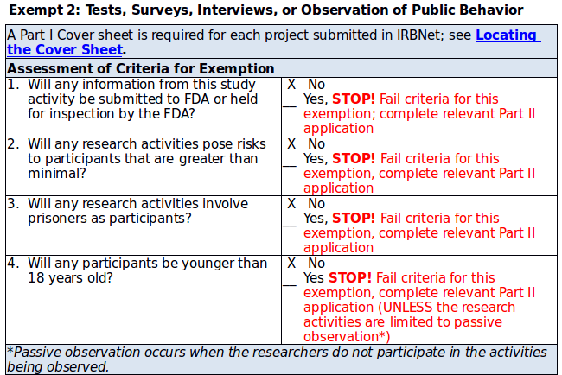
Exempt Form

Slide 12
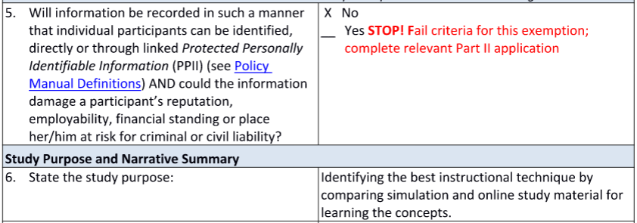
Exempt Form - Contd..

Slide 13
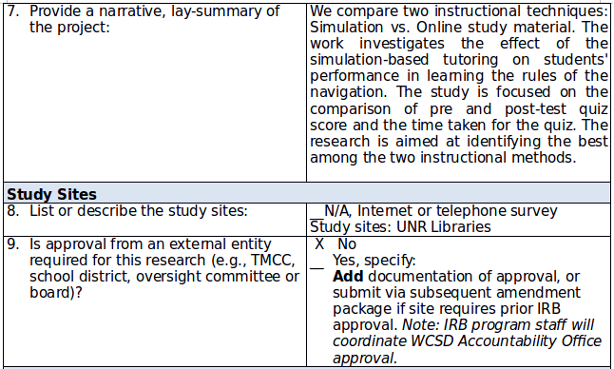
Exempt Form - Contd..

Slide 14
Exempt Form - Contd..

Slide 15
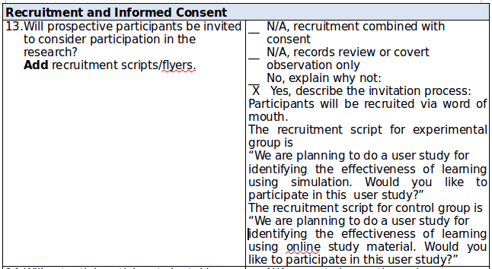
Exempt Form - Contd..

Slide 16
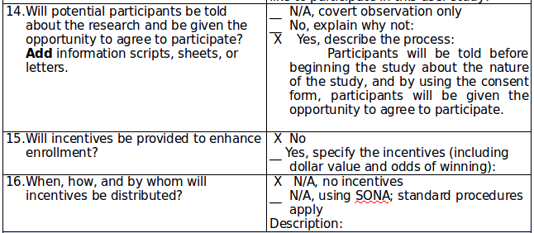
Exempt Form - Contd..

Slide 17
Exempt Form - Contd..

Slide 18
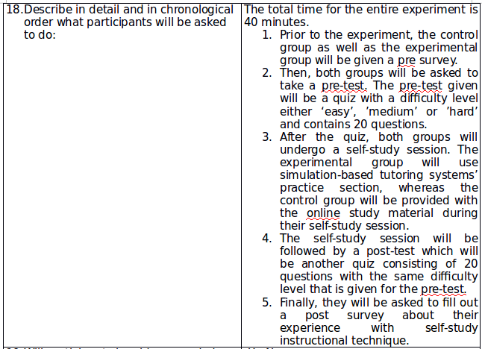
Exempt Form - Contd..

Slide 19
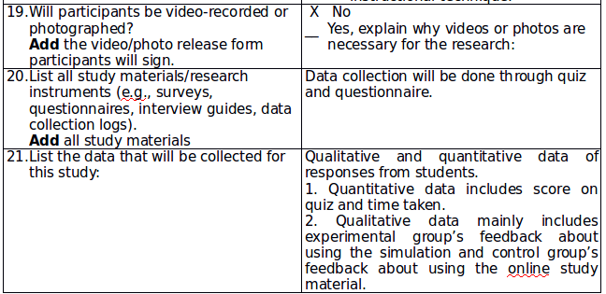
Exempt Form - Contd..

Slide 20
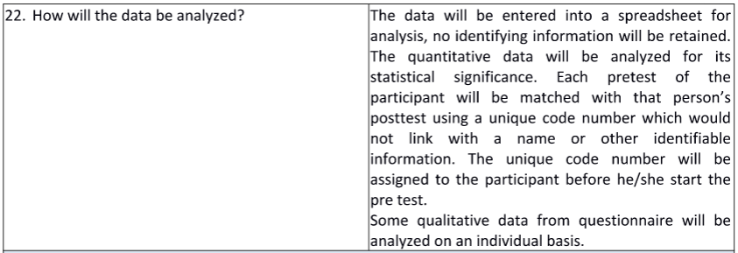
Exempt Form - Contd..

Slide 21
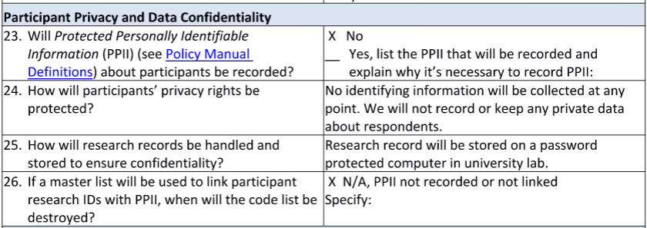
Exempt Form - Contd..

Slide 22
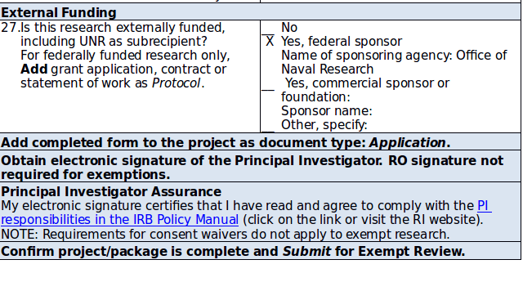
Exempt Form - Contd..

Slide 23
RESEARCH PAPER RESULTED FROM IRB

Slide 24
Learning through Simulations: The Ship Simulator for Learning the Rules of the Road
Authors: Sonu Jose, Sushil J. Louis, Siming Liu, and Sergiu M. Dascalu

Slide 25
GOALS
To develop a simulation in order to learn concepts while doing or experiencing things in the real world
To help the users to learn about the Rules of Navigation
To educate the users about the ship types, target angle and light configuration using an interactive simulation-based learning.
To identify the best of two instructional techniques -Simulation vs Online Study material

Slide 26
RESEARCH QUESTIONS
Can we maximize learning using simulation when compared with online study material?
- Do users perform better while learning using simulation than with other traditional learning methods?
- Do users learn a set of concepts in less time while using simulation?

Slide 27
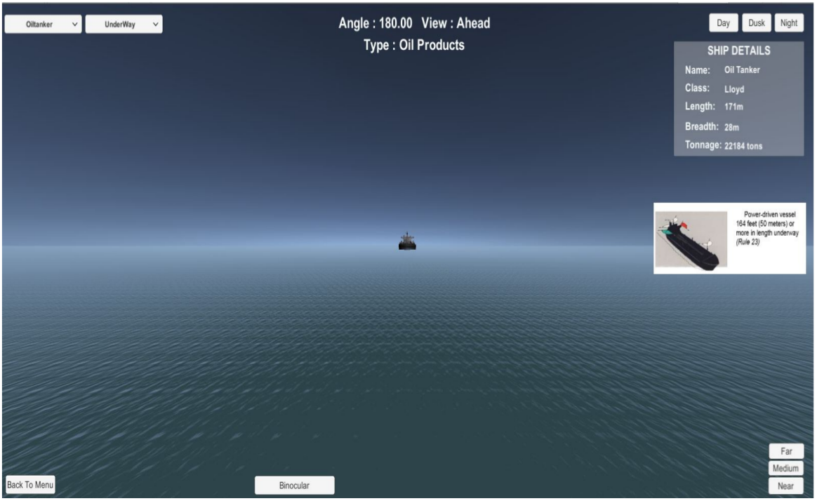
SIMULATION

Slide 28
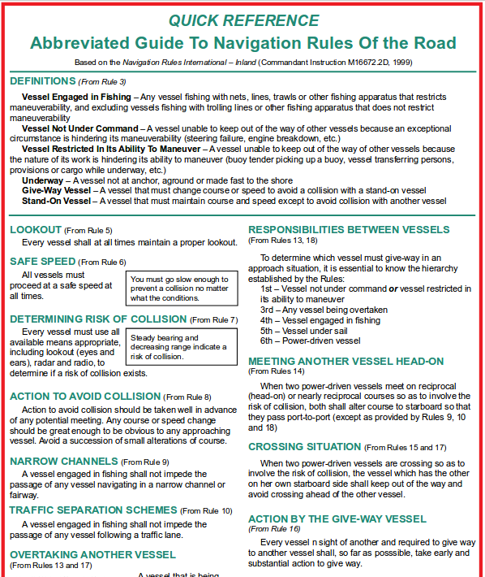
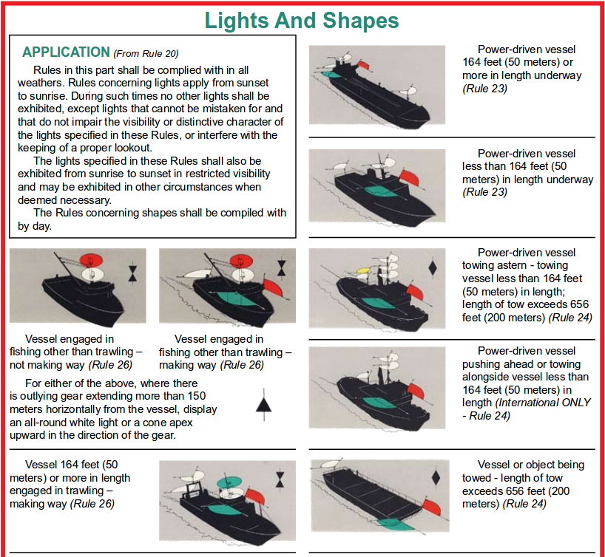
Online Study Material

Slide 29
PARTICIPANTS
University students
44 participants
- 22 participants in the intervention group (Simulation)
- 22 participants in the control group (Online study material)
Age ranged from 18 to 35 years
An equal percentage of male and female participants

Slide 30
PROCEDURE
Pre-approval from IRB (Institutional Review Board)
Conducted in the university library
Out of 44 participants:
-> 22 participants used RoR Simulation
-> 22 participants used Online study material
Prior to the experiment, a consent form was provided to the participant
Consent form explained the objective of the research and the procedure of the experiment
Participation in this study was on a voluntary basis
Pre-study questionnaire
Pre-test: A quiz that contains 20 questions
A self-study session - 20 minutes
Post-test: A quiz that contains 20 questions
Post-study questionnaire

Slide 31
PRE-STUDY QUESTIONNAIRE
Demographic data
Knowledge about ship navigation rules
Most preferred learning method

Slide 32
PRE-TEST and POST-TEST: Quiz Questions

Slide 33
PRE-TEST and POST-TEST: Quiz Questions (Contd..)

Slide 34
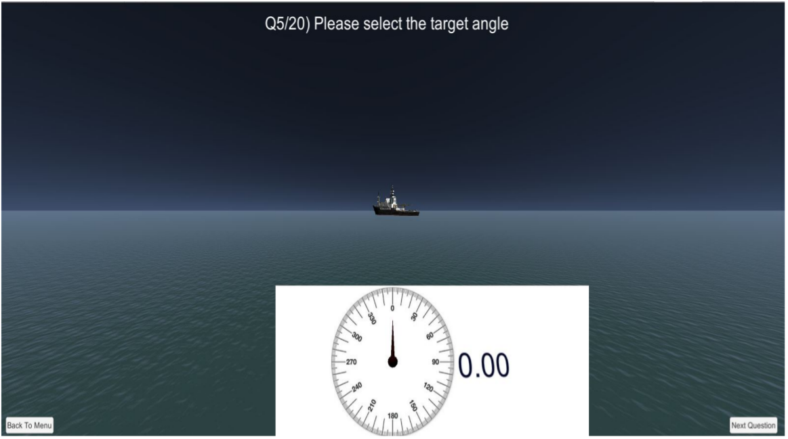
PRE-TEST and POST-TEST: Quiz Questions (Contd..)

Slide 35
POST-STUDY QUESTIONNAIRE
Effectiveness of simulation in learning the ship navigation concepts
User friendliness
Prefered learning method
Feedback and suggestions

Slide 36
DESIGN
2 x 2 in-between subjects
2 independent variables:
- Simulation
- Online study material
2 dependent variables:
- Quiz score
- Quiz completion time

Slide 37
RESULTS
IBM SPSS Statistics Data Editor Tool used for analyzing data
Paired-samples T-test: For testing within-subjects factors
Mixed-Design ANOVA or Split-Plot ANOVA: For testing in-between subject factors

Slide 38
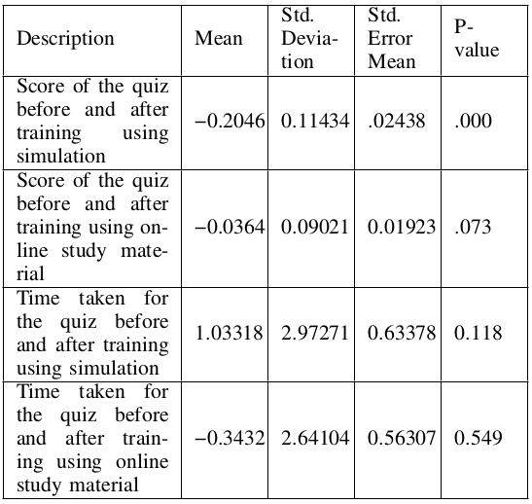
Table 1: Analysis Within Subjects

Slide 39
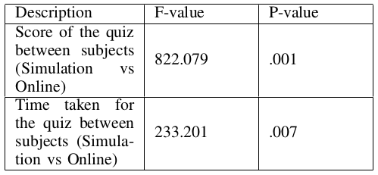
Table 2: Analysis Between Subjects

Slide 40
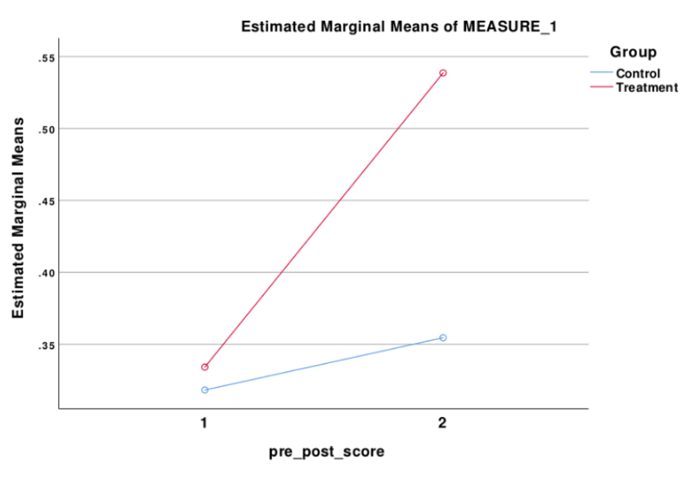
Fig 1: Online vs. Simulation in terms of pre-test and post-test
score

Slide 41
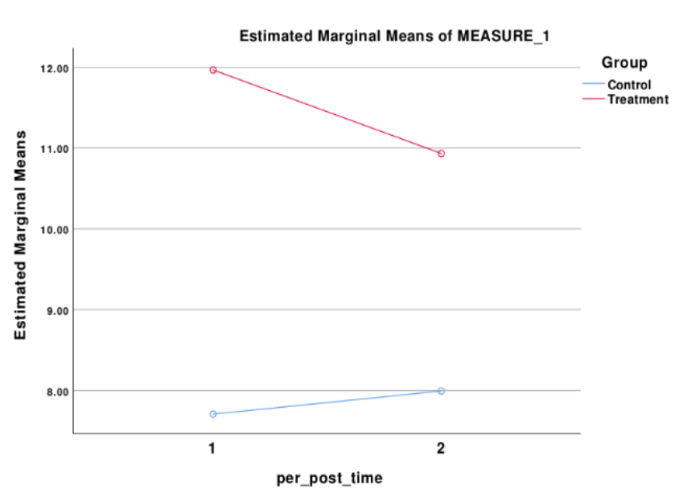
Fig 2: Online vs. Simulation in terms of pre-test and post-test
time

Slide 42
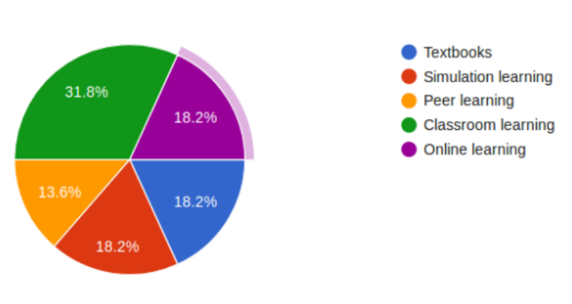
Fig 3: Students’ most preferred learning method before
self-study using simulation

Slide 43
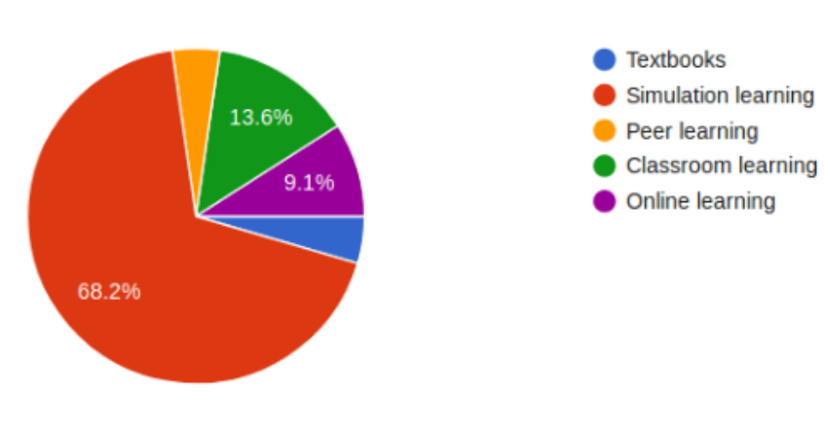
Fig 4: Students’ most preferred learning method after
learning using RoR simulation

Slide 44
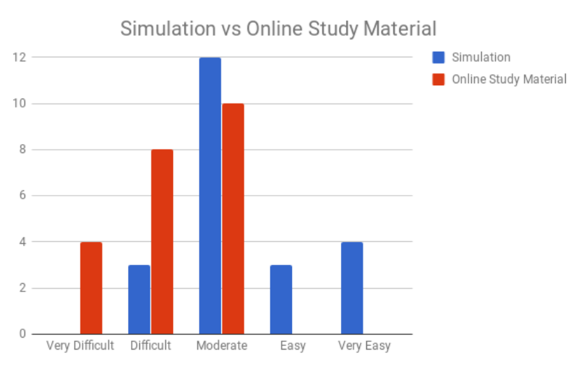
Fig 5: The difficulty level of learning using Simulation vs
Online Study Material

Slide 45
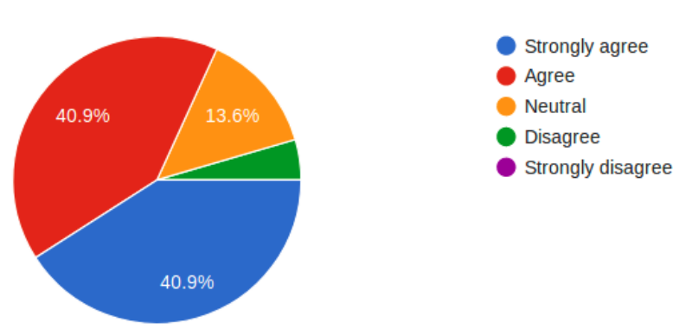
Fig 7: Users likely to recommend learning using simulation
to others

Slide 46
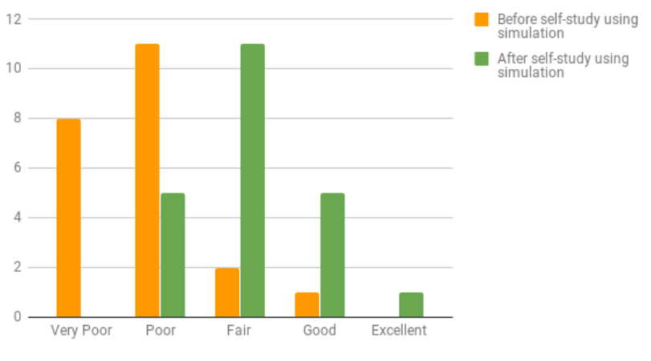
Fig 8: Level of knowledge about the rules of navigation
before and after self-study using simulation

Slide 47
CONCLUSION
Presented a simulation for learning the Rules of Navigation
Users who used simulation achieved significantly better results on the posttest quiz than who used online study material
The intended users of this simulation are midshipmen where they can experience real environment for learning about the different ship types, target angles, and light configuration
Results showed that simulation could enhance learning outcome when compared with a traditional educational method
Students are motivated to use the simulation as the learning tool in future

Slide 48
THANK YOU

