Slide 1
Constraints – Don Norman [part of Chapter 4 DOET]
CS420/620 – Human Computer Interaction
Based on slides initially prepared by Majed Al Zayer (former course instructor)
University of Nevada, Reno
Fall’19

Slide 2
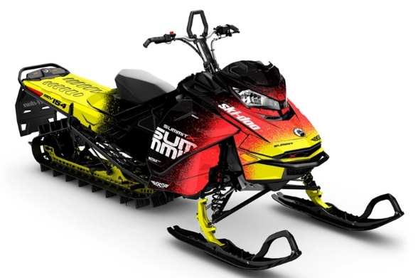
How do we determine how to operate something that we never saw before?
[Don Norman, DOET, pp. 123]

Slide 3
We must rely on
Knowledge in the world, which includes:
Affordances and signifiers
Mappings between parts that seem to be control or places to manipulate and the resulting actions
Physical constraints that limit what can be done
Knowledge in the head, which includes:
Conceptual models
Cultural, semantic and logical constraints
Analogies between the current situation and previous experiences with other situations

Slide 4
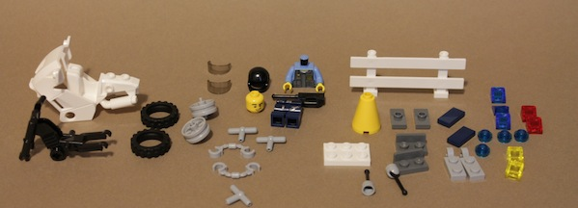
Notes:
The affordances of the pieces gave participants clues about their operation
Participants used the process of elimination to determine which pieces fit together (physical constraints)
Physical constraints were not enough to help participants decide on parts that can fit in multiple places (e.g., the lights) (cultural constraints)
Participants also needed more information to decide on parts that can fit in multiple directions (semantic constraints)
Participants also needed to depend on their logic to decide on what to do the remaining pieces (logical constraints)

Slide 6
Notes:
The affordance of the pieces gave participants clues about their operation
Participants used the process of elimination to determine which pieces fit together (physical constraints)
Physical constraints were not enough to help participants decide on parts that can fit in multiple places (e.g., the lights) (cultural constraints)
Participants also needed more information to decide on parts that can fit in multiple directions (semantic constraints)
Participants also needed to depend on their logic to decide on what to do the remaining pieces (logical constraints)

Slide 7
Agenda
What are constraints?
Types of constraints
Forcing functions

Slide 8
Agenda
What are constraints?
Types of constraints
Forcing functions

Slide 9
What are constraints?
Alternative
Alternative
Alternative
Decision
Constraints
Notes:
Definition
Characteristics
Perceivable (trial and error, otherwise)
Examples
Lego pieces
Batteries
From interaction design?

Slide 10
What are constraints?
Alternative
Alternative
Alternative
Decision
2 weeks

Slide 11
What are constraints?
Alternative
Alternative
Alternative
Decision
$300

Slide 12
What are constraints?
Alternative
Alternative
Alternative
Decision
Android

Slide 13
What are constraints?
Alternative
Alternative
Alternative
Decision
Gluten free

Slide 14
Agenda
What are constraints?
Types of constraints
Forcing functions

Slide 15
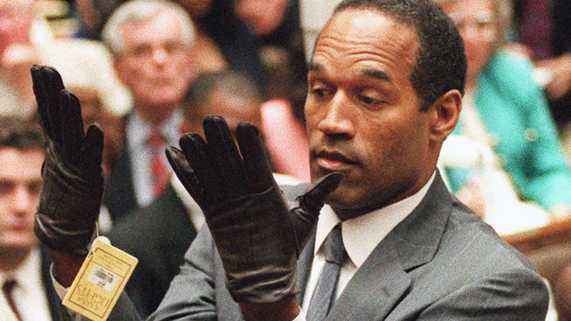
Physical constraints
We use physical properties of objects to make a judgement

Slide 16
Physical constraints
Good physical constraints are perceivable

Slide 17
Physical constraints
Physical limitations constrain possible operations (thus, errors)

Slide 18
Physical constraints
They are more effective and useful if they are easy to see and interpret

Slide 19
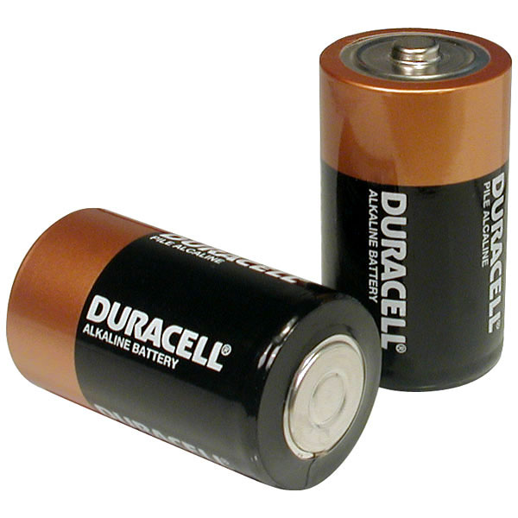
Physical constraints
Constraints in design let people determine the proper course of action even in new situations

Slide 20
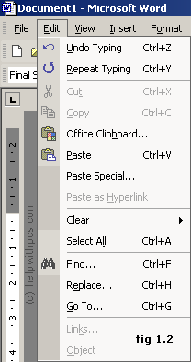
Physical constraints
Physical constraints in user interface design

Slide 21
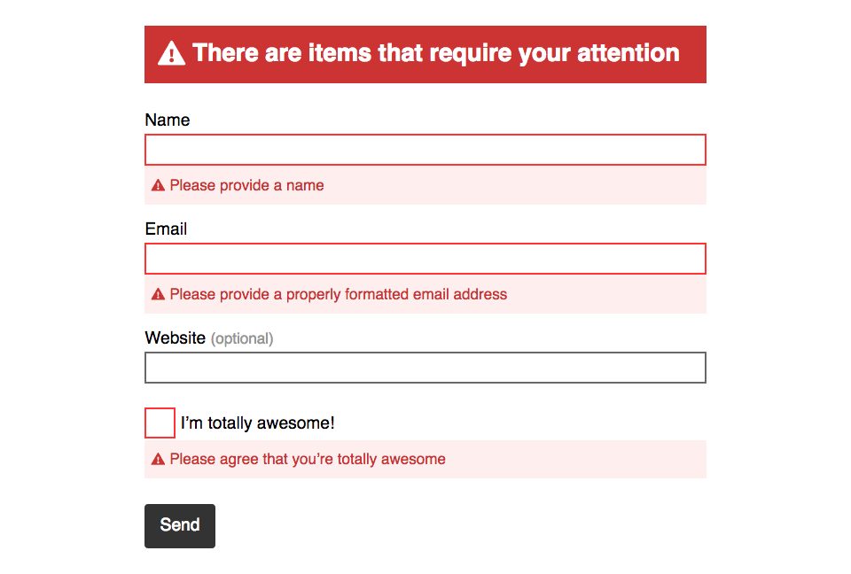
Physical constraints
Physical constraints in user interface design

Slide 22
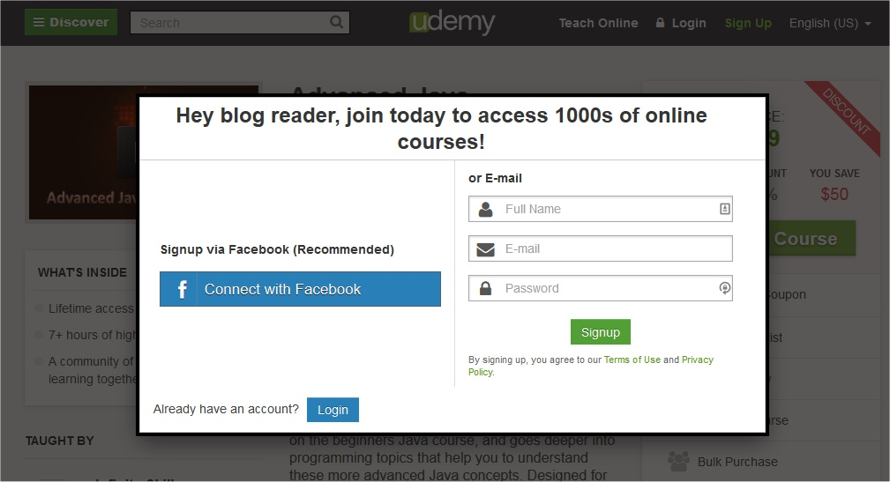
Physical constraints
Physical constraints in user interface design

Slide 23
Cultural constraints
Conventions shared by a cultural group
That a group of people use them to deal with specific situations
Restrictions are not physical
Violations cause unease
Notes:
Scripts that we invoke when encountering a situation
Choices that represent the “norm” at a certain culture
Changes with time
Examples:
The placement of the three lights at the Lego set
At interaction design?
Being used to the Mac, iOS, or Android conventions

Slide 24
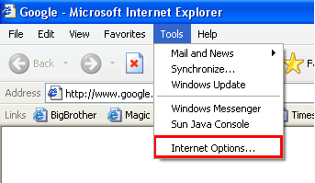
Cultural constraints
Notes:
Scripts that we invoke when encountering a situation
Choices that represent the “norm” at a certain culture
Changes with time
Examples:
The placement of the three lights at the lego set
At interaction design?
Being used to the Mac, iOS, or android conventions
preferences under Edit on mac while it’s under tools in windows
Double clicking

Slide 25
Conventions
Conventions are cultural constraints that evolved over time
They prohibit some activities and encourage others
Are slow to be adopted but once adopted slow to go away
They require a community of practice and can change over time

Slide 26
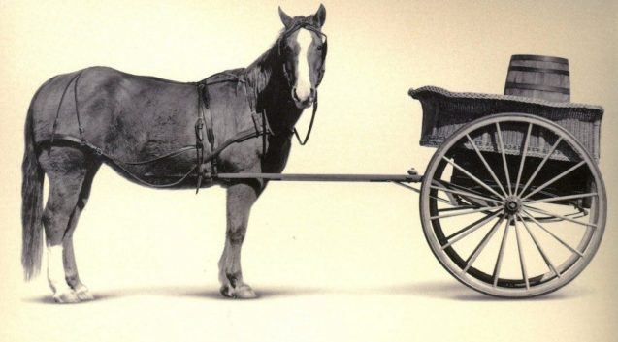
Semantic constraints
Semantic constraints rely on the meaning of a situation to control the set of possible actions
Choosing the most meaningful action
Notes:
The choice of the most meaningful action/behavior
Changes with time
Example
Placing the lego police officer
The need to add unnecessary elements of design as technology changes (e.g., in self-driving cars)
At HCI?

Slide 27
Semantic constraints
Choosing the most meaningful action
File
Edit
Insert
Tools

Slide 28
Semantic constraints
Choosing the most meaningful action
File
Edit
Insert
Tools
New …
Print
Save
Exit application

Slide 29
Semantic constraints
Choosing the most meaningful action
File
Edit
Insert
Tools
Shape
New slide
Table
Exit application

Slide 30
Semantic constraints
Choosing the most meaningful action

Slide 31
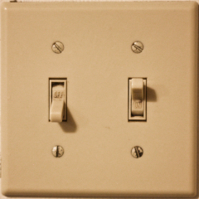
Logical constraints
Logical constraints use reasoning to determine the alternatives
Notes:
When your process of elimination involved logical constructs (e.g., if-else)
Examples:
If that’s the only piece left AND there is there is only one empty space left, then it goes there
In HCI?

Slide 32
Logical constraints
The use of reasoning to determine what control maps to what action
Down ↓
Up ↑

Slide 33
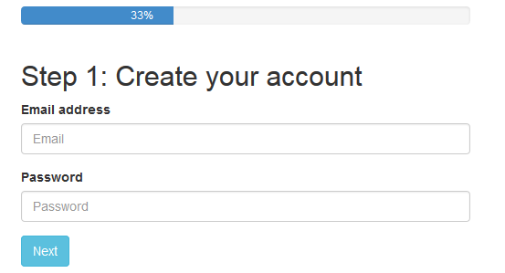
Logical constraints
The use of reasoning to determine what can be done next

Slide 34
Constraints
Physical constraints
Affordances
Signifiers
Logical constraints
Conceptual model
Feedback
Semantic constraints
Mappings
Cultural constraints

Slide 35
Constraints
Physical constraints
Formed from
Affordances
Signifiers
Exposed by
Formed from
Formed from
Logical constraints
Conceptual model
Feedback
Formed from
Formed from
Formed from
Semantic constraints
Mappings
Cultural constraints

Slide 36
Agenda
What are constraints?
Types of constraints
Forcing functions

Slide 37
Forcing functions
Constraints that regulate behavior and prevent inappropriate actions; they are a form of (soft) physical constraints
Interlocks – force operations to take place in proper sequence
Lock-ins - keep operations active, preventing someone to stop them prematurely [or keep someone in a space]
Lock-outs – prevent events to occur [or someone to enter a dangerous space]
Notes:
Failing to do the precondition prevents you to perform the action
Makes us think at a high level to understand that the purpose of some actions is just to act as forcing functions
Result of this thinking ➔ more innovative forcing functions
Examples:
Can’t drive the car UNLESS you have the ignition key (or token)
Can’t get to your inbox unless you are authenticated
In your projects, if you see people make inappropriate behavior that wish to prevent, think of a forcing function

Slide 38
Forcing functions: Interlocks
One action must follow another action
An action
Triggers
Another action

Slide 39
Forcing functions: Interlocks
One action must follow another action
Open microwave
door
Triggers
Stop power

Slide 40
Forcing functions: Interlocks
One action must follow another action
Open Windows file
Triggers
Disable file system ops

Slide 41
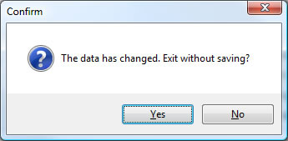
Forcing functions: Lock-ins
Regulate exit from an action
Notes:
The operation must continue UNLESS an appropriate action is done
Example
The document must not be closed UNLESS the user makes a decision to save or not to save

Slide 42
Forcing functions: Lock-outs
Regulate entry to an action
Precondition
✓
Action

Slide 43
Forcing functions: Lock-outs
Regulate entry to an action
Precondition
❌
Action

Slide 44
Forcing functions: Lock-outs
Regulate entry to an action
Authenticate
View inbox
Notes:
Failing to do the precondition prevents you to perform the action
Makes us think at a high level to understand that the purpose of some actions is just to act as forcing functions
Result of this thinking ➔ more innovative forcing functions
Examples:
Can’t drive the car UNLESS you have the ignition key (or token)
Can’t get to your inbox unless you are authenticated
In your projects, if you see people make inappropriate behavior that wish to prevent, think of a forcing function

Slide 45
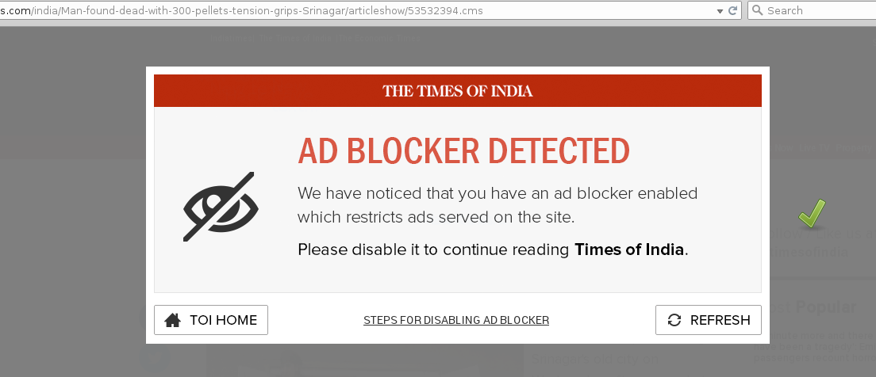
Forcing functions: Lock-outs
Regulate entry to an action

Slide 46
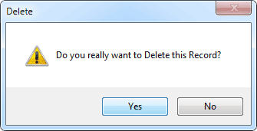
Issues with forcing functions
With time, we ignore them
Notes:
With time, we ignore them
Example
Clicking OK without thinking when we deleted files in a hurry, then we regret it
Solution
Graceful interfaces (e.g., undo)
Backups (for those who mistakenly choose not to save)

Slide 47
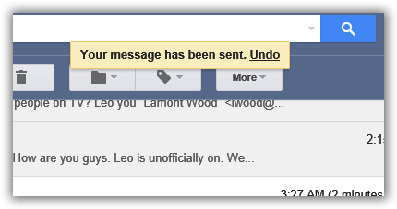
Issues with forcing functions
Solution: graceful interaction

Slide 48
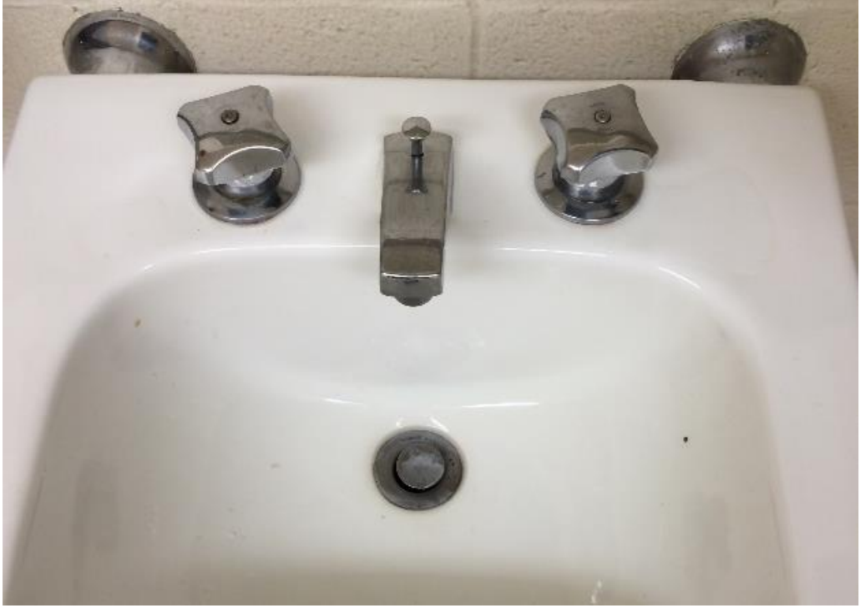
Hall of Fame or Hall of Shame?
http://www.indiana.edu/~iucdp/examplessignifiers.pdf

Slide 49
Hall of Fame or Hall of Shame?
http://www.indiana.edu/~iucdp/examplessignifiers.pdf

Slide 50
Hall of Fame or Hall of Shame?
http://www.indiana.edu/~iucdp/examplessignifiers.pdf

Slide 51
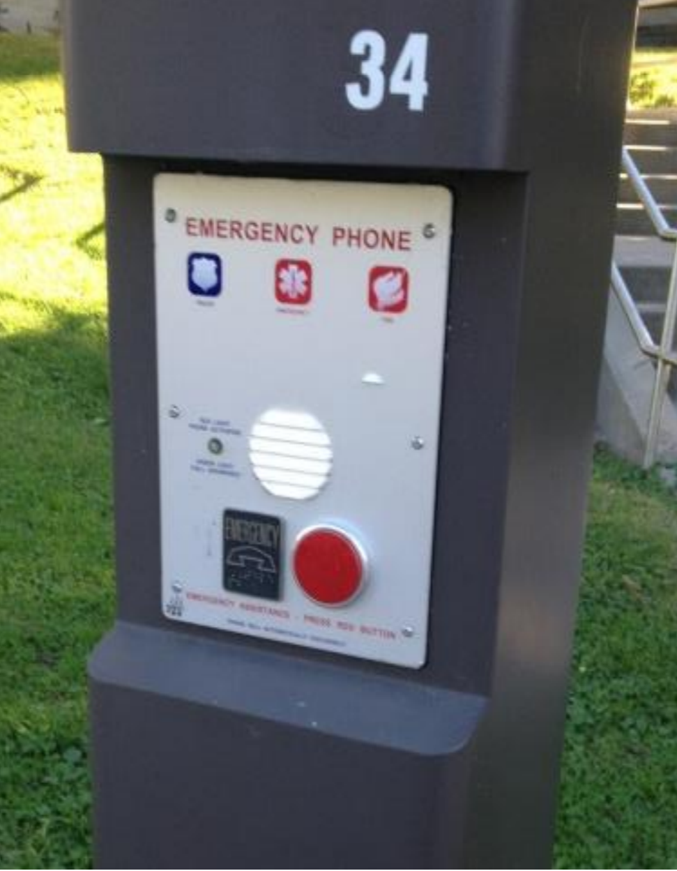
Hall of Fame or Hall of Shame?
http://www.indiana.edu/~iucdp/examplessignifiers.pdf

Slide 52
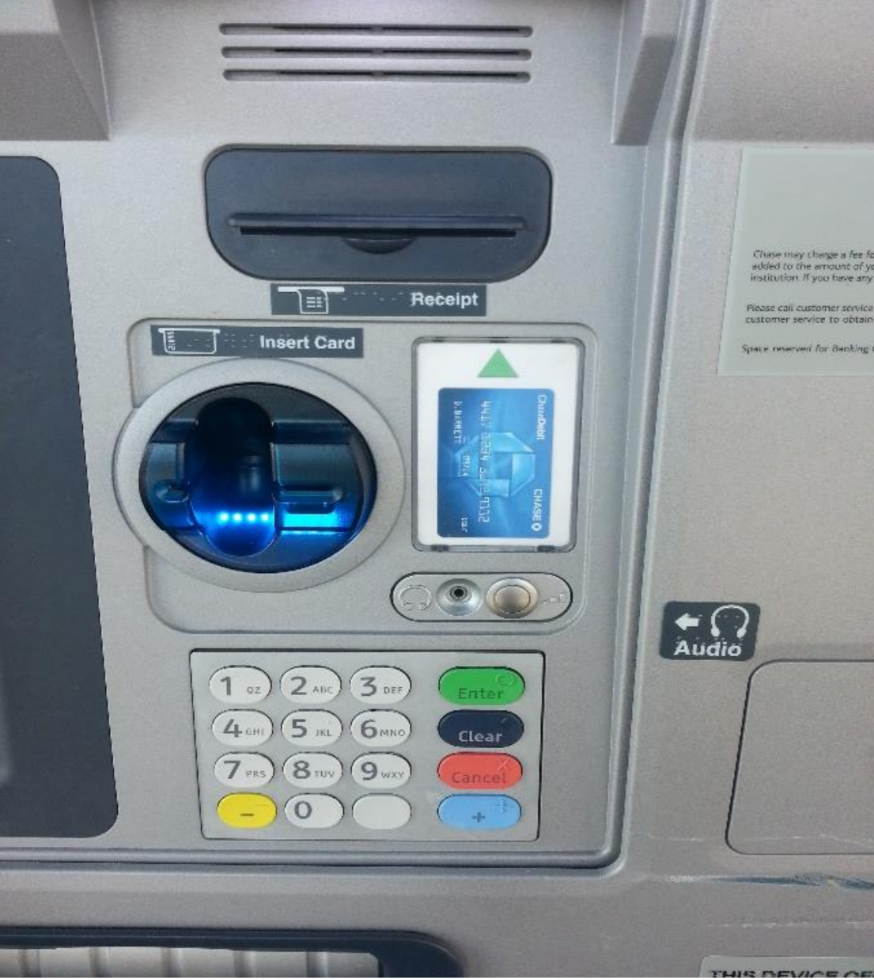
Hall of Fame or Hall of Shame?
http://www.indiana.edu/~iucdp/examplessignifiers.pdf

