Slide 1
CHAPTER 8: Fluid Navigation
Designing the User Interface:
Strategies for Effective Human-Computer Interaction
Sixth Edition
Ben Shneiderman, Catherine Plaisant, Maxine S. Cohen, Steven M. Jacobs, and Niklas Elmqvist
in collaboration with
Nicholas Diakopoulos
Slides edited by: Amberly Wang, Ben Estela, Terra Williams, Alexis Diaz, & Brandon Freshour

Slide 2
Fluid Navigation
Topics
Introduction
Navigation by selection
Small displays
Content Organization
Audio menus
Form fill-in and dialog boxes

Slide 3
1. Introduction***
Websites provide access to all kinds of information and tasks to perform - users are dependent on interface navigation to find what they’re looking for.
research shows 70% of people rely on navigation vs search
can be the difference between quick and easy transactions vs. empty shopping carts

Slide 4
Introduction (continued)
Navigation
Enables users to know where they are and to steer themselves to their intended destination
is about getting work done or having fun through a series of actions, much like sailors who steer their boat to a harbor
Is key to:
successfully operating interactive applications, such as installing a mobile app, completing an online survey, or purchasing a flight
(task navigation)
finding information on a website or browsing social media (web navigation)
finding the action needed in a desktop application (command menu navigation)

Slide 5
Introduction (continued)
Navigation
Note that even if a designer uses slick graphical menus, elegant form fill-in, or well known gestures there is no guarantee that the interface will be appealing and easy to use
Effective interfaces emerge only after careful consideration of and testing for numerous design issues, such as:
task-related organization
phrasing of items
sequence of items
graphic layout and design
responsive design to adapt to various sizes of devices
shortcuts for knowledgeable frequent users
online help and error correction
(Bailly, G., Lecolinet, E., Nigay, L., Visual menu techniques (2015) in preparation)

Slide 6
Introduction (continued)***
Example of “slick” graphical interface that is impractical + unappealing

Slide 7
Introduction (concluded)
“The goal for designers is to enable fluid navigation that allows users to gracefully and confidently get to where they want to go, explore novel possible routes, and back-track when necessary” - DTUI, 272

Slide 8
2. Navigation By Selection***
Various methods to present choices to users:
embedded links
graphically (e.g. calendars/timelines to visualize availability before user selects date/time)
grid menu + icons (common in mobile apps)
+ many more well-established methods

Slide 9
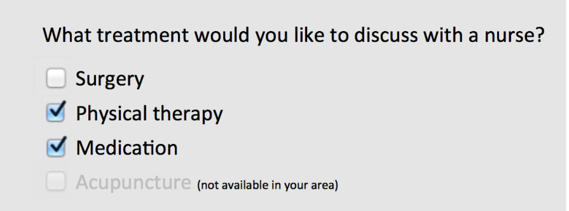
Navigation By Selection (continued)***
Radio Buttons and Checkboxes - good for handling multiple binary choices, as user can scan all items while deciding
Notes:
Fig. 8.3 and 8.4

Slide 10
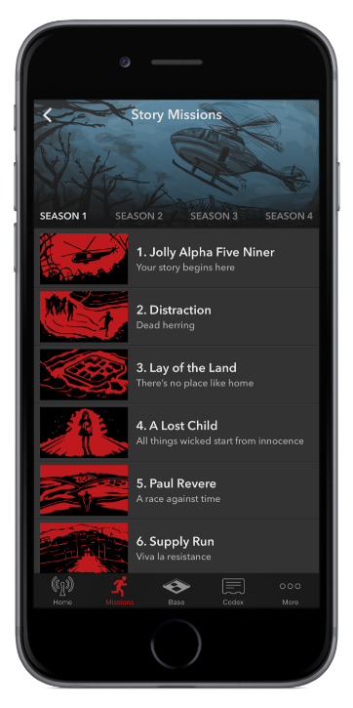
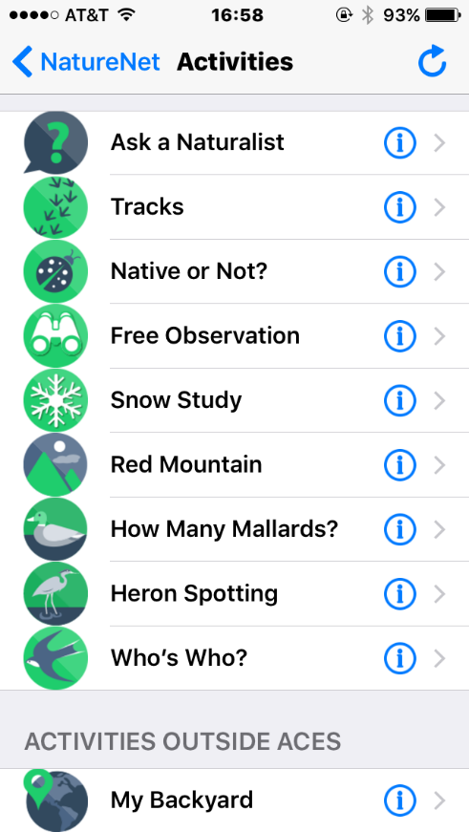
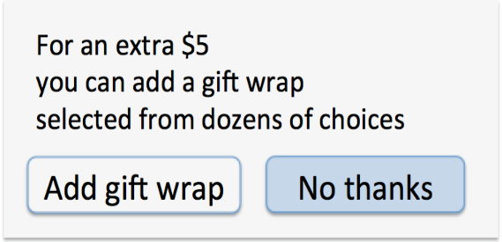
Navigation By Selection (continued)***

Slide 11
Navigation By Selection (continued)***
Menu bars, pop-up menus, toolbars, palettes and ribbons
typically found at the top of each application
positional constancy strong principle (e.g. gray out unavailable items for selection rather than remove from list, maintain order of File, Edit, View, and Help in menu bar)
Notes:
Fig. 8.1 and 8.2

Slide 12
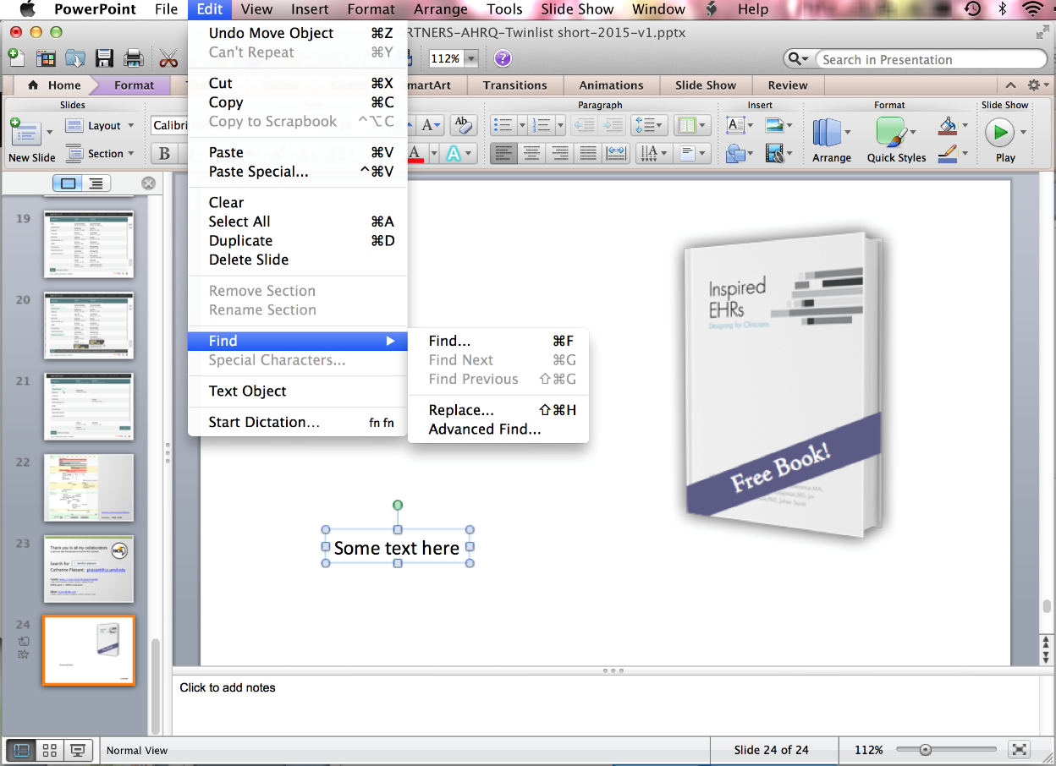
Navigation By Selection (continued)
Menu bars, pop-up menus, toolbars, palettes and ribbons
On the top menu bar of Microsoft Powerpoint the Edit cascading pull-down menu (also called pulled-right) is open, followed by the Find menu
Notes:
Fig. 8.5

Slide 13
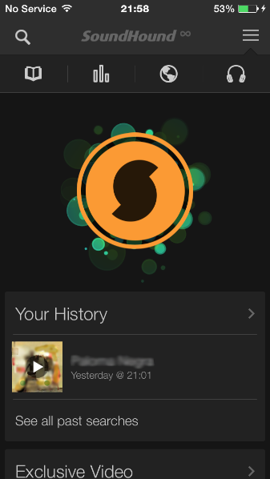
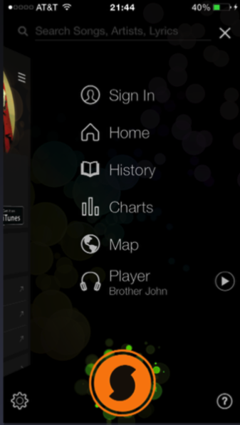
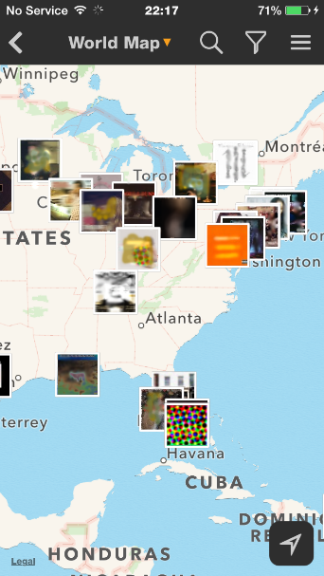
Navigation By Selection (continued)
Menu bars, pop-up menus, toolbars, palettes and ribbons
A B C D
The main menu of Soundhound has only 6 items, but it is still too much to be displayed on every page
A main menu “hamburger” icon appears at the top right of all appropriate pages, e.g. it appears in A and C, but not in the recording screen D, where only the X close icon is visible
Notes:
Fig. 8.7

Slide 14
Navigation By Selection (continued)
Examples of common gestures and their effect:
Tap: select
Long press: varied, from magnified cursor (iOS) to showing a tooltip (Windows 8)
Double tap: varied, e.g. zoom (iOS)
Small swipe: varied, e.g. move location or order of objects, reveal a delete button
Large swipe: usually scroll
Rapid swipe or fling: fast scroll with inertia
Pinch and spread: zoom in and out
Variation with two or more fingers: varied effects

Slide 15
Navigation by Selection (continued)***
Gestures can speed interaction, but they are hard to discover. The same gestures on different objects (background, edge of screen, item) can perform different actions.
Consistent application of gestures remains an issue
important to ensure easy reversal of actions

Slide 16
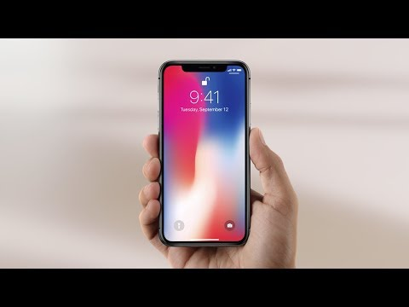
Navigation By Selection (continued)***

Slide 17
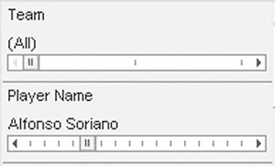
Navigation By Selection (continued)
Menus for long lists
Sliders and alpha-sliders
When items consist of ranges or numerical values, a slider is a natural choice to allow the selection of a value
The alpha-slider uses multiple levels of granularity in moving the slider thumb and therefore can support tens or hundreds of thousand of items
Notes:
Fig. 8.9

Slide 18
Navigation By Selection (continued)***
Linear vs Simultaneous Presentation
pizza-ordering interface might include a linear sequence of menus for users to choose size, toppings, and sides
installation wizards
simultaneous menus present multiple filters on a screen to enter choices in any order

Slide 19
Navigation By Selection (continued)
Menu bars, pop-up menus, toolbars, palettes and ribbons
http://www.awwwards.com gives awards to a large number of websites, which are tagged
A tag index at the top of the page displays all the tags, sorted by total count
The counts are indicated in parenthesis
The green colored tags are the popular tags that have been selected more often (which most likely will lead to even more selection)
Notes:
Fig. 8.12

Slide 20
Navigation By Selection (continued)***
text-only large 2D menus aren’t always bad
compact text menus allow users to rapidly scan hundreds of choices without dizzying effect of reorientation
good for websites with little competition or sites whose success comes from access to lower-level pages through search

Slide 21
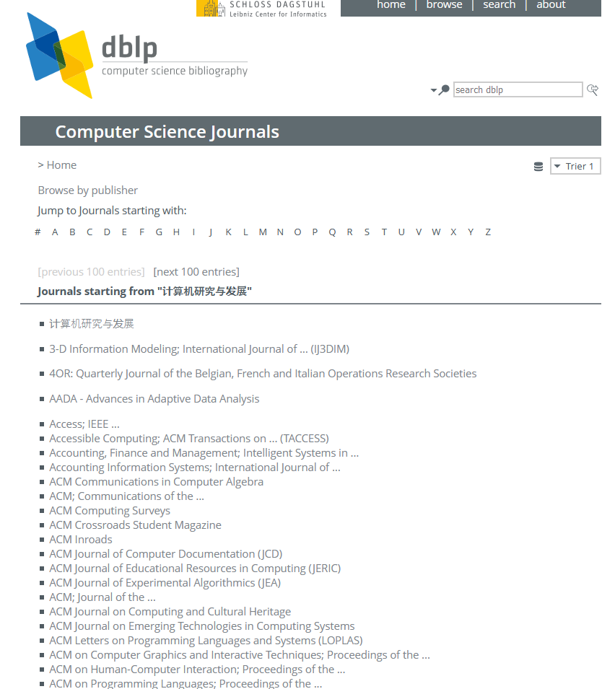
Navigation By Selection (continued)***

Slide 22
3. Small Displays
Small devices have very focused functionalities and few selectable areas.
Discoverability is often an issue
Notes:
Fig. 8.14

Slide 23
Small Displays (continued)***
Design considerations for small displays:
Simplify: “less is more”
Desktop to smartphone
Strive to reduce or eliminate data entry
Less space, less info
Learnability is key
Few visible actions/gestures
Consider use frequency and importance
Notes:
Fig. 8.14

Slide 24
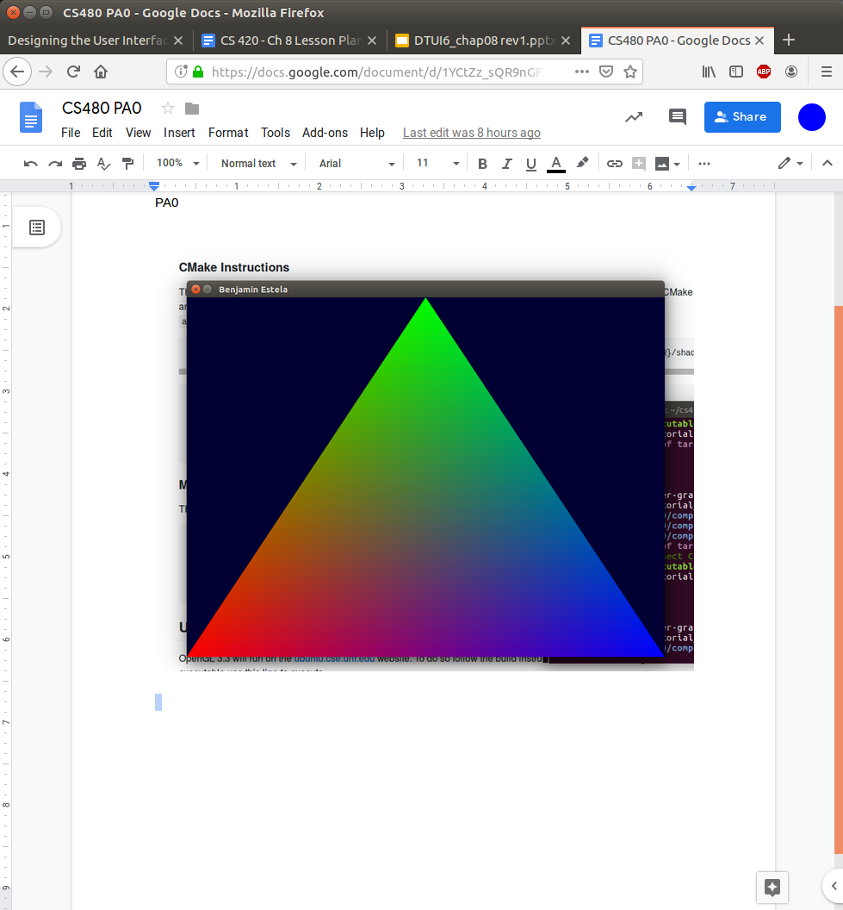
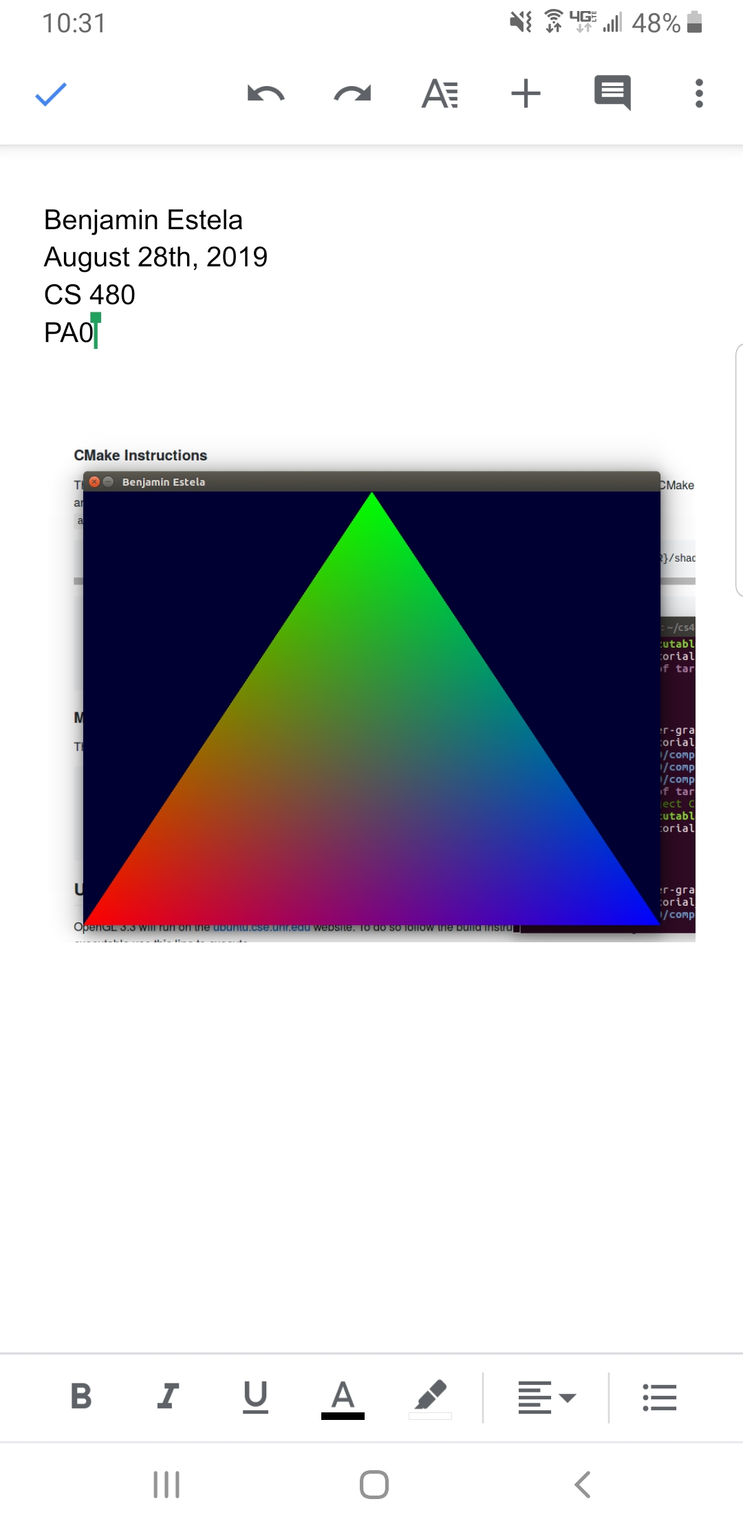
Small Displays (continued)***
Design considerations w/Google Docs:
Notes:
Fig. 8.14

Slide 25
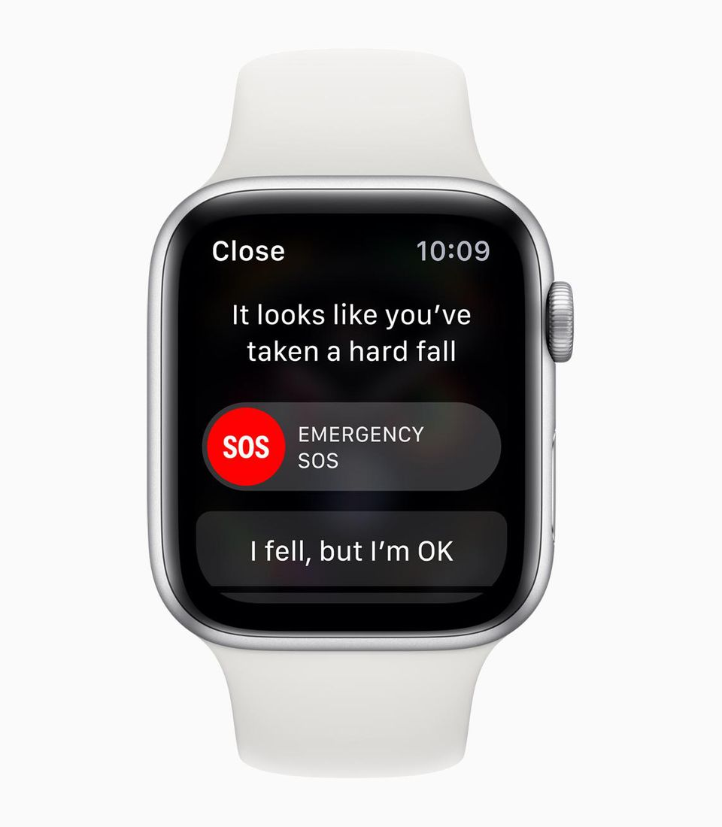
Small Displays (continued)***
Design considerations for small displays:
Plan for interruptions
Use of contextual information
Make clear what is and is not selectable
Leave room for gestures to avoid inadvertent actions
Consider relegating less important functions to other platforms
Notes:
Fig. 8.14

Slide 26
Small Displays (continued)***
Data input:
Avoided as much as possible on small devices
Simple touch widgets
Autocomplete
Suggested messages
Soft keys
Consistency across devices
Notes:
Fig. 8.14

Slide 27
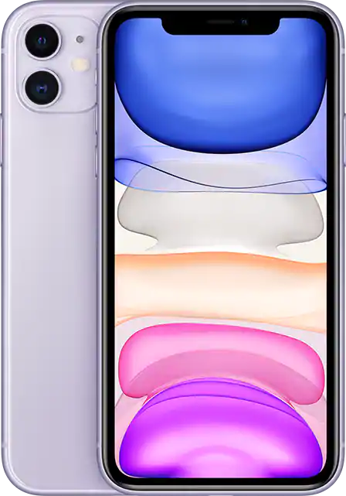
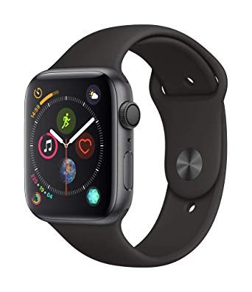
Small Displays (concluded)***
Design considerations for small displays:
Responsive Menus
Adapting to smaller screens
Hamburger menu
Design for mobile -> for desktops
Small -> Large
Notes:
Fig. 8.14

Slide 28
4. Content Organization
Organizing menus in a meaningful structure results in faster selection time and higher user satisfaction
Approaches:
Linear sequence (e.g. in a wizard or survey)
Hierarchical structure that is natural and comprehensible (e.g. a store split into departments)
Network structure when choices may be reachable by more than one path (e.g. websites)

Slide 29
Content Organization (continued)
Content organization design:
Tree-structure: designers can form categories of similar items, e.g. online grocery markets divided into produce, meat, dairy, etc. further divided into vegetables, fruit, etc. for produce, and milk, cheese, etc. for dairy
Breadth versus depth: the depth (number of levels) of a menu tree depends in part on the breadth (number of items per level)
Networks: choices may be reachable by more than one path, e.g. websites for online shopping that provide access to banking information from both the personal profile and the checkout section of a link structure

Slide 30
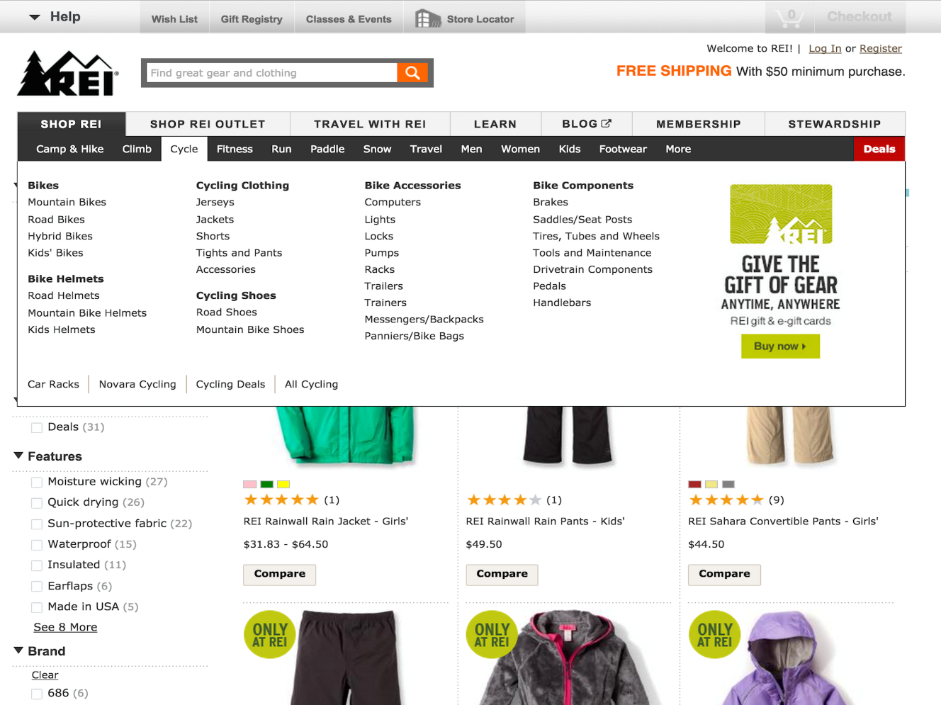
Content Organization (continued)
In the REI website, the categories for “Cycle” are expanded all at once below the top menu, showing 34 items organized in a meaningful hierarchy as a large menu
Notes:
Fig. 8.6

Slide 31
Content Organization (continued)
Rules for forming menu trees:
Use task semantics to organize menus
Limit the number of levels (i.e. prefer broad–shallow to narrow–deep)
Create groups of logically similar items: e.g. Level 1: countries, Level 2: states, Level 3: cities
Form groups that cover all possibilities: e.g. Age ranges: [0–9] [10–19] [20–29] and [>= 30]
Make sure that items are non-overlapping: e.g. use “Concerts” and “Sports.” over “Entertainment” and “Events”
Arrange items in each branch by natural sequence (not alphabetically) or group related items
Keep ordering of items fixed (or possibly duplicate frequent items in dedicated section of the menu)

Slide 32
***Content Organization (continued)
Additional considerations for content organization design include:
Sequence: order in which items are presented
Phrasing: how to title categories
Layout: design of the page
Notes:
Fig. 8.15

Slide 33
***Content Organization (continued)
Sequencing:
Order that items are listed
Typical lists are alphabetically ordered, but categorical lists may be
useful
Ex. Microsoft Word puts most
frequently used fonts first

Slide 34
***Content Organization (continued)
Phrasing:
Use familiar and consistent terminology
Ex. using the word “cart” for a shopping website
Ensure that items are distinct from one another
Ex. use “Bike Tours” and “Cruises” rather than “Slow Tours” and “Leisurely Voyages”
Use consistent and concise phrasing
Ex. use “Animals” rather than “Information about Animals”
Bring the keyword to the fore
Ex. use “Size of Font” rather than “Set the font size”

Slide 35
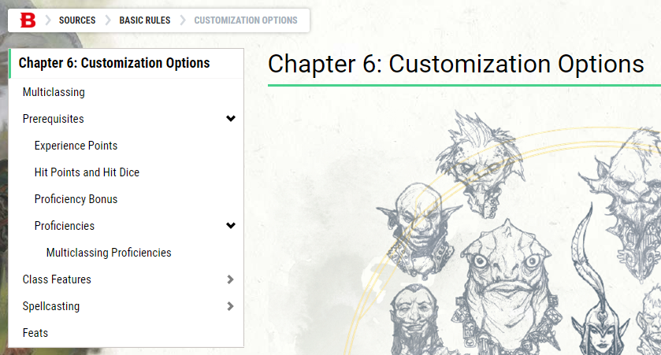
***Content Organization (continued)
Layout
Position of titles, images, instructions, etc.
Indicate position in the menu structure
The set of headers below from D&D Beyond gives a clear indication of progress down the tree
Notes:
Section 8.4.2

Slide 36
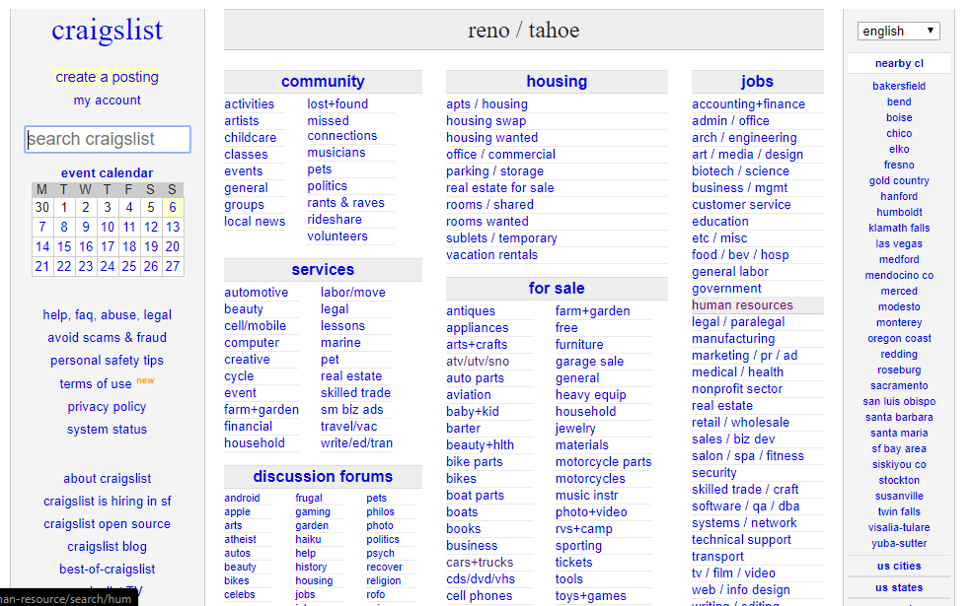
***Content Organization (continued)
A bad example: Craigslist

Slide 37
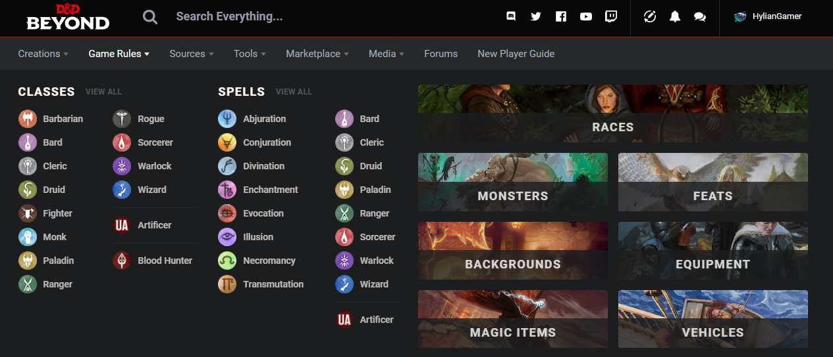
***Content Organization (concluded)
A good example: D&D Beyond

Slide 38
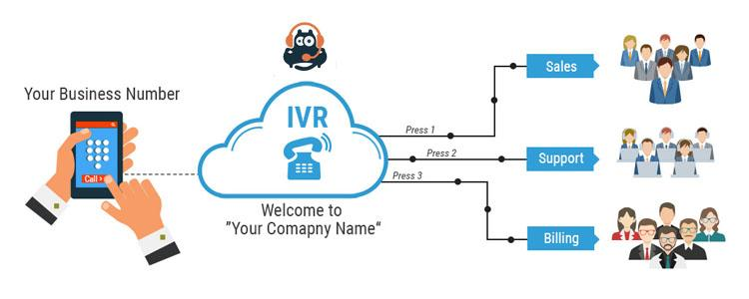
***5. Audio Menus
Interactive Voice Response (IVR) systems:
Lists of options are spoken to users
Users respond by using the keys of a keyboard, phone, or by speaking.
Execute user selection, or repeat the options and have an exit mechanism.

Slide 39
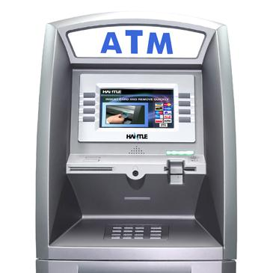
***Audio Menus: Uses***
Hands-free and eyes-free
Driving
Phone surveys
Phone services
Public access situations for visually impaired
Information kiosks
Voting machines

Slide 40
***Audio Menus: Video***
Louis Rossmann

Slide 41
***Audio Menus: Benefits
No need to display menu
Also sometimes doesn’t need buttons
Dial-ahead capabilities

Slide 42
***Audio Menus: Downsides
Memorization
Confirmation step after selection
Lack of clarity
Might have too many options

Slide 43
***Audio Menus: Good Audio Menus
Four key parts of a good audio menu:
Know the user’s goals
Common selections are said first
Keep it simple. 3-4 options is best
Avoid the following phrase:
“Listen carefully, as our menu options have recently changed”

Slide 44
***Audio Menus: Voice Recognition
Voice recognition is viable with today’s technology
No button pressing
Prompts can be lengthy if both voice recognition and number options are used.

Slide 45
***Audio Menus: Newer Technology
IVAs (Intelligent Virtual Assistants)*
Process simple phrases
Some mimic real humans
Requires less time traversing through menus
Callback Scheduling*
No need to wait in queue
*https://static1.squarespace.com/static/5a8f9198f79392a0212ecb6e/t/5c663ddd4785d3840e6b3f1b/1550204385104/Inference+Solutions_ProductBrochure.pdf

Slide 46
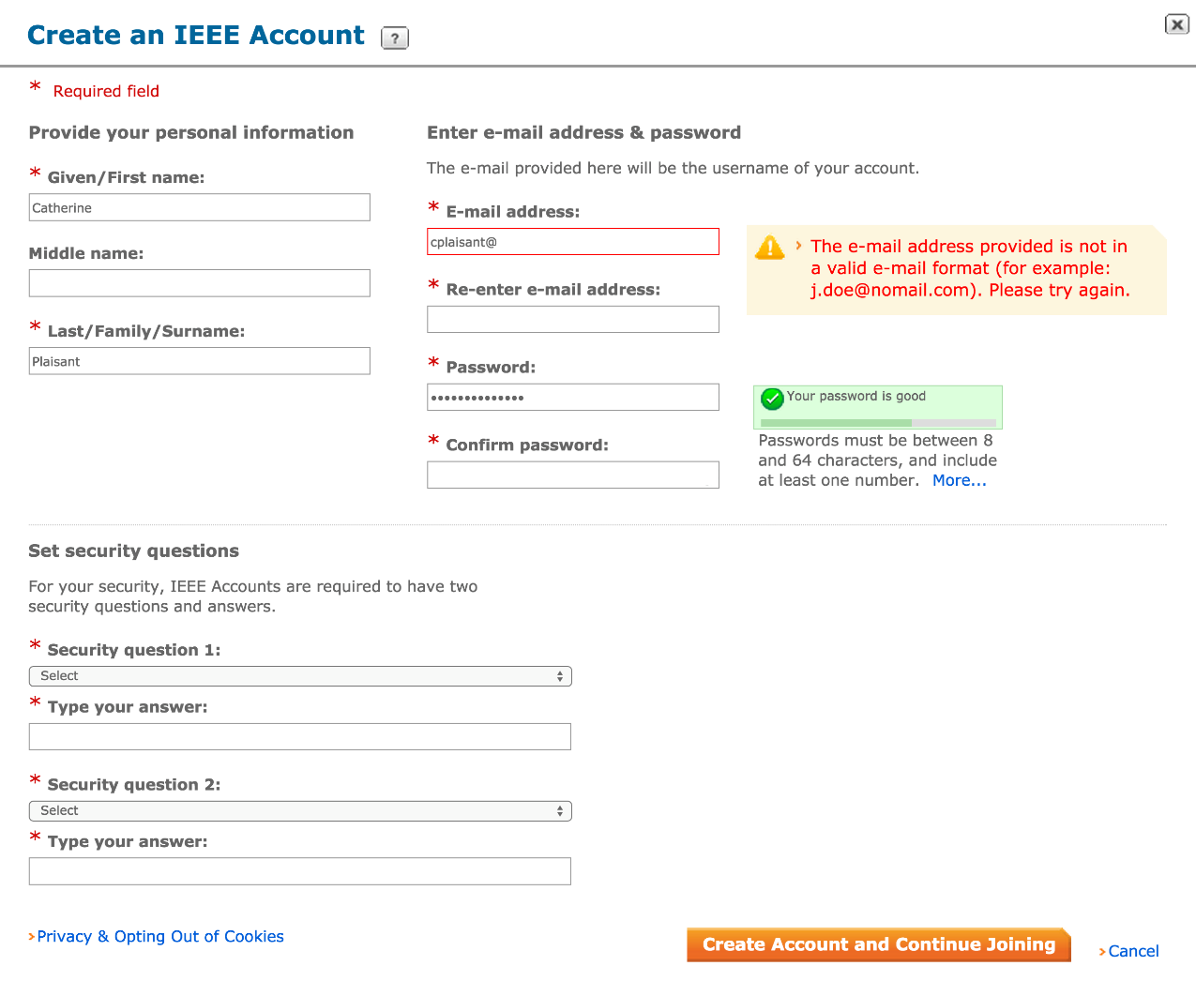
6. Form Fill-in
This form fill-in allows users to enter information when joining the IEEE Society
Fields are grouped meaningfully, and field-specific rules such as password requirements are provided next to the fields
The data is validated as soon as it is being provided (opposed to being validated when the form is submitted) and error messages explain how to correct the problem
(http://www.ieee.org)
Notes:
Fig. 8.16

Slide 47
Data Entry with Form Fill-in
Form Fill-in
Appropriate when many fields of data must be entered:
Full complement of information is visible to user
Display resembles familiar paper forms
Few instructions are required for many types of entries
Users must be familiar with:
Keyboards
Use of TAB key or mouse to move the cursor
Error correction methods
Field-label meanings
Permissible field contents
Use of the ENTER and/or RETURN key

Slide 48
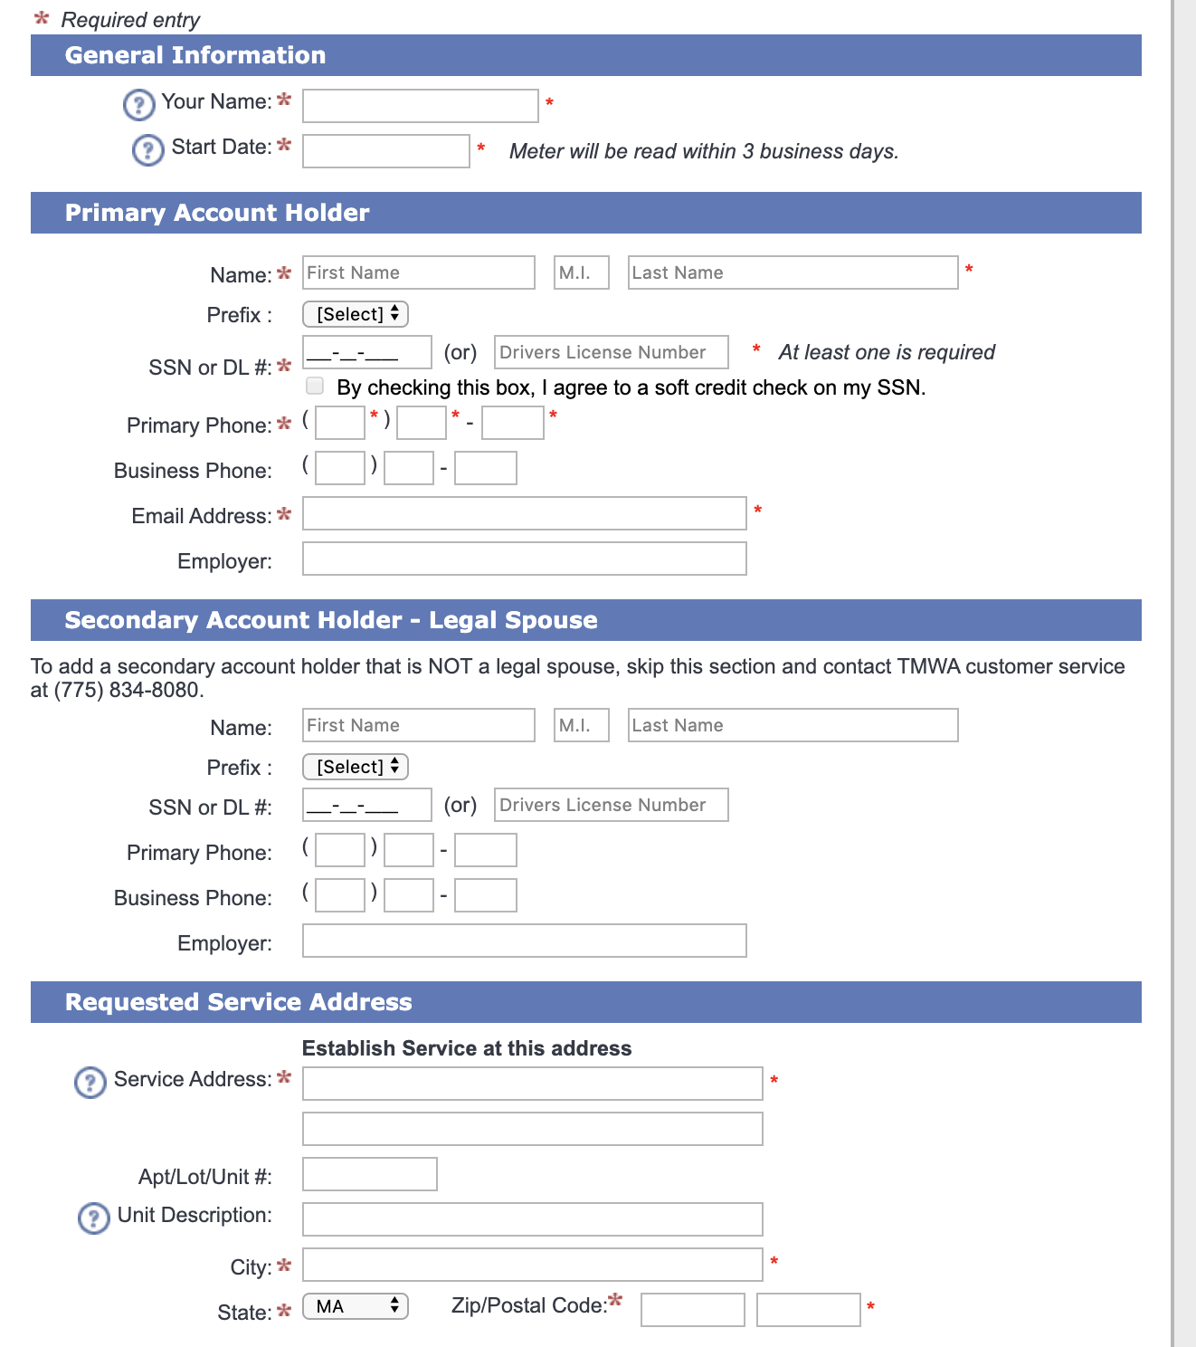
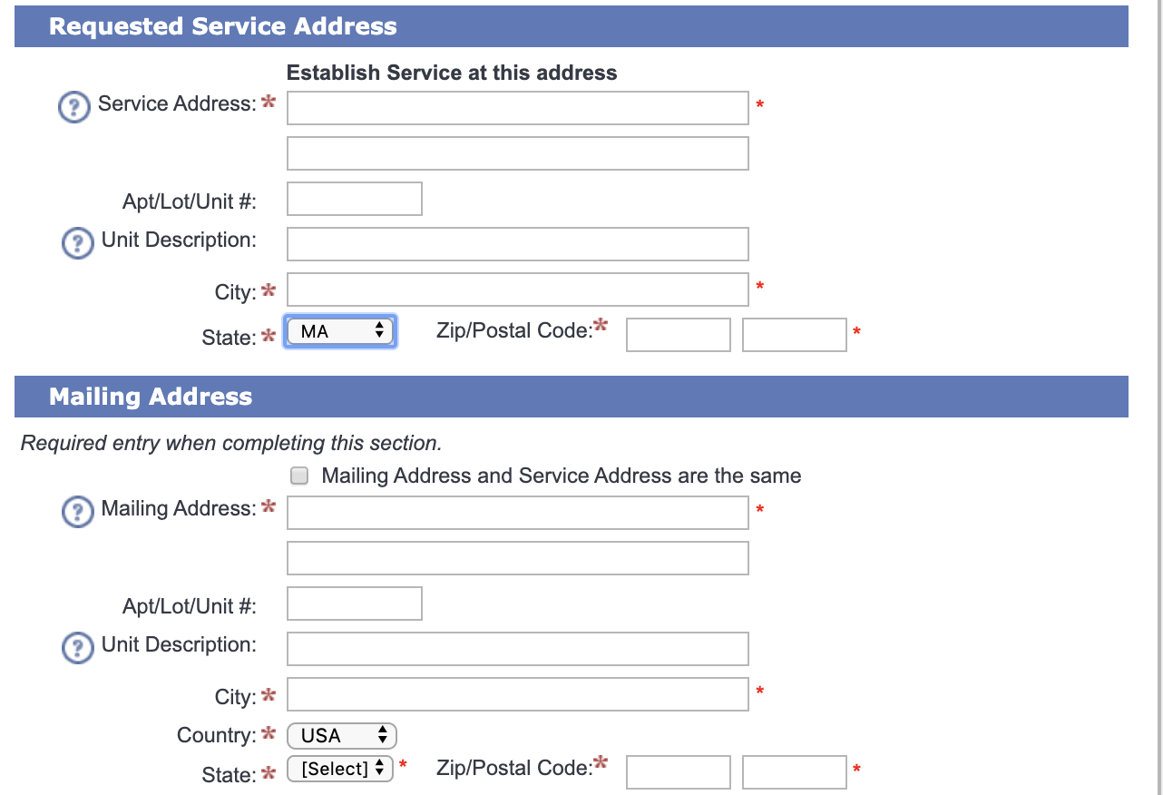
Question ***
Notes:
What is good/bad about this web form?
Bad:
Duplicate entry fields
What is up with all those astrisks?

Slide 49
Rules of Thumb for Forms ***
Provide feedback and validation
Avoid duplicate fields
Group similar fields
Collect only the necessary information
Don’t use custom input formats

Slide 50
Consequences of Bad Forms***
Can lead to user confusion
Users won’t complete the form
Inaccurate data
Lost revenue

Slide 51
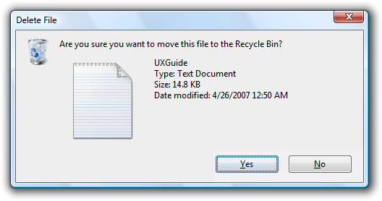
Dialog Boxes
This dialog box includes a binary menu with two choices (Yes or No)
The blue highlighting on Yes indicates that this selection is the default and that pressing Return will select it
Specific keyboard shortcuts can be made available
Escape closes the dialog box
Typing the letter ‘N’ will select ‘No’ as indicated by the underlined letter ‘N’
Notes:
Fig. 8.18

Slide 52
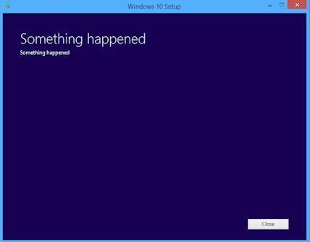
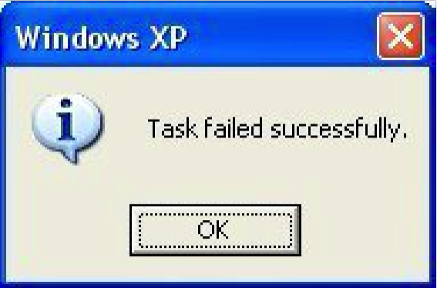
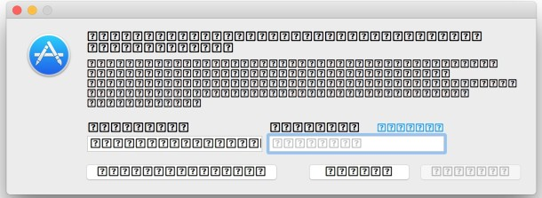
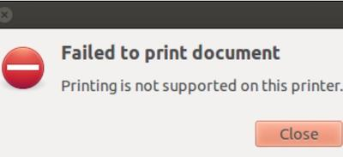
Dialog Boxes (continued) ***
Notes:
Example of bad dialog boxes.
Provides little to no actionable info
Confusing to the user
It would almost be better if there was never a dialog box

Slide 53
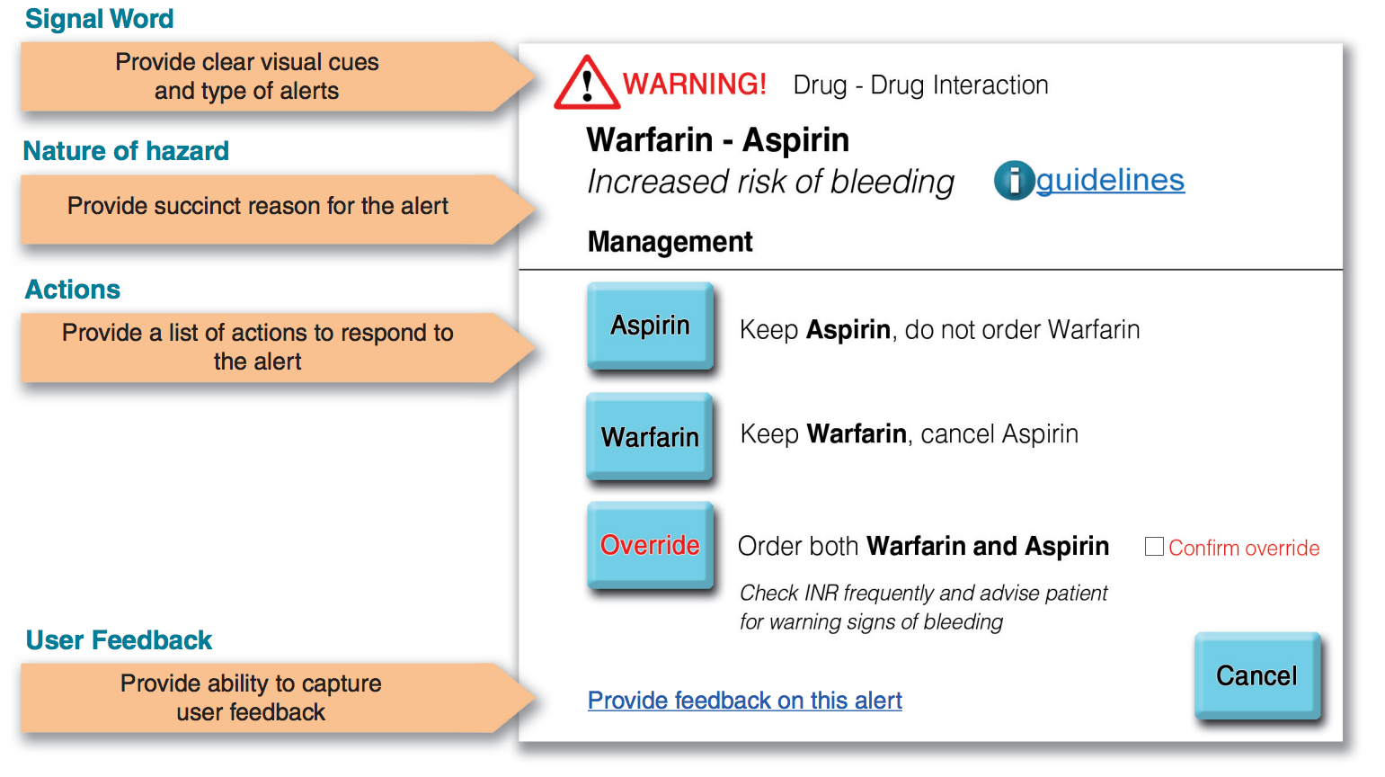
Dialog Boxes (continued)
This dialog box is used to alert clinicians who try to prescribe the drug Warfarin, because it increases the risk of bleeding of patients already on Aspirin
Several possible actions are proposed
Overriding the alert is possible but requires confirmation by clicking a check box
Because of the severity of the alert, this is a modal dialog box and it requires immediate action
Notes:
Fig. 8.19

Slide 54
Data Entry with Dialog Boxes
Dialog Boxes
Combination of menu and form fill-in techniques
Internal layout guidelines:
Meaningful title, consistent style
Top-left to bottom-right sequencing
Clustering and emphasis
Consistent layouts (margins, grid, white space, lines, boxes)
Consistent terminology, fonts, capitalization, justification
Standard buttons (OK, Cancel)
Error prevention by direct manipulation

Slide 55
Data Entry with Dialog Boxes (concluded)
Dialog Boxes
External Relationship
Smooth appearance and disappearance
Distinguishable but small boundary
Size small enough to reduce overlap problems
Display close to appropriate items
No overlap of required items
Easy to make disappear
Clear how to complete/cancel

