Slide 1
CHAPTER 15: Information Search
Designing the User Interface:
Strategies for Effective Human-Computer Interaction
Sixth Edition
Ben Shneiderman, Catherine Plaisant, Maxine S. Cohen, Steven M. Jacobs, and Niklas Elmqvist
in collaboration with
Nicholas Diakopoulos

Slide 2
Introduction to Information Search
Topics
Introduction
Five-phase search framework
Dynamic queries and faceted search
Command languages and “natural” language queries
Multimedia Document Search & specialized search
The Social aspects of search
Notes:
Jake will be speaking on the introduction and the five-phase search framework
Chris will be talking about Dynamic queries and faceted search
Amanda will be talking about Command languages and “natural” language queries
Will is talking about Multimedia Document Search & specialized search
Brandon will wrap us up with The Social aspects of search

Slide 3
Introduction to Information Search (continued)
The way users conduct searches have dramatically changed over the past decades.
This chapter’s main focus is on web or database searches of text & multimedia collections
Information retrieval and database management have evolved into:
Information seeking, filtering, collaborative filtering, sensemaking, and visual analytics.
Alternating these strategies is called “berry picking”
All the above is complicated by the increased volume of material to search
Data mining
Deep learning

Slide 4
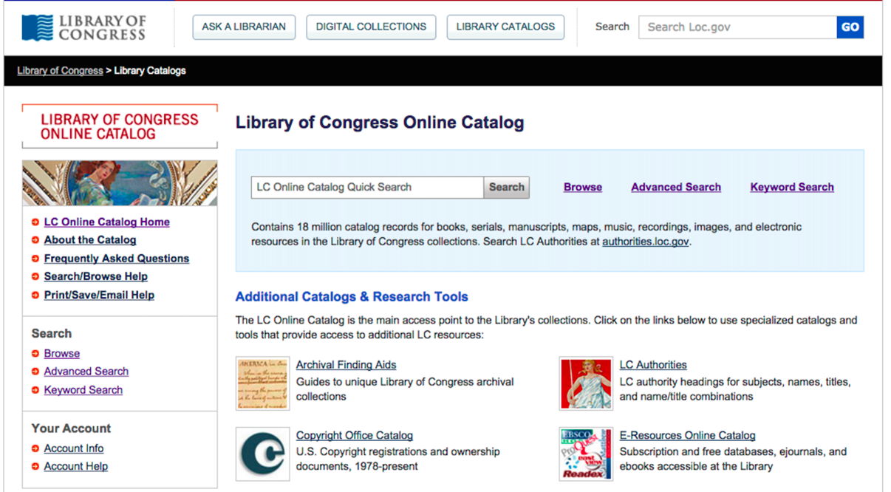
Introduction to Information Search (continued)
The home page of the U.S. Library of Congress Online Catalog (catalog.loc.gov) shows the simple search box prominently placed at the top of the page, and provides alternative means of finding items of interest in the diverse collections
Advanced search interfaces are provided to accommodate experienced searchers
Notes:
Fig. 15.1
It is important for us as designers to think of a way to balance both experienced users and beginners. Here is the main page of the Library of Congress search page which has a simple search bar to enter keywords or terms for a user that might not quite know where to look.

Slide 5
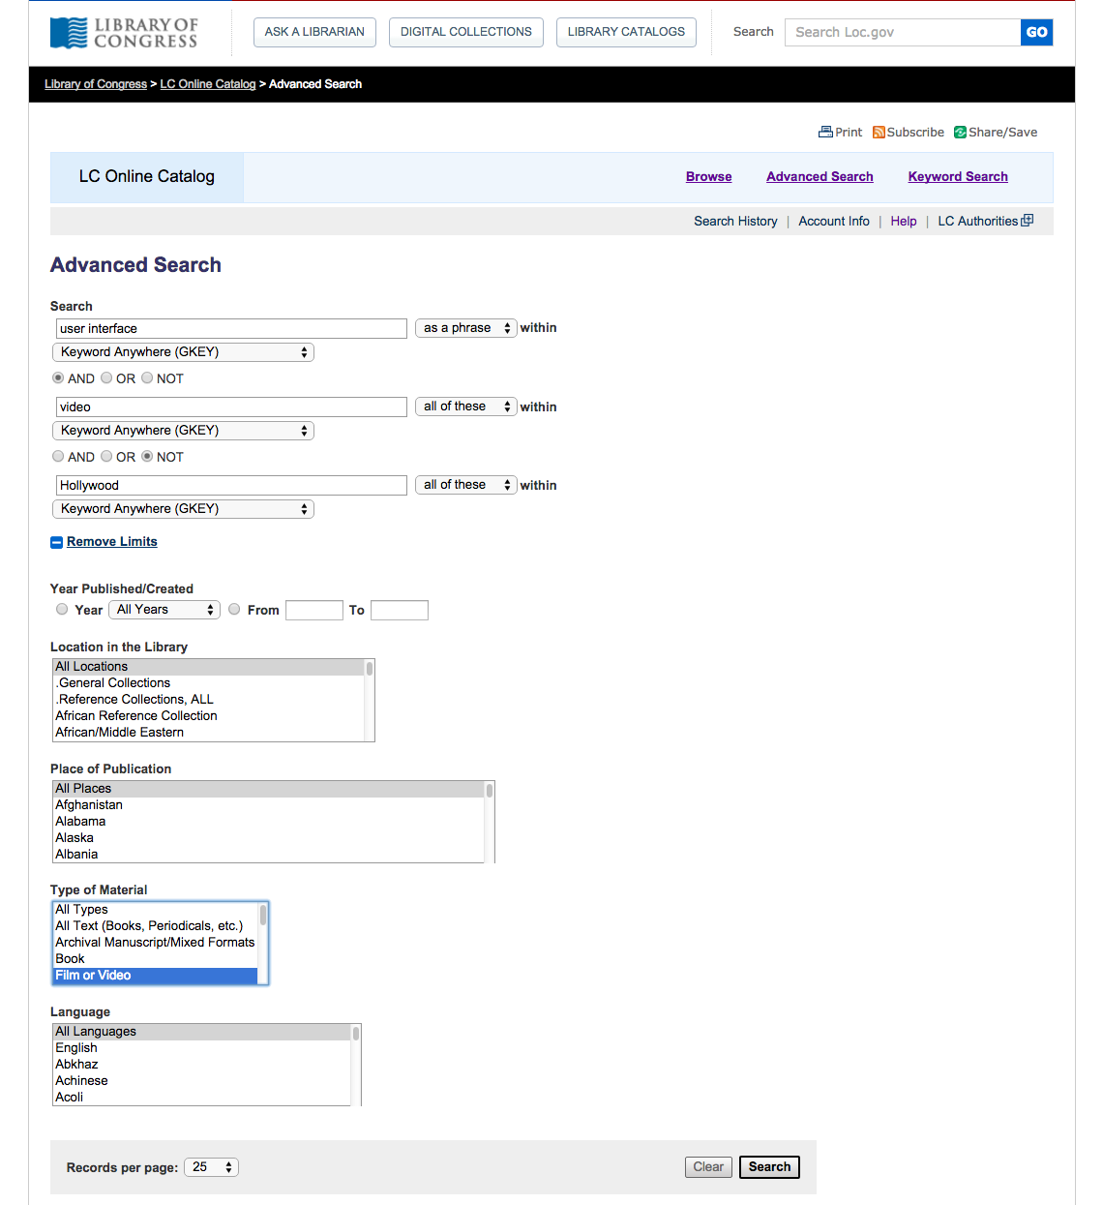
Introduction to Information Search (concluded)
The advanced search interface of the U.S. Library of Congress Online Catalog (catalog.loc.gov)
The entire page is now dedicated to search controls and tips
Using checkboxes, text fields and menus users can compose Boolean queries, restrict the search scope to a subset of the collections, and apply filters based on metadata
Regular users sign up for an account to save results and keep a search history to facilitate re-finding
Notes:
Fig. 15.2
While having an advanced search for users who know what they are looking for and can really narrow down their search results to get exactly what they are looking for

Slide 6
Search terminology
Task objects (such as movies for rent) are stored in structured relational databases, textual document libraries, or multimedia document libraries
A structured relational database consists of relations and a schema to describe the relations
Relations have items (usually called tuples or records), and each item has multiple attributes (often called fields), which each have attribute values
A library consists of a set of collections (typically up to a few hundred collections per library) plus some descriptive attributes or metadata about the library (for example, name, location, owner)
Notes:
Here is a list of search terminologies that order and structure these databases.

Slide 7
Search terminology (continued)
Digital libraries are generally sets of carefully selected and cataloged collections
Digital archives tend to be more loosely organized
Directories hold metadata about the items in a library and point users to the appropriate locations
for example, the NASA Global Change Master Directory helps scientists locate datasets in the many NASA’s archives
Items in unstructured collections like the web have no (or very few) attributes

Slide 8
Search terminology (continued)
Task actions are decomposed into browsing or searching
Here are some examples of task actions:
Specific fact finding (known-item search)
Find the e-mail address of the President of the United States.
Extended fact finding
What other books are by the author of “Jurassic Park”?
Exploration of availability
Is there new work on voice recognition in the ACM digital library?
Open-ended browsing and problem analysis
Is there promising new research on fibromyalgia that might help my patient?
Notes:
When users are searching for information they have task actions.

Slide 9
Search terminology (concluded)
Once users have clarified their information needs, the first step towards satisfying those needs is deciding where to search
Supplemental finding aids can help users to clarify and pursue their information needs, e.g. table of contents or indexes
Additional preview and overview surrogates for items and collections can be created to facilitate browsing
Notes:
Once users have figured out what they want to search, they then need to decide where to search. Finding aids can help with this as well as preview and overview surrogates for items and collections to organize and facilitate browsing to guide the user to what they are trying to find.
Next we have the 5 stage seach.

Slide 10
Five-phase framework for search user interfaces
Information seeking is an iterative process. So these 5 steps can repeated many times until the users needs are met.
Formulation: expressing the search
Initiation of action: launching the search
Review of results: reading messages and outcomes
Refinement: formulating the next step
Use: compiling or disseminating insight

Slide 11
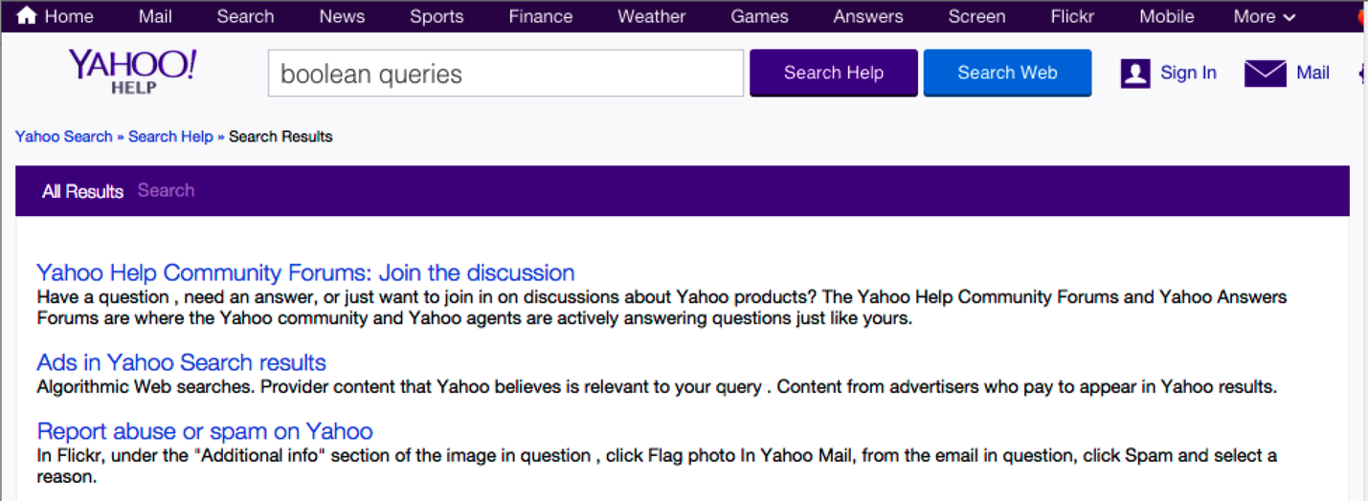
Five-phase framework for search user interfaces (continued)***
Formulation
The formulation stage is about identifying the source of information (i.e. where to search).
Users often prefer a limited search to a few sites not the entire web.
Notes:
Box 15.1
In this example we have yahoo search with a purple box which limits the search to just help info while the blue box will search the entire web. This is limiting the source of info to receive a more concise result.

Slide 12
Five-phase framework for search user interfaces (continued)***
2. Initiation of action
Launching the action which may be implicit or explicit
Explicit is the normal initiation of the search (pressing the Magnifying Glass
Implicit initiation is when any change to any component of the formulation stage produces a new result
Dynamic Queries are a way for users to adjusts query widgets to produce continuous updates
Notes:
Fig. 15.5
This is the example of an Explicit search result initiated with a # of results and highlighting the term searched.

Slide 13
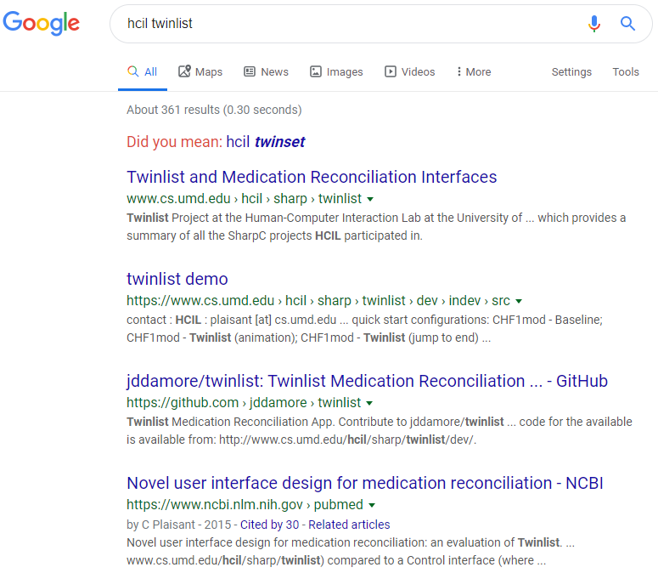
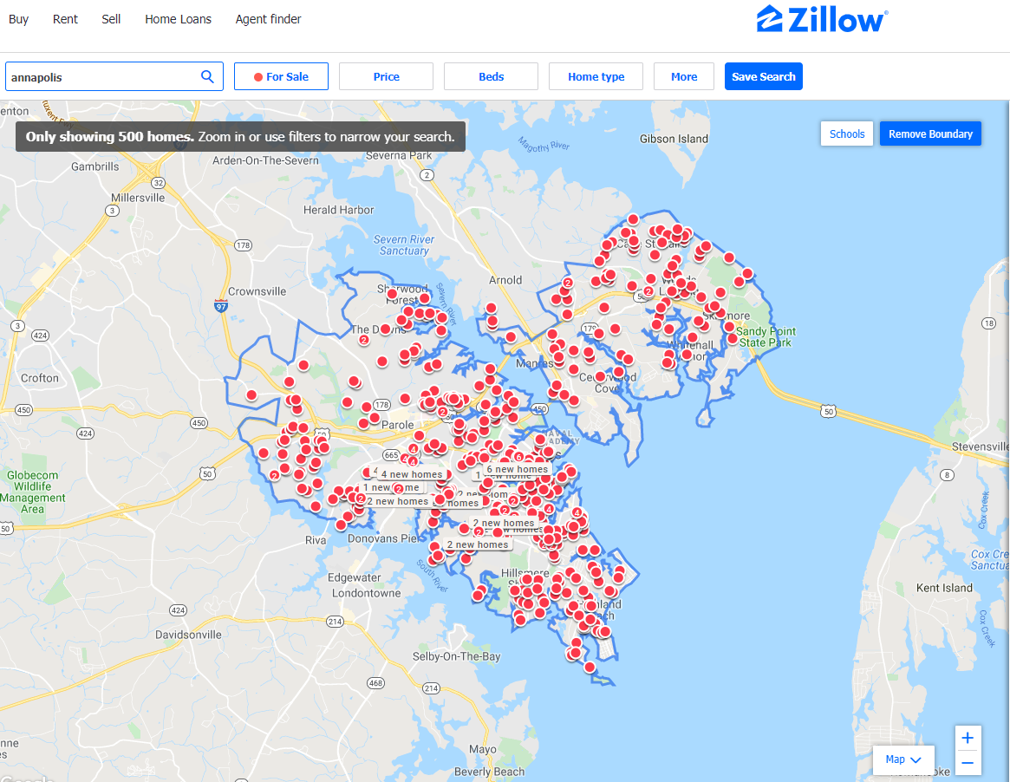
Five-phase framework for search user interfaces (continued)***
3. Review of Results
Users can review their search results in textual lists or on geographical maps.
Notes:
Screenshots taken from my own computer
Results in a list and a geographical map

Slide 14
Five-phase framework for search user interfaces (continued)***
4. Refinement
Search interfaces can provide meaningful messages to explain search outcomes and to support progressive refinement.
Progressive refinement meaning the results of the search are refined by changing search parameters.
Notes:
Screenshot taken from my own pc

Slide 15
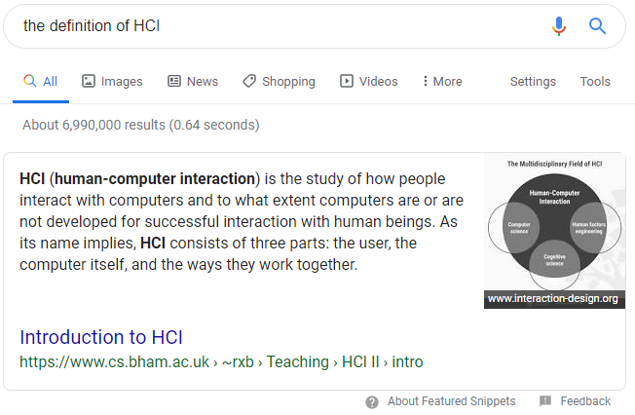
Five-phase framework for search user interfaces (continued)***
5. Use
The final stage is Use of the results and where the payoff comes.
This is where the users can use the results for their benefit.
Notes:
Screenshot taken from my own pc
here we have the results of what the user wanted right on the search page and did not have to click on the site itself. I will now pass it on to Chris.

Slide 16
Dynamic Queries and Faceted Search
(Presented by Christopher Eichstedt)

Slide 17
What is Metadata?***
“Metadata is "data that provides information about other data". In short, it's data about data.” -Wikipedia

Slide 18
What are Dynamic Queries?***
When metadata is available, dynamic query interfaces provide:
(1) a visual representation of the possible actions (e.g., menus, sliders, or buttons to represent choices for each field),
(2) a visual representation of the objects being queried (e.g., a list of items, a map or any other visual overview), and
(3) rapid, incremental, and reversible actions and immediate feedback.

Slide 19
Why use Dynamic Queries?***
The dynamic query approach is appealing as it prevents errors and encourages exploration…
They are attractive and can reduce error messages such as "data out of range" while providing information about data availability and a feeling of thoroughness to users.

Slide 20
Why use Dynamic Queries? (cont.)***
...dynamic queries and query previews demonstrated the benefit of applying direct-manipulation principles to queries…
(tldr) Allow the user to see changes in real time via direct manipulation.

Slide 21
Early Development for Dynamic Queries***
Early work on query previews used bar charts to show the distribution of attribute values for each field.
It eliminated zero-hit queries as users could only select values leading to some results and also laid the foundation for faceted browsing (that typically uses the more compact numeric counts instead of bar charts to provide preview information about availability).

Slide 22
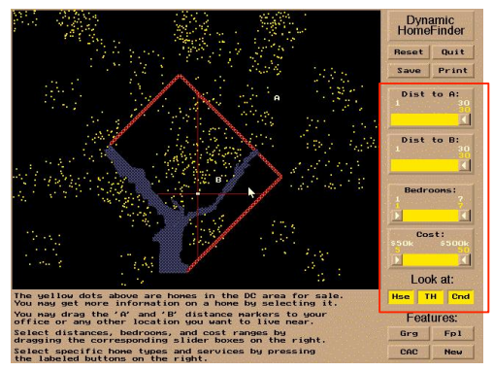
Example of Early Dynamic Queries***
https://www.youtube.com/watch?v=zthhyUVmq9M&t=20s

Slide 23
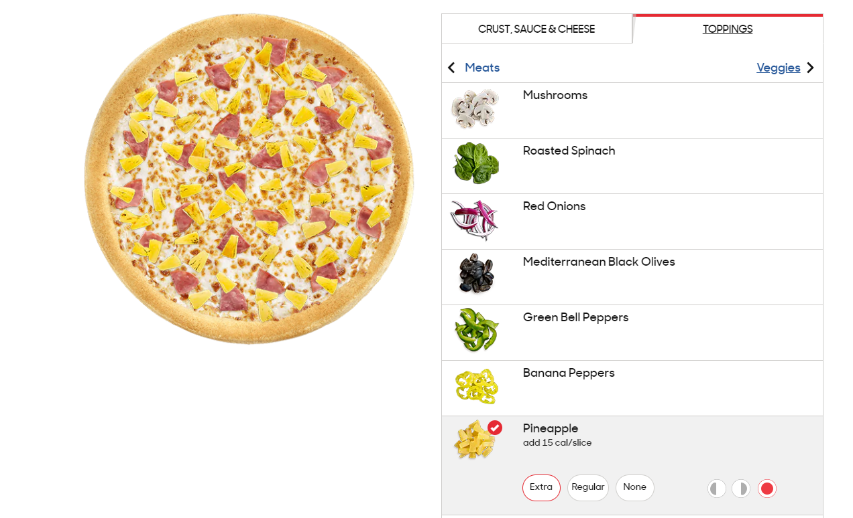
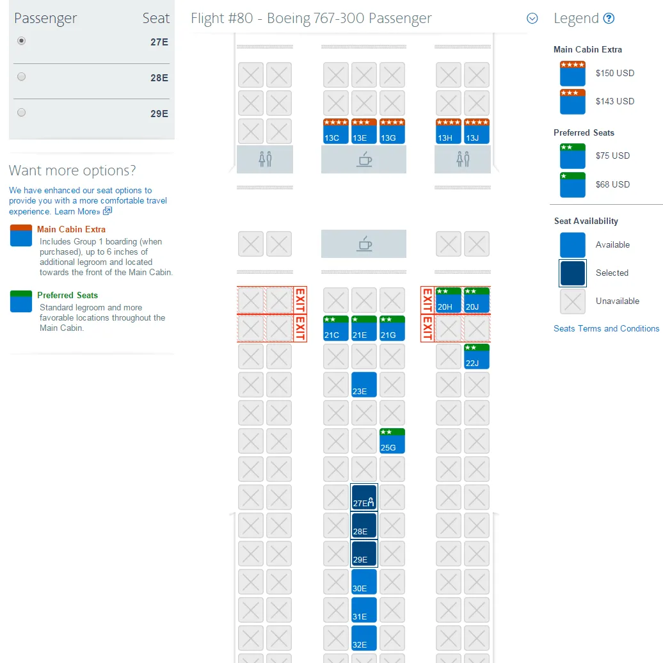
Example of Modern Dynamic Queries***

Slide 24
What is a Faceted Search?***
"COMPUTING (of a search engine, browser, etc.) allowing the use of multiple filters that specify different aspects and qualities of the type of thing being searched for." -Wikipedia

Slide 25
How does Faceted search work?***
It tightly integrates category browsing with keyword searching (i.e., navigation and search).
Faceted search makes use of hierarchical faceted metadata presented as simultaneous menus and dynamically updated counts as a preview of the results.

Slide 26
What are the benefits of a Faceted search?***
It allows users to navigate explicitly along multiple conceptual dimensions that describe tile items and to progressively narrow or expand the scope of the query while browsing.
It shows the structure as a starting point, organizes results in a recognizable structure, and gives control and flexibility over the order of
metadata use and over when to navigate and when to search.

Slide 27
Interactive Faceted Search***
https://www.amazon.com

Slide 28
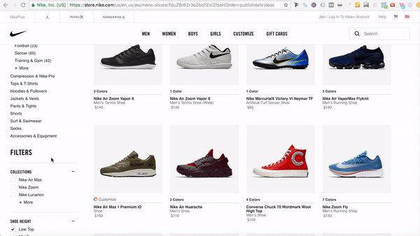
Example of a Faceted Search***

Slide 29
Search Design Consistency***
The lack of consistency between search interfaces means that users have to
discover how to search each time they use a different application. An analogy to
the evolution of automobile user interfaces might clarify the need for standardization of search interfaces. Early competitors offered a profusion of controls,and each manufacturer had a distinct design. Some designs - such as having a brake pedal that was far from the gas pedal - were dangerous. Furthermore, if you were accustomed to driving a car with the brake to the left of the gas pedal and your neighbor's car had the reverse design, it might be risky to trade cars. It took half a century to achieve good design and appropriate consistency in automobiles; let's hope we can make the transition faster for search user interfaces.
(tldr) Design convention is a good thing.

Slide 30
Further reading on Dynamic Queries and Faceted Search***
Graduate Thesis from Stefan Ganchev at the Univ. of Iowa
https://lib.dr.iastate.edu/cgi/viewcontent.cgi?article=4295&context=etd

Slide 31
Command Language and Natural Language Queries

Slide 32
***Command languages and “natural” language queries
Command Languages: language for job control in computing.
Used for communication between the user and the OS
Natural Languages: everyday phrases, the languages that humans speak
Notes:
Section 15.4

Slide 33
***Command languages and “natural” language queries
Command Languages Examples
Command to print document
UNIX Command for deleting blank lines in a file
Notes:
Section 15.4

Slide 34
***Command languages and “natural” language queries
What is a Query?
Notes:
Section 15.4

Slide 35
***Command languages and “natural” language queries
Query
Definition: Request for information or data from a database
Easier to view, add, delete or change data
Find specific data quickly
Calculate or summarize data
Automate data management tasks
Notes:
Section 15.4

Slide 36
***Command languages and “natural” language queries
Query – Cont
Common Types of Queries:
Select Queries
Action Queries
Notes:
Section 15.4

Slide 37
***Command languages and “natural” language queries
Query – Cont
Select Query – Data retrieval
Action Query – performs additional operations on the data
add,change or delete
Notes:
Section 15.4

Slide 38
***Command languages and “natural” language queries
SQL – Structured Query Language
Standard language for relational database management systems
Used to retrieve, modify, add, and delete data from databases
Notes:
Section 15.4

Slide 39
Command languages and “natural” language queries (example)
SELECT DOCUMENT#
FROM JOURNAL-DB
WHERE (DATE >= 2014 AND DATE <= 2017)
AND (LANGUAGE = ENGLISH OR FRENCH)
AND (PUBLISHER = ASIST OR HFES OR ACM)
Notes:
Section 15.4

Slide 40
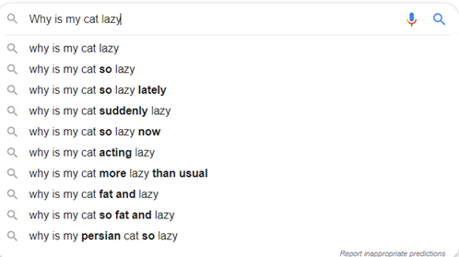
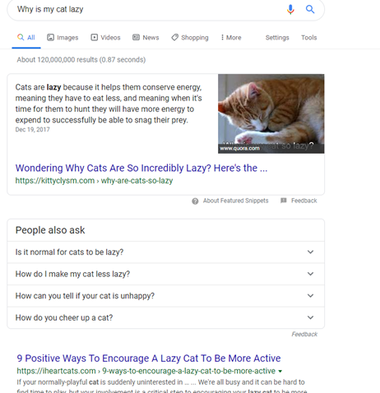
***Command languages and “natural” language queries
Notes:
Section 15.4

Slide 41
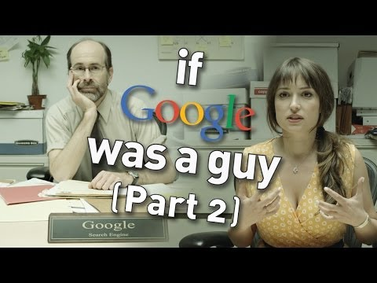
***Command languages and “natural” language queries
Notes:
Section 15.4

Slide 42
***Command languages and “natural” language queries
Command Languages
Advantages Appeals to expert users Supports creation of user-defined “scripts” or macros Easy to modify and make additional commands | Disadvantages Error rates are high Requires training and memorization System state is invisible No universal Undo; need to know inverse command
Notes:
Section 15.4

Slide 43
***Command languages and “natural” language queries
Natural Languages
Advantages Easy to learn and remember Requires minimal training Flexibility | Disadvantages Requires clarifications Unpredictable
Notes:
Section 15.4

Slide 44
Multimedia Document Search and Specialized Search

Slide 45
Multimedia Document Search and other specialized searches
Image search
Video search
Audio search
Geographic information search
Multilingual search
Other specializes searches
Notes:
Fig. 15.17

Slide 46
Image Search ***
Difficult because photos are diverse and numerous
Use features
Lady Liberty’s torch or the seven spikes in the crown
Downside: similarity
Colors on flags

Slide 47
Image Search ***
“More success is attainable with searches based on similarity, where users provide an image and retrieve items with similar features”
Photo tagging
Automatic tagging with human confirmation
Notes:
I will do a image search with mystery.png and google images

Slide 48
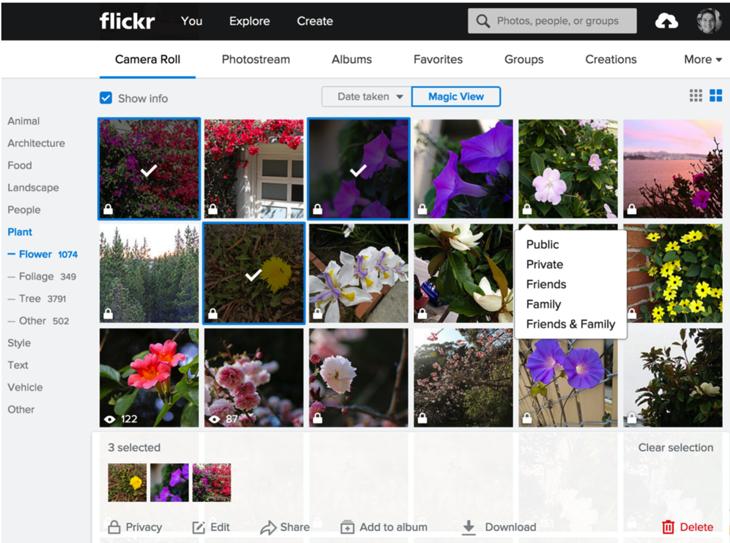
Multimedia Document Search (example)
The “Magic View” of Yahoo photos automatically generates topic tags for each photo
Here users selected the photos with flowers
Three photos are selected and ready to be shared
The privacy setting is visible and can be changed with a menu
Notes:
Fig. 15.15

Slide 49
Video Search ***
Easy to search using title when the videos are short and have narrow focus
Difficult to analyze videos and identify objects, actions, or events.
Essentially image analysis on super hard mode
Analysis of the text in the scenes and speech-to-text transcripts help make large volumes of digital video more searchable.

Slide 50
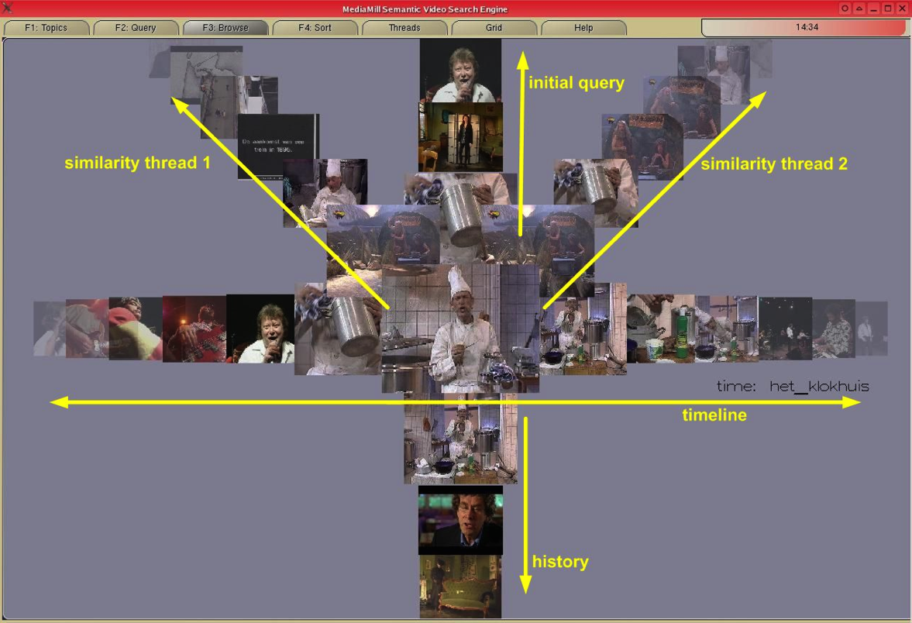
Another Multimedia Document Search example ***
The ForkBrowser of the MediaMill semantic video search engine (de Rooij, 2008) which allows the user to browse the video collection along various dimensions exploring different characteristics of the collection https://www.youtube.com/watch?v=IPq_LanED60
Notes:
Will play part of the video about this tool

Slide 51
Audio Search***
Music-information retrieval systems can now use audio input
Shazam or Soundhound
Using your voice to search
Speaker identification (voice biometrics)

Slide 52
Geographic information search***
Looking for geographic information: Google maps
Geographic information is complex, and many challenges need to be addressed: deciding what to show the map, designing dynamic legends that could summarize results, etc.

Slide 53
Multilingual searches and other specialized searches
Not just translation but also a way to search for something that is in a language the user does not know
Many other search interfaces are being designed to tackle specialized data types such as event sequences, graphs, structure document layouts, engineering diagrams, and so on.

Slide 54
The Social Aspects of Search

Slide 55
The social aspects of search
Social search as “an umbrella term” describing search acts that make use of social interactions with others
May be explicit or implicit, co-located or remote, synchronous or asynchronous
Social bookmarking and ranking, e.g. Reddit
Personalized search built on user profiles, e.g. past site visits
Collaborative filtering and recommender systems, e.g Netflix
Music recommendation, e.g. Pandora

Slide 56
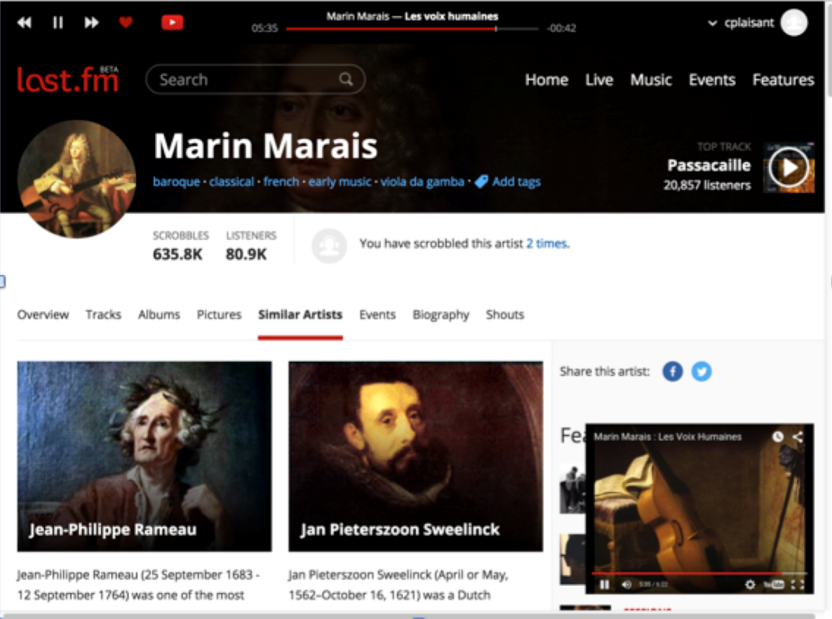
The social aspects of search (example)
Last.fm is an example of online radio using playlists created automatically
The process starts by users selecting a start point (e.g. a song or artist they like) then users provide feedback on the suggestions by clicking on the heart or skipping the track
Notes:
Fig. 15.18

Slide 57
Explicit Search
To directly search for information
Searching for a restaurant on Yelp, then filtering results by ratings
Posting on Facebook for restaurant recommendations from friends
Explicit Filters
Dropdown menu to select options such as: “Most Viewed” or “Most Popular”
Social Bookmarking/Ranking (The wisdom of the crowd)

Slide 58
Implicit Search
Results presented to the user without ever making a query
An implicit “search” is an algorithm deciding what it believes you want to be shown
Implicit search signals
Time spent on a page, mouse trails, social media connections
Personalized Search
A profile is built about the user and personalized data is displayed that the user might search for

Slide 59
Implicit Search
Problem: implicit search creates filter bubbles
Filter bubbles are when the user is not being shown new ideas, subjects, products, or important information
Users are generally more satisfied when they known why the information is being shown to them
They like to know what those implicit filters are

Slide 60
Implicit Search
Solutions
Designing algorithms differently to bring in new ideas
Users should be consciously looking for new information
Government regulation on information filtering
Removal of explicit/implicit search bias from social platforms

Slide 61
Collaborative Search
Users work together to accomplish a search task
One person will do general search while another analyzes the searches information
ex: Family members planning a vacation
Collaborative Filtering
A user who rated a movie a 6/10 will be shown other movies watched by users that rated that movie the same way
ex: Netflix percentage “rating” based on how much they think you’d a movie

Slide 62
Questions?

