Slide 1
CS 420/620
Preparation Project Part 3 (Design)
Chapter 14: Activity Diagrams
[Arlow and Neustadt, 2005]
University of Nevada, Reno
Department of Computer Science & Engineering

Slide 2
Outline
Activity diagrams
Introduction
Activities
Nodes
Action nodes
Control nodes
Object nodes
Activity parameters
Pins

Slide 3
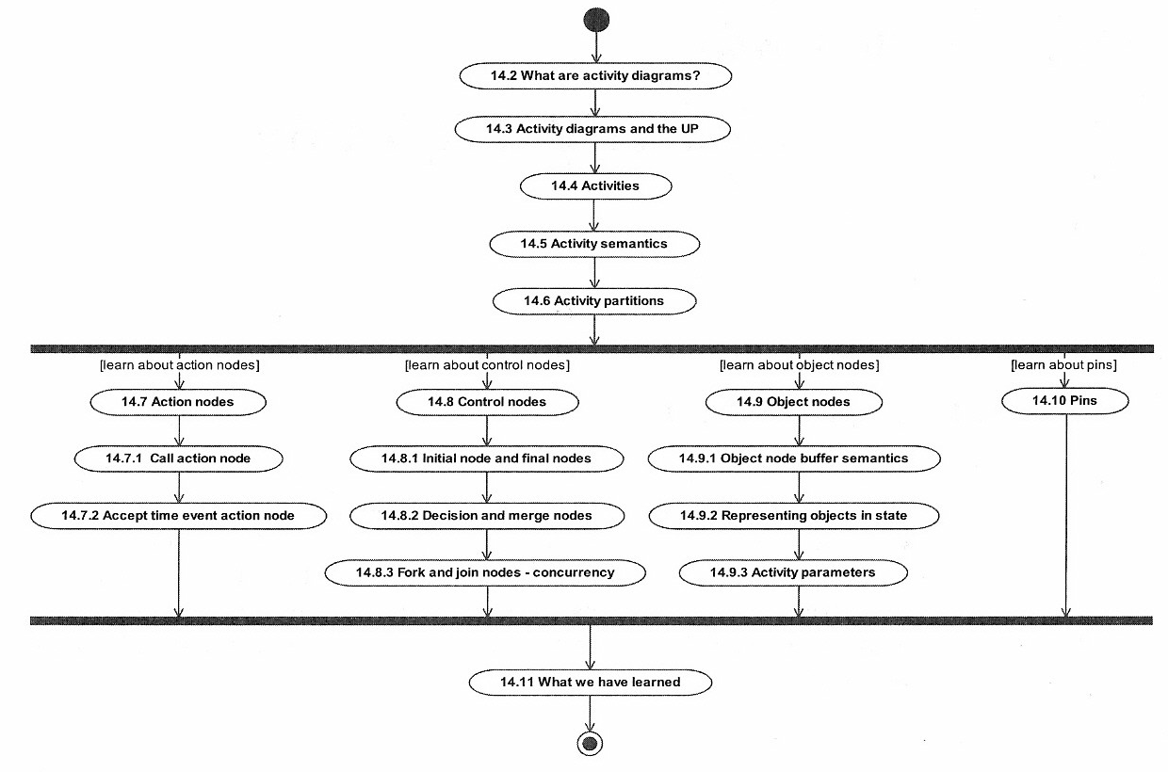
Introduction: Chapter roadmap
Notes:
3

Slide 4
Introduction: What are activity diagrams?
Activity diagrams:
A form of “object-oriented flowcharts”
In UML 1 they were special cases of state machines; in UML 2 they have new semantics, based on Petri Nets
Greater flexibility to model different types of flow
Clearer distinction between activity diagrams and state machines
Attached to modeling elements to describe behavior
Typically attached to use cases, classes, components, interfaces, and operations
Can also be used to model business processes and workflows

Slide 5
Introduction: Where are activity diagrams used?
Commonly used in:
Analysis
To model the flow of a use case
To model the flow between use cases
Design
To model details of an operation
To model details of an algorithm
Business modeling
To model a business process
As always in modeling, it is important to keep them simple and understandable by their intended audience

Slide 6
Activities *****
Activity diagrams are networks of nodes connected by edges
Nodes
Action nodes – atomic units of work within the activity
Control nodes – control the flow through the activity
Object nodes – represent objects used in the activity
Edges
Control flows – depict the flow of control through activity
Object flows – depict the flow of objects through activity

Slide 7
* Activities ****
Activities and actions can have pre- and post-conditions
Tokens (part of semantics but not shown graphically) abstractly flow in the network and can represent:
The flow of control
An object
Some data
A token moves from a source node to a target node across an edge depending on:
Source node post-conditions
Edge guard conditions
Target node preconditions

Slide 8
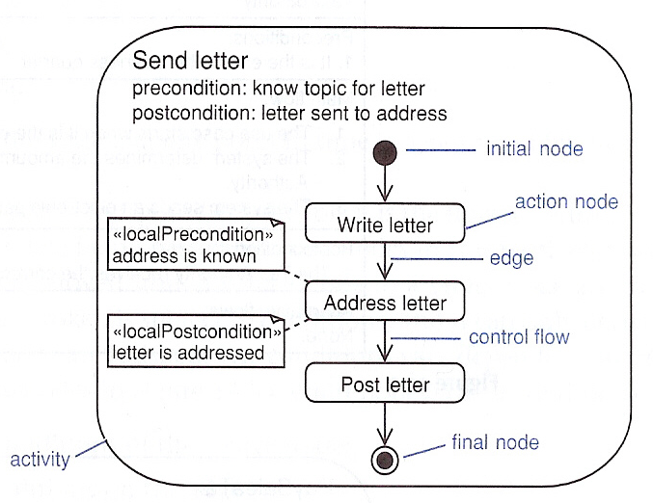
** Activities ***
Example of an activity (“send letter”), Fig. 14.2 [Arlow & Neustadt 2005]

Slide 9
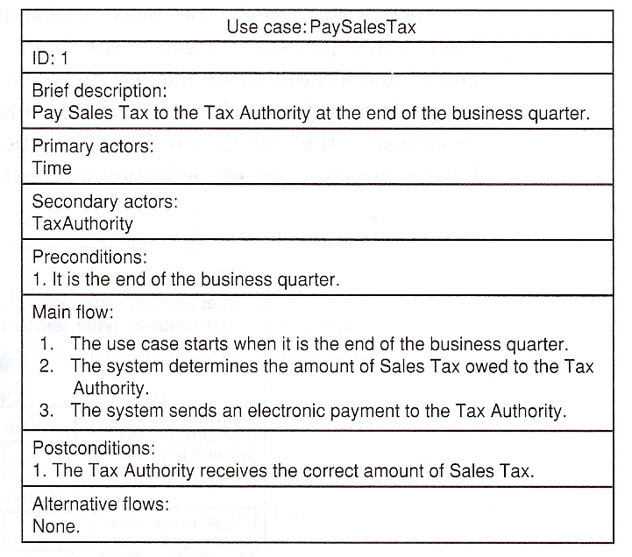
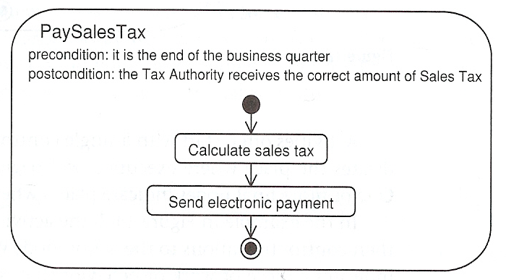
*** Activities **
Activity diagrams can model use cases as a series of actions. Example: Fig. 14.3 and Fig. 14.4 [Arlow & Neustadt 2005]

Slide 10
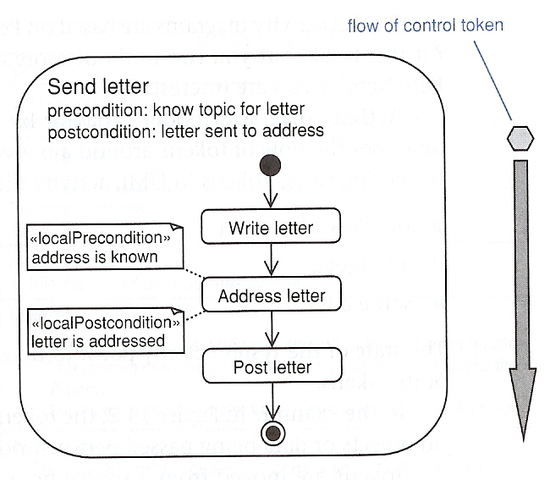
**** Activities *
Activity diagrams have semantics based on Petri Nets
They model behavior using the token game
Tokens move through the network subject to conditions
Object nodes represent objects flowing around the system
Example of flow of control token, Fig. 14.5 [Arlow & Neustadt 2005]

Slide 11
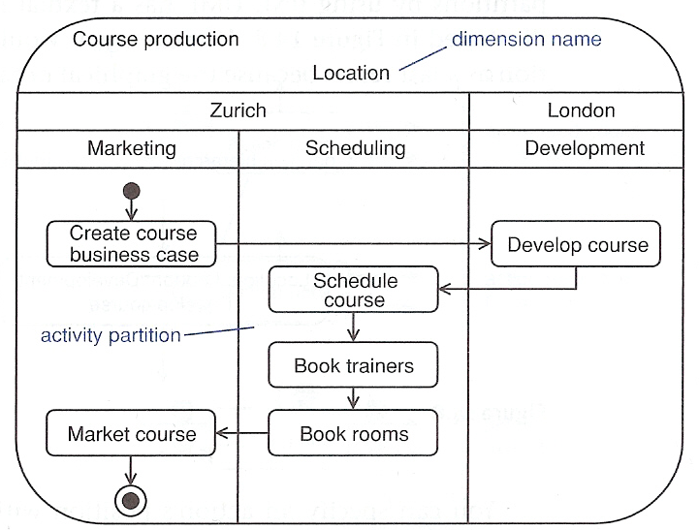
***** Activities
Activity diagrams can be divided in partitions (swimlanes) using vertical, horizontal, or curved lines. Example, Fig. 14.6 [Arlow & Neustadt 2005]

Slide 12
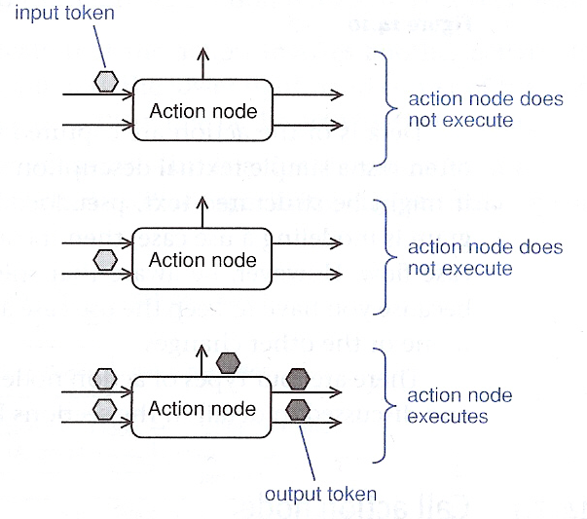
Action nodes ****
Action nodes execute when:
There are tokens present at all their input nodes AND
The input tokens satisfy all action node’s local preconditions
Fig. 14.9 [Arlow & Neustadt 2005]

Slide 13
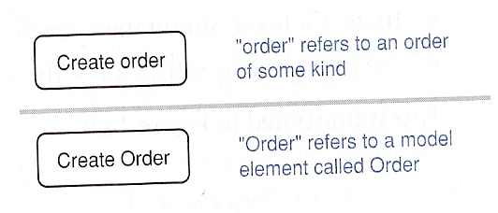
* Action nodes ***
After execution, the local postconditions are checked; if all are satisfied, the node simultaneously offers tokens to all its output edges (this is an implicit fork that may give rise to many flows)
Naming convention, Fig. 14.10 [Arlow & Neustadt 2005]

Slide 14
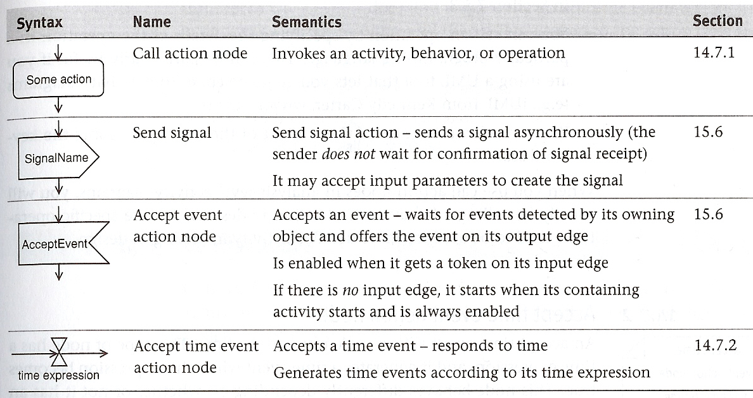
** Action nodes **
Types of action nodes, Table. 14.1 [Arlow & Neustadt 2005]

Slide 15
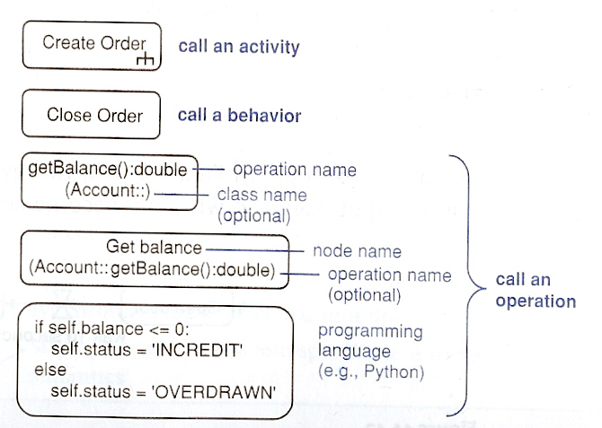
*** Action nodes *
A call action node invokes an activity, behavior, or operation, Fig. 14.11 [Arlow & Neustadt 2005]

Slide 16
**** Action nodes
An accept time event action node responds to time, Fig. 14.12 and Fig. 14.13 [Arlow & Neustadt 2005]

Slide 17
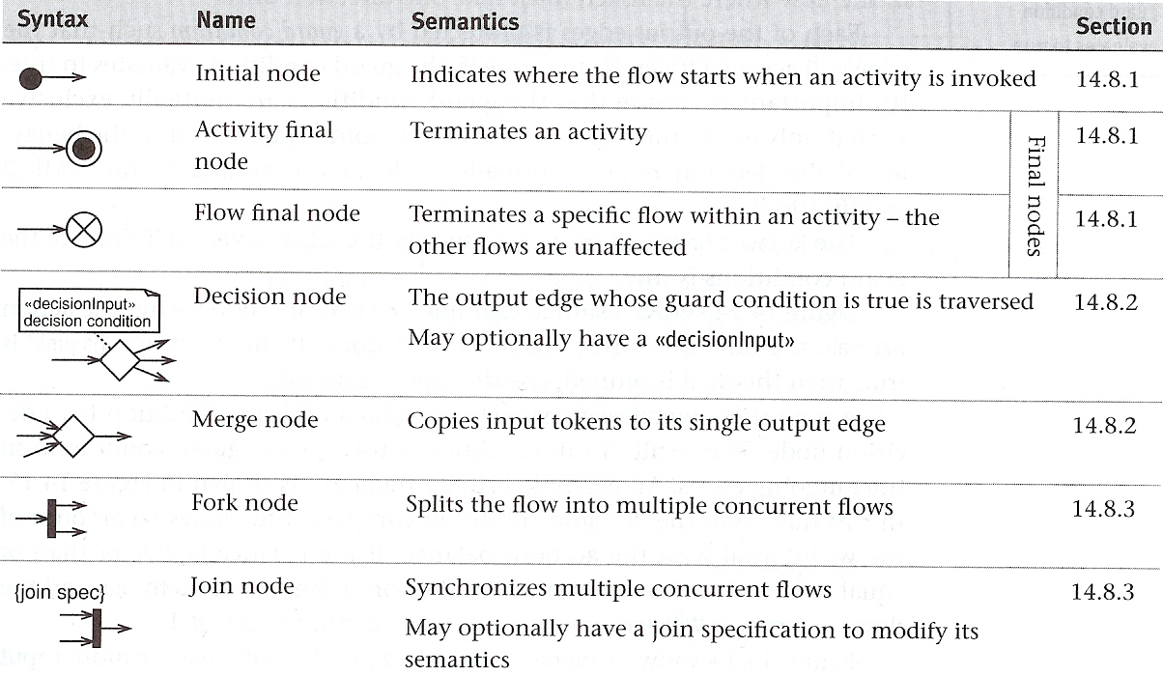
Control nodes **
Control nodes manage the flow of control within an activity
Table 14.2 [Arlow & Neustadt 2005] shows the types of control nodes

Slide 18
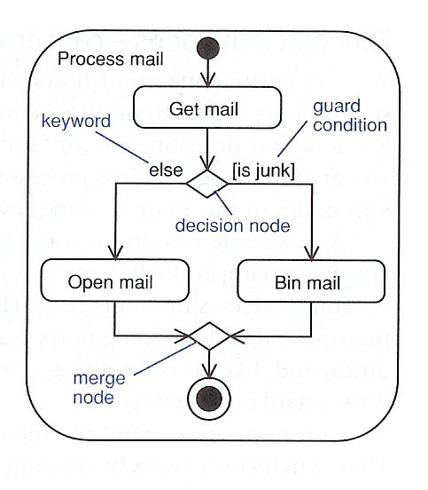
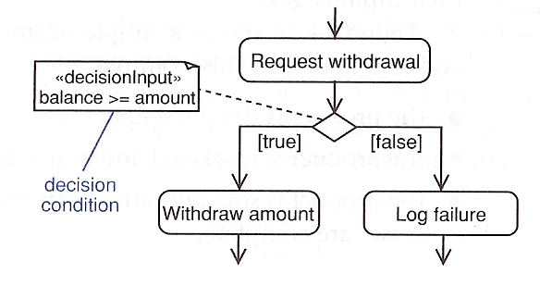
* Control nodes *
Examples of decision and merge nodes, Fig. 14.14 and Fig 14.15 [Arlow & Neustadt 2005]

Slide 19
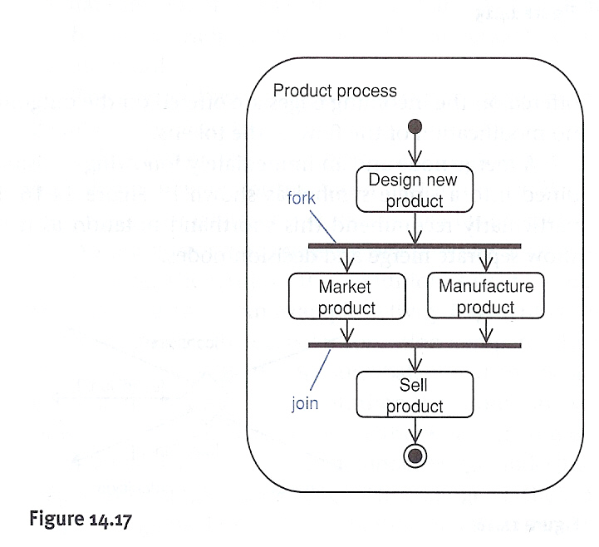
** Control nodes
Examples of join and fork nodes, Fig. 14.17 [Arlow & Neustadt 2005]

Slide 20
Object nodes **
Object nodes indicate that instances of a particular classifier are available at a specific point in the activity
They are labeled with the name of the classifier and represent instances of that classifier or its subclasses
The input and output edges are object flows
Object flows are special types of flow that describe movement of objects within the activity
The objects are created and consumed by action nodes
When an object node receives an object token on one of its input edges, it offers this token to all its output edges, which compete for the token.

Slide 21
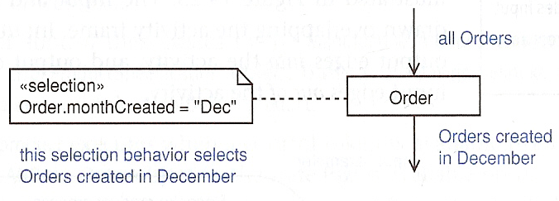
* Object nodes *
Object node notation and their buffer semantics: Figs. 14. 18, 14.20 and 14.21 [Arlow & Neustadt 2005]. Object nodes act as buffers – places in the activity diagram where object tokens can reside while waiting to be accepted by other nodes (via edges).

Slide 22
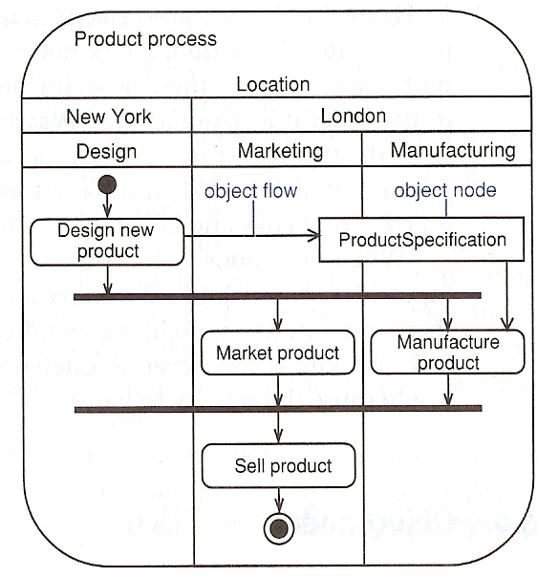
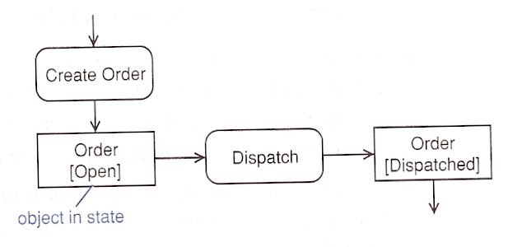
** Object nodes
Examples of using object nodes: Figs. 14. 19 and 14.22 [Arlow & Neustadt 2005]. Note that object nodes can represent objects in particular states.

Slide 23
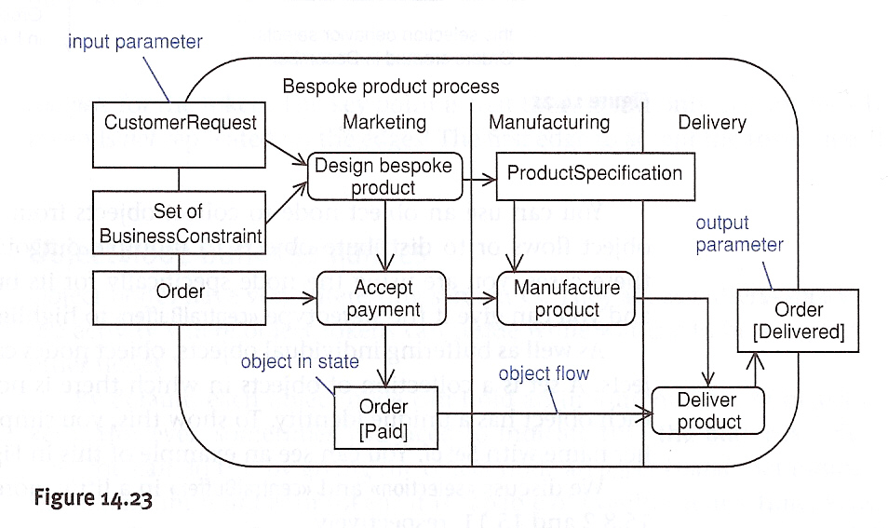
Activity parameters
Activities can have object nodes to provide inputs and outputs, Fig. 14. 23 [Arlow & Neustadt 2005].

Slide 24
Pins
A pin is an object node that represents an input to or output from an action node. Pins can simplify activity diagrams that use many object nodes. Example: Figs. 14. 23 and 14. 25 [Arlow & Neustadt 2005].

