Slide 1
CS 425/625
Interface for Motion Planning
In Physically Realistic 3D Virtual Worlds
Kostas Bekris
University of Nevada, Reno
September 22, 2008

Slide 2
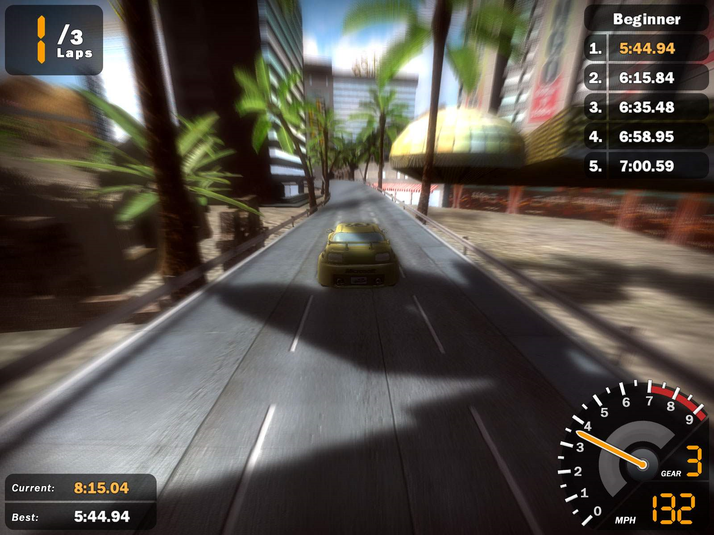
Game Engines

Slide 3
Components
Model
Database
AI
(Motion
Planning)
User
Game Engine
Interface
Physics-based
Simulation
Visualization
Software

Slide 4
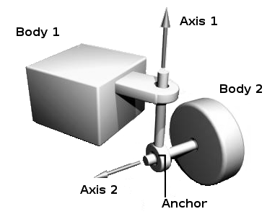
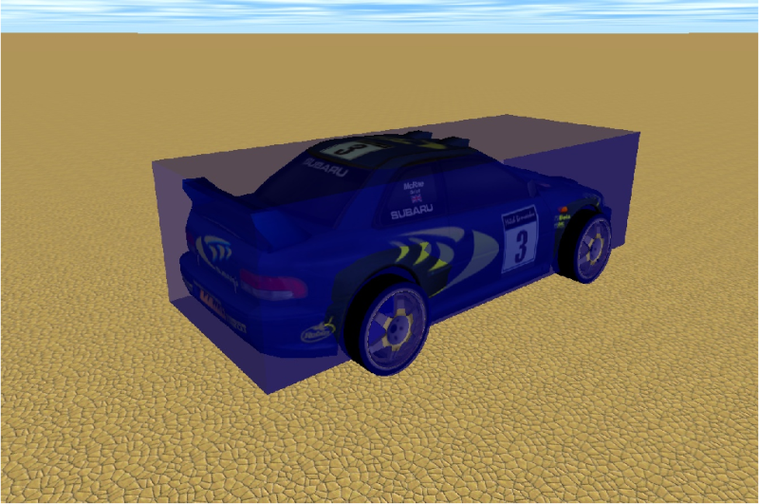
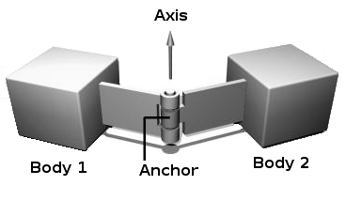
Physics-based Simulation
Car model and racing track from:
“The Open Racing Car Simulator” (TORCS)
Software:
Open Dynamics Engine (ODE)
and OpenSceneGraph
Front
wheels
turn
Rear wheel
drive

Slide 5
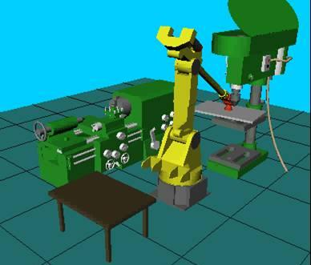
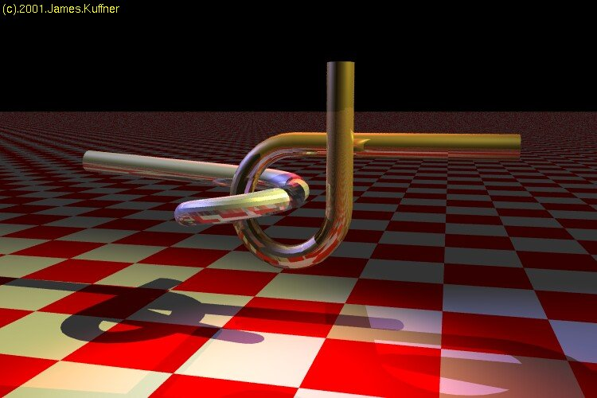
Motion Planning
Industrial Manipulation
Simulation
Jean Claude Latombe
Stanford
Geometric Puzzles
Kostas Bekris
James Kuffner
CMU

Slide 6
Physically Realistic Motion Planning
Geometric Paths are not Sufficient
Lack of Physical Realism
Cannot be easily followed

Slide 7
Physically Realistic Motion Planning
Trajectory Planning:
Higher-Dimensional Problem
More constrains

