Slide 1
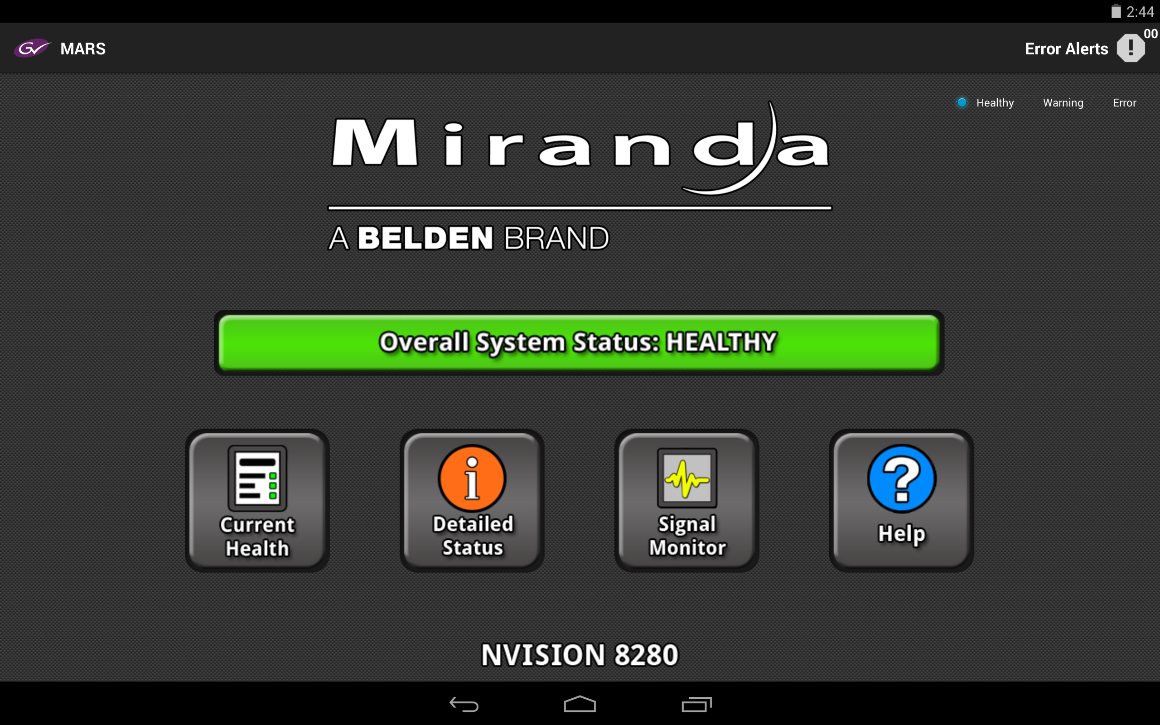
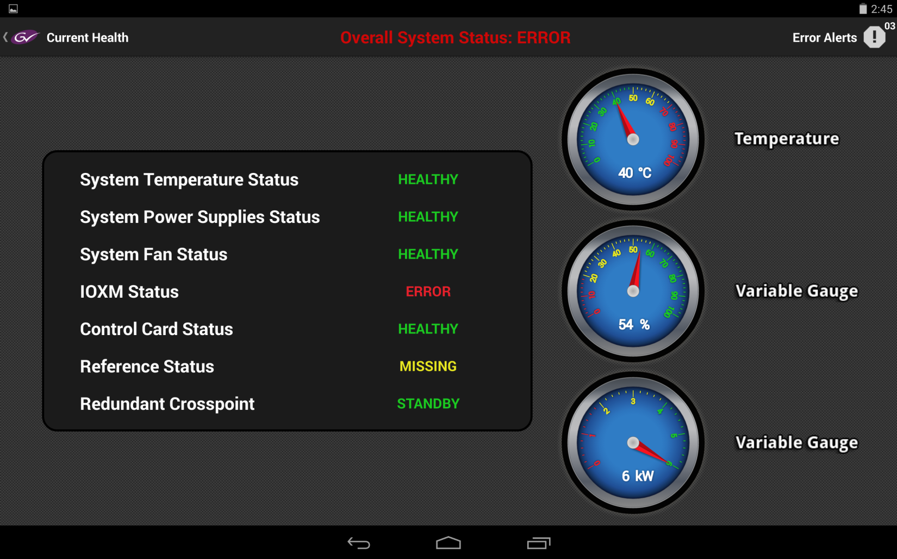
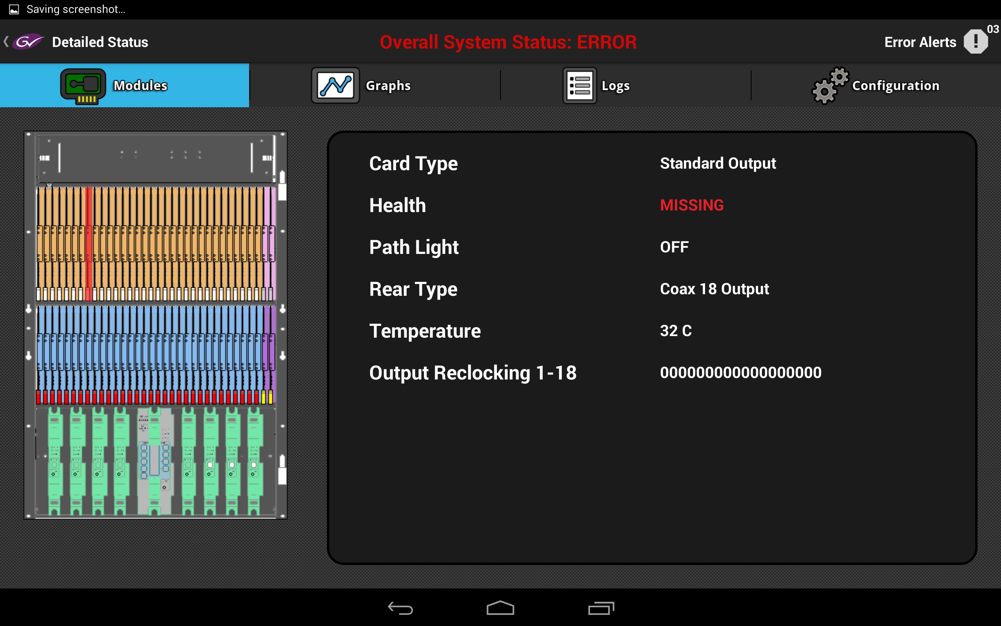
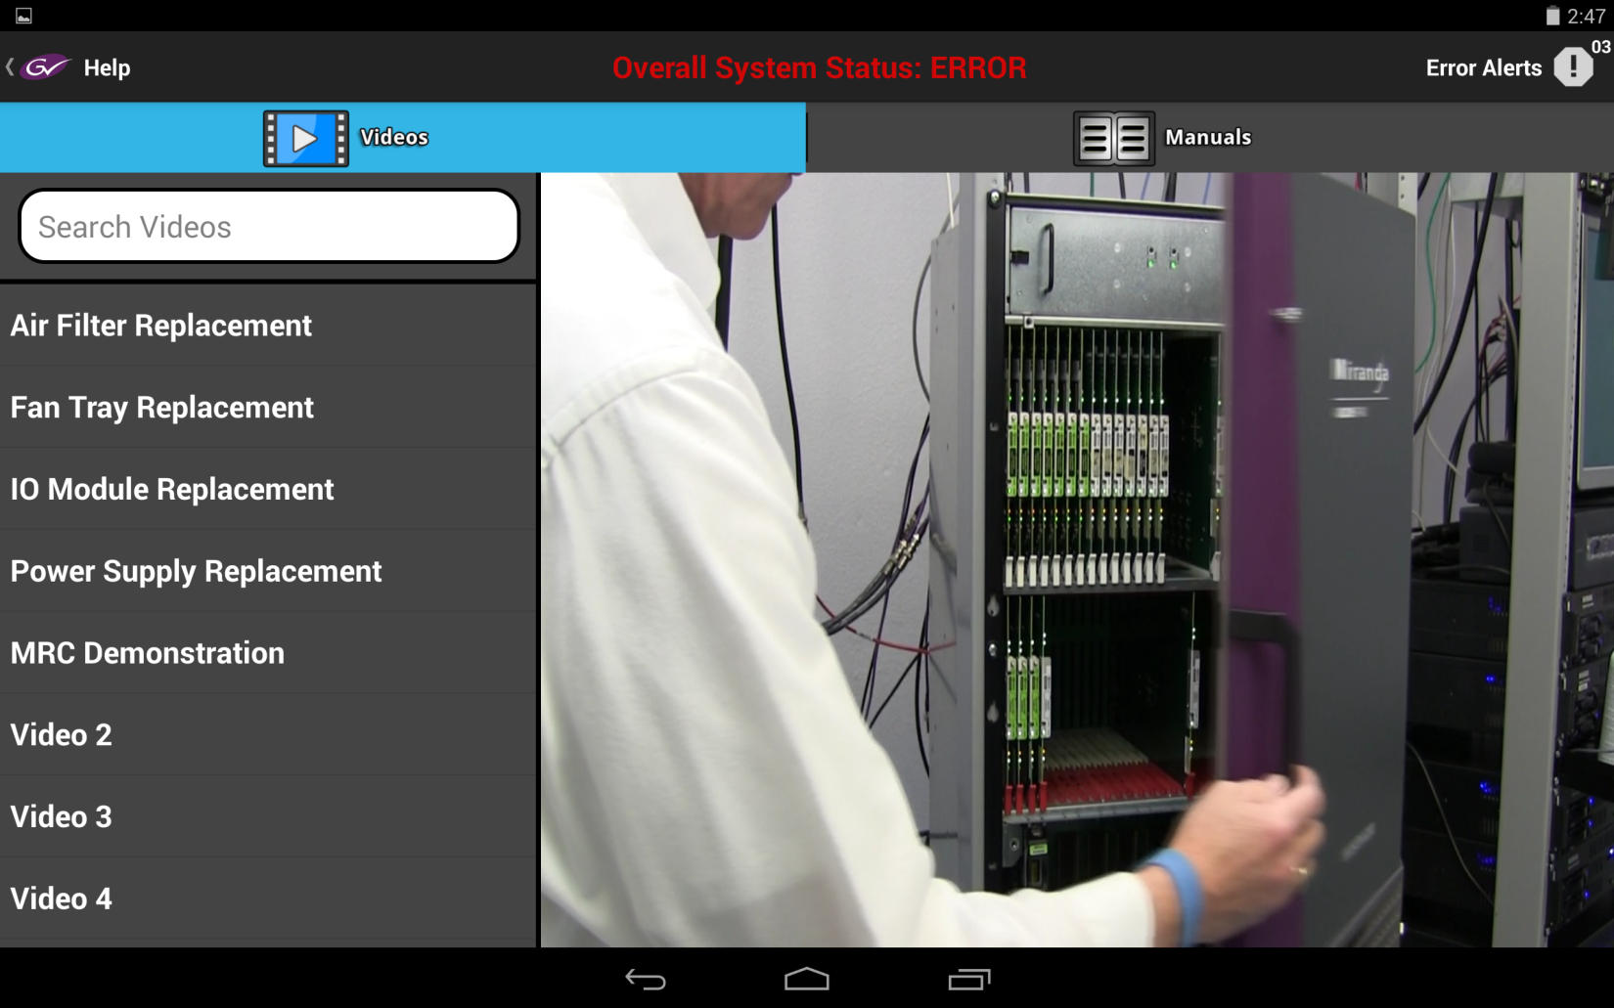
MARS: Mobile Application for Router Status
CS 426 Senior Project - Spring 2014
Christine Johnson ● Eric Klukovich ● Matthew VanCompernolle
Department of Computer Science and Engineering, University of Nevada, Reno
Dr. Sergiu Dascalu, UNR CSE Department ○ Bob Hudelson, Miranda Technologies ○ Tim Walker, Miranda Technologies
Abstract
Interface
Communication
MARS is an Android application that has been developed for Miranda Technologies, a company that designs and develops television broadcasting equipment. MARS allows router status monitoring, configuration and control, self-diagnosis, and resolution planning from the front panel of the router. The demand for an application of this type is very high because the router is the core of a broadcast facility; any amount of time that it is not operational is lost revenue and viewership. MARS provides a tool that assists with maintaining routers through a graphical user interface that is visually appealing and easy to navigate.
MARS Communication Diagram
Future Development
Main Page – Healthy State
Current Health Page – Error State
Currently MARS runs on a tablet mounted to the front of the router panel and communicates with the router via a wired Ethernet connection. Further developments for MARS include a wireless configuration allowing any Android mobile device with MARS installed to communicate with the router through a database. MARS could also be ported onto the iOS platform for the iPhone and other mobile operating systems. Additional application features that could be developed include audio and video signal monitoring, advanced router configurations, and a dynamic heat map.
Goals
The ultimate goal of MARS is to create a user interface that is easy to navigate because MARS is a troubleshooting application, so it will be used in time critical situations. Other goals of MARS include providing real-time router status information, significant event notifications, troubleshooting assistance, and graphic data visualization to provide fast status viewing.
Module Status Page – Error Card
Help – Video Tutorials
Architecture
Interface
Styling/Layout
Navigation
Status Information
Graphs/Logs
Module Status
Troubleshooting
Videos/Manual
Alerts
Error Notifications
Communications
Data Polling
Configuration
Conclusion
Application Features
MARS was developed to conform to the ultimate goals of ease of use and comprehension by an international audience in time critical situations. It achieves this by having an intuitive interface and a unique set of features that it allow for easy and fast troubleshooting. MARS is innovative because it is the only application developed for a mobile device platform that provides broadcast router status and configuration. The features it provides are unique not only for Miranda products, but also for any monitoring and configuration software currently offered by Miranda’s competitors. The group has agreed to handoff MARS to Miranda Technologies, so it can continue to be developed, maintained, and hopefully sold with Miranda routers as a powerful troubleshooting tool.
Router health displayed in all pages
Component map with individual module status information
Dynamic temperature, power, and fan speed graphs
Event and error logging
Error alerts
Router configuration and settings controls
Troubleshooting videos for simple maintenance procedures
Ability to access router manual
Gauge animations for instantaneous data
MARS Main Activity Chart
This project was developed in Spring 2014 as part of the course
CS 426 Senior Projects in Computer Science

