Slide 1
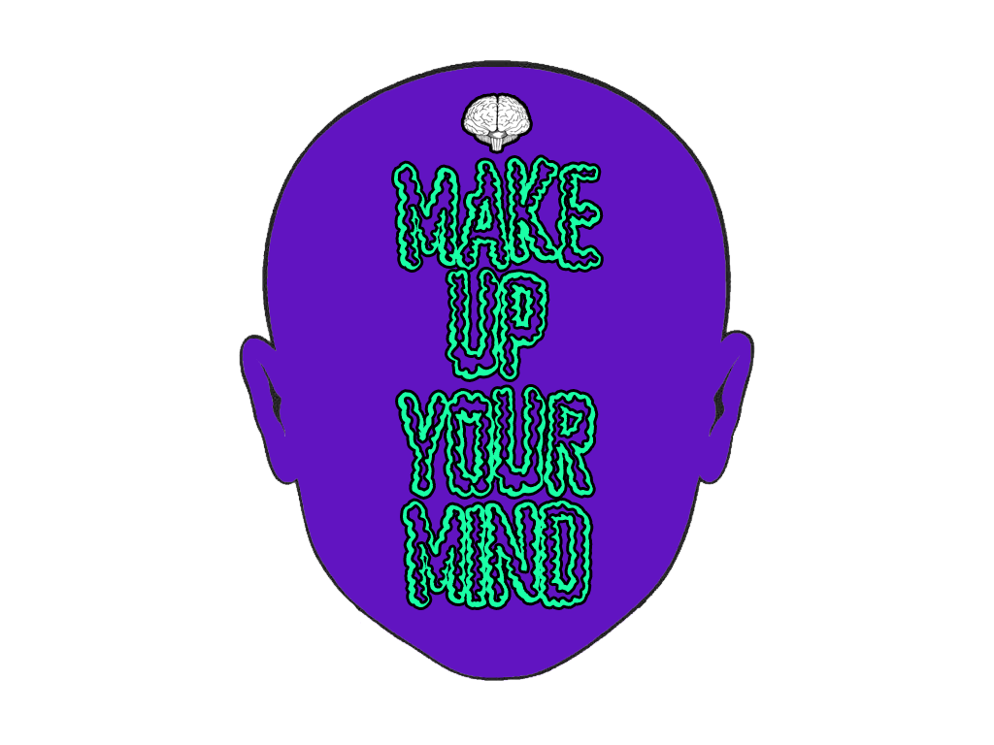
CS420 - HCI
Professor Sergiu Dascalu
Team 02: Christopher EIchstedt, Nicholas Jordy

Slide 2
Outline
Why are we making this?
What are we making?
Who this is for?
How are we making it?
Demonstration
Questions

Slide 3
The Why?

Slide 4
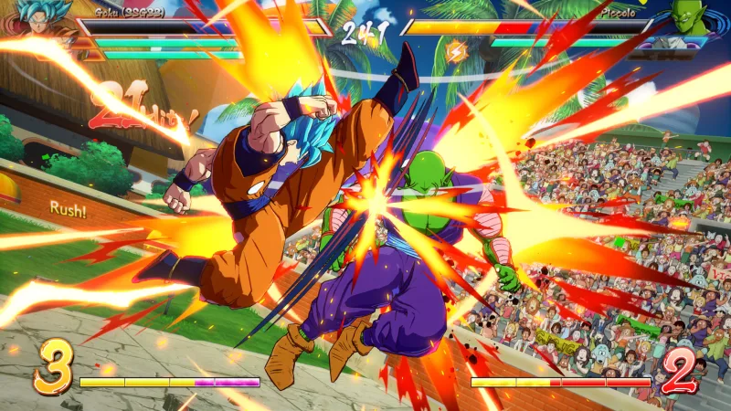
Friends for Five years
Taken multiple classes together since starting our undergrad
Designed, Developed and Presented our Senior Project together (Spring 2019)
Nick cannot beat Chris in any fighting game
  He still gets really salty about it
Credit: https://kotaku.com/dragon-ball-fighterz-has-been-mysteriously-pulled-from-1831343928

Slide 5
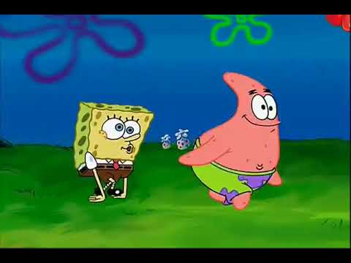
We can never make up our mind
Source: https://www.youtube.com/watch?time_continue=1&v=qLDKYeSUl7c&feature=emb_title

Slide 6
The What

Slide 7
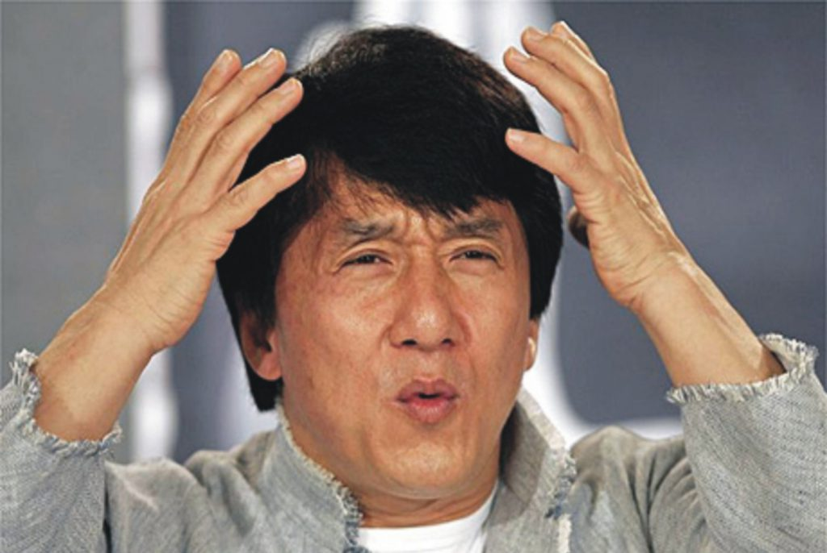
Make Up Your Mind
A decision making web application with a specialization in food.
A way for us to tackle the Paradox of choice and the Fear of missing out.
Credit: https://www.icoastalnet.com/blog/digital-marketing-myth-1-4/confused-jackie-chan/

Slide 8
Great, another food app...
Food is Relative, we take recommendations but reviews are mostly conjecture and bias.
So we didn’t want to just make it about stars, 200 word reviews and premium memberships.
We wanted to make something that just mattered to us.
“As a writer of criticism, the consumer thing is the least interesting thing, but as a critic, the single worst thing you can do is send a reader to waste time and money on something—even if it’s something you personally love. You have to indicate the reasons why you love it and they’ll hate it.”
-Jonathan Gold
Source: https://believermag.com/an-interview-with-jonathan-gold/

Slide 9

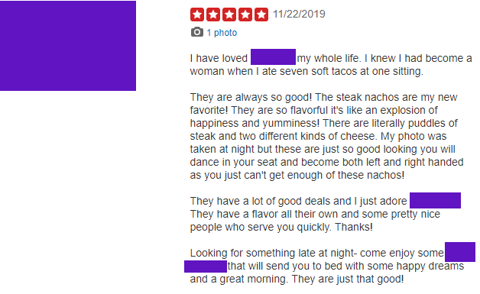
Example

Slide 10
The Who?

Slide 11
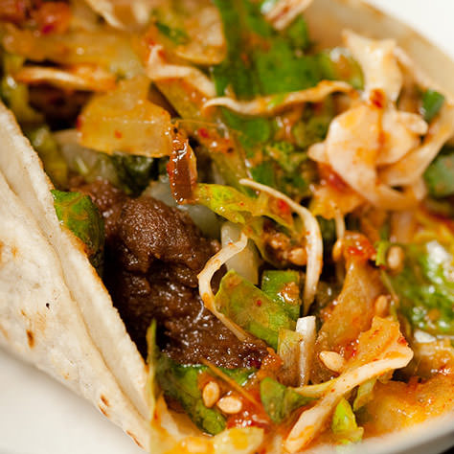
We made it for us
Sometimes we just want something quick but we (like everyone else) really love food, so we don’t want junk.
We wanted a web application that would already have our interests and allergies, so the process is EXTREMELY simple.
Credit: http://kogibbq.com/menu/

Slide 12
The How

Slide 13






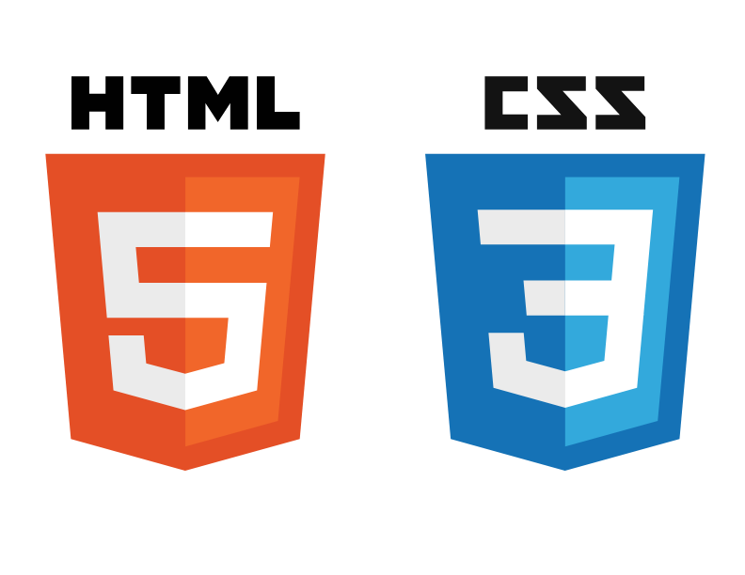

Technologies

Slide 14
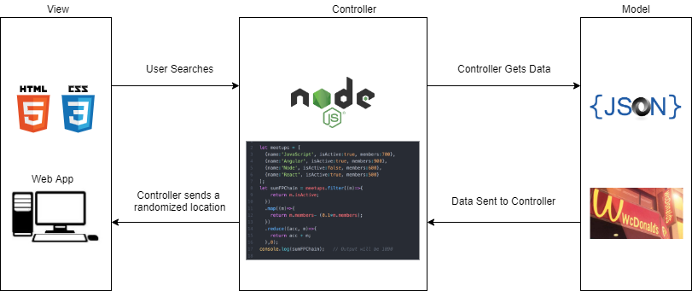
System Design

Slide 15
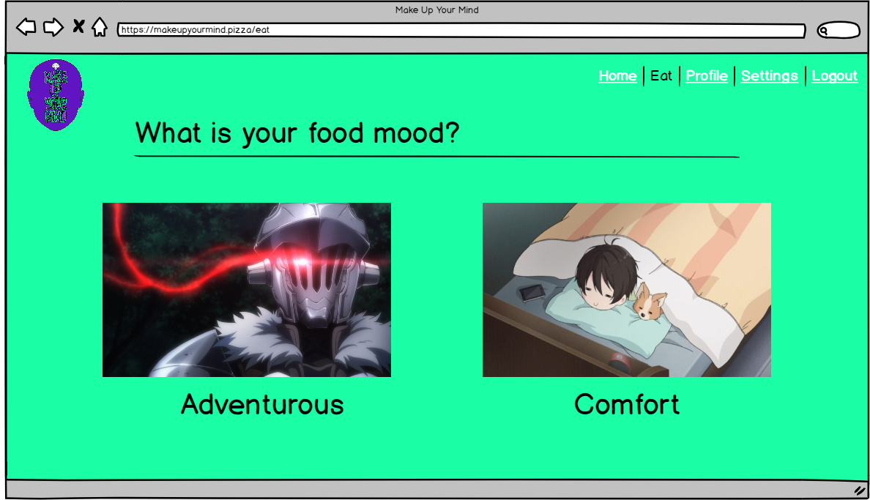
User Interface

Slide 16
Functionality Demo
*Final prototype subject to change

Slide 17
Questions?

