Slide 1
Team Members:
Kurtis Rodrigue, Simon Shrestha, Amberly Wang

Slide 2
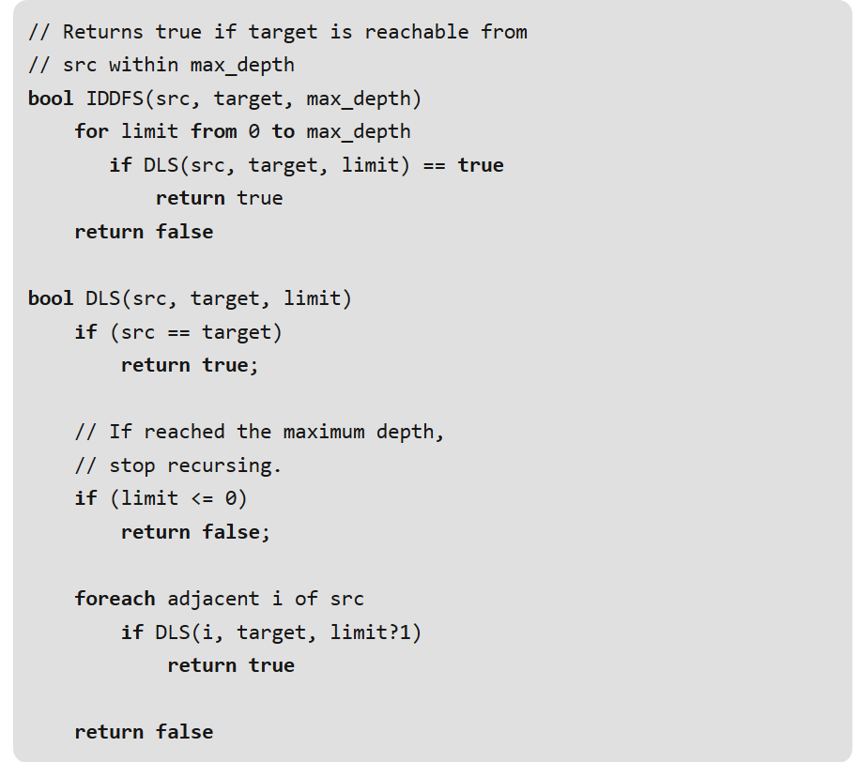
VisGraph
???
???
Ever had difficulty learning about graph traversal algorithms? (CS302)
Are you a visual learner?
???

Slide 3
Potential Users
Students or beginner learners who need help conceptualizing and understanding graph traversal algorithms
Supplement to pseudocode + theory learned in class
People who need a refresher on the material for other applications
Artificial Intelligence
Networking

Slide 4
Why we chose this project
Because we would use it!
Topic has become more relevant again in our upper CS courses
Improve upon available educational material for computer science

Slide 5
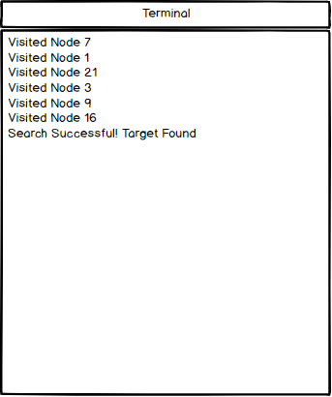
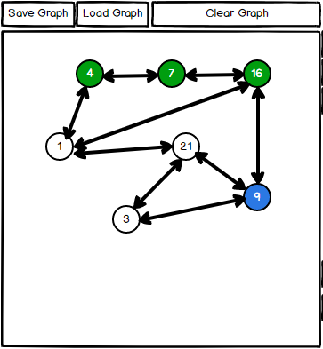
HCI Elements
Eight Golden Rules
Consistency
Easy reversal of actions
Remove Node
Feedback
Terminal
Graph Traversal
Color Scheme

Slide 6
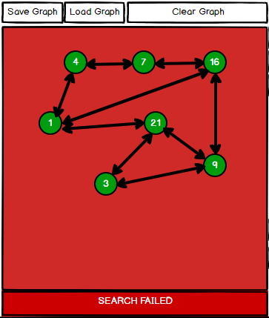
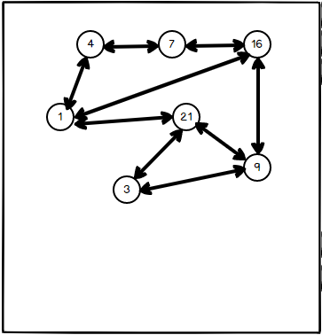
HCI Elements
Prevent Errors
Reduce Memorization
Graph
Keeps the user in control
Direct Manipulation

Slide 7
Project Demo!

Slide 8
Future Plans
For the demo
BFS/DFS Algorithm implementations
Terminal output (in the window)
Make it prettier
Future implementations
Save/Load Graphs
Weighted connections
Animating the algorithms

Slide 9
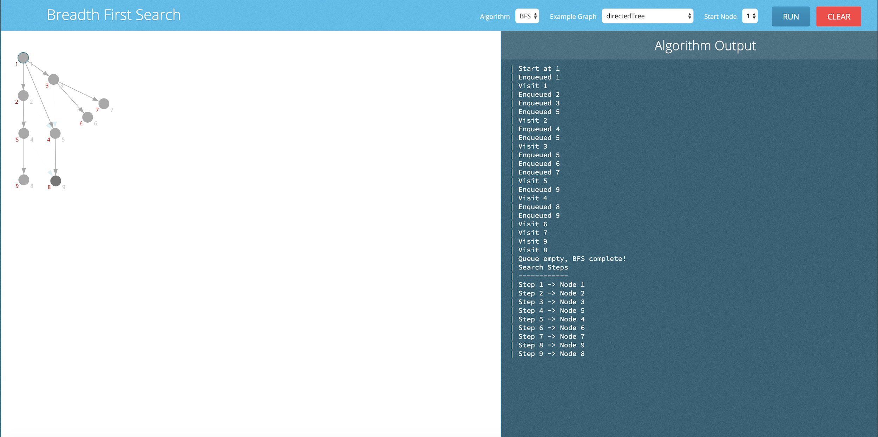
Alternative
Designs

Slide 10
Questions?
And maybe answers!

