Slide 1
AYCE
All Your Culinary Eats
By Sherman Lee, Amanda Lee, and Richard Wang

Slide 2
Project Description
AYCE
Food blog focused on the city of Reno
Provide reviews and nutritional information about restaurants and other eateries
Goals
Help the community make more informed dining decisions
Drive traffic to local businesses

Slide 3
Core Features
Account creation and login for frequent users
Individual restaurant pages
Display reviews and other key information to users
Recommendation and Explore Feed
Pinterest-like feed that displays new and trendy restaurants
Decision-making tool
Makes restaurant suggestion based on user preferences

Slide 4
The Conception
Our team consists of foodies who love the food scene in urban cities
San Francisco
Los Angeles
Las Vegas
We wanted to support and improve that scene to our local community
Unlike other web applications, we wanted to include additional features
Decision making
Nutrition

Slide 5
Usability Features
Community Evaluation
Retention over time
Subjective satisfaction
Interaction Styles
Form fill-in
Menu selection

Slide 6
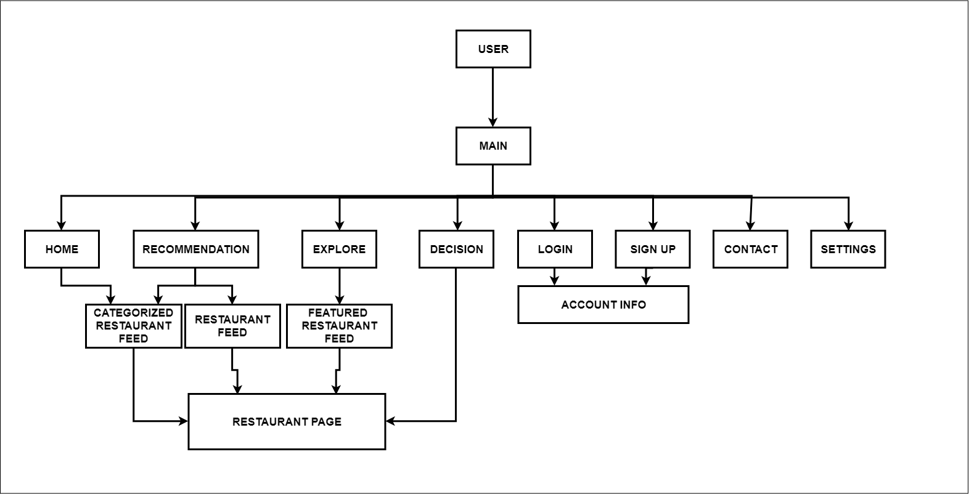
High Level Design

Slide 7
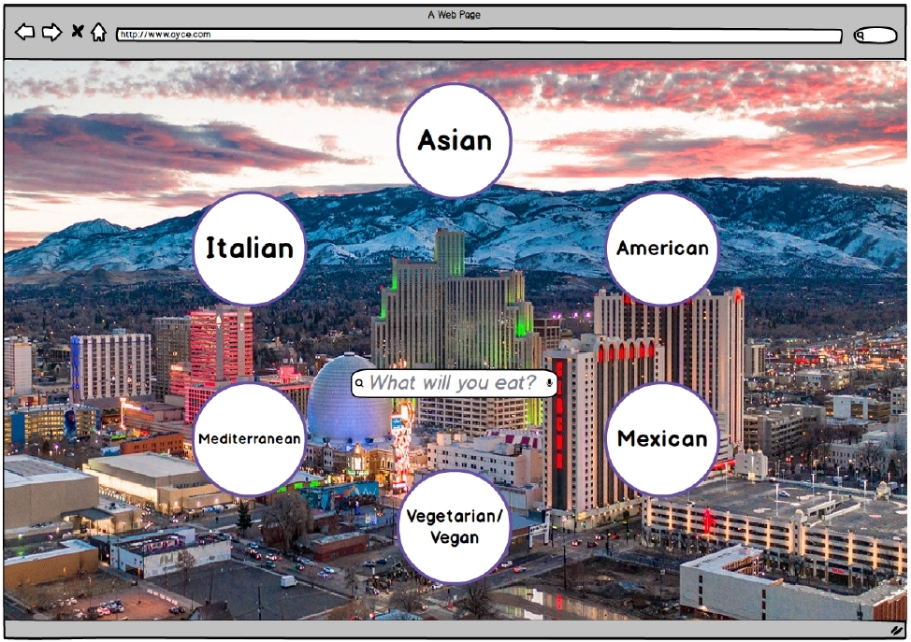
Prototype: Home Page

Slide 8
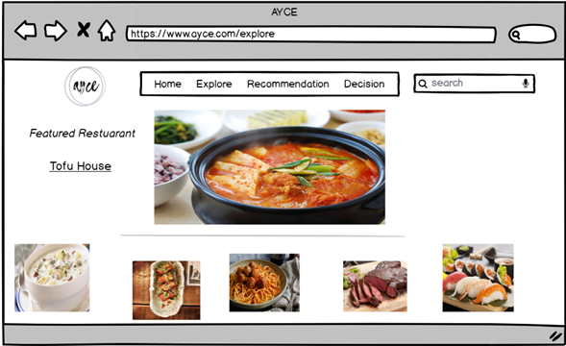
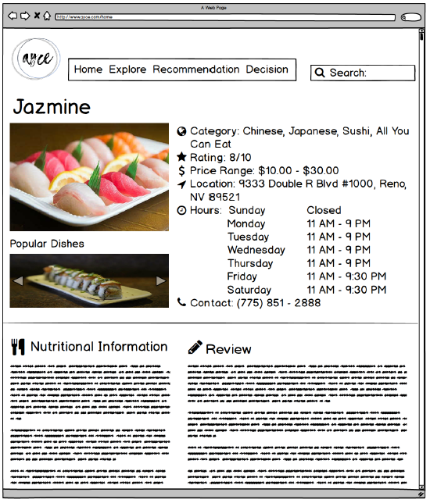
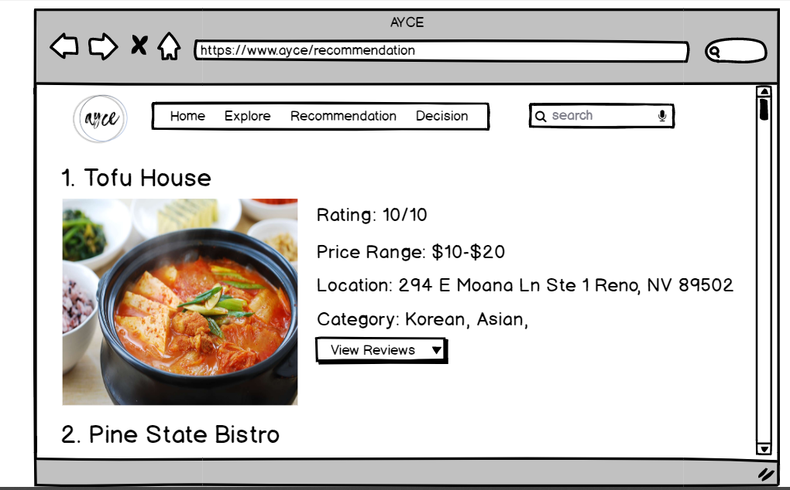
Prototype: Browsing → Restaurant Page

Slide 9
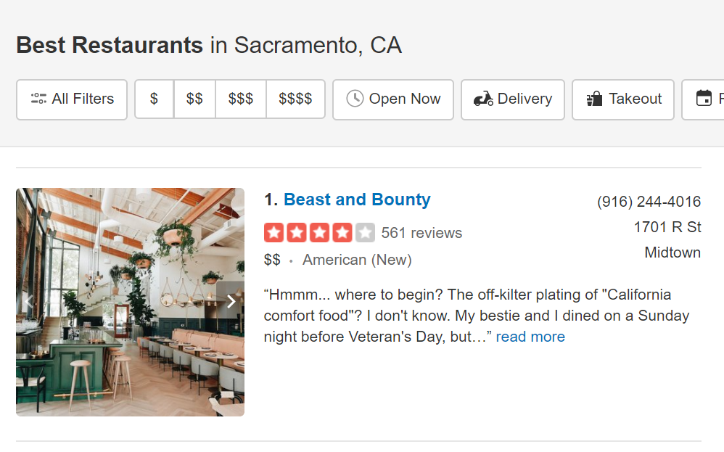
Prototype: Browsing Inspiration

Slide 10
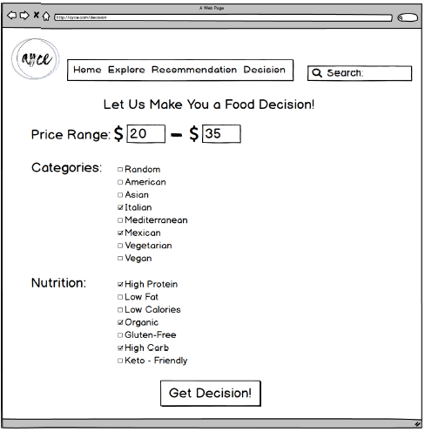
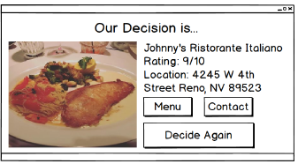
Prototype: Decision Feature

