Slide 1
Take-a-BYTE
Team 7
Erik Johnson
Alexandra Pasinski
Gianni Pinneri

Slide 2
(1)
What it’s all about
Let’s talk about what we’re doing here.

Slide 3
SIMPLY PUT...
Social Network
Calorie Tracker

Slide 4
WHAT WE’RE DOING
Create a mobile app that allows users to track calories.
Allow users to join groups
Allow groups to share goals

Slide 5
SOCIAL NETWORKING
Weight management users are looking towards group support for motivation.
Make this a first-class feature of our application (instead of relying on third-party solutions such as Facebook).

Slide 6
(2)
How? Why?
We’re here to tell you why you should think it’s cool.

Slide 7
HOW WE DECIDED ON THIS TOPIC
All group members have a desire to get or stay healthy
Wanted to create a space where people feel encouraged to live healthy lives instead of being intimidated by them

Slide 8
WHY YOU SHOULD THINK IT’S COOL AND USEFUL
Easy method to track caloric intake
Tracking of intake vs. goals over time
Providing spaces where people can give advice tailored to the community’s goals

Slide 9
(3)
Intended Users
Who benefits from our project?

Slide 10
WHO BENEFITS?
Our intended users include anyone looking to manage their weight.
Lose/Gain/Maintain weight goals.
Looking for support.
Mobile users.

Slide 11
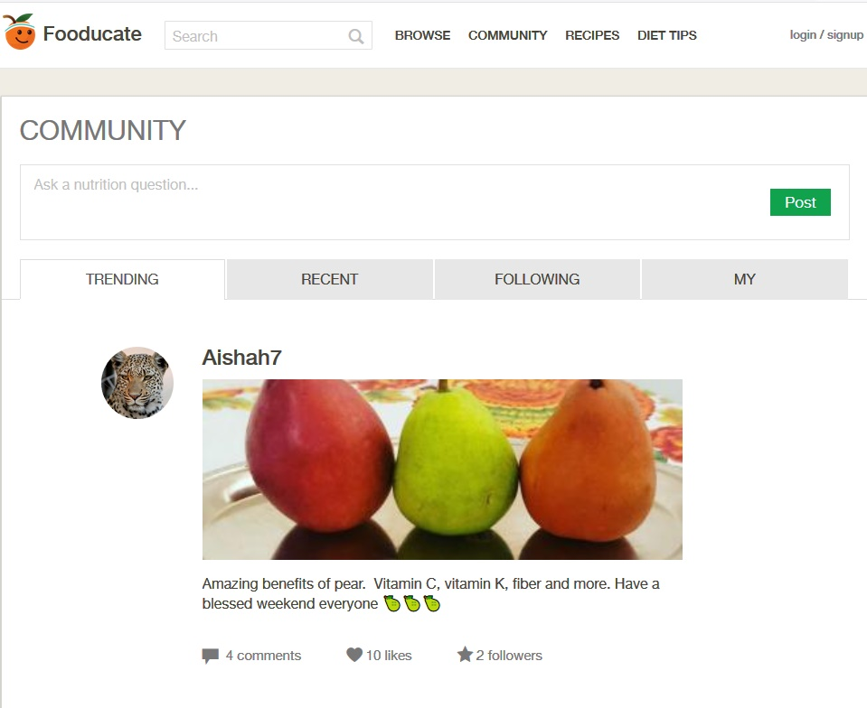
SIMILAR PRODUCTS (FOODUCATE)
Twitter style feed.
Ability to follow creators.
Ability to post own questions.

Slide 12
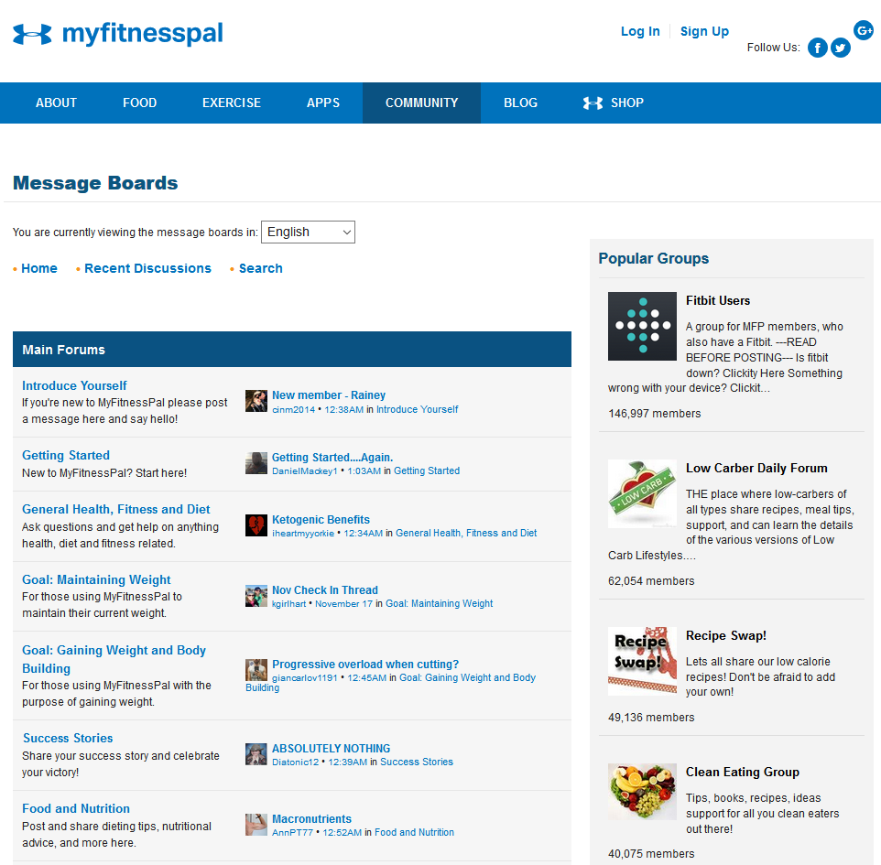
SIMILAR PRODUCTS (MYFITNESSPAL)
Closer to our idea of community groups.
Ability to create private groups
No mobile apps for groups

Slide 13
(4)
Design & Functionality
What we designed, and how we designed it.

Slide 14
OUR DESIGN PROCESS
Listing features and functionality
Mockup designs in Balsamiq
Implementation in Android Studio

Slide 15
PLANNED FUNCTIONALITY
Calorie Tracking
Fitness Goals
Social Groups
Implemented in that order.

Slide 16
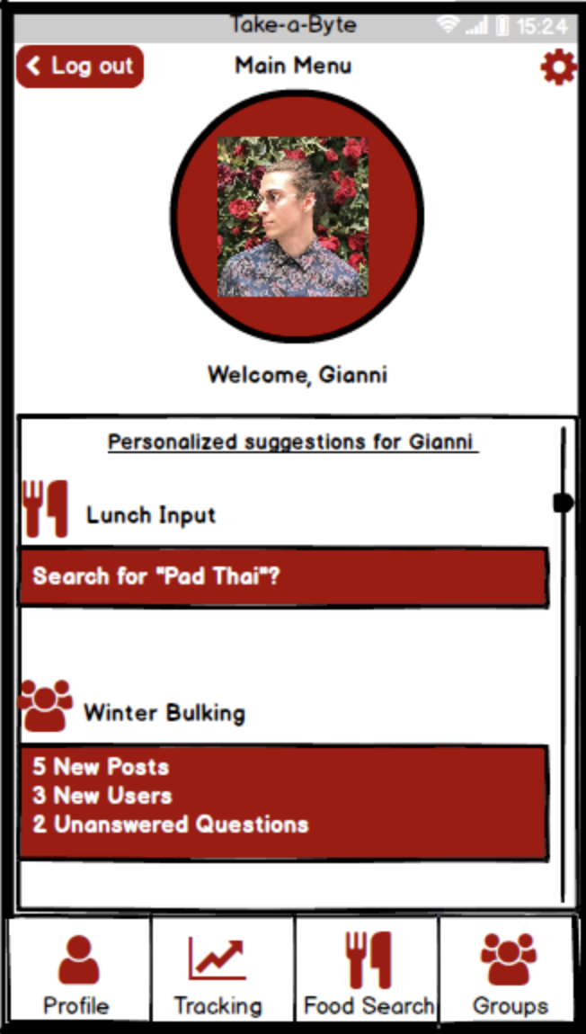
MAIN MENU
The first thing the user sees when they log in. Access to all components of the application, as well as a personalized suggestion feed.
Place your screenshot here

Slide 17
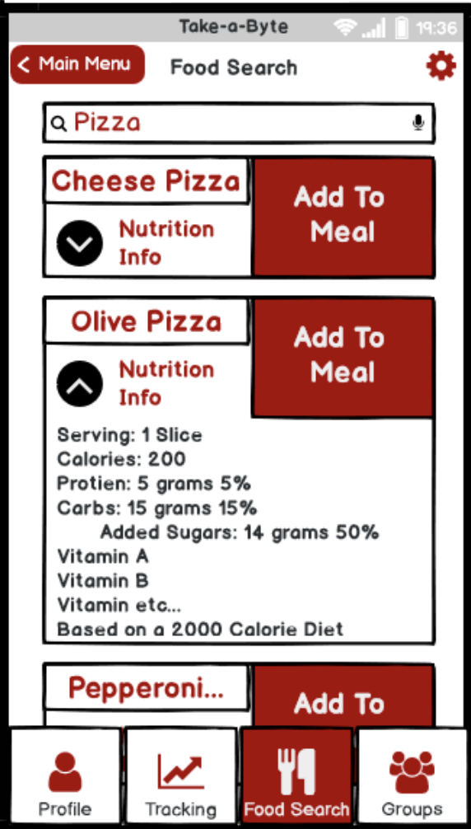
FOOD SEARCH
This is where users can search through a database of food in order to track their caloric intake throughout the day.

Slide 18
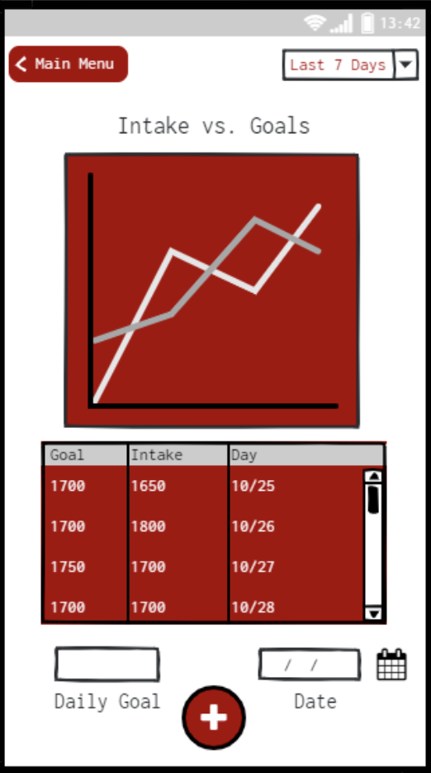
GOAL STATISTICS
Here, the user can track their goals in a neat interface using several different statistical displays.
Place your screenshot here

Slide 19
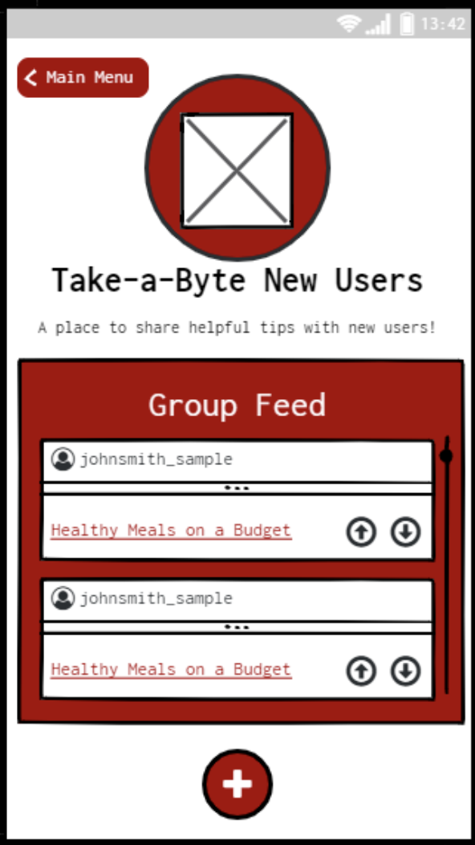
GROUPS
Here, the user can see posts from members of the groups that they are a part of.

Slide 20
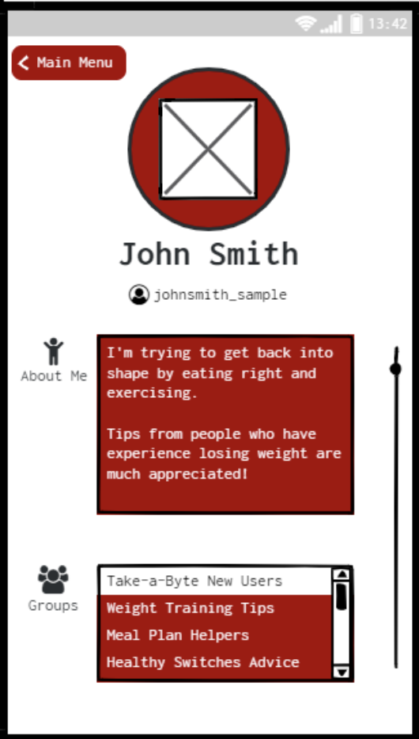
PROFILE
Users can view other users’ username, goals, group information, and other things that they choose to share.

Slide 21
(5)
HCI
How does this project relate to human-computer interaction?

Slide 22
HUMAN-COMPUTER INTERACTION
Create an universally accessible interface (or as close as we can get to it in the time that we have)
Reducing short and long term memory load
Offering informative feedback

Slide 23
HUMAN-COMPUTER INTERACTION
Keeping interface consistent and simple
Preventing errors to best of our ability
Creating an overall enjoyable UX that helps users stay on track to their fitness goals

Slide 24
THANK YOU
ANY QUESTIONS?
Slide theme: https://www.slidescarnival.com/laertes-free-presentation-template/2038#preview

