Slide 1
By: Derek Stratton
Terra Williams

Slide 2
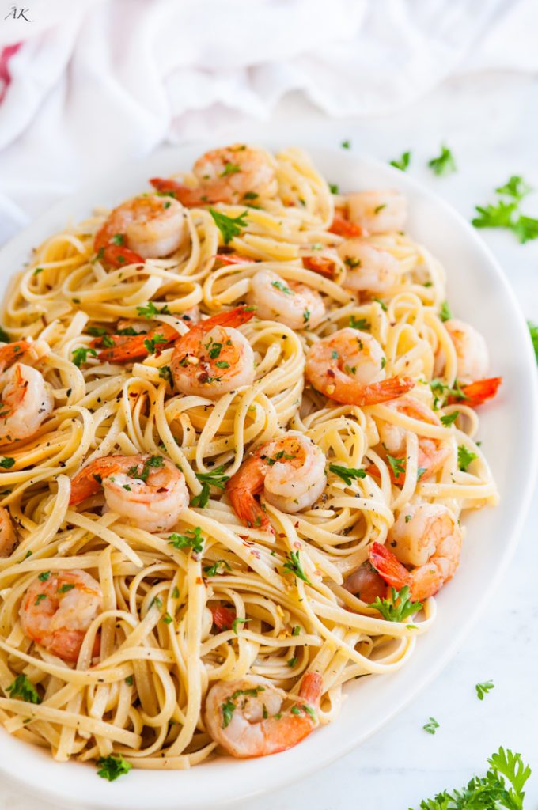
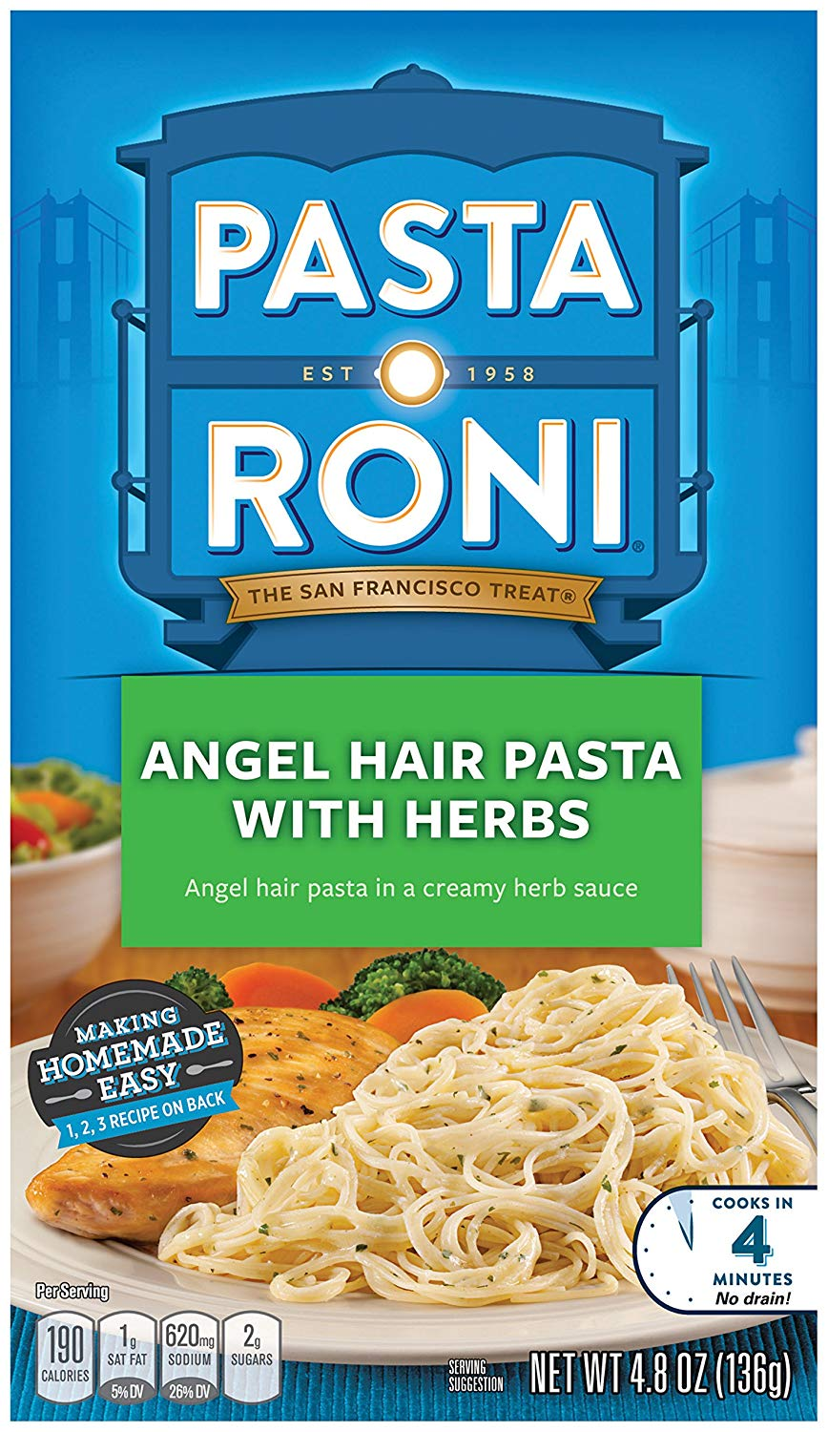
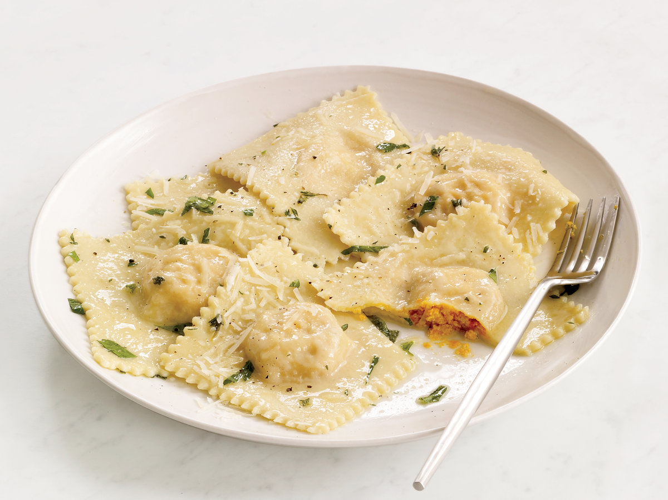

Slide 3
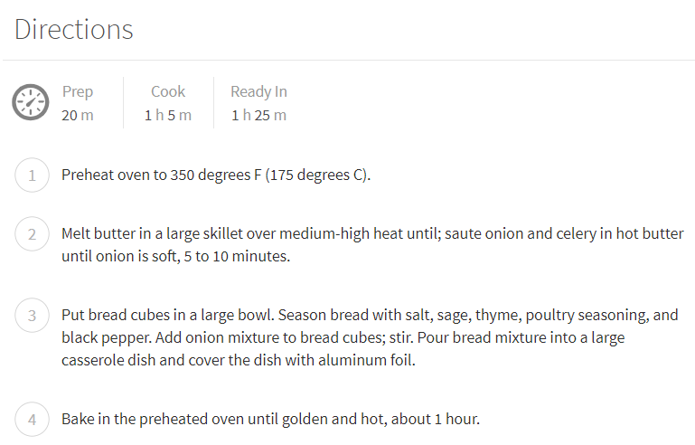
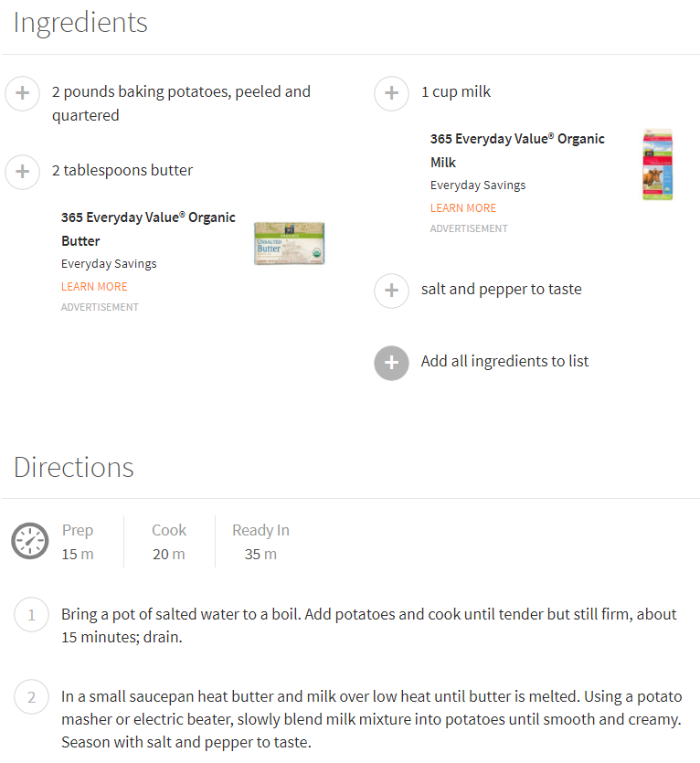
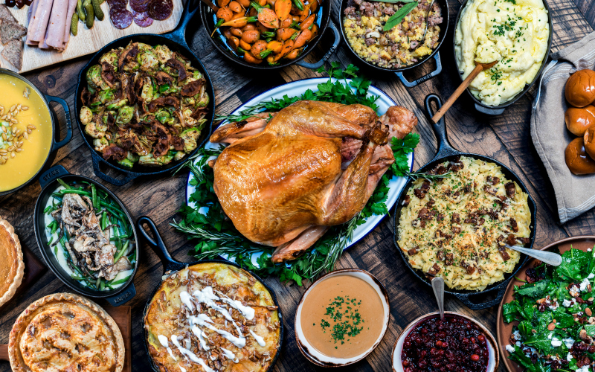
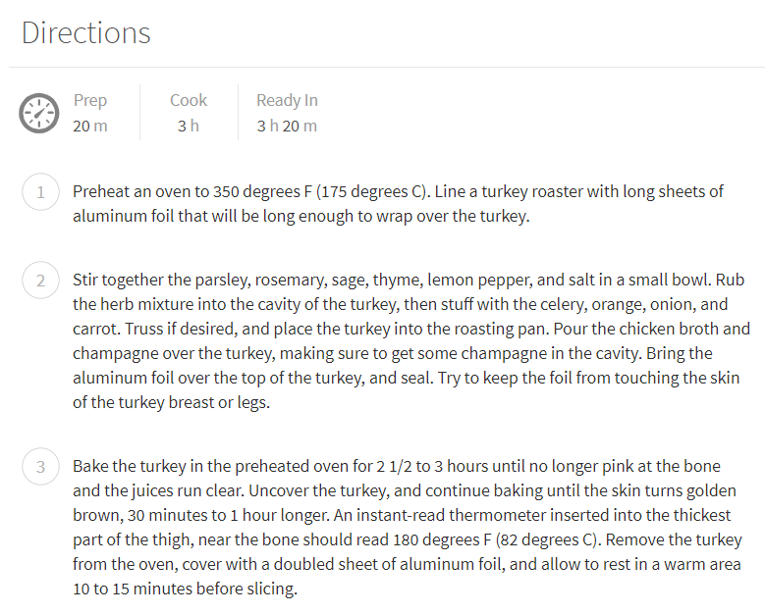
Planning a Big Family Dinner

Slide 4
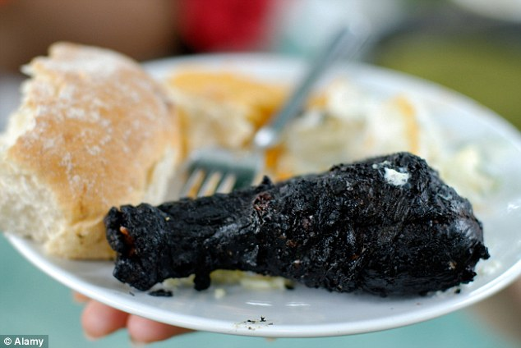
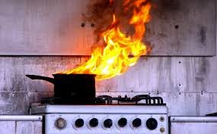
The Problem
Notes:
Trying to stay on track for multiple recipes at the same time can cause:
Stress in the kitchen
Undesirable food
And other disasters
How many of you have had any of these happen to you?

Slide 5
The Solution!
Combine the steps of multiple recipes into a single list that is easier to follow than multiple lists
The order of tasks are optimized based on how long they should take and if they take “active” effort or not (“passive”)
Example: Mashing the potatoes vs Cooking the chicken in the oven

Slide 6
Why did we choose this?
It’s a fun idea that fits well into the scope of this class project
We wanted to make a Windows app with C# and WPF (using Visual Studio)
I would use this next Thanksgiving! (if I was in charge of making stuff)

Slide 7
Intended Users
HCI Persona
Archetype | The Working Mom
Name | Sharon Baker
Job Title | Real Estate Agent
Demographics | 37 years old Mother of three Married Home owner Michigan Real Estate License holder
Goals | Sharon wants to be able to plan and cook holiday dinners for her family and extended family.
Busy chefs
People planning a large meal (Thanksgiving, Family Gathering)
Inexperienced chefs

Slide 8
Interface Considerations
Consistency
The different screens have similar information laid out in a similar way to encourage familiarity and make usage easier to learn and easier to retain
Menu Navigation
The menus are used to help logically sort items for easy access
Simplicity
The “Start Cooking” page is designed for simplicity: with all of the information you need on one page. This is so the user can focus on the app as little as possible.
One button press to start
One simple tap for each instruction complete

Slide 9
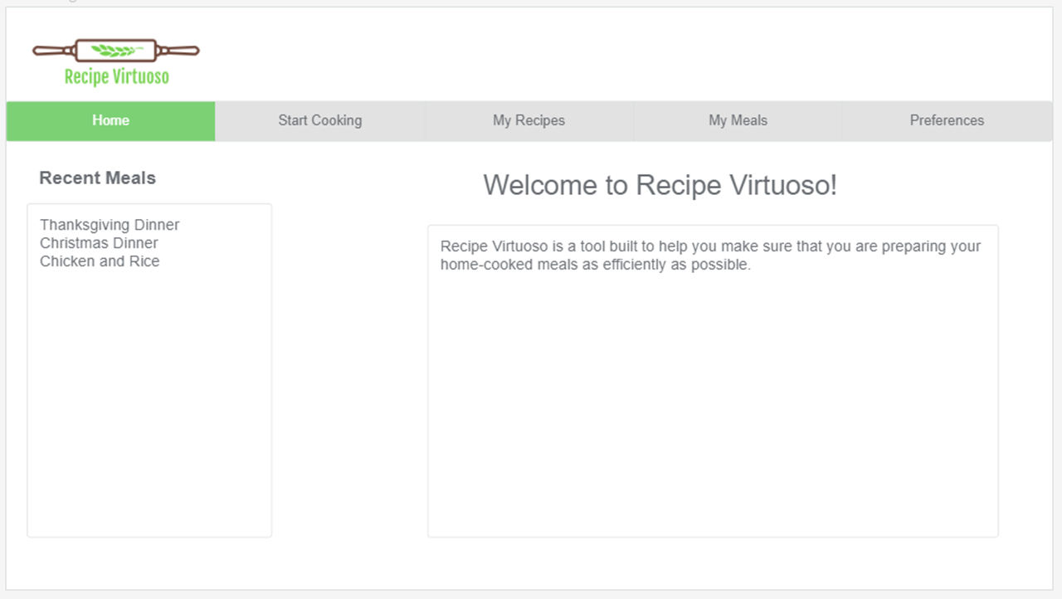

Slide 10
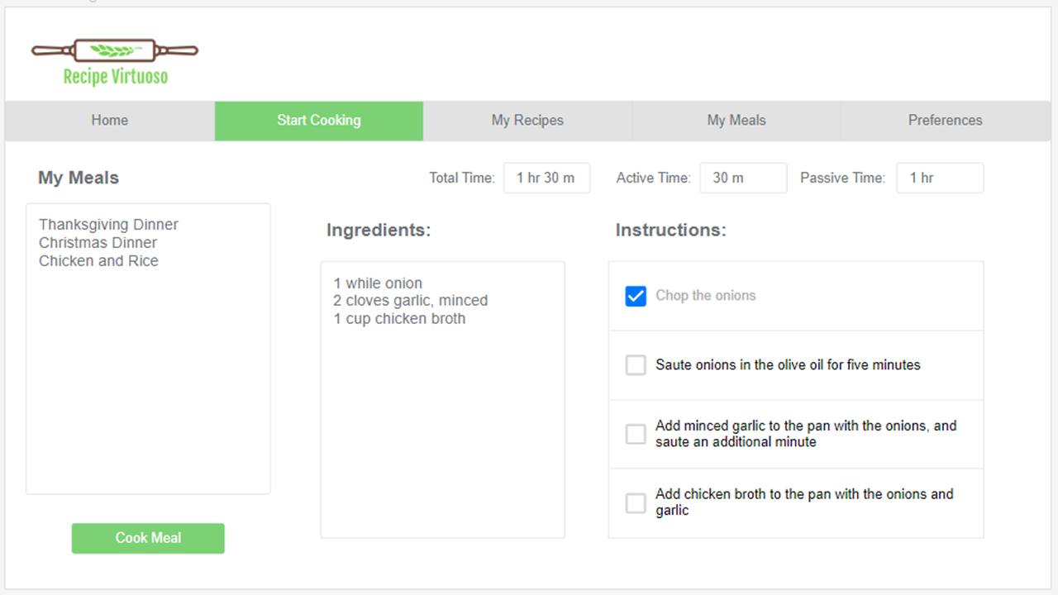

Slide 11
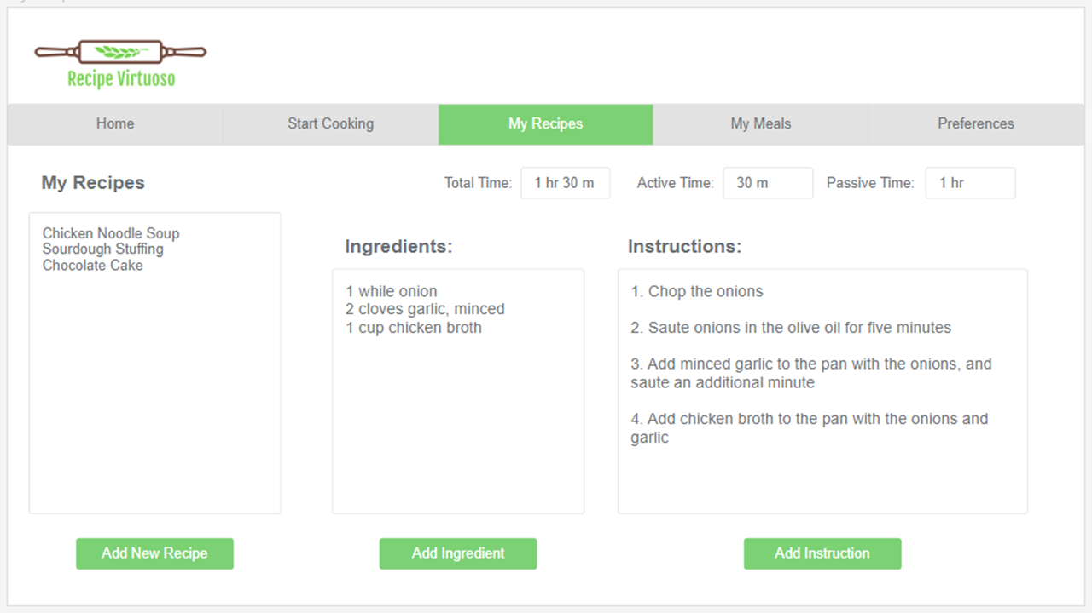

Slide 12
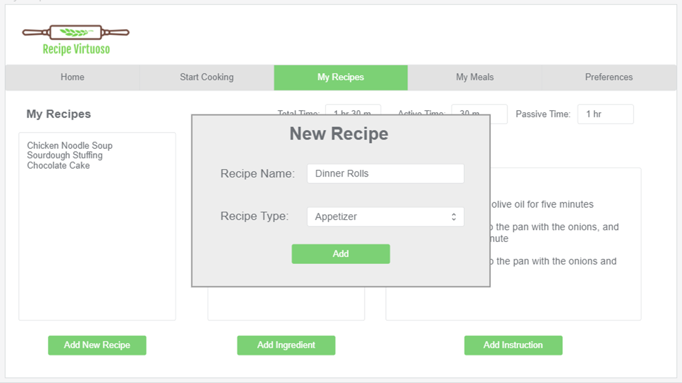

Slide 13
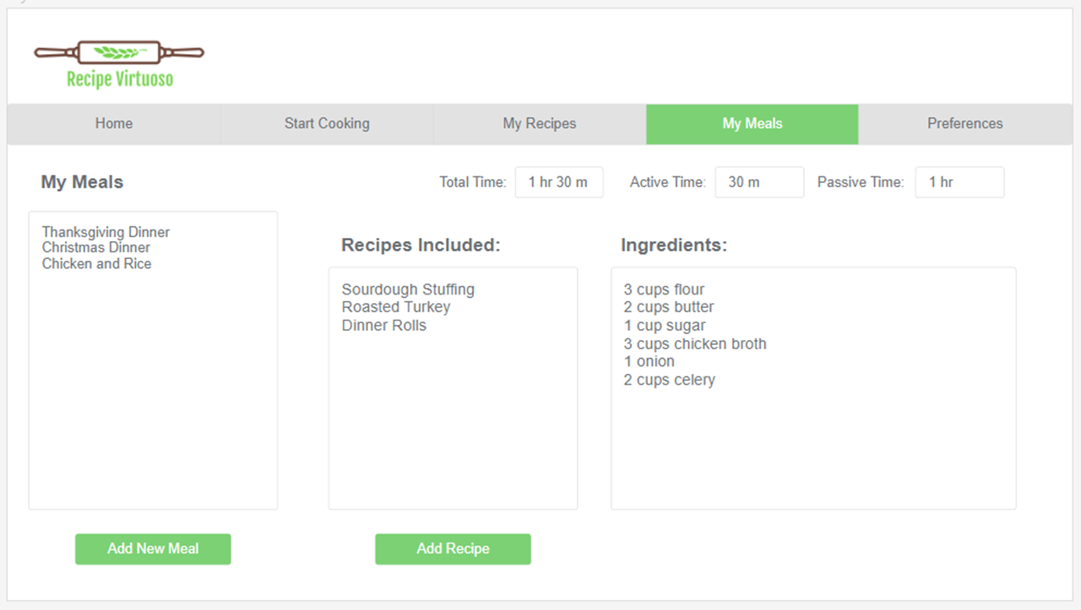

Slide 14
