Slide 1
Team #9 Project Presentation
Gunner Stone, Matthew Swanson, Lee Bryant

Slide 2
Presentation Roadmap
Background
Project Video
Challenges
Questions

Slide 3
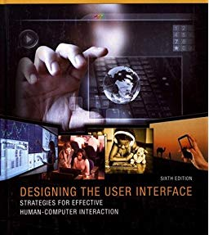

Slide 4
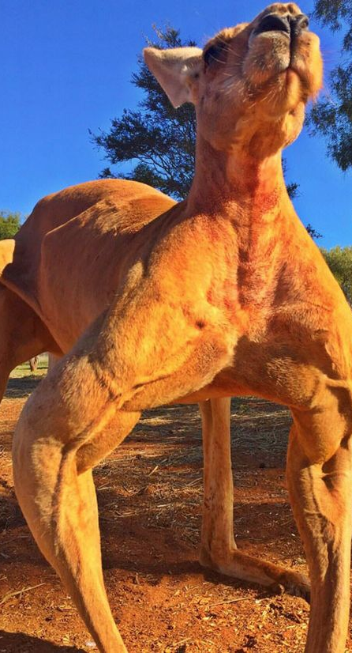
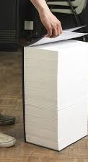

Slide 6
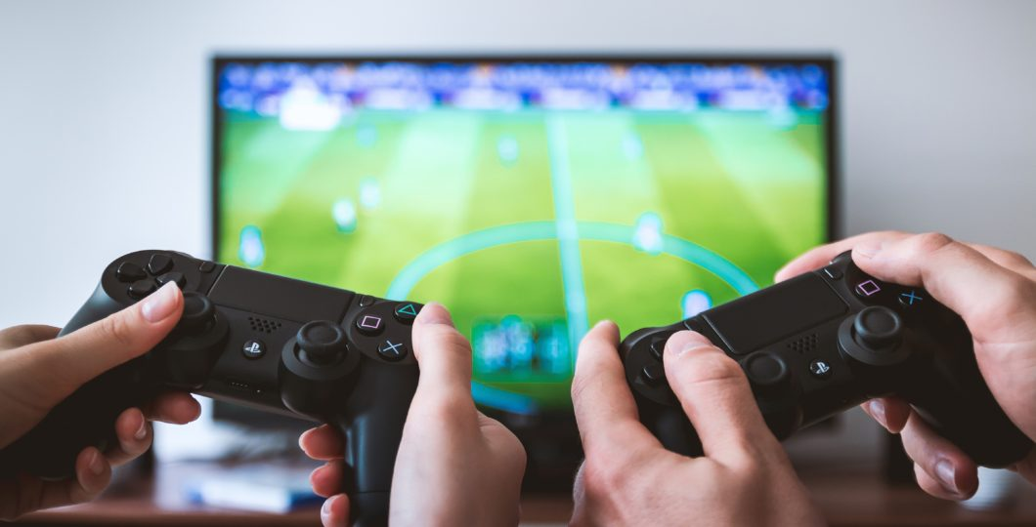

Slide 7
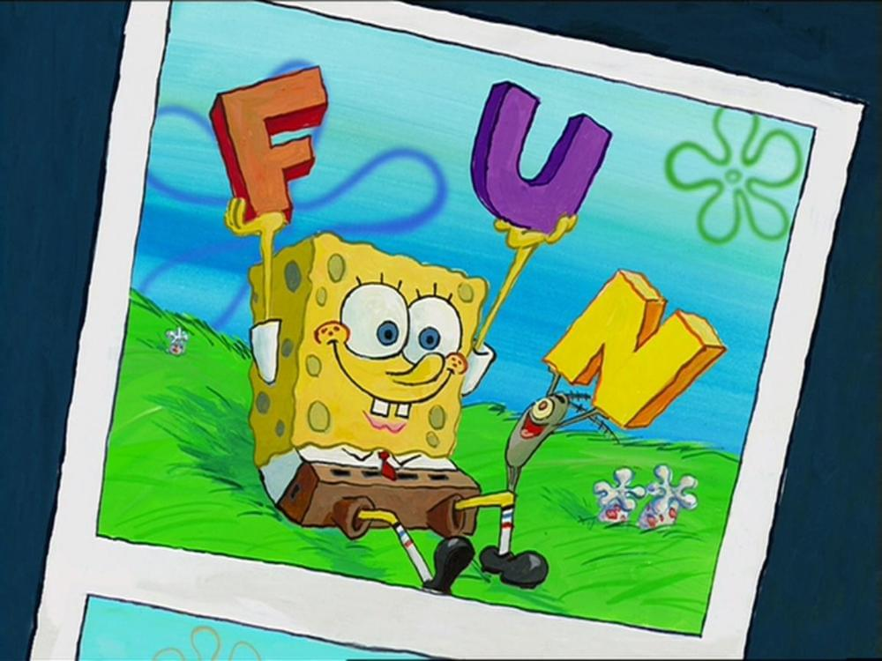

Slide 8
Team #9 Presents...

Slide 9
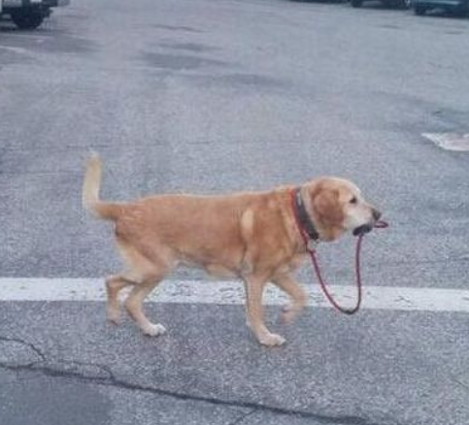
The HCI Self-Teacher

Slide 10
It’s Cool!
The user may experiment to learn good gui design
The user may design a GUI for an actual mock up
The user may enjoy playing a game while learning design
Similar to a GUI designer, except it grades you

Slide 11
Let’s see it in action!
[Load Program for live Demo]
OR
https://www.youtube.com/watch?v=fDHT_anLBr8

Slide 12
Challenges?

Slide 13
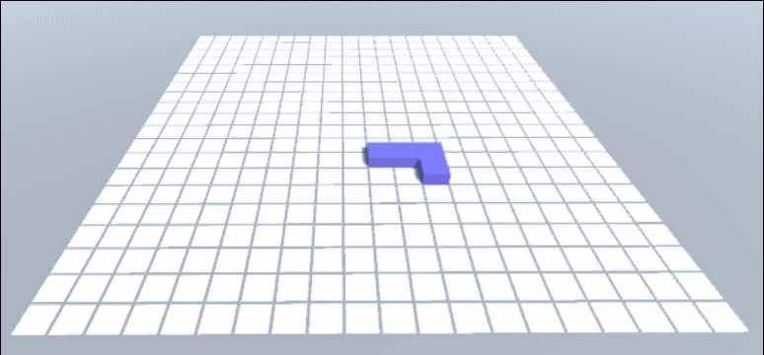
Challenges
Grid Snapping

Slide 14
Challenges
User testing
Overall Fun

Slide 15
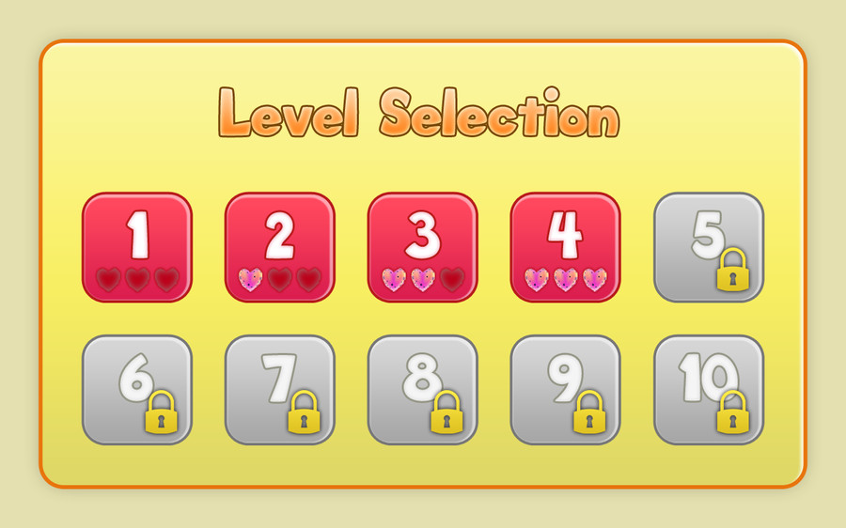
Challenges
Game Objectives

Slide 16
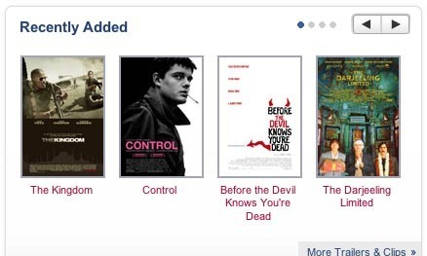
Challenges
Custom Menu Objects
Carousel
Fisheye Menu

Slide 17
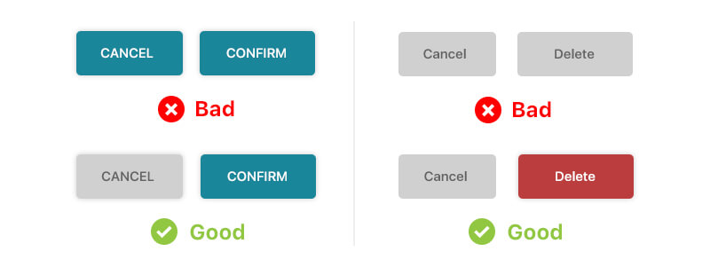
Challenges
Automatic UI grading

Slide 18
Conclusion

Slide 19
Questions

