Slide 1
Game? A CS420 Project
By Benjamin Estela and Miles McDonald

Slide 2
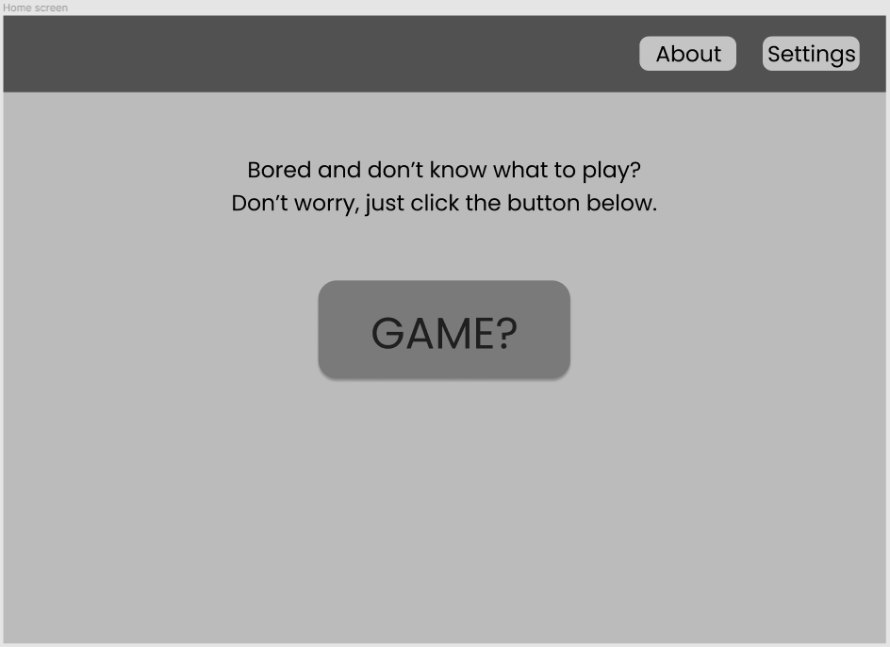
Game?
Application to help gamers find games to play
Help solve a big problem in the gaming world
It can help people find a new community to play with

Slide 3
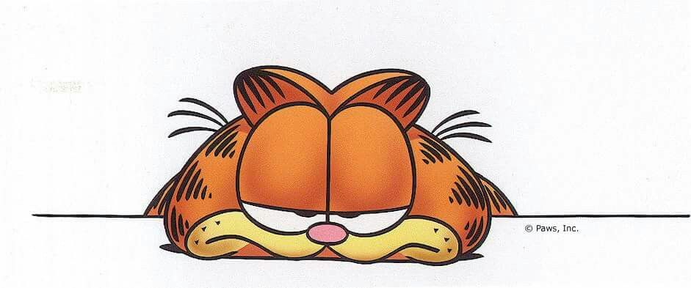
Why Game?
Too many games!
Bored gamers
We are potential users
Have the opportunity to create something that makes things easier for people

Slide 4
Intended Users of Game?
Primarily Gamers
People who don't know what to play
People who are looking for something new to play
Groups of friends who can’t agree on what to play

Slide 5
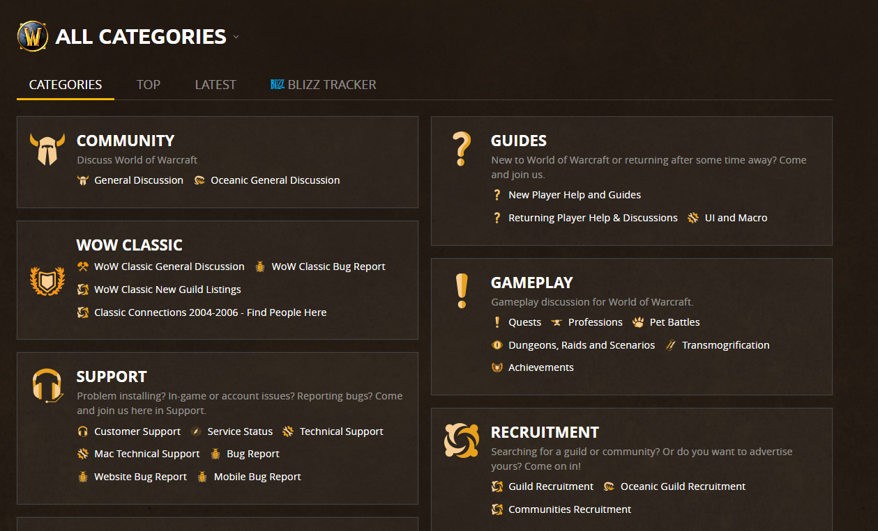
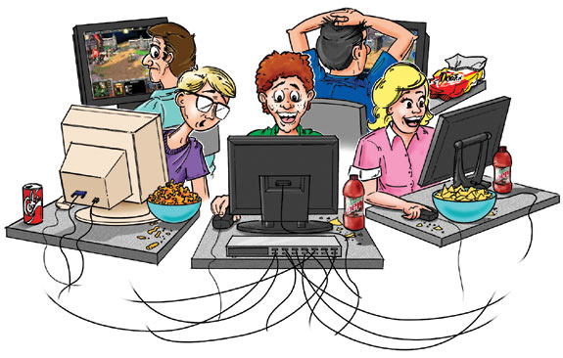
Social Aspects of Game?
Find new communities to be apart of
Find new friends that play the same games as you
Try new things and meet new people

Slide 6
HCI Elements
Consistent Design
Reversible Actions
Simple
Data Entry
Fluid Navigation
Theme

Slide 7
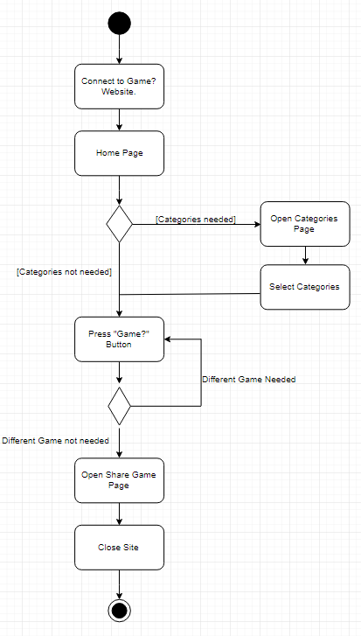
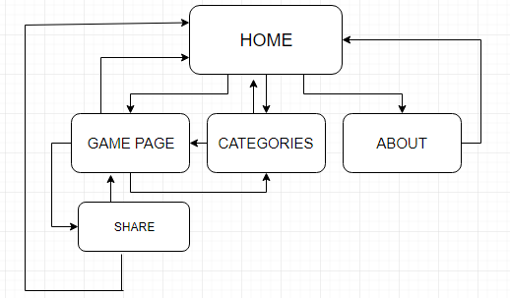
Design of Game?
Home
About
Settings
History
Categories
Game!

Slide 8
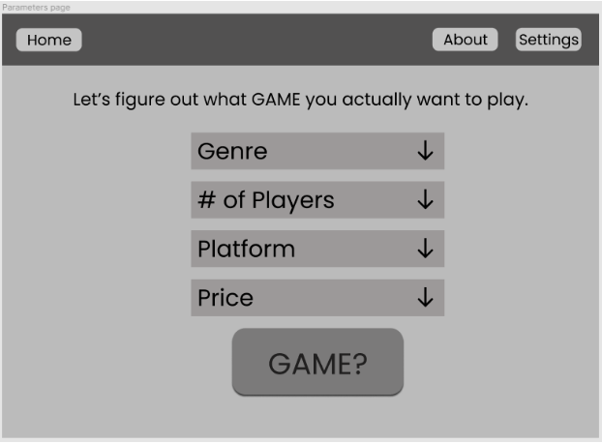
Planned Functionality for Game?
Parameters
Databases outside of scope
Client-side
Share
Link to recommended game
Colors
Mostly monochromatic

Slide 9
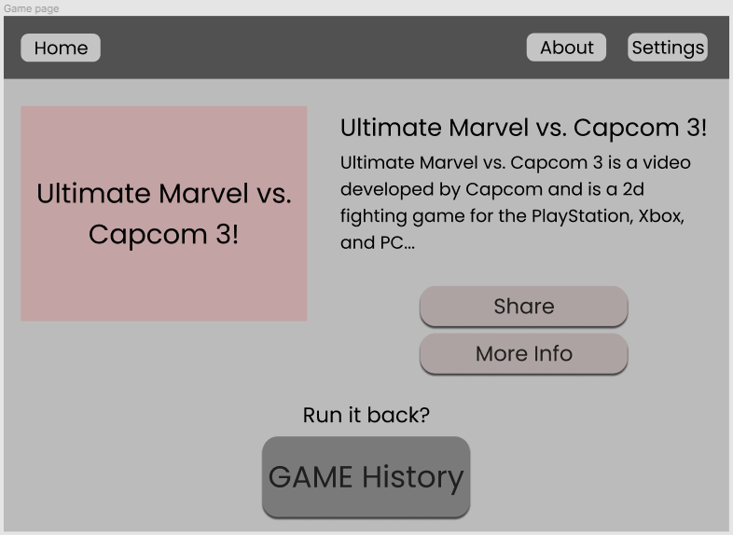
Game!

Slide 10
Questions about...

