Slide 1
MyNevada Makeover
By: Brandon Main, Brandon Freshour, Ryan Poston
Team 14

Slide 2
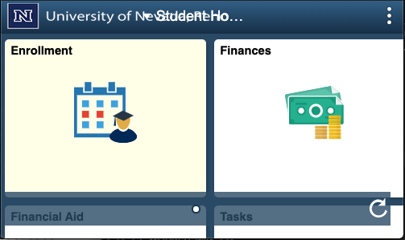
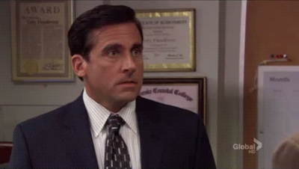
How would you describe your MyNevada experience?
Fast?
Mobile Friendly?
Reliable?
Notes:
Brandon F
How is your experience with myNevada?
Would you says it’s Fast … Smooth… Mobile Friendly?

Slide 3
What is it?
A redesign of the MyNevada web interface
Student Center
Academic tasks
Notifications and TODOs
Navigation
Mobile friendly and responsive
An improvement to user workflows
Navigating to information
Help users understand what needs to be done and what has already been done
Notes:
Brandon F

Slide 4
Why do it?
MyNevada should be friend not foe
We’re forced to use it, why not make it enjoyable?
Studies have shown a direct correlation between user satisfaction of MyNevada (Student Information Systems) and how much a student trusts a university
MyNevada does not conform to how a normal user expects a website's navigation to be
No navigation bar
Tasks of a type of genre are not alway located under the same navigation location (i.e. non intuitive navigation)
The lack of mobile support makes the experience feel clunky and outdated
Make the use of MyNevada a frictionless process from enrollment to graduation and beyond.
Notes:
Brandon F

Slide 5
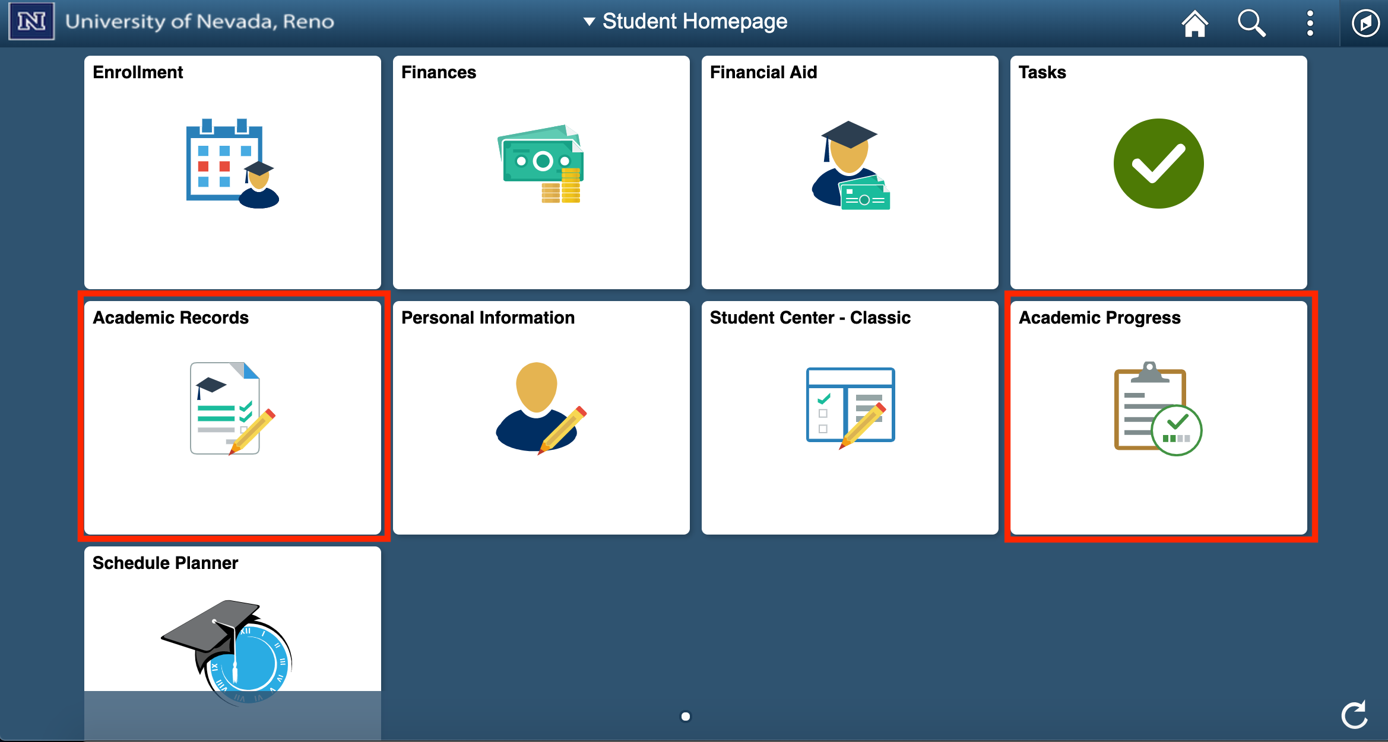
Ex: Two different Academic categories. Which do you click to apply for graduation?
Notes:
Ryan

Slide 6
Ex: This amazing navigation dropdown
Notes:
Ryan

Slide 7
Audience
MyNevada was designed for:
Students
Faculty
Potential Students
Notes:
Ryan

Slide 8
HCI Components
Efficiency
Less clicks to get to where you want to go
Tasks performed more quickly
Memorability
The redesign is more centric to how a user expects the site to operate
Therefore, the user already understands the navigation and knows where to go
Satisfaction
Users will be more satisfied with a site that works for them and not against them
Notes:
Ryan

Slide 9
Design
A reorganization of vital components
An updated/modern look and feel
Conforms to how the user expects a site to operate
Gives graphical representations of important data
Proven that graphical representation of data greatly improves user satisfaction [Website Design and User Engagement (https://www.ncbi.nlm.nih.gov/pmc/articles/PMC4974011/)]
Responsive to various screen sizes
Captures the visual language of the University

Slide 10
Design - Navigation
Notes:
We included an actual navigation bar in our redesign:
Efficiency
Easier to find what you want

Slide 11
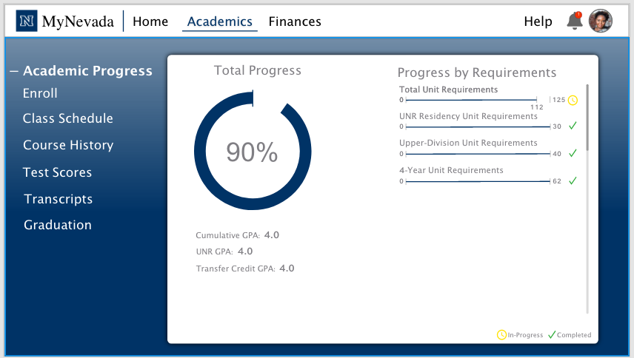
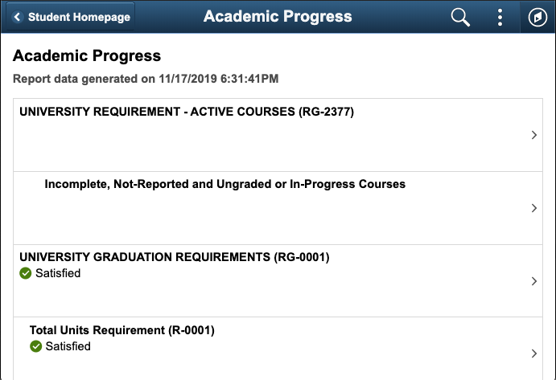
Design - Organization
Ex: Reorganized Components
Notes:
Intuitive

Slide 12
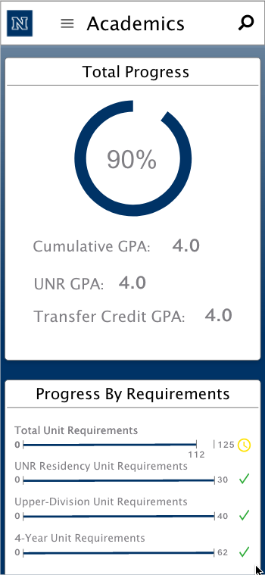
Design - Mobile Friendly
Notes:
Similar experience on Desktop and Mobile

Slide 13
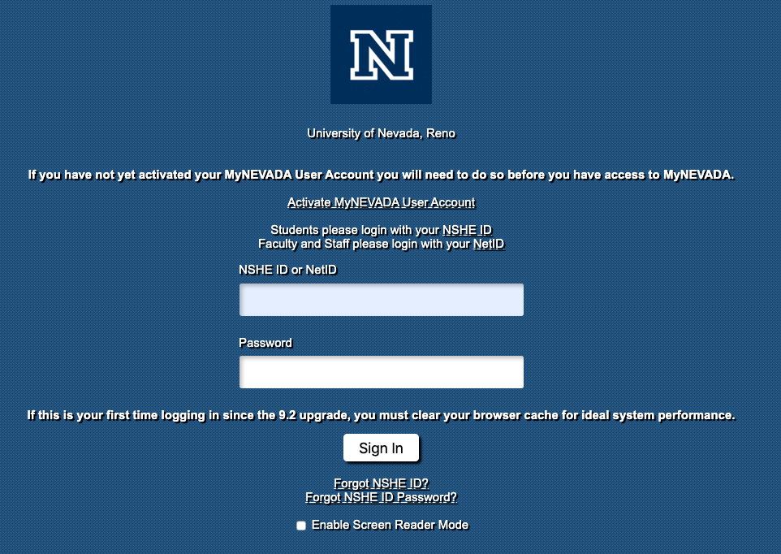
Design - Updated Look

Slide 14
Questions?

