Slide 1
Athena
The artificial intelligence that turns machine learning into you learning!
Alexis Tudor
Human-Computer Interaction

Slide 2
What is Athena?

Slide 3
What do you look for in a study partner?
Patient
Knowledgeable
Able to keep on task
Fun
Humorous
Appeal

Slide 4
What would you look for in an AI study partner?
Encouraging
Patient
Able to scan and process information
Knowledgeable
Able to keep on task
Able to keep me on task
Fun
Engaging
Can Tell Jokes
Humorous
Appeal
Geometric appeal

Slide 5
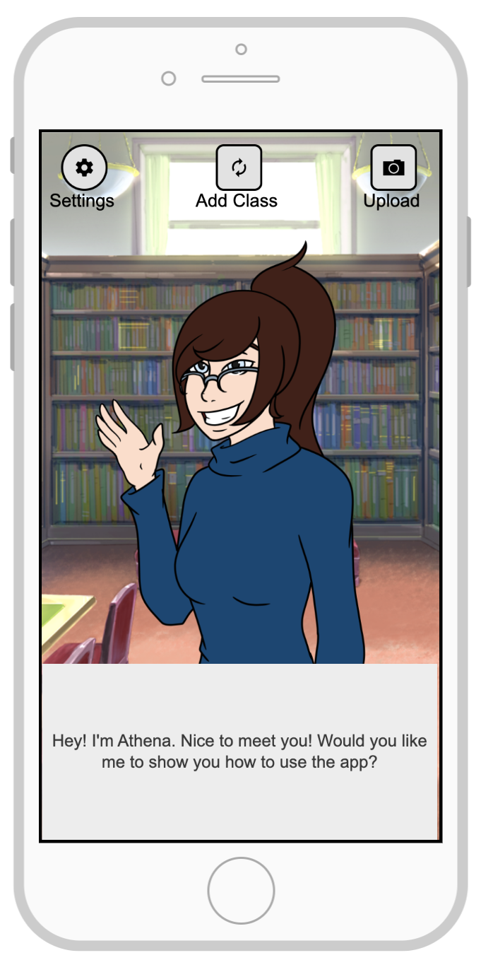
Introducing: Athena
Athena has many functionalities based on user input such as:
Quizzing the user
Letting the user ‘teach’ the material
Uploading study material
Keeping a calendar of important dates
And preventing exit from the app during study session

Slide 6
What are 3 benefits of direct manipulation devices?
That’s a good question. Let me think...
Don’t forget your CS 620 exam is tomorrow!
Athena

Slide 7
Changing Athena

Slide 8
Intended Users

Slide 9
HCI Traits
Easy to use
Engaging
Anthropomorphic
User input
Uses a combination of many different disciplines to design a user-friendly system
Accessible

Slide 10
But what does it do?
What it should do:
Have a fully functioning AI that learns from the user and from others using the app
Have full text to speech and text recognition and processing
Be able to take in a photo of a paper and decipher the writing and gain information from it
Be able to decipher internet resources and connect to other devices
All of the use cases described before
What it will do:
Have a very limited, pre-prepared text parser with limited machine learning
Be able to recognize and parse user text
Be able to understand very limited preformatted information
Be able to have a calendar with class deadlines and information
Be able to change appearance
Be able to crack jokes

Slide 11
Questions?
How are a user interface and a joke alike? If you have to explain it, it’s probably no good!

Slide 12
Thank You
https://www.surveymonkey.com/r/NMD3FHX

