Slide 1
Cybex-p Threat Intelligence Graph
T17- Adam Cassell

Slide 2
State of Cybersecurity Research at UNR
https://www.unr.edu/nevada-today/news/2019/cybersecurity-programs
(0:00 – 1:45)

Slide 3
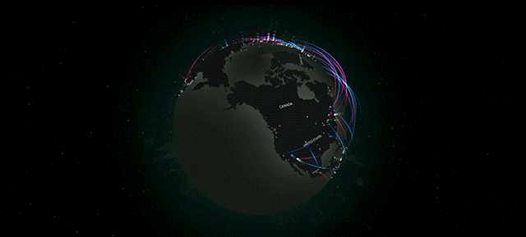
Agenda
Why TI-Graph?
What is it?
Why me?
Features
Who benefits?
Conclusion

Slide 4
Why Do we need Cybex TI-Graph?
The world needs a centralized platform for cybersecurity research and information exchange
Cybex-P is the proposed solution
Led by Dr. Sengupta
Cybex-P requires a front-end interface for researchers and analysts
Cybex-P Threat Intelligence Graph (TI-Graph) is the answer!

Slide 5
What is the Cybex-p threat intelligence graph?
Front-end web application for the Cybex-P platform
User can view Indicators of Compromise (IOCs)
Graph-based view
View network entities, their relationships, and attributes
Cybex-P database provides cybersecurity context

Slide 6
why am I doing it?
Opens the door for future HCI research opportunities on this project
Gain exposure to new web technologies
Improve React development skillset
Explore graph and data visualization techniques

Slide 7
Feature DEMO

Slide 8
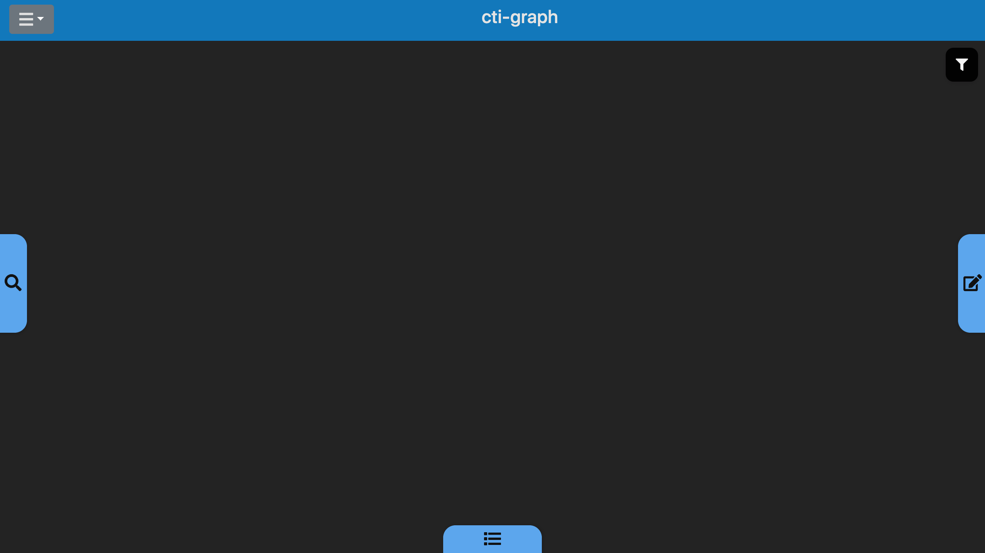
Start View

Slide 9
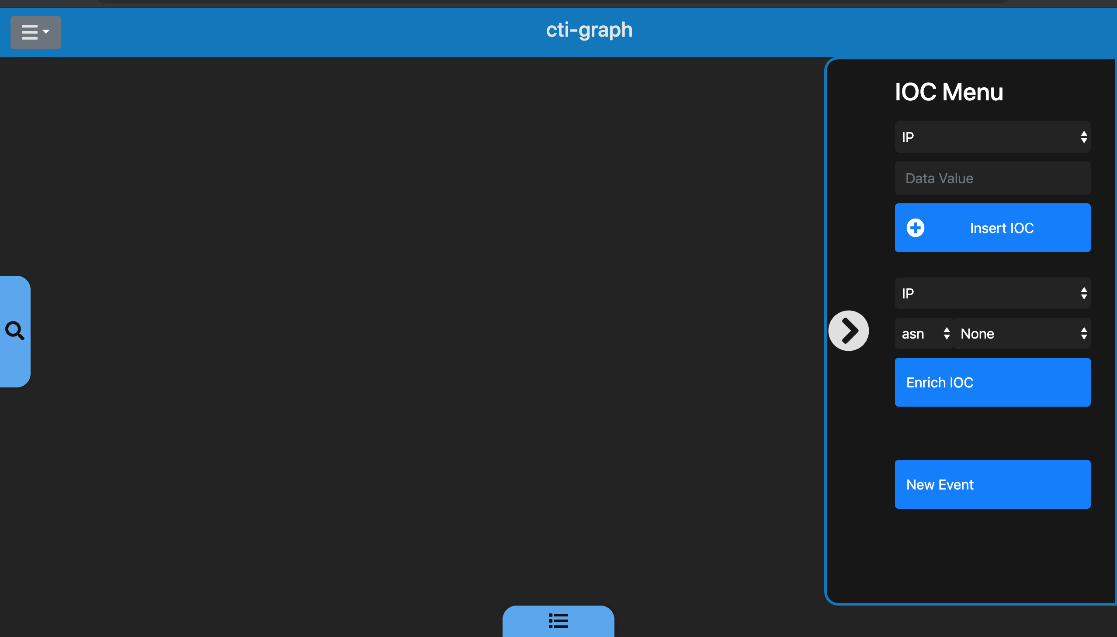
Feature 1- Choose an IP to investigate

Slide 10
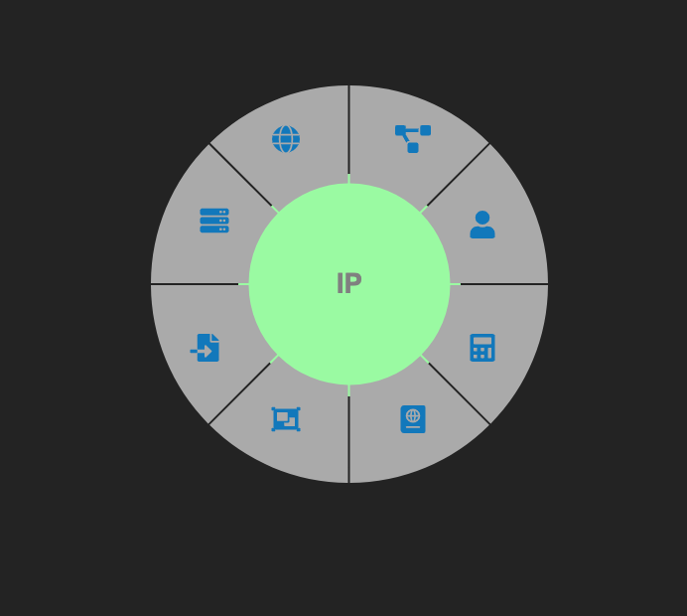
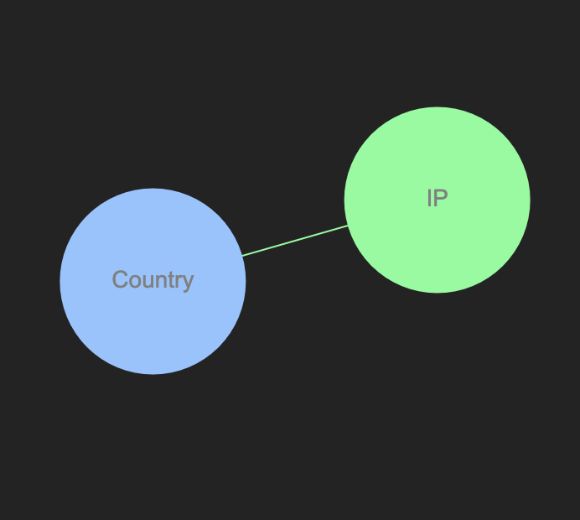
Feature 2 – Enrich an IP

Slide 11
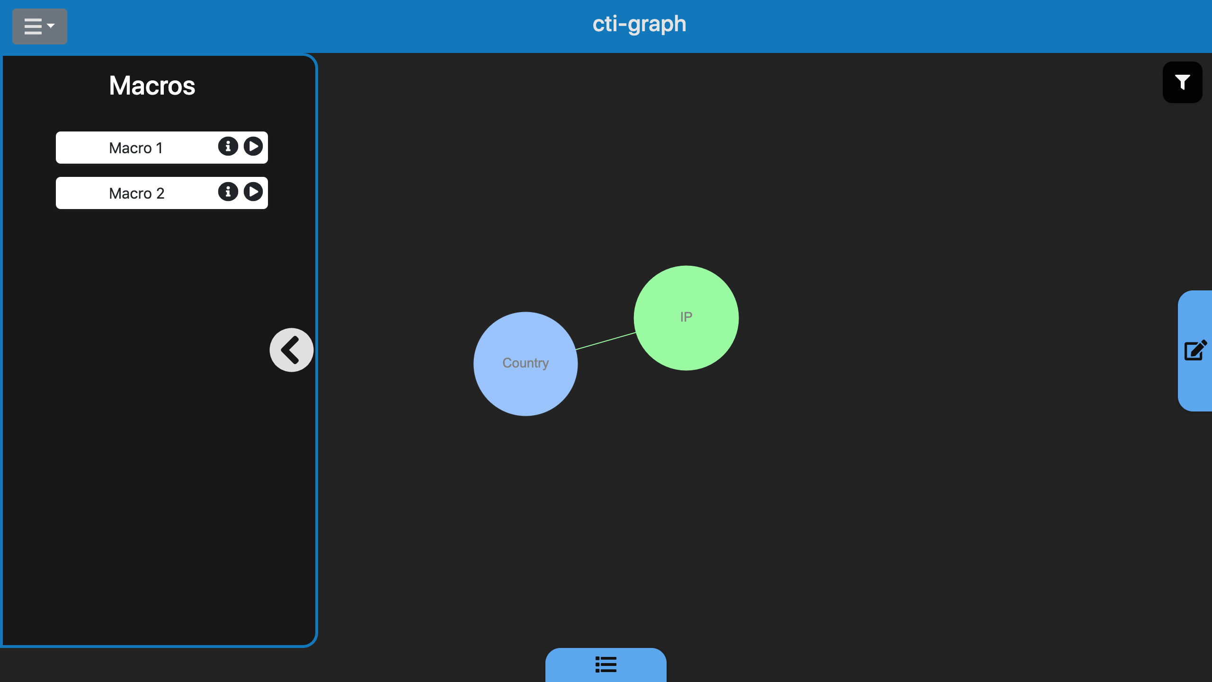
Feature 3 – Run a macro

Slide 12
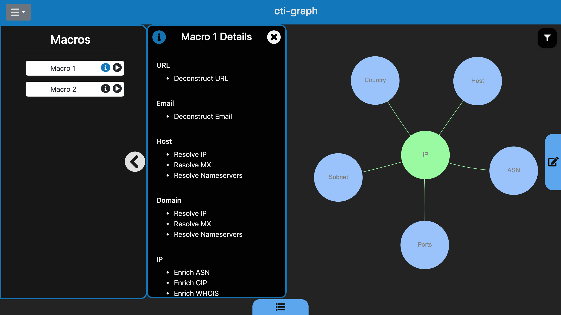
Feature 3 – Run a macro (Cont)

Slide 13
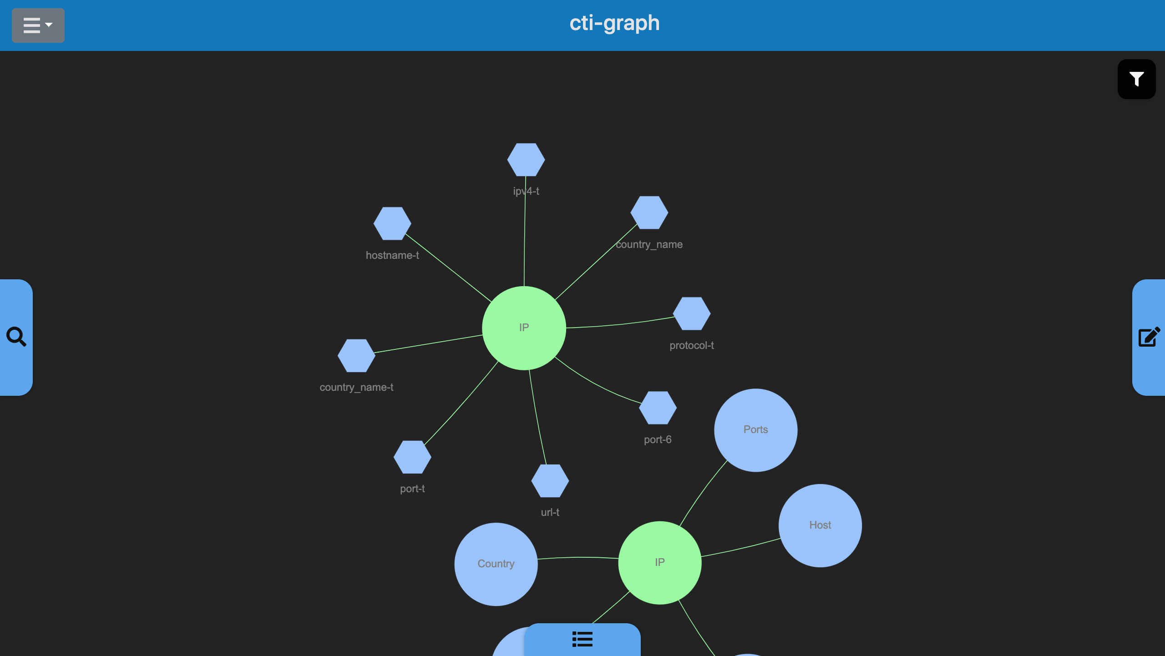
Feature 4 – Cybex Enrichment

Slide 14
Feature 5 – Focus on a node

Slide 15
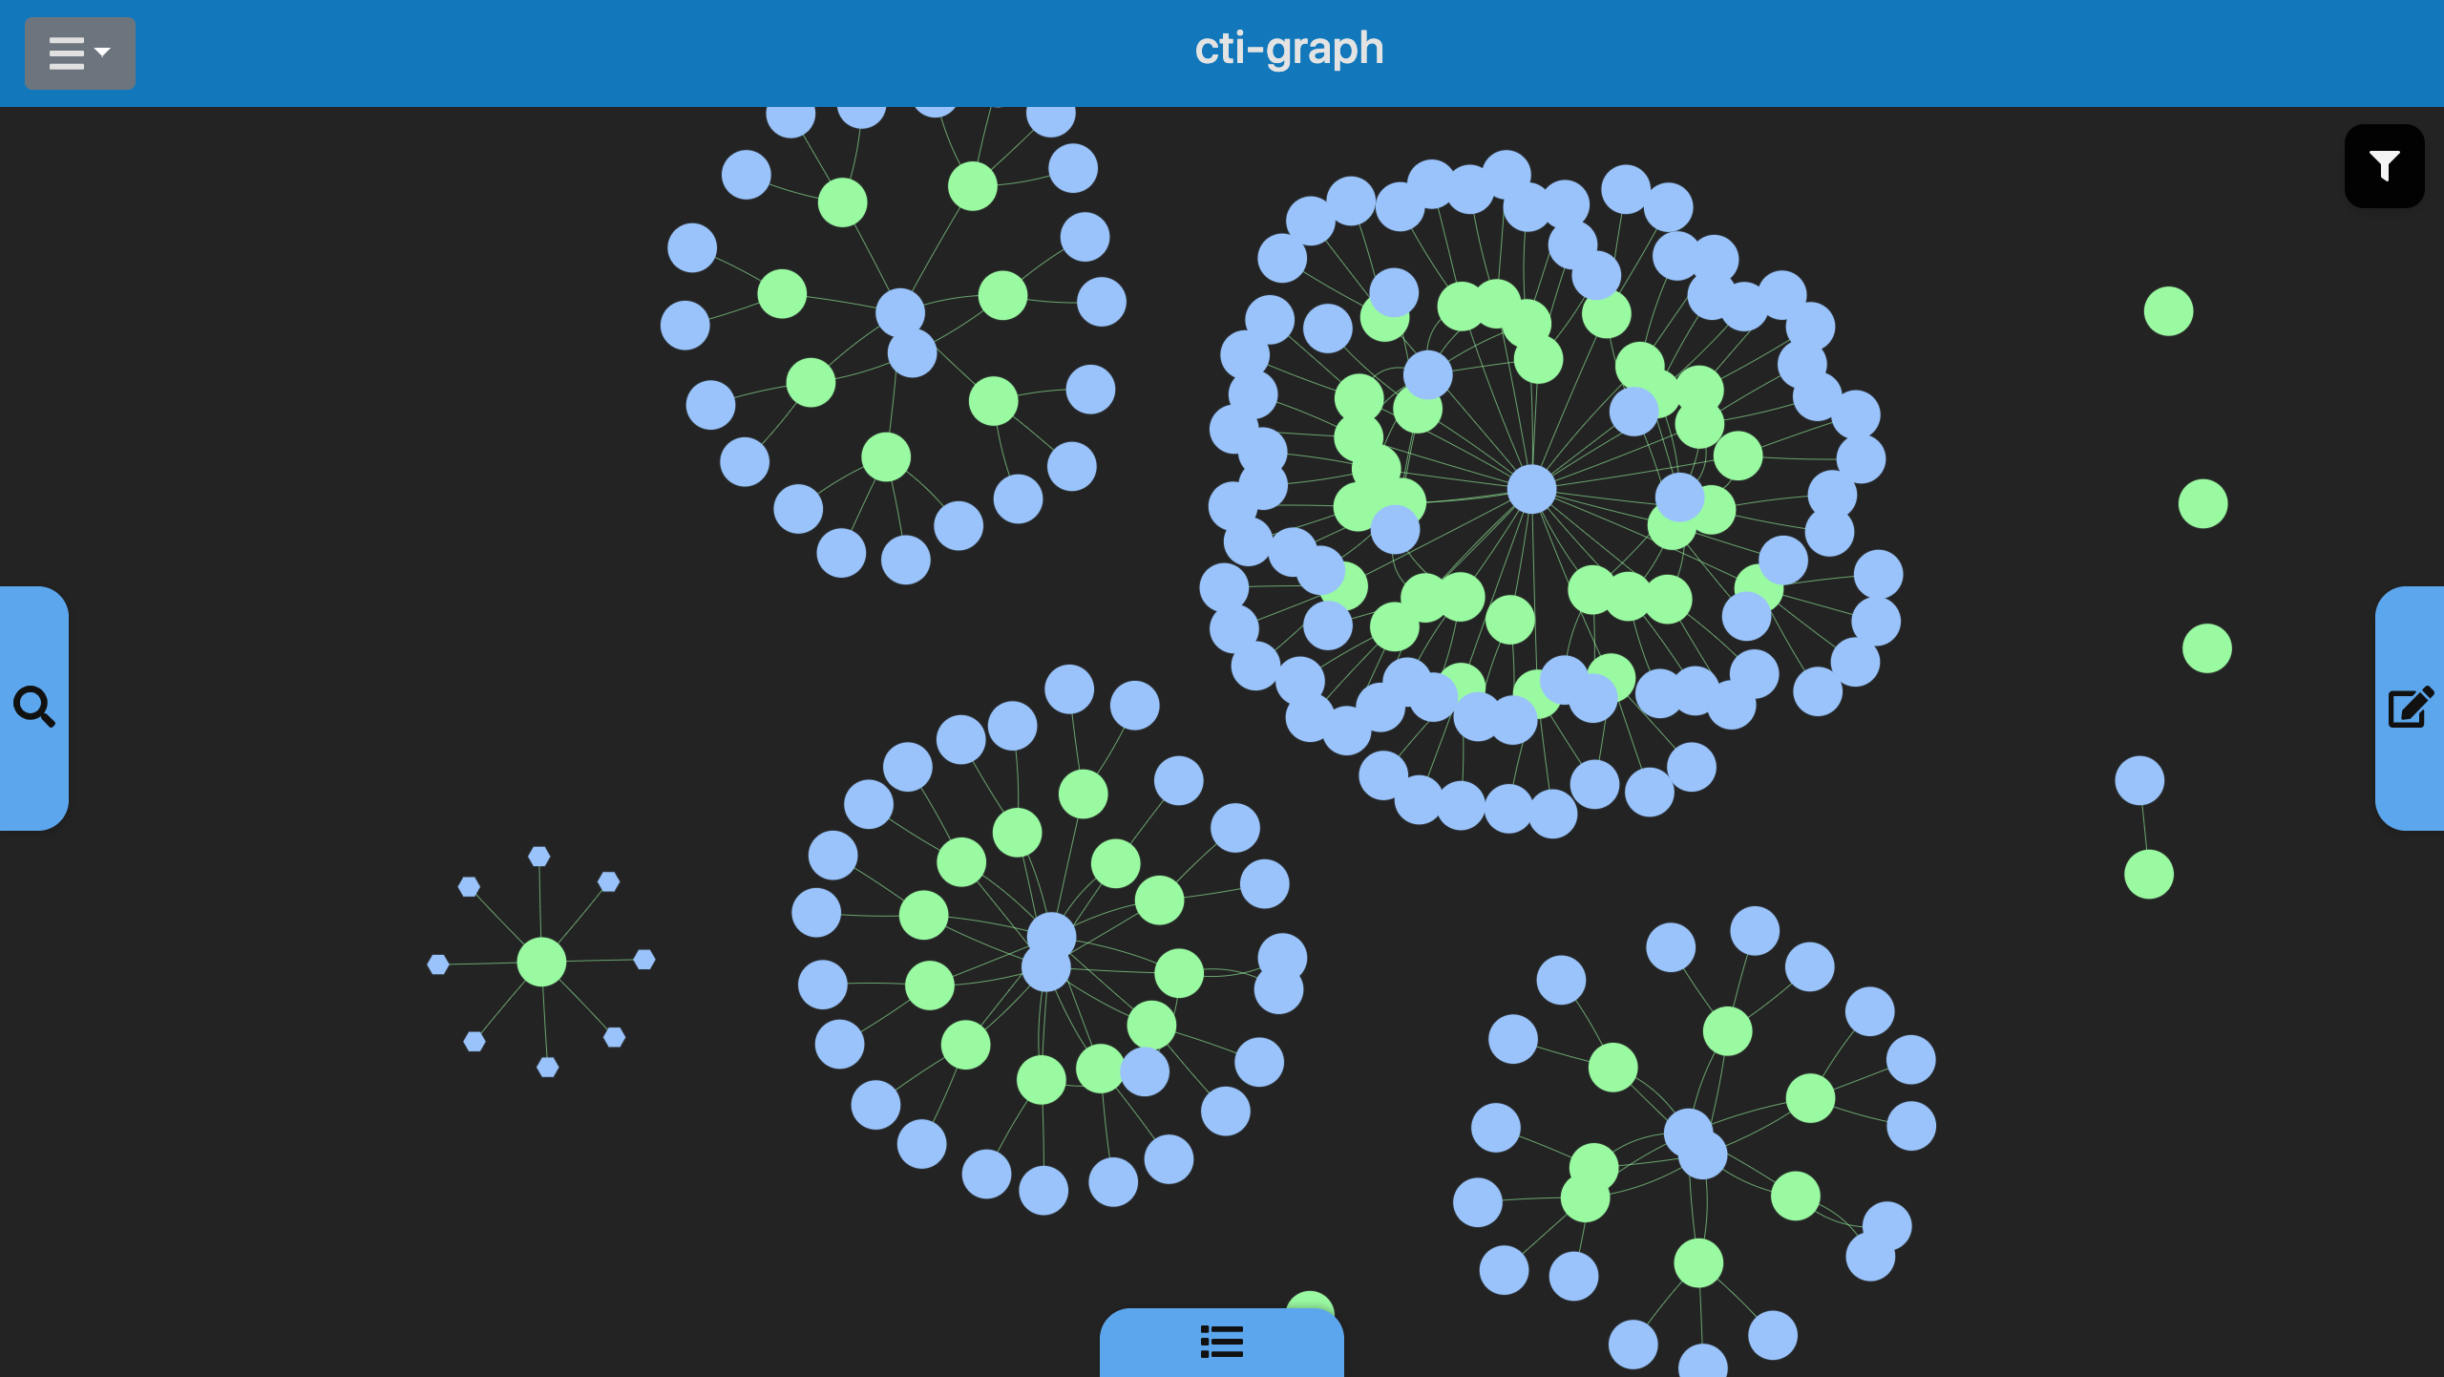

Slide 16
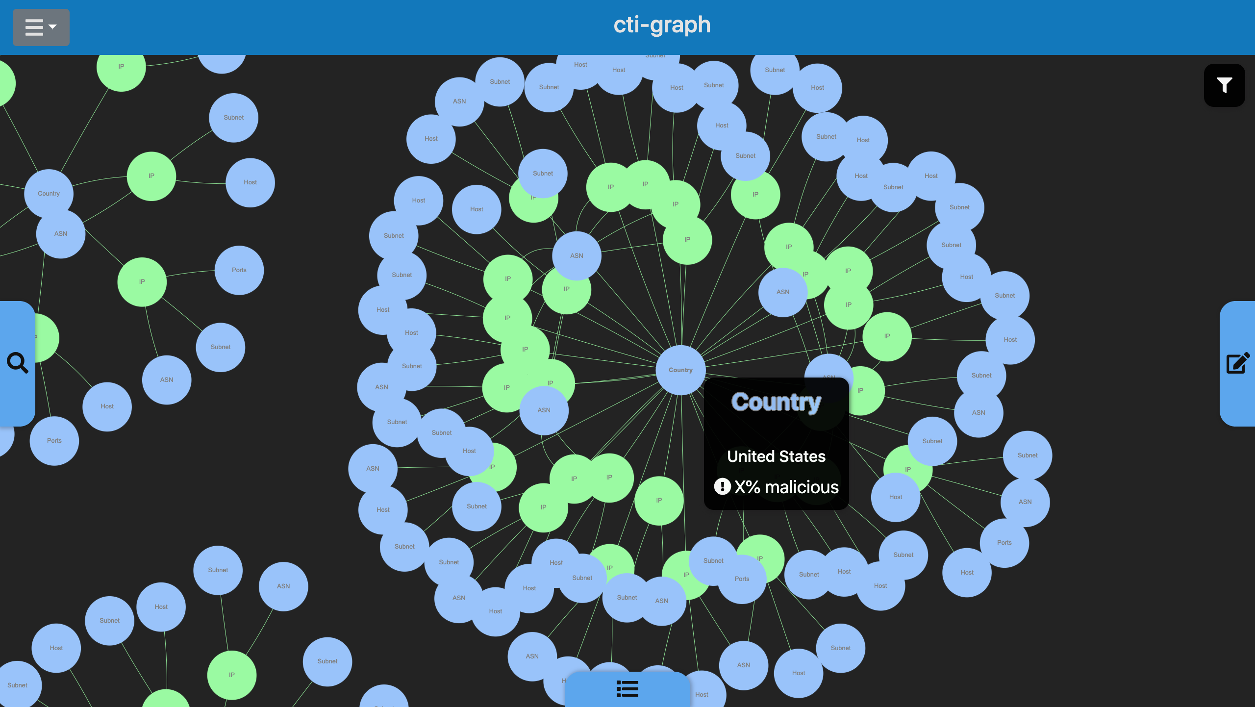

Slide 17
Who is this for?
Cybex-P team
Validate and test backend platform
Researchers
Analyze relationships and trends
Cybersecurity engineers (governments, businesses)
Identify the biggest threats to critical assets

Slide 18
Thank you
Questions?

