Slide 1
IWPS
CS 620 Project
By: Hudson Lynam

Slide 2
What Is it?
Immersive World Progressive System (IWPS)
A New Paradigm
Enhances narrative experiences through increased immersion
How?
Notes:
New paradigm for design and development for narratives

Slide 3
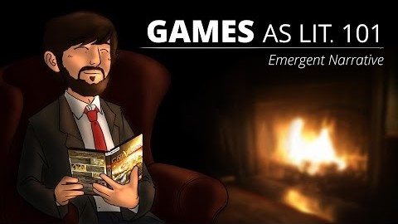
How does it work?
Changes elements of fictional worlds over time
Allows for emergent narratives
Notes:
Our reality changes, so to should fictional worlds

Slide 4
How Does IT Work? --Con’t
3 basic parts to the system:
  Elements (Fairy Town, John the Merchant, Fire Nation)
  States (Happy, Prosperous, Unhappy, Threatened)
  Variables (Income, Security Level)
Elements have at least two States and one Variable associated with them
Variables can affect other variables—Variable Links
Notes:
Examples of changes based on states

Slide 5
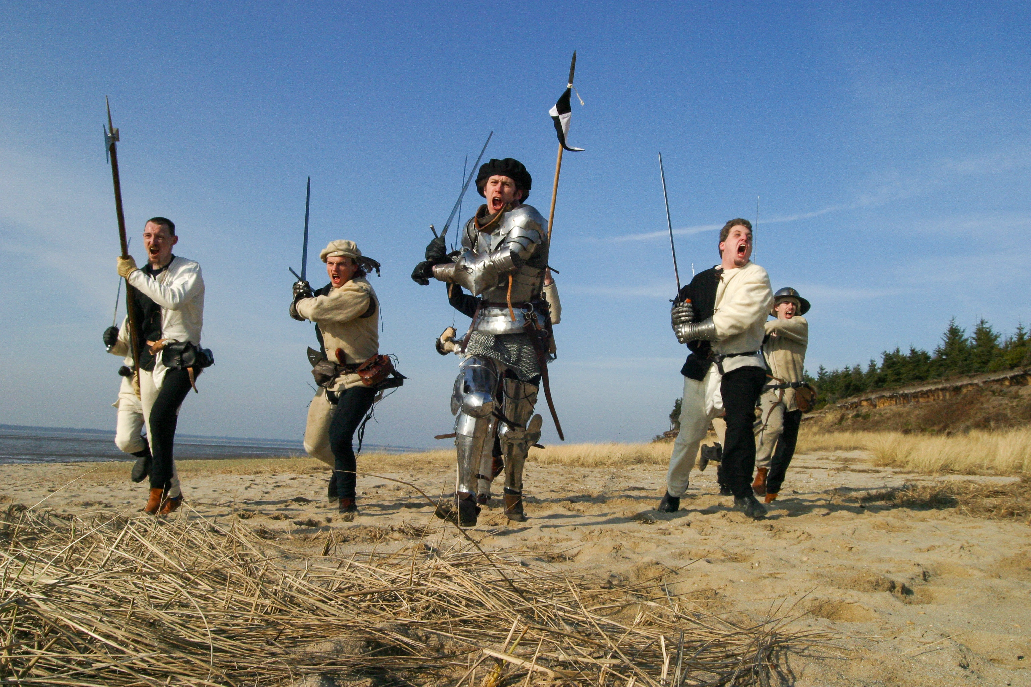
Scenario: Adventurer
We’ve got to save the town!
Notes:
Adventurer tries to save a town from bandits.

Slide 6
Scenario: Adventurer
The Town (Element) has a low Security Level (Variable) which drew bandits to it (Threatened State)
Adventurers/Players/Hero eliminates the bandits which increases the Security Level, which is linked to the Income variable
Time passes, the Town’s State updates to Happy and Prosperous based on Variable values (Income increases too due to Variable Link)

Slide 7
Target Users
Video Game Developers (Prototyping Narratives, Embedding)
Writers (Time-Skips, Testing Narrative Fidelity)
Dungeon/Game Masters (Managing Elements, Simulating Time Passage)

Slide 8
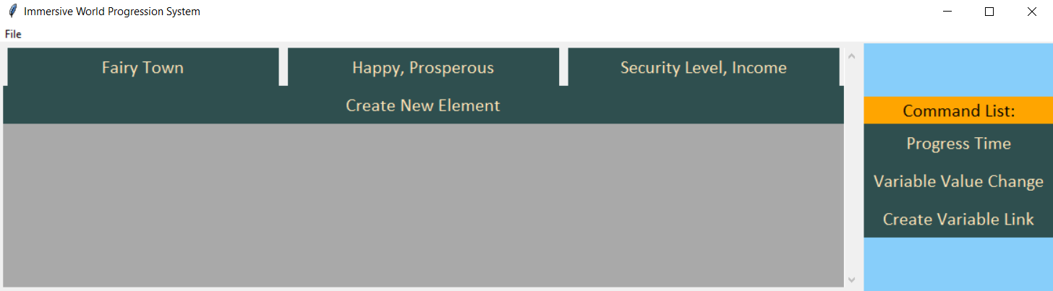
Implementation Details
Python
Tkinter
Main GUI Display

Slide 9
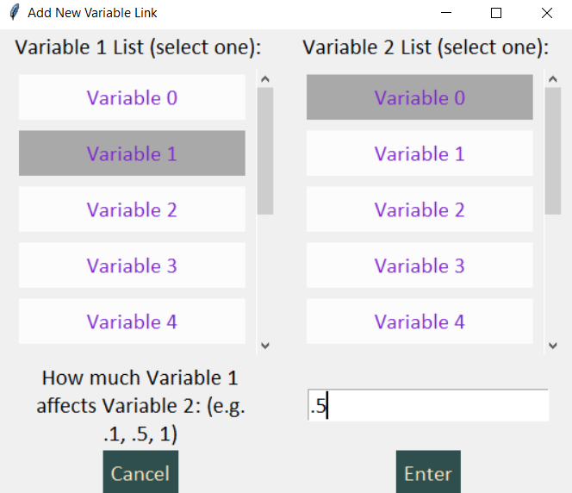
Implementation Details—Con’t
Adding New Variable Link Display

Slide 10
Why I Chose this
Love fictional worlds that make sense
Emergent narratives emphasize player choice
Requires planning, but could reduce development work in long term

Slide 11
Questions?

