Slide 1
Reading application:
Evereading

Slide 2
Overview
Why Evereading
What is required
What I have now
What is more

Slide 3
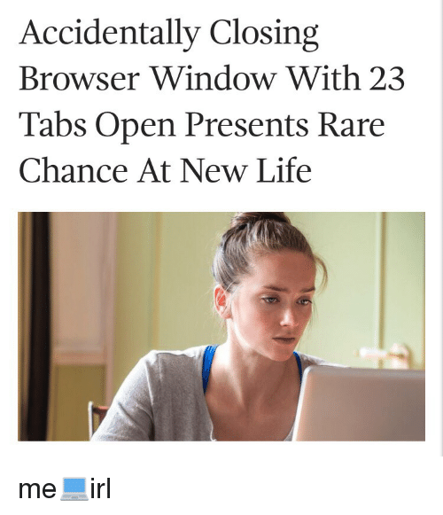
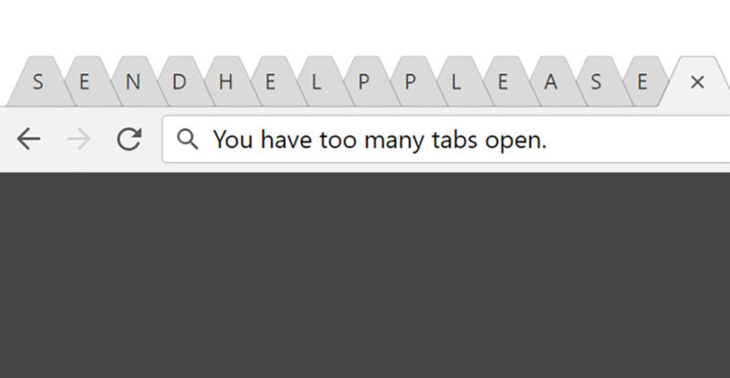
My Browser

Slide 4
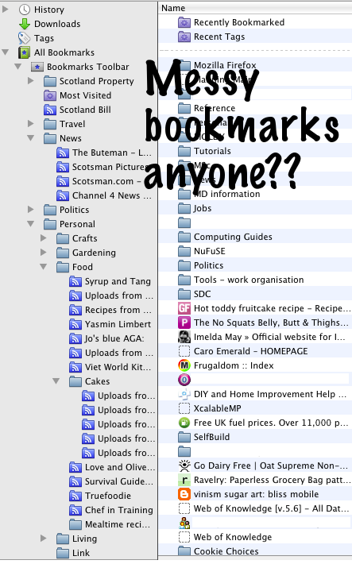
Other problems

Slide 5
Why Evereading
Too many tabs, messy bookmarks, Website design of a wide variety, annoying ads or phishing stuff
Too many unnecessary information(images, similar article, other like XXX also)

Slide 6
Why Evereading - existing apps
Safari: Reader view
iOS
MacOS
Chrome: Reader view extension

Slide 7
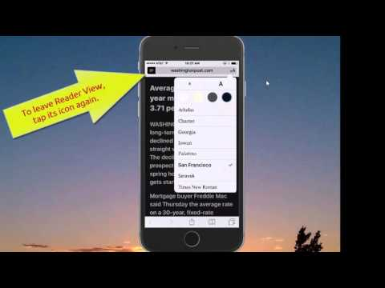
Why Evereading - Safari on iPhone/iPad
Notes:
https://www.youtube.com/watch?v=fIhzv143opk

Slide 8
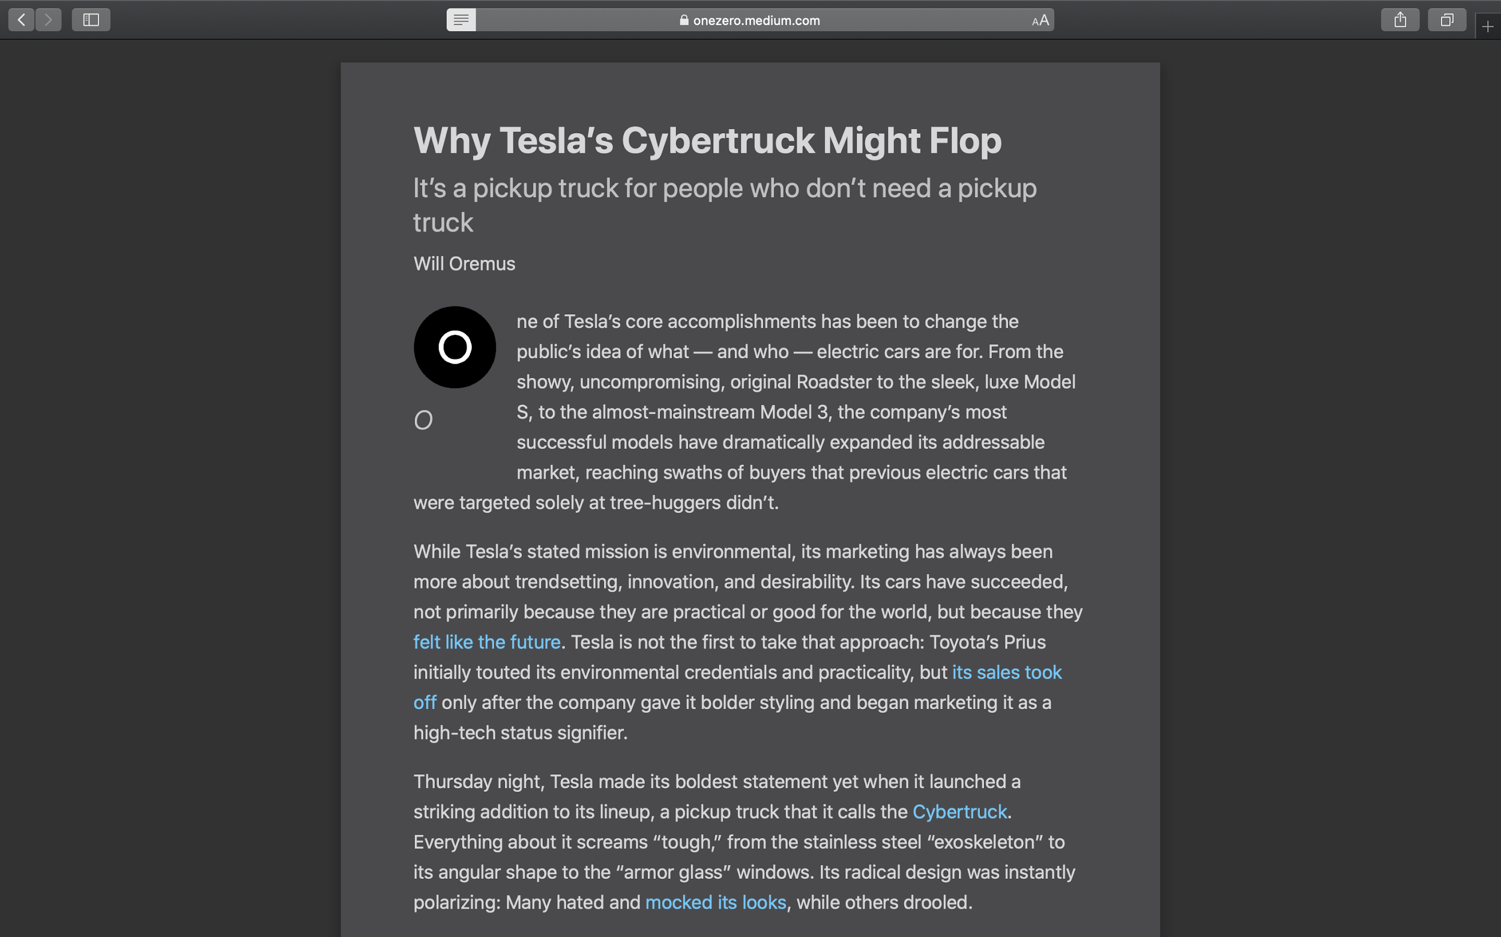
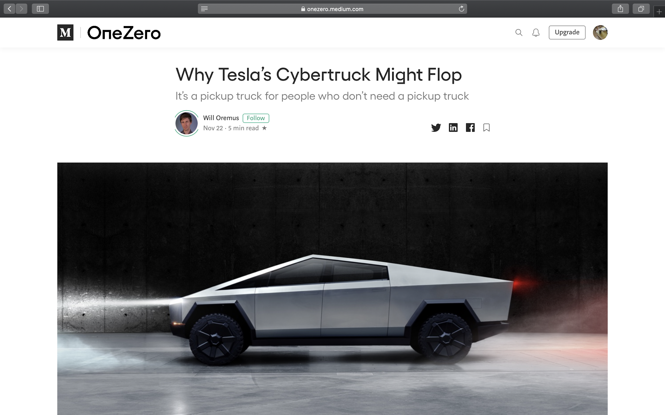
Why Evereading - Safari on Macbook/iMac
Notes:
https://www.youtube.com/watch?v=fIhzv143opk

Slide 9
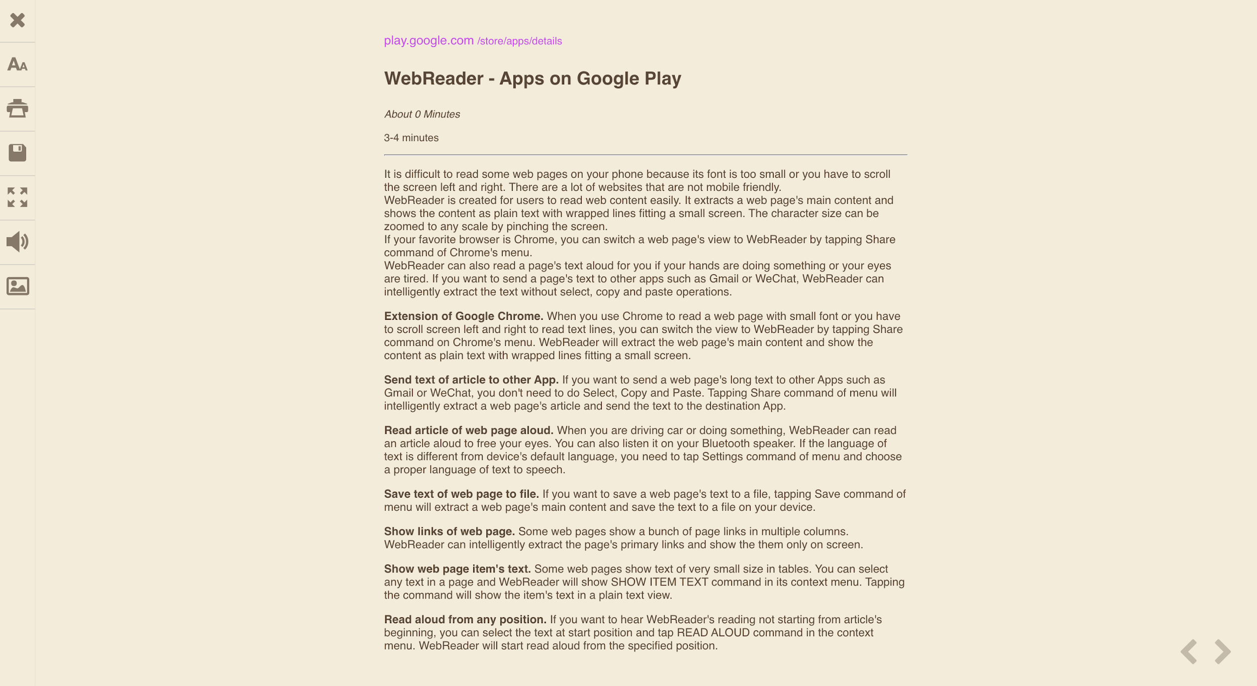
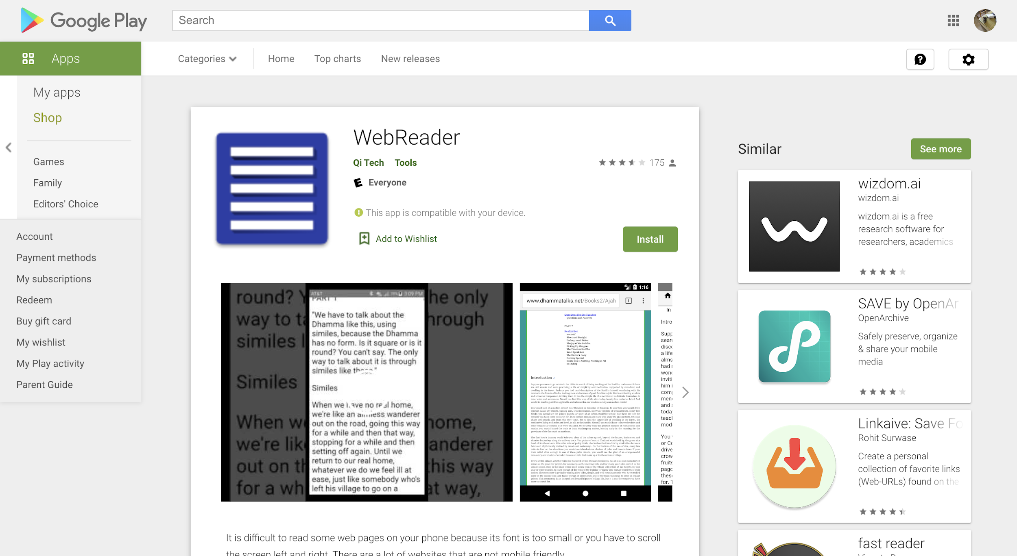
Why Evereading - Chrome extension

Slide 10
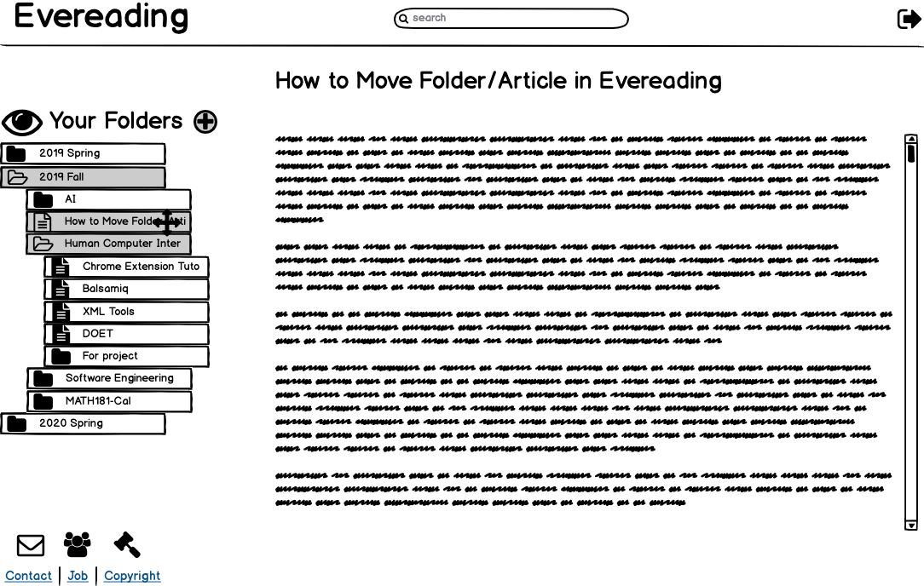
Evereading - mockup
Reading view
Search
Folder
Fig. 1 Reading view

Slide 11
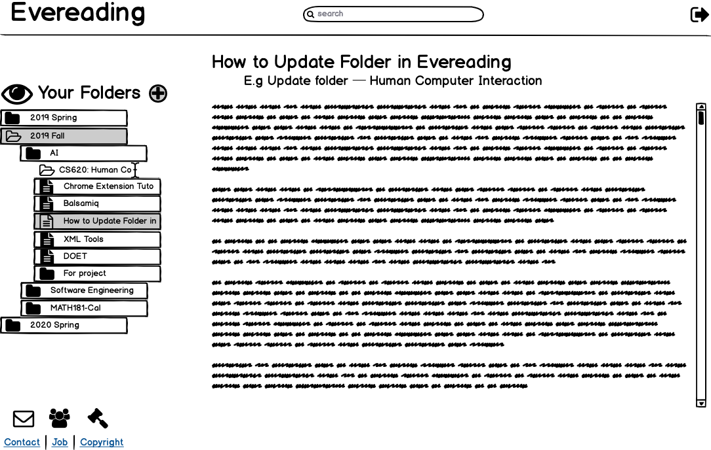
Evereading - mockup
Reading view
Search
Folder
updates
Fig. 1 Reading view

Slide 12
What is required
API
Reader view
Mercury-parser

Slide 13
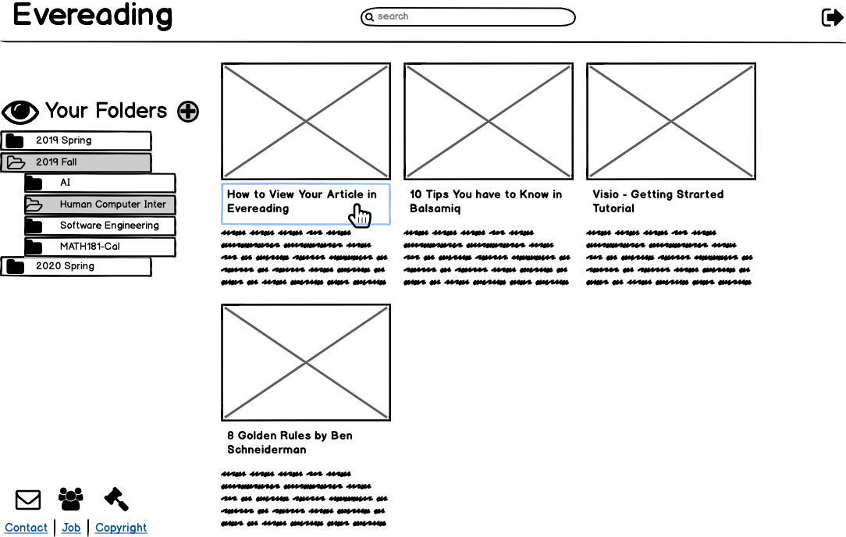
What is required
2. Good Interface
Design concise interface: eliminate “recommended” & “related”
Remove unnecessary information: remove ads
Improve readability
Familiar formatting style
Intuition manipulation
Fig. 2 Homepage

Slide 14
What I have now
Clearly
Evereading
Fig. 2 Homepage

Slide 15
What is more
More options
Font style
Size
Background color
“Better” Interface
Principles
Experience
Research

Slide 16
Thanks!
Question time

