Slide 1
ECLIPSE IDE
Name: Ashok Padmaraju
Course: Topics on Software Engineering
Instructor: Dr. Sergiu Dascalu

Slide 2
What is an ide ?
Integrated Development Environment or Interactive Development Environment.
A software application that is used for Software Development.
E.g. : CodeLite for C/C++, Android Studio for building Android apps, Xcode for OS X and iOS and many more
Has inbuilt compiler, interpreter or both.
Some special functionalities like Version Control System, Graphical User Interface etc.
Open source IDEs with free distribution
E.g. : IDLE (Python GUI), Android Studio, NetBeans etc.
Proprietary IDEs
E.g. : Flash Builder for ActionScript, Microsoft Visual Studio, LispWorks for Lisp etc.
Cross-Platform IDEs
E.g. : NetBeans C/C++ Development pack, CodeLite, Eclipse etc.

Slide 3
ECLIPSE IDE - Introduction
One of the mostly used IDEs available for programming in different languages.
E.g. : JAVA, HTML, PYTHON, PERL, COBOL etc.
Eclipse SDK is open source software and freely available online.
https://www.eclipse.org/downloads/
Eclipse Foundation is developing and producing different versions of Eclipse IDE.
Most recent version is Eclipse Luna 4.4.1.
Older versions released are Austin 3.0, Bravo 3.1, Indigo 3.7, Kepler 4.3 etc.
Future release is Mars 4.5
Eclipse Public License.

Slide 4
More…..
Eclipse supports coding in multiple languages in single package.
E.g. : JavaScript in HTML, CSS in HTML etc.
Runs on Windows, Linux, Max OS and Solaris.
Supports extensions and third party plug-ins after installation.
E.g. : Android application development with the help of ADT plug-in.
Supports other functionalities for clean code.
E.g. : Auto formatter, Syntax checking, Spell check, Debugging etc.
Supports Concurrent version systems that are provided by third party plug-ins.
E.g. : GitHub Mylyn Connector
Supports program debugging tools.

Slide 5
Eclipse Desktop IDEs
Eclipse IDE for Java Developers.
Eclipse Java Development Tools
Eclipse XML Editors and Tools
Code Recommenders tools for Java Developers
Eclipse Git Team provider
Eclipse IDE for Java EE Developers.
Data Tools provided
Eclipse Java Development Tools
Eclipse Java EE Development Tools
JavaScript Development Tools
Eclipse Plug-in Development Environment
Eclipse IDE for C/C++ Developers.
C/C++ Development Tools
Eclipse Git Team Provider
Mylyn Task List
Remote System Explorer
Eclipse IDE for PHP Developers.
PHP Development Tools (PDT)
Eclipse XML Editors and Tools
Mylyn Task List
Eclipse Git Team Provider
Eclipse Web IDE
Orion
Online IDE
Need access to cloud
Compatible with Mobile web browsers

Slide 6
Eclipse Projects & Integrations
Language Tools :
Lua Development Tool (LDT)
C/C++ Development Tool (CDT)
Object Teams
Modeling Tools :
Business Process Model and Notation
Xpand
Requirements Modeling Framework
Eclipse Generation Factories
Acceleo
Testing Tools :
SWTBot
RCP Testing Tool
Test and Performance Tools Platform
Other Tools
Mylyn Task Focused Interface
Java Workflow Tooling
Subversive – SVN Team provider
Voice Tools project for IVR voiceXML
Visual Editor for XML
Eclipse Git Team Provider
Mobile Tools for Java
Cloud Application Management Framework
Third party Eclipse plug-ins
Android
Google Web ToolKit
PyDev
Eclipse Visual Editor

Slide 7
Eclipse Workbench Loading

Slide 8
Eclipse IDE

Slide 9
Internal Web Browser

Slide 10
Orion Web IDE

Slide 11
Syntax checking, Spell checking

Slide 12
Auto formatter

Slide 13
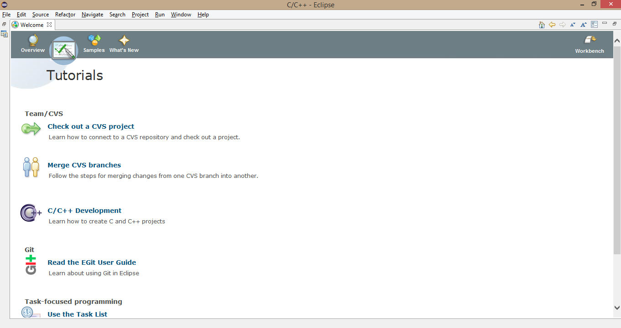
Tutorials

Slide 14
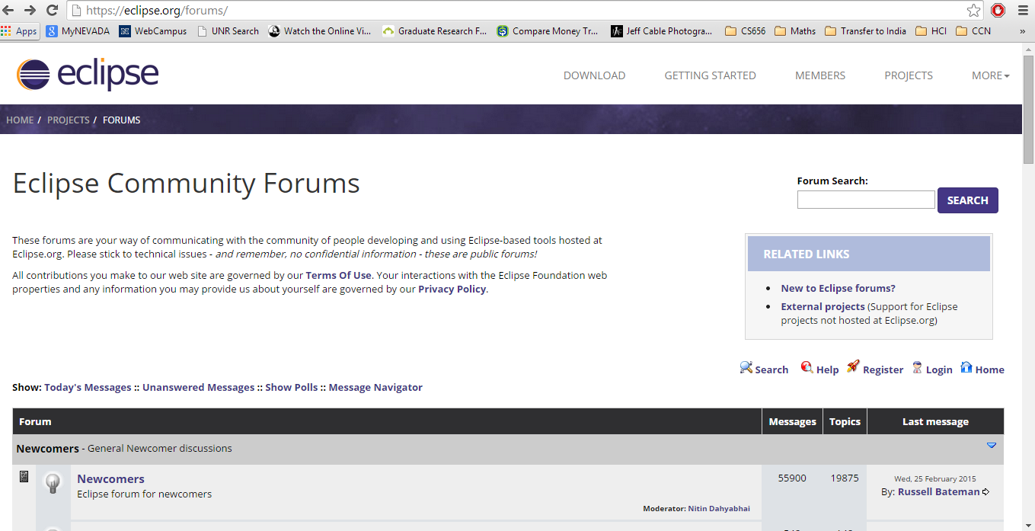
Eclipse Community Forum

Slide 15
Pros Cons
Performance
Multi-language support
Tutorials
Cross-platform support
In-built compiler and interpreter
Community forums
Integrations and Plug-in support
User Interface
Open Source (I like it)
Task Scheduler
In-built Debugger
And many more…..
Some Open Bugs
Crashes very rarely
Large installation folder
May be few more(that I don’t know)…

Slide 17
Thank you
Questions ?

