Slide 1
Big Data Workflows
Name: Ashok Padmaraju
Course: Topics on Software Engineering
Instructor: Dr. Sergiu Dascalu

Slide 2
Introduction to Big Data workflows
“Big Data” is a broad term for datasets that are so large or complex.
“Workflows” are the task oriented and often require more specific data than process.
A “Process” is designed on a higher level scenarios that helps for decision making in organizational level.
Big Data workflow is best illustrated in comparing traditional IT workloads with Big Data workloads.
  Big Data workloads may require many servers to run one application whereas traditional IT workloads requires one server to run many application.
  Big Data workloads run to the completion and traditional IT workloads run forever.
Notes:
1. Traditional data processing applications are inadequate.

Slide 3
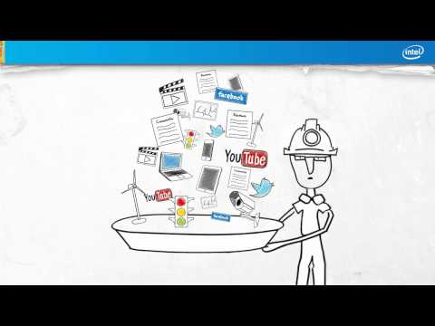
How Big Data Makes Big Impacts
https://www.youtube.com/watch?v=D4ZQxBPtyHg

Slide 4
Characteristics: (5Vs and 1C)
Volume:
  Amount of data that is being generated is increasing drastically every day.
  Size of the data determines the value and potential of the data and whether it can be considered as Big Data or not.
Velocity:
  In this context refers to the speed of generation of data
  How fast the data being generated is processed to meet the demands.
Variety:
  Different formats of data
  E.g. Documents, Emails, Videos, Images, Audio, Machine logs, Sensor generated data etc.

Slide 5
Variability:
  How consistent is the data in terms of availability or interval of reporting.
  Refers to the inconsistency of data available at times.
Veracity:
  The quality of the data that is being captured can vary greatly.
  Accuracy of the analysis depends on the veracity of the source data.
Complexity:
  Data management can be very complex process, especially when large volumes of data come from multiple sources.
  These data needs to be linked, connected and correlated in order to be able to extract information from the data.

Slide 6
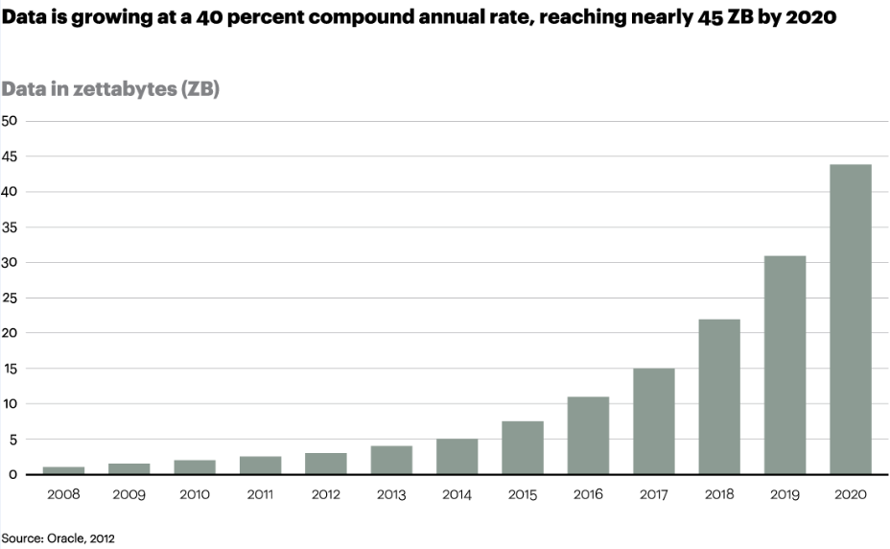

Slide 7
Big Data Software Tools:
Platform:
  Apache Hadoop
  SAP HANA etc.
Business Analytics:
  JasperSoft BI Suite
  Pentaho Business Analytics
  Karmasphere Studio and Analyst
  Talend Open Studio etc.
Databases/Data Warehouses:
  Cassandra- NoSQL Database developed by Facebook
  HBase- Apache project
  Hive- Hadoop’s data warehouse etc.
Notes:
GridGain is an alternative to Hadoop’s MapReduce. “Storm” is owned by Twitter

Slide 8
Big Data Software Tools:
Data Mining:
  RapidMiner
  Orange
  KEEL
  SPMF etc
Software programming and framework:
  R- Statistical Software
  Python
  Julia- Expensive language, faster than R, fairly easy to learn
  Hadoop and Hive
  Java
  SCALA- Java based language for building high-level algorithms
  KAFKA and STORM

Slide 9
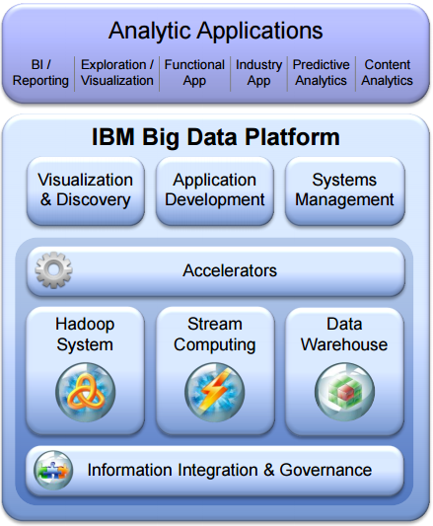
Figure: IBM Big Data Platform (Source: IBM Research)
Notes:
architecture of IBM Big Data platform which helps in Integrating and managing the full variety, velocity and volume of data, to apply advanced analytics to information

Slide 10

Intel Distribution for Apache Hadoop
https://www.youtube.com/watch?v=82qJvYq0lIE

Slide 11
Challenges:
Data Challenges:
  Dealing with the size of big data.
  Handling multiplicity of types, sources and formats.
  Reacting to the flood of information in the time required by the application.
  Handling uncertainty in data quality, data availability.
  How timely are the readings.
  Finding high quality data from the vast collections of data.
  Scalability in generating the data.
Notes:
All of these data challenges combined to create a STORM of challenges and opportunities to create much cheaper, faster and better solutions for big data than that of traditional approaches that are currently available.

Slide 12
Process Challenges:
  Analyzing the data.
  Finding the right model for analysis.
  Ability to iterate quickly.
  Deriving insights in capturing data.
  Aligning data from different source.
  Transforming data into suitable form for analysis and modeling it.
Management Challenges:
  Related to Data privacy, Security, Governance and Ethical issues.
  Ensuring that data is used correctly.
  Tracking how the data is used, transformed and derived.
  Managing its lifecycle.

Slide 13
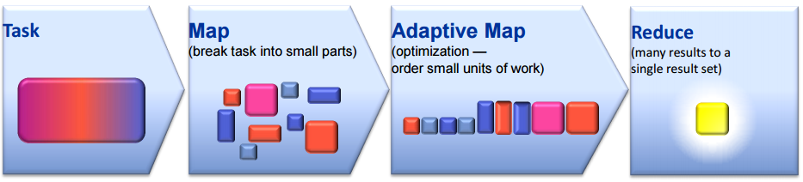
Workload Optimization in Big Data
A task is divided into several subtasks.
Use Map step to break the task into several smaller tasks and index for processing.
Optimization-Order small units of work
Use Reduce step will fetch many results to a single result set.
Figure: Steps to optimize performance of Big Data workloads (Source: www.nist.gov)
Notes:
Different approaches are being followed by different organizations.

Slide 14
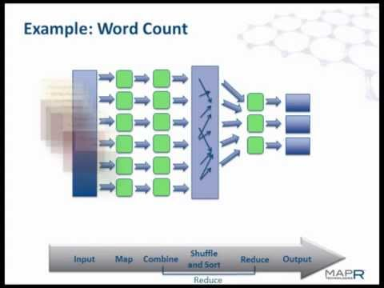
MapReduced Explained
https://www.youtube.com/watch?v=HFplUBeBhcM [3:15 - 8:00]

Slide 15
Application areas for Big Data:
Private Sector
  Retail- E.g. Walmart, BestBuy, Target.
  Retail Banking- E.g. Bank of America, Wells Fargo, Citi Bank.
  Real Estate- E.g. Windermere Real Estate.
  Science and Research- E.g. NASA.
Manufacturing
Government
Financial sector
Technology
  Social Networking- E.g. Facebook, LinkedIn, Twitter etc.
  Electronic Commerce- E.g. eBay, Amazon
  Internet Of Things.
Notes:
Retail: Walmart handles more than 1 million customer transactions every hour. Manufacturing- Product quality/defect tracking, supply planning etc.

Slide 16
Briefly explain the challenges in Big Data
Describe the characteristics of Big Data. (5Vs & 1C).
What are the major application areas for Big Data?

Slide 17
Questions ?

Slide 18
Thank you

