Slide 1
git --fast-version-control
Alex Yovev

Slide 2
What?

Slide 3
Git is a free and open source distributed version control system designed to handle everything from small to very large projects with speed and efficiency.
Git is easy to learn and has a tiny footprint with lightning fast performance. It outclasses SCM tools like Subversion, CVS, Perforce, and ClearCase with features like cheap local branching, convenient staging areas, and multiple workflows.
— git-scm.com

Slide 4
Why?

Slide 5
The Git feature that really makes it stand apart from nearly every other VCS out there is its branching model.
Git allows and encourages you to have multiple local branches that can be entirely independent of each other. The creation, merging, and deletion of those lines of development takes seconds.

Slide 6
Branching and Merging
Frictionless Context Switching
Role-Based Codelines
Feature Based Workflow
Disposable Experimentation

Slide 7
How?

Slide 8
Result

Slide 9
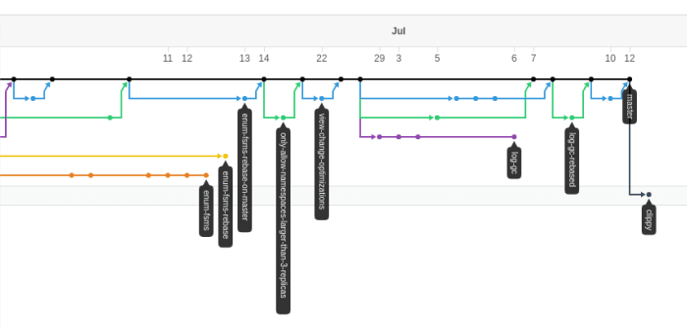
Git Network Graph

Slide 10
Thank You

