Slide 1
By: Amr Abdelhady
TensorFlow

Slide 2
What is TensorFlow?
TensorFlow is an end-to-end open source platform for machine learning.
It has a comprehensive, flexible ecosystem of tools, libraries and community resources that help in building and deploying ML powered applications.
TensorFlow was developed by the Google Brain team for internal Google use. It was released under the Apache License 2.0 on November 9, 2015.
The latest version is TensorFlow 2.0
Main Use Cases of TensorFlow
Voice/Sound Recognition
Text Based Applications
Image Recognition
Video Detection
Notes:
Text based applications such as sentimental analysis
This is mainly used in Motion Detection, Real-Time Thread Detection in Gaming, Security, Airports

Slide 3
Why Tensor flow?
Easy model building
TensorFlow offers multiple levels of abstraction.
Build and train models by using the high-level Keras API.
For large ML training tasks, we can use the Distribution Strategy API.
Robust ML production anywhere
Train and deploy your model easily, no matter what language or platform you use.
Use TensorFlow Extended for full ML Pipeline.
Use TensorFlow lite for running interface on mobile and embedded devices like Android, iOS, Edge TPU, and Raspberry Pi.
Use TensorFlow.js to train and deploy models in JavaScript environments
Powerful experimentation for research
Flexibility and control with features like the Keras Functional API.
For easy prototyping and fast debugging, use eager execution.
Supports an ecosystem of powerful add-on libraries and models to experiment with.
Notes:
API (Application program interface)
TensorFlow offers multiple levels of abstraction so you can choose the right one for your needs.
Keras is a high-level neural networks API, written in Python and capable of running on top of TensorFlow . It Allows for easy and fast prototyping
For large ML training tasks, we can use the Distribution Strategy API for distributed training on different hardware configurations without changing the model definition.
Distribution strategy to distribute training across multiple GPUs, multiple machines
Eager execution is a flexible machine learning platform for research and experimentation, providing: An intuitive interface—Structure your code naturally and use Python data structures.

Slide 4
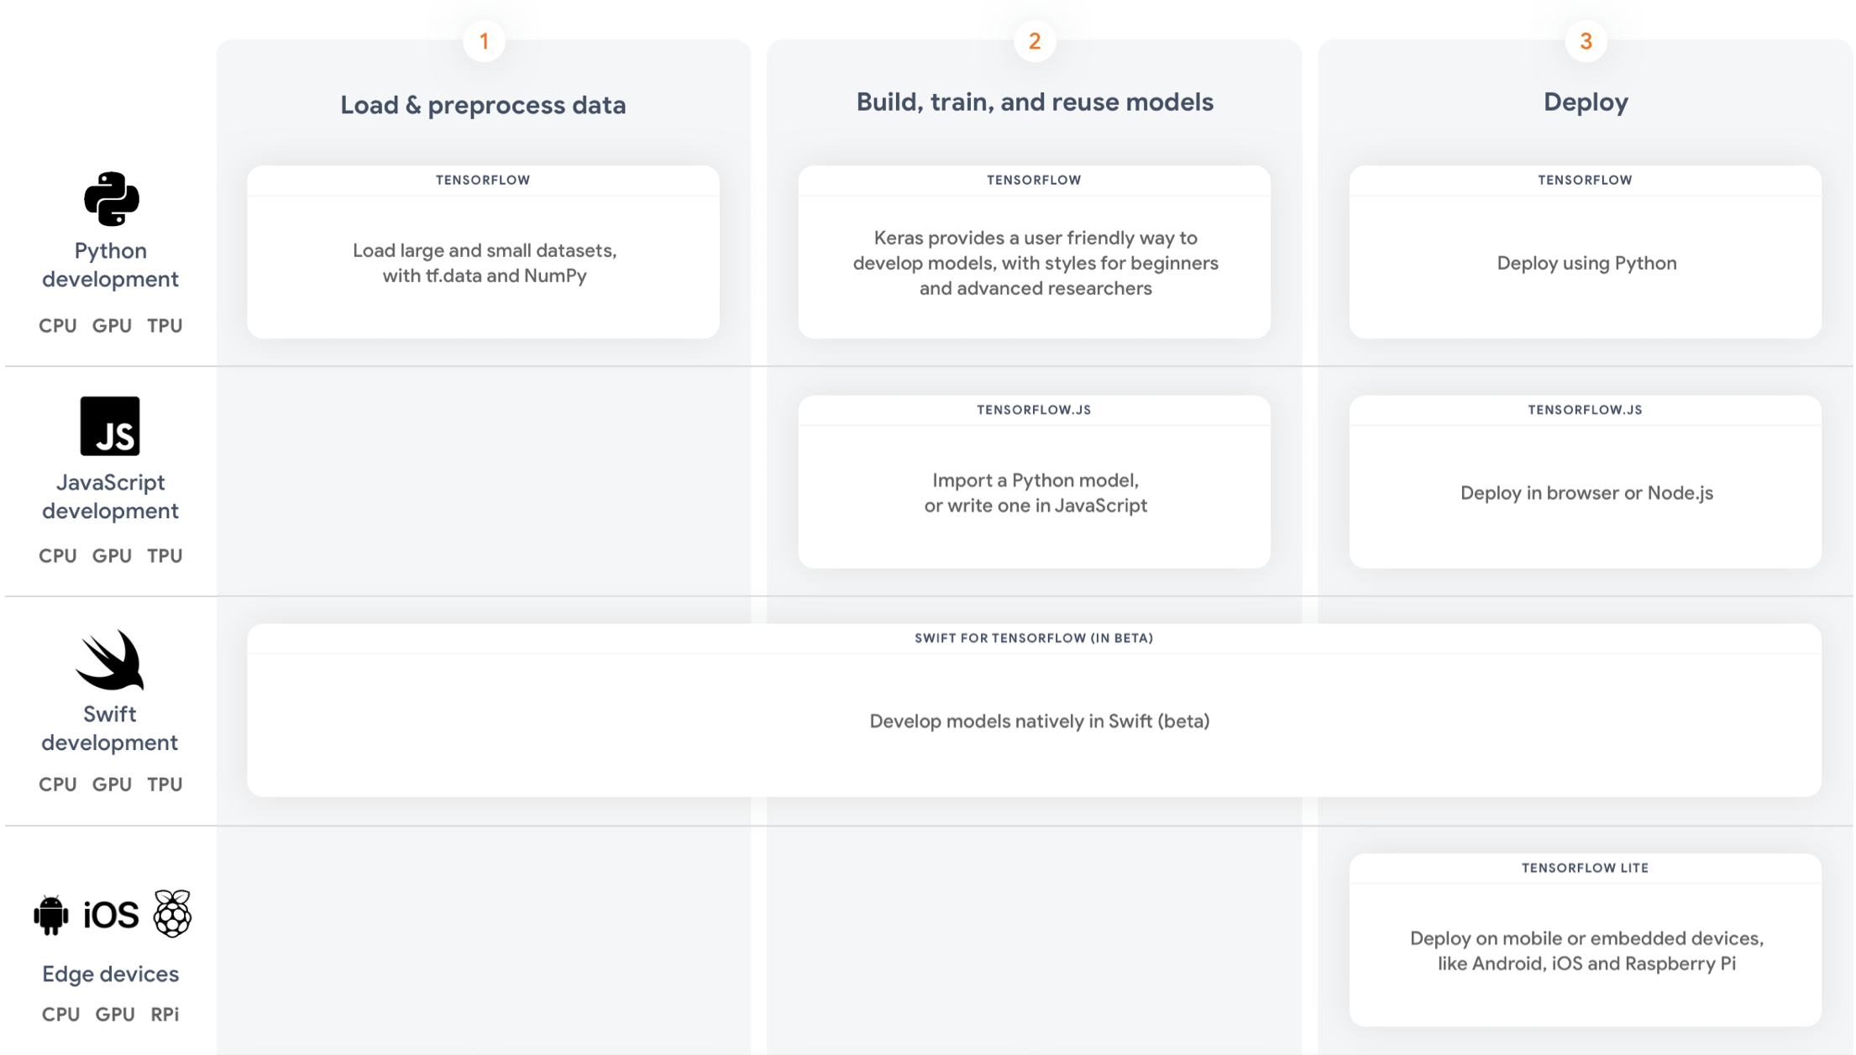
TensorFlow ecosystem
https://youtu.be/NlpS-DhayQA
Notes:
TensorFlow provides a collection of workflows to develop and train models using Python, JavaScript, or Swift, and to easily deploy in the cloud, on-prem, in the browser, or on-device no matter what language you use

Slide 5
Introduction to Machine Learning
Machine learning is the practice of helping software perform a task without explicit programming or rules.
A programmer specifies rules that the computer should use.
Programmers provide a set of examples and the computer learns patterns from the data “programming with data”.
Real-world ML focuses far more on data analysis than coding.

Slide 6
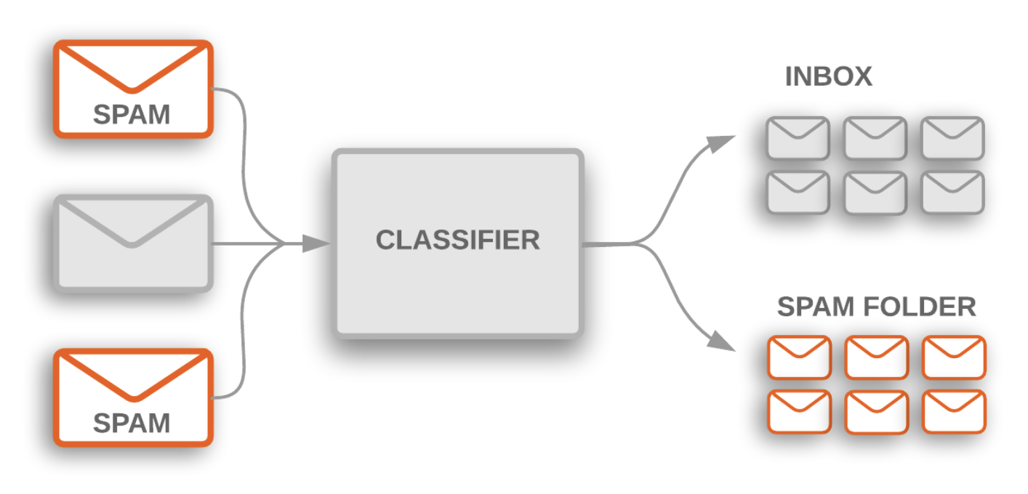
Solving an ML problem
Notes:
Email software uses text classification to determine whether incoming mail is sent to the inbox or filtered into the spam folder.
These are two examples of topic classification, categorizing a text document into one of a predefined set of topics. In many topic classification problems, this categorization is based primarily on keywords in the text.
Gather data : The more training examples (referred to as samples in the rest of this guide) you have, the better. This will help your model generalize better.
Explore the dataset by knowing what features does it have. In this example would be :
Number of samples
Number of classes
Number of samples per class
Number of words per sample
Supervised learning , since the training data you feed to the algorithm include the desired solution
naieve bayes classifier

Slide 7
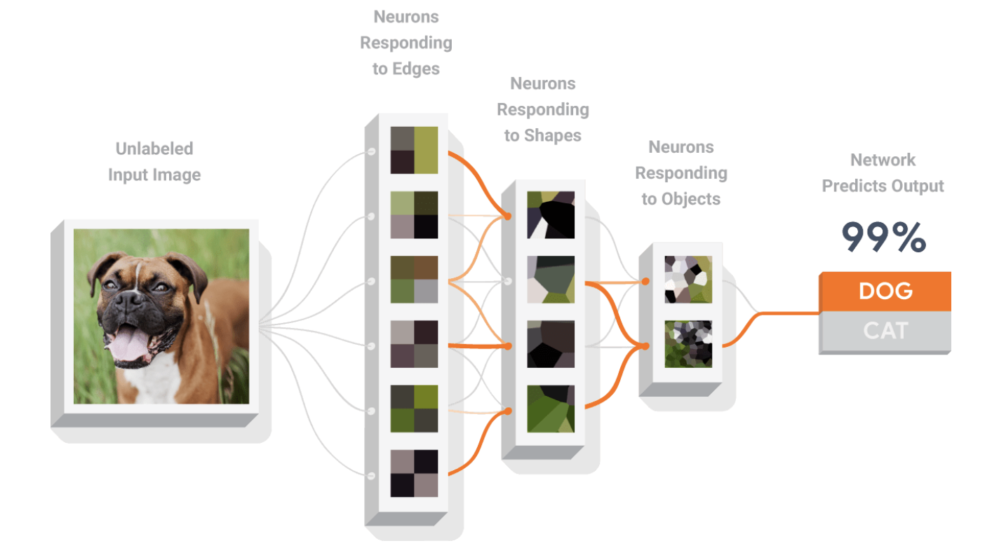
Anatomy of a Neural Network
A neural network is a type of model that can be trained to recognize patterns.
It is composed of layers, including input and output layers, and at least one hidden layer.
Neurons in each layer learn increasingly abstract representations of the data.
Notes:
hidden layer
A synthetic layer in a neural network between the input layer (that is, the features) and the output layer (the prediction). Hidden layers typically contain an activation function (such as ReLU) for training. A deep neural network contains more than one hidden layer.
activation function
A function (for example, ReLU rectified Linear Unit or sigmoid) that takes in the weighted sum of all of the inputs from the previous layer and then generates and passes an output value (typically nonlinear) to the next layer.
For example, in this visual diagram we see neurons detecting lines, shapes, and textures. These representations (or learned features) make it possible to classify the data.

Slide 8
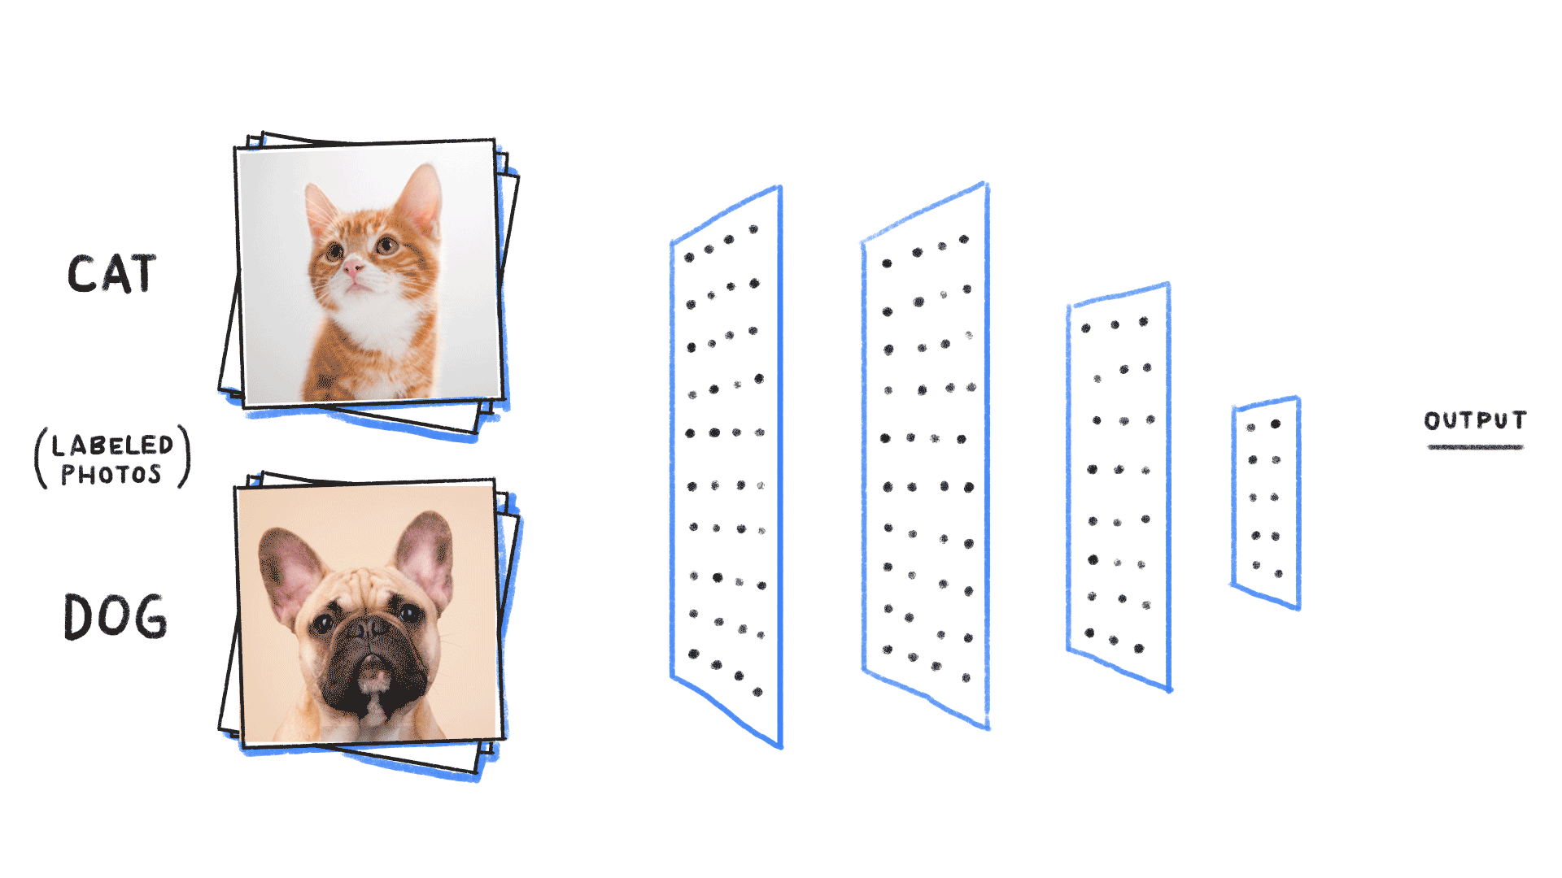
Training a Neural Network
Neural networks are trained by gradient descent.
The weights in each layer begin with random values, and these are iteratively improved over time to make the network more accurate.
A loss function is used to quantify how inaccurate the network is, and a procedure called backpropagation is used to determine whether each weight should be increased, or decreased, to reduce the loss.
Notes:
The process of training a neural network is to determine a set of parameters that minimize the difference between expected value and model output. There are two steps: calculating gradients of the loss/error function, then updating existing parameters in response to the gradients, by using the back propagation.

Slide 9
Companies using TensorFlow

Slide 10
Examples
Airbnb
Improves the guest experience by classifying the images and detecting objects at scale.
Twitter
Ranking Tweets to ensure that users don’t miss important tweets even if they follow thousands of users.
Airbus
Monitor changes to the earth’s surface for urban planning, fighting illegal construction and mapping damage and landscape changes caused by natural catastrophes.
Notes:
There are videos to put

Slide 11
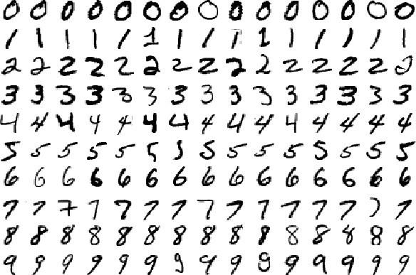
Simple Example
https://colab.research.google.com/github/tensorflow/docs/blob/master/site/en/tutorials/quickstart/beginner.ipynb#scrollTo=7NAbSZiaoJ4z
Mnist dataset
Notes:
Show an example live on screen

Slide 12
My Experience
CS 791 Machine Learning Applications.
Breast Cancer diagnosis
The objective is to train classifier models on cancer cells characteristics dataset to predict whether the cell is Benign or Malignant using minimum set of features.
Dataset: University of Wisconsin dataset.

Slide 13
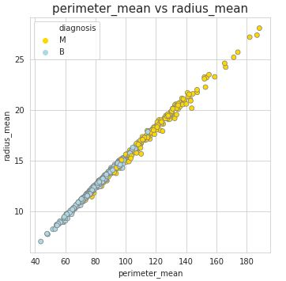
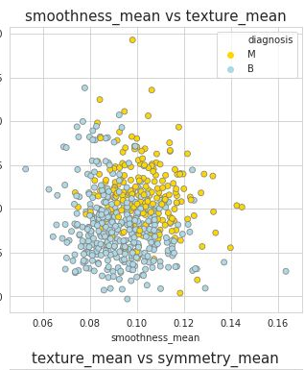
Methodology
Determine the features to use.
Detect outliers.
Apply and improve classifiers
KNeighbors Classifier
Bernoulli Naive Bayes
Random Forest Classifier
SVM
Notes:
Radius , Perimeter and Area are highly correlated.
Compactness, Concavity and concave point are highly correlated as well.
Selected Parameters will be Perimeter, Texture, Compactness , Symmetry.
Using the scatter plot:which is the simplest way to check relationship between two variables.
Lets look at relationship between radius mean and area mean. In scatter plot you can see that when radius mean increases, perimeter mean also increases. Therefore, they are positively correlated with each other.
There is no correlation between area mean and fractal dimension se. Because when area mean changes, fractal dimension se is not affected by chance of area mean

Slide 14
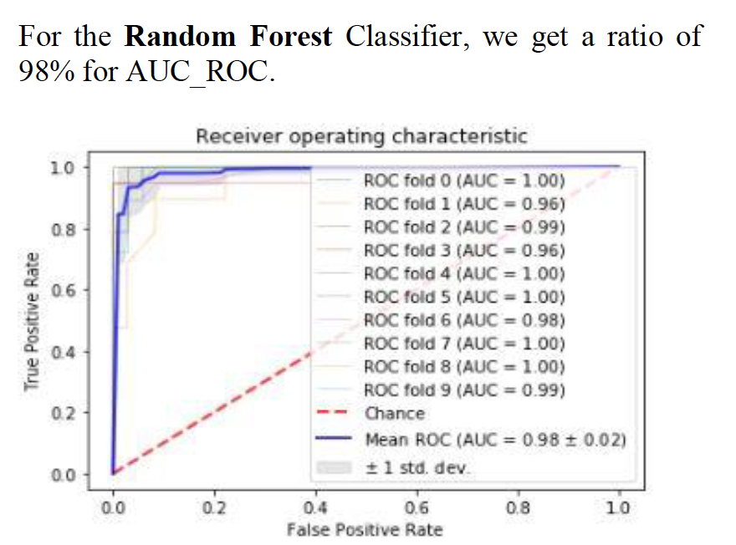
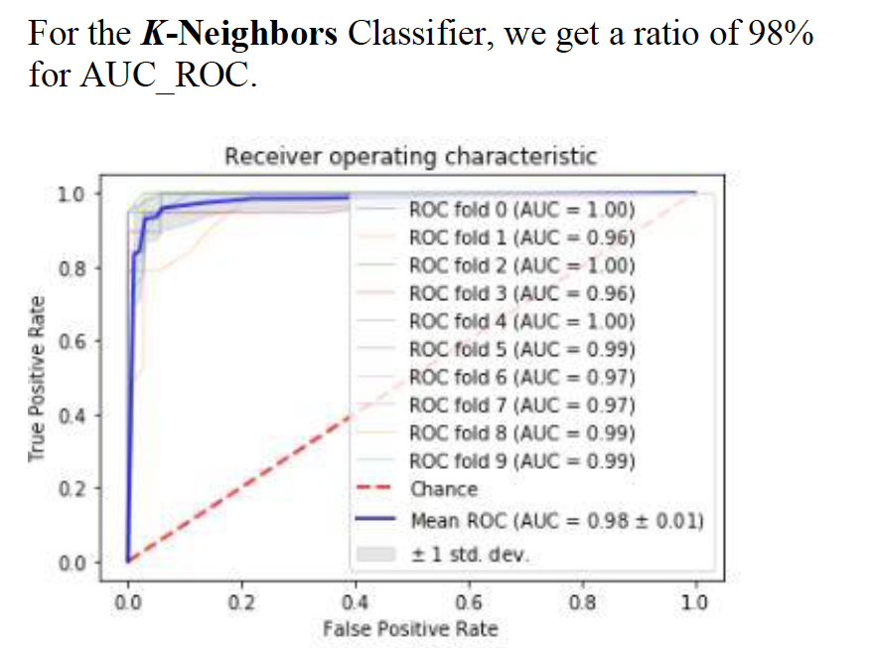
Results
Notes:
Results showed that when applying an approach of using a smaller number of features rather than using all the dataset's features Random Forest and k-neighbor performed well with an AUC_ROC of 98% and accuracy for confusion matrix of 95%.

Slide 15
Questions?
Thank you!

