Slide 1
CyberChef: swiss-army knife conversion tool
Presented By Andrew Flangas

Slide 2
Outline
What is it?
Where to access it?
How it works?
Using it to encrypt/decrypt data
Generate and analyze hashes
Using it as a testing tool
Other functionalities

Slide 3
What is CyberChef?
It is a web app used for carrying out all types of “cyber” operations
These operations include simple encoding like Hex, Base64, or XOR, as well as more complex encryption
Its main purpose is to allow both non-technical and technical analysts to manipulate data in countless ways without having to use advanced algorithms or tools.

Slide 4
Where to access it?
Its free and open-sourced!
You can instantly access it by going to https://gchq.github.io/CyberChef/
It can also be cloned on GitHub so it can be used without connection to the internet
Still in development on GitHub

Slide 5
How it Works?

Slide 6
Example
https://youtu.be/eqbTQpGSR7g?t=265

Slide 7
Using it to encrypt/decrypt data
Contains a large number of encryption/decryption tools
Can be combined into one recipe for more complex encryptions along with descriptions of each.
Some of the well known tools include AES, DES, Blowfish, Triple DES, RC2, as well as the Enigma encoder

Slide 8
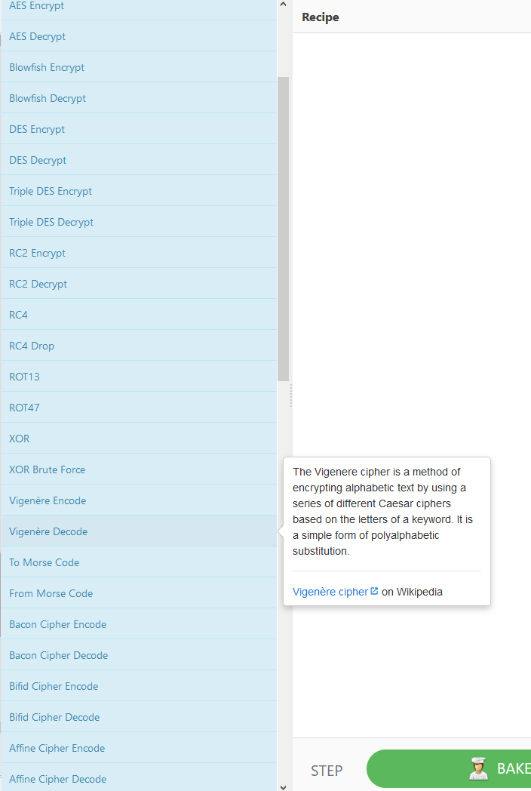

Slide 9
Generate and analyze hashes
Hash is a one-way encryption
Useful for storing user passwords on web applications
CyberChef offers a range of hashing algorithms to generate and analyze hashes
Useful to see which ones are easier to crack(MD5)

Slide 10
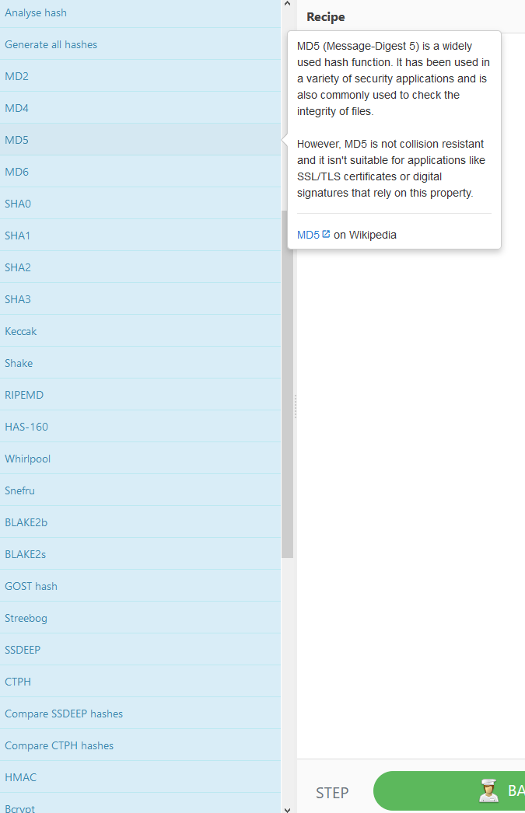

Slide 11
Using it as a testing tool
CyberChef is widely used for fields such as penetration testing and forensics
Is also useful for the overall strengthening of web applications
Offers a way to test which hashing algorithms or encryption methods will be useful

Slide 12
Other functionalities
Public, logical, and networking operations
Translate data from character encodings
Run multiple operations on text input
Convert between different file formats
Compress and extract data
Tidy up code (CSS minify, JavaScript parser, strip HTML tags)

Slide 13
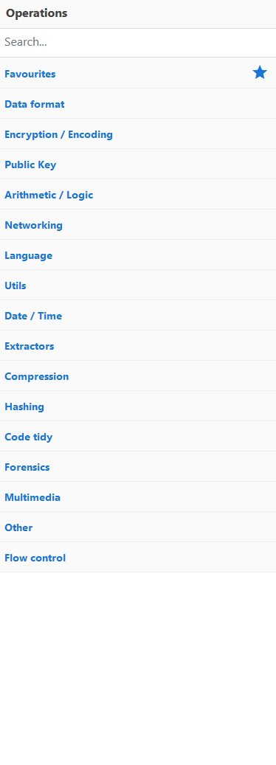

Slide 14
Decrypt these.
hzuvob dzin wlxgli
- .... . / ... . -.-. .-. . - / --- ..-. / --. . - - .. -. --. / .- .... . .- -.. / .. ... / --. . - - .. -. --. / ... - .- .-. - . -.. ..-. .-.. .- --. / -.. -.- ...- -... / -.... .---- ---.. ....-

Slide 15
Cited From
(n.d.). Retrieved from https://gchq.github.io/CyberChef/.

