Slide 1
Presentation II:
Software Tool
Presented by: Andrew Munoz
CS 791 - Software Engineering

Slide 2
Overview
Introduction
What is Balsamiq?
How is it Used?
Interface
Conclusion
Questions

Slide 3
Introduction
Generally speaking, software tools are tools that software developers can use to aid in the development of other software
Software development tools are typically utilized in the implementation and testing phases of the software development life cycle

Slide 4
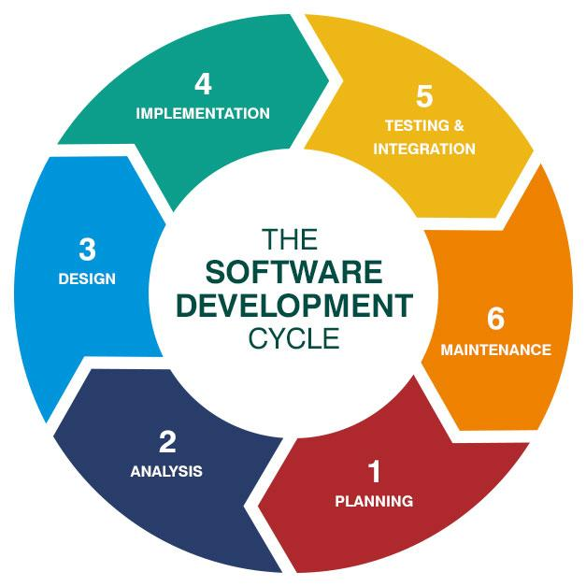
Software Development Life Cycle

Slide 5
What is Balsamiq?
Balsamiq is a wireframe software tool that aids in development of user interfaces
It can be used to sketch interfaces for both websites and mobile applications
There are many design templates that include: Android, iOS, Windows, Google Chrome
These design templates can be found on Wireframes to Go
This tool is designed to be used during the planning phase of the software development life cycle

Slide 6
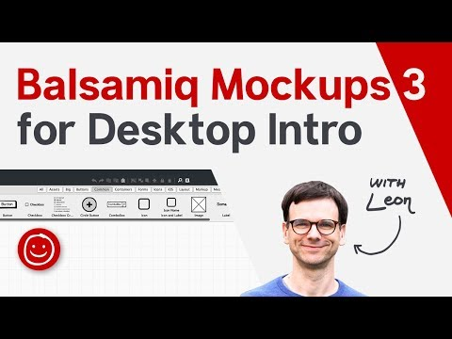
Balsamiq Introduction Video

Slide 7
How is it Used?
Balsamiq wireframe software allows users to create interactive diagrams that can act as a prototype to the application design
It is easy to use and collaborate with others on an interface design
Application is designed for collaboration
There are three versions which include:
Balsamiq Cloud
Balsamiq Desktop
Balsamiq for Google Drive

Slide 8
How is it Used?

Slide 9
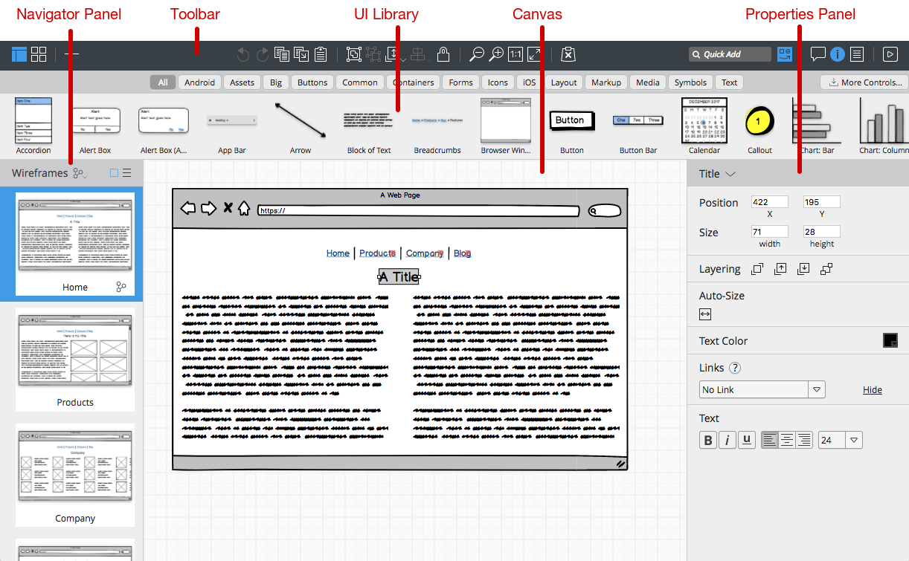
Interface

Slide 10
Conclusion
Introduced the software tool Balsamiq wireframes
Discussed its use, capabilities, and how it can be accessed
Examined example wireframes/balsamiq interface

Slide 11
Thank You! Questions?

