Slide 1
Jenkins Blue Ocean
James Schnebly
CS791 SE
Dr. Dascalu

Slide 2
CI/CD Pipeline Background
A CI/CD pipeline helps you automate steps in your software delivery process, such as initiating code builds, running automated tests, and deploying to a staging or production environment.
Automated pipelines remove manual errors, provide standardized development feedback loops and enable fast product iterations.

Slide 3
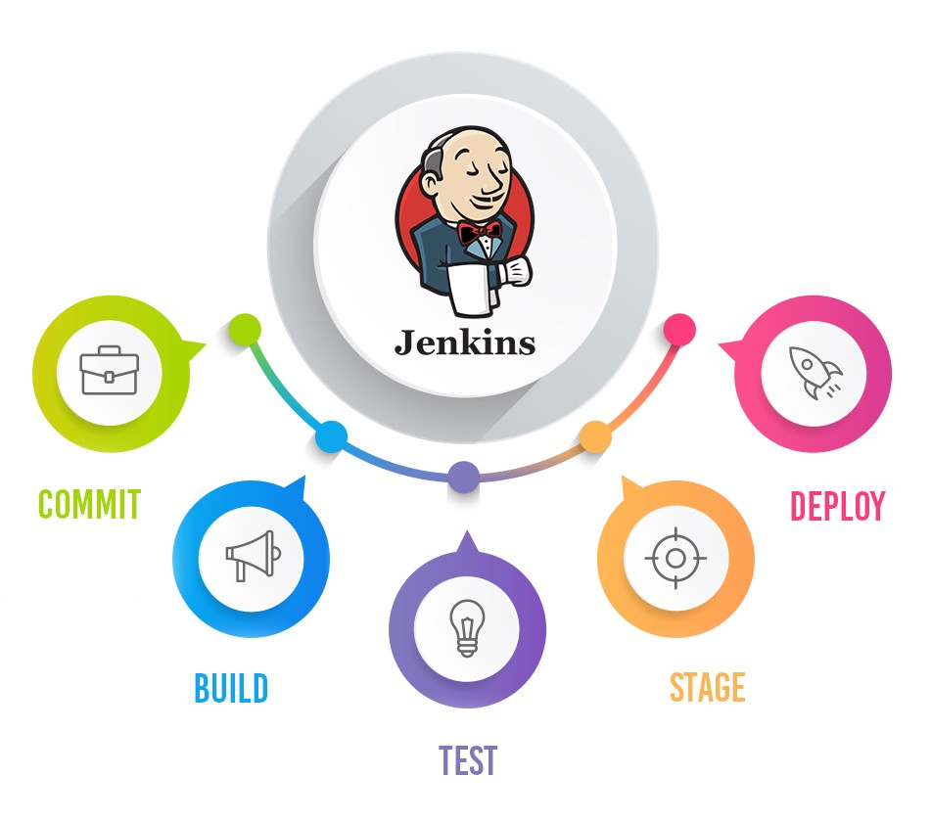
What is Jenkins?
Jenkins is a self-contained, open source automation server which can be used to automate all sorts of tasks related to building, testing, and delivering or deploying software.

Slide 4
Git:Github :: Jenkins:Jenkins Blue Ocean

Slide 5
Important Characteristics (1/3)
Continuous Integration and Continuous Delivery
As an extensible automation server, Jenkins can be used as a simple CI server or turned into the continuous delivery hub for any project.
Easy installation
Jenkins is a self-contained Java-based program, ready to run out-of-the-box, with packages for Windows, Mac OS X and other Unix-like operating systems.

Slide 6
Important Characteristics (2/3)
Easy configuration
Jenkins can be easily set up and configured via its web interface, which includes on-the-fly error checks and built-in help.
Plugins
With hundreds of plugins in the Update Center, Jenkins integrates with practically every tool in the continuous integration and continuous delivery toolchain.

Slide 7
Important Characteristics (3/3)
Extensible
Jenkins can be extended via its plugin architecture, providing nearly infinite possibilities for what Jenkins can do.
Distributed
Jenkins can easily distribute work across multiple machines, helping drive builds, tests and deployments across multiple platforms faster.

Slide 8
Jenkinsfile Parameters
The agent directive, which is required, instructs Jenkins to allocate an executor and workspace for the Pipeline.
The stages directive, and steps directives are also required for a valid Declarative Pipeline as they instruct Jenkins what to execute and in which stage it should be executed.
Stages: {Build, Test, Deploy}
Jenkins has a number of plugins for invoking practically any build tool in general use, but this example will simply invoke make from a shell step (sh).
The sh step assumes the system is Unix/Linux-based
Windows-based systems the bat could be used instead.

Slide 9
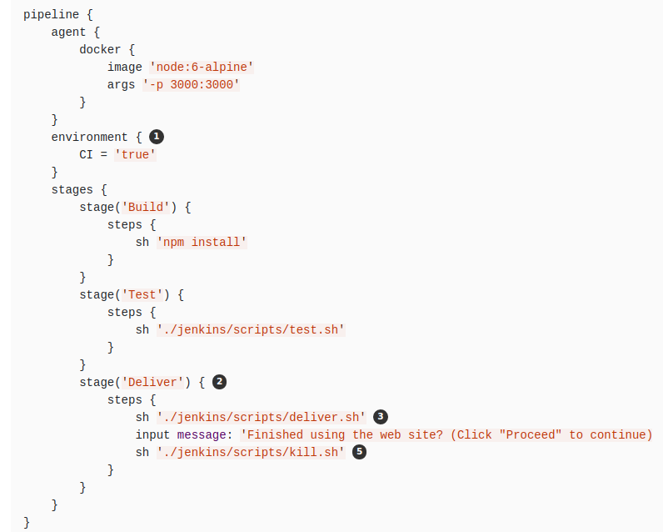
Jenkinsfile

Slide 10
https://youtu.be/k_fVlU1FwP4

Slide 11
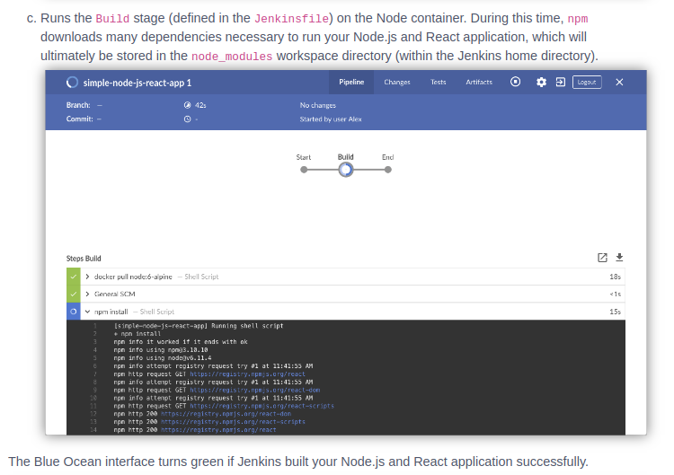

Slide 12
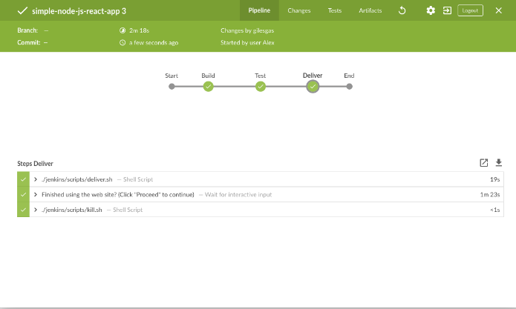

Slide 13
Conclusion
We covered:
Six important characteristics
Jenkinsfiles
Basic Pipeline Configuration for a react.js app

Slide 14
QUESTIONS?

