Slide 1
Software tool — Phabricator
CS 791
presented by Ke Xu

Slide 2
What is Phabricator?
originally developed as an internal tool at Facebook
Phabricator's principal developer is Evan Priestley. Priestley left Facebook to continue Phabricator's development in a new company called Phacility.
“It just brings a wide array of tools together and integrates them tightly”.
a suite of web-based software development collaboration tools
code review
repository browser
bug tracker
…
integrates with Git, Mercurial, and Subversion

Slide 3
Code review
Wiki: Code review (sometimes referred to as peer review) is a software quality assurance activity in which one or several persons check a program mainly by viewing and reading parts of its source code, and they do so after implementation or as an interruption of implementation.
To be short: improve code quality
Code review is a necessary skill, but students are lack of practicing.

Slide 4
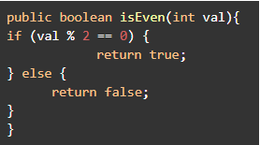
Task: write a function that checks if the given integer is even or odd
“Works, but can be simpler. Also, code format and indentation can be improved.”
“Can be faster using bit operation.”
“Good job! 👍You can ship the diff now.”

Slide 5
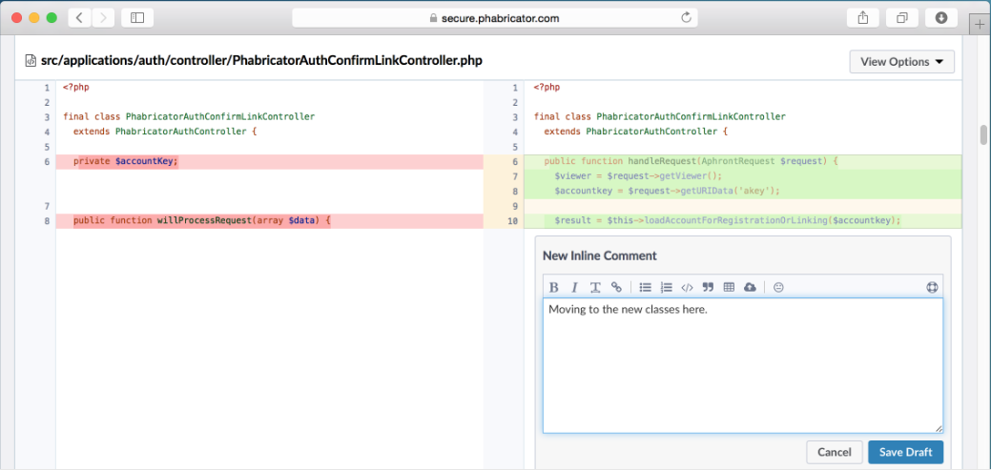
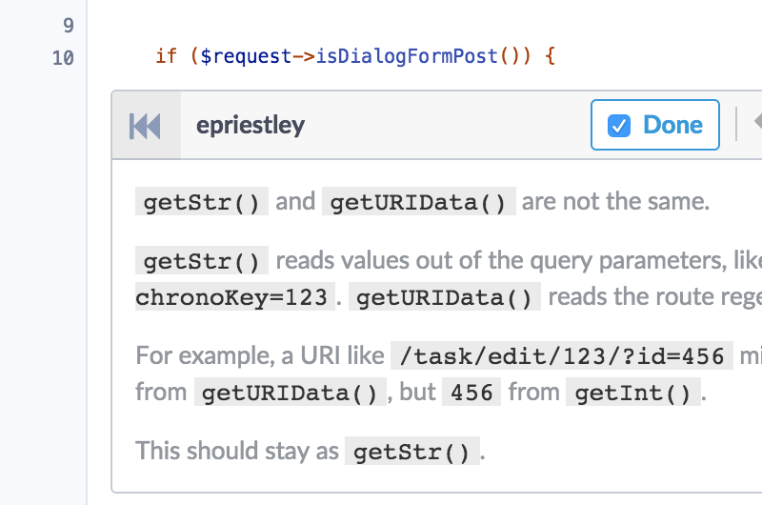
Differential
The tool of Phabricator to review code
Side-by-side code review
Inline comment
Example: https://youtu.be/3e-eaeeIDXk?t=1287

Slide 6
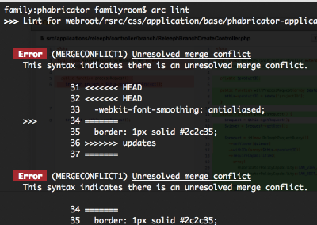
Arcanist
a wrapper script that sits on top of other tools (e.g., Differential, linters, unit test frameworks, Git, Mercurial, and SVN)
provides pretty good command-line access to manage code review and perform some related revision control operations
also can analyze your code, including check your code for syntax and style errors with arc lint

Slide 7
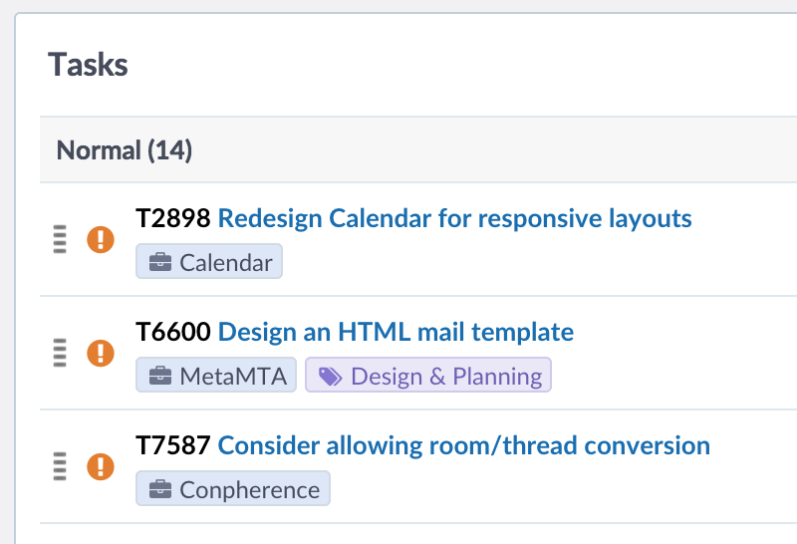
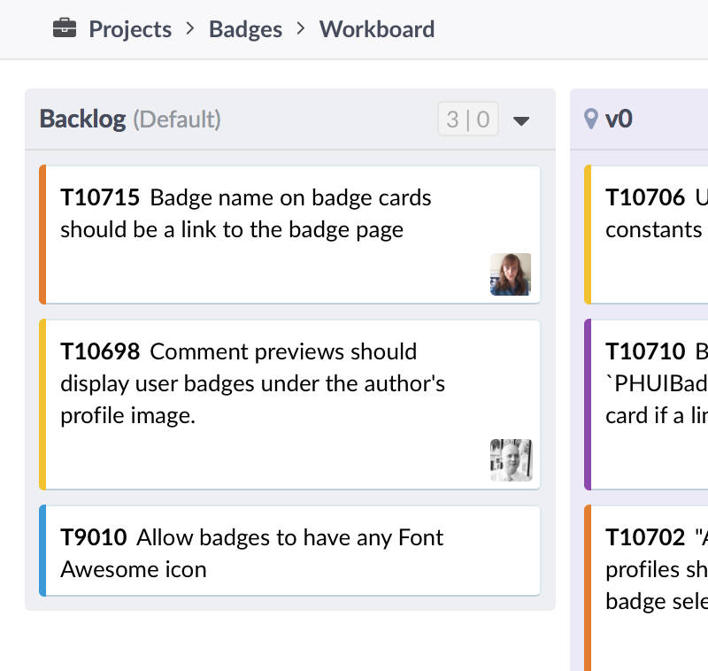
Maniphest
a customizable tool for tracking issues and features throughout your product's development cycle
integrates with other Phabricator applications, from attaching Differential revisions and commits

Slide 8
Takeaway
Phabricator is a suite of web-based software development collaboration tools.
What is code review?
3 Phabricator tools: Differential, Arcanist, and Maniphest.

Slide 9
References
https://www.phacility.com/
https://en.wikipedia.org/wiki/Phabricator
https://en.wikipedia.org/wiki/Code_review
https://youtu.be/3e-eaeeIDXk
https://www.google.com/url?sa=i&source=images&cd=&ved=2ahUKEwig76fK8eXlAhW6GDQIHXx8B6cQjRx6BAgBEAQ&url=http%3A%2F%2Fguides.beanstalkapp.com%2Fcode-review%2Fthe-big-picture.html&psig=AOvVaw34Ss2CgTQAj0Fia1fhSjGR&ust=1573685779700460

