Slide 1
Unity
Software by Unity Technologies
Presentation by Lucas Calabrese
Notes:
Presentation times around 9 minutes.

Slide 2
Unity
Unity is a game engine. It provides useful features. It can be used to make 2D or 3D games.
Current Version: Unity 2019.2.12 [3]

Slide 3
Overview
Have many slides, will try to go through slides quickly.
Pricing
Functionality
Interface
Scripting
Asset Store
Collab
Ease of Use
Ratings

Slide 4
Unity Prices
Personal: Free you or your company must make less than $100,000 profit or funding in the last 12 months . Less features, lower priority customer service than Pro.
Plus: $35 per month. If you or your company makes between $100,000 and $200,000 profit or funding in the last 12 months. One feature is analytics.
Pro: $125 per month. More features including Plus.
https://store.unity.com/#plans-business [7]

Slide 5
Functionality
Physics engine: simulates physics in 2D or 3D. Includes drag (fluid resistance), velocity, collision, mass, etc. Rigidbody components are attached to objects (GameObjects) to do this.
Some useful features: Cloth Simulations: useful for flags, dresses (if they don’t get caught into colliders), parenting, raycasting, some lights for things like sunlight, etc.
Notes:
https://unity3d.com/get-unity/download/archive

Slide 6
Functionality
Scripts: add functionality to objects in the game. For example, you can attach an AI script to an object to make it react to a player when they are nearby.
Too much functionality to go over. Unity provides many useful functions which can be seen in their Documentation: https://docs.unity3d.com/ScriptReference/. (Update(), OnCollisionEnter(), AddForce, Vector3.Distance(), etc. )

Slide 7
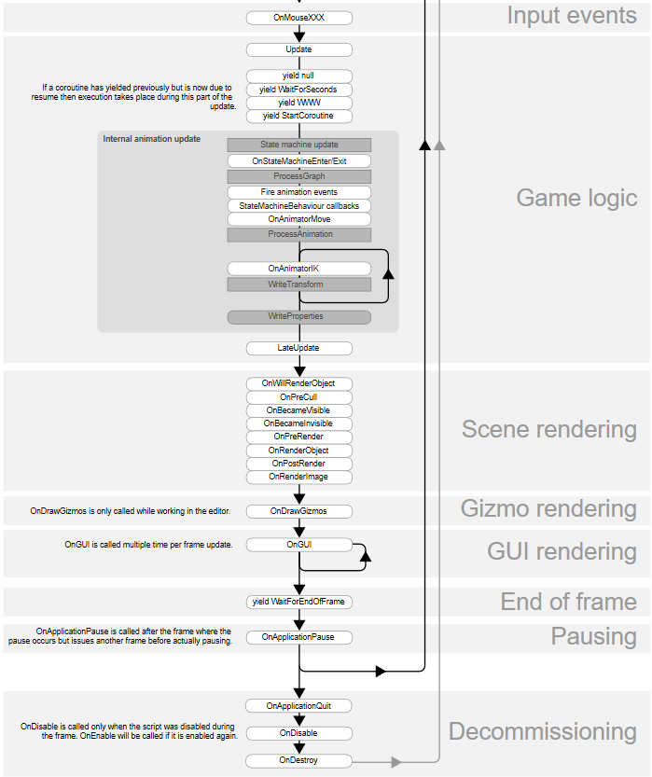
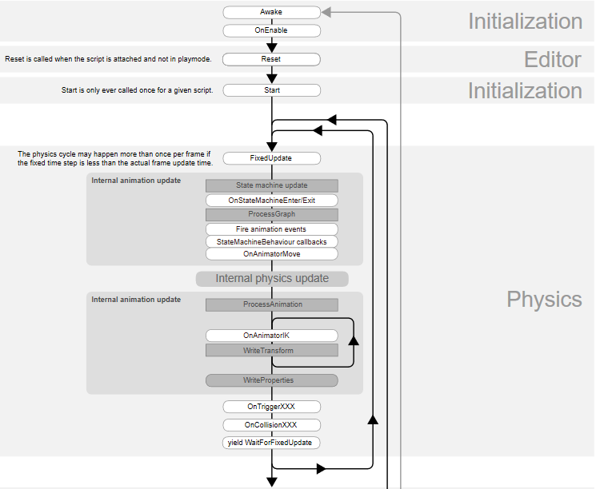
Flow of Events [ ]
https://docs.unity3d.com/Manual/ExecutionOrder.html [7]
Notes:
https://docs.unity3d.com/Manual/ExecutionOrder.html
Start is called
Update is called once per frame

Slide 8
Interface
[2]

Slide 9
Interface
[2]
Notes:
Example of scripts, animation, animation states, and adjustments of public variables at runtime

Slide 10
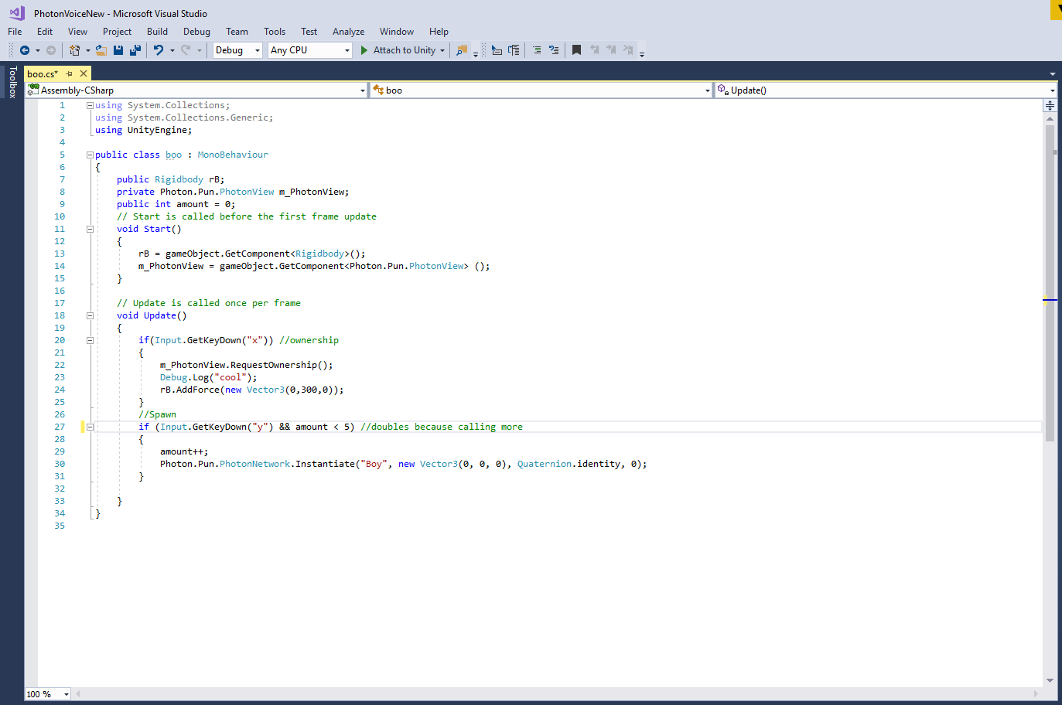
Scripting Example
[5]

Slide 11
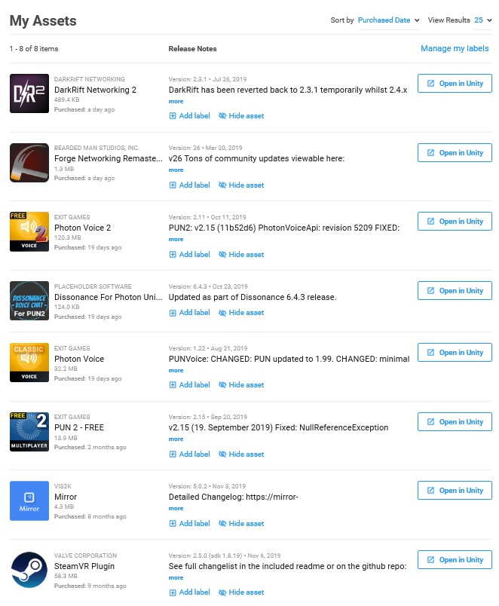
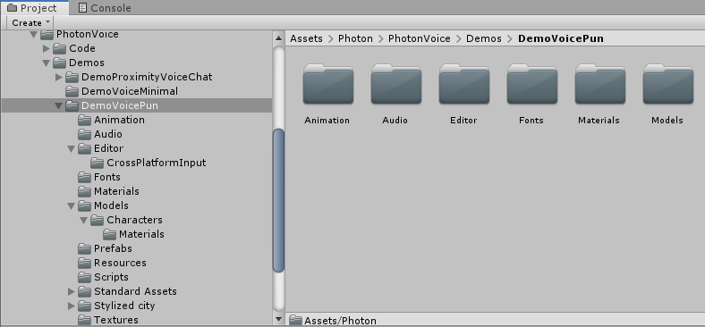
Asset Store
[9] [2]

Slide 12
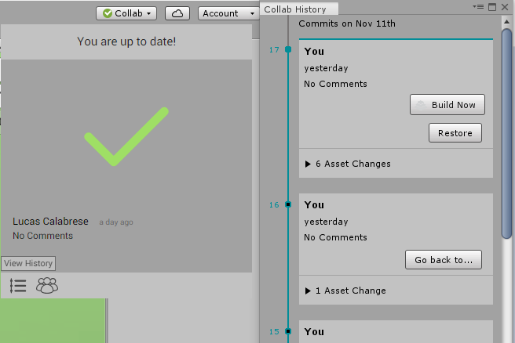
Collab
Won’t go into too much detail
Less functionality than Git, but simple
Upload changes, download them
If conflicts occur choose your or your teammates changes [2]
Go back to previous versions
Different pricing, but free allows 3 people per project [1]

Slide 13
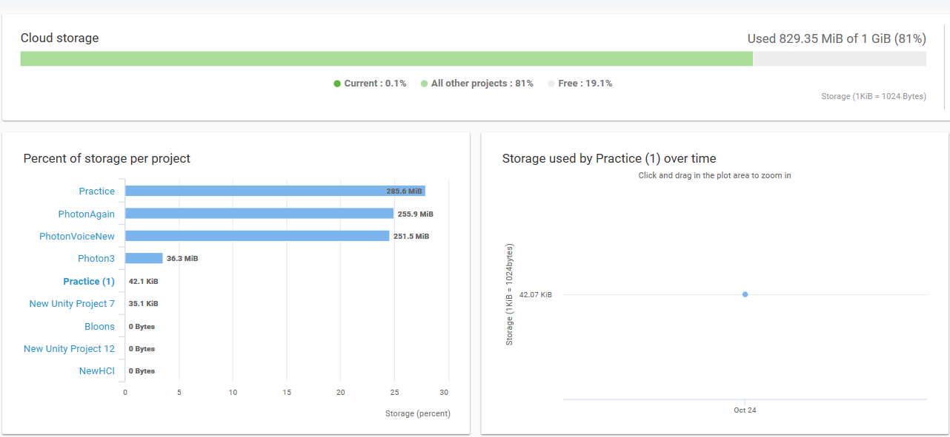
Storage Limit (for free option) [10]
Notes:
Archive them moves them to “cold storage” to free up memory

Slide 14
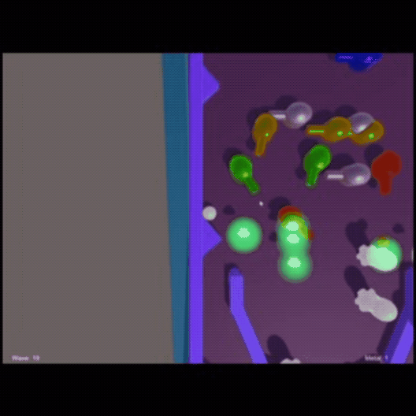
My first Project (≈3 weeks)
Pinball Tower Defence
It took me about 3 weeks to get
a decent feel for how to use Unity.
Worked with art major: Kaeli Giron
Made some decisions with game
that could have been better
(had some bugs).
.gif affected colors

Slide 15
Difficulty in Understanding Unity
I would say it is not too bad to learn how to use Unity.
It can take some getting used to.
But there are plenty of tutorials online to help. There are also forums and Youtube videos.
Roll-a-ball tutorial is a good place to start: https://learn.unity.com/project/roll-a-ball-tutorial

Slide 16
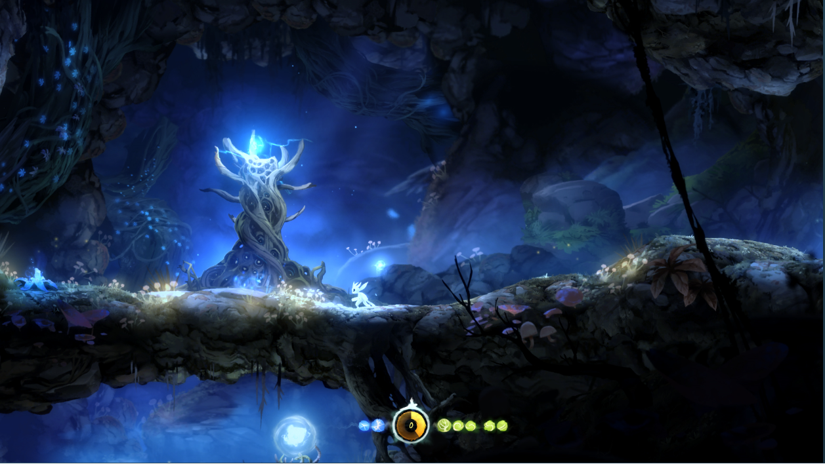
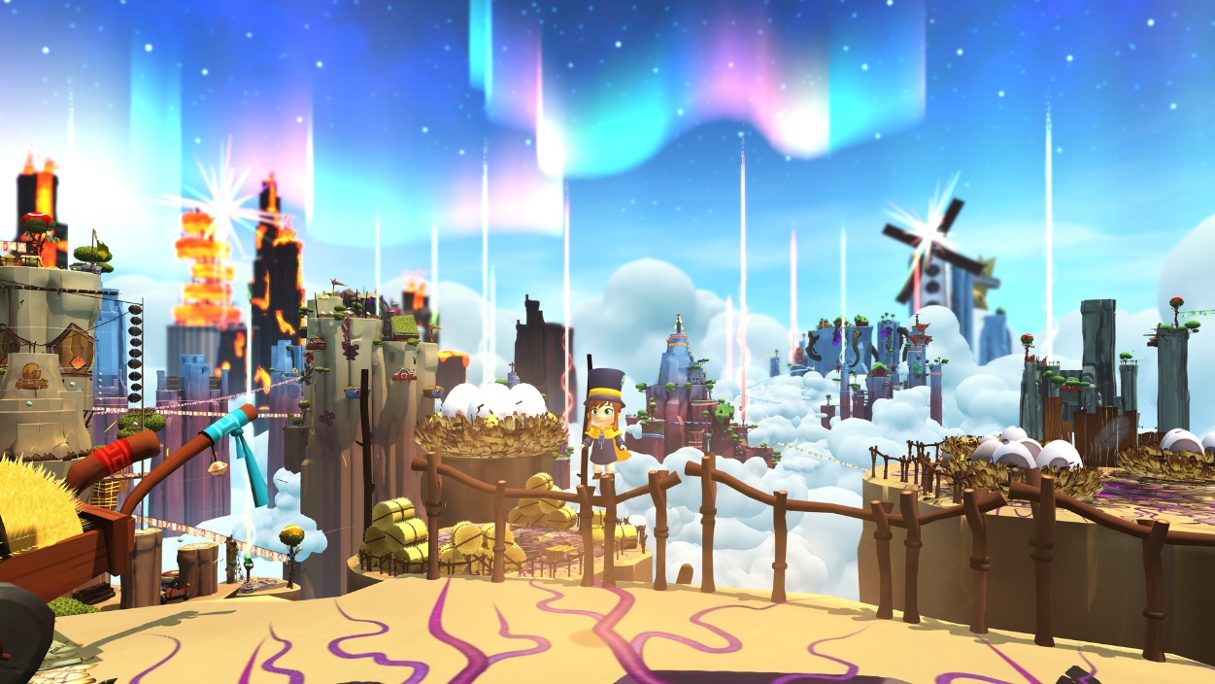
Successful Games made with Unity
Ori and the Blind Forest [4]
A Hat in Time [1]

Slide 17
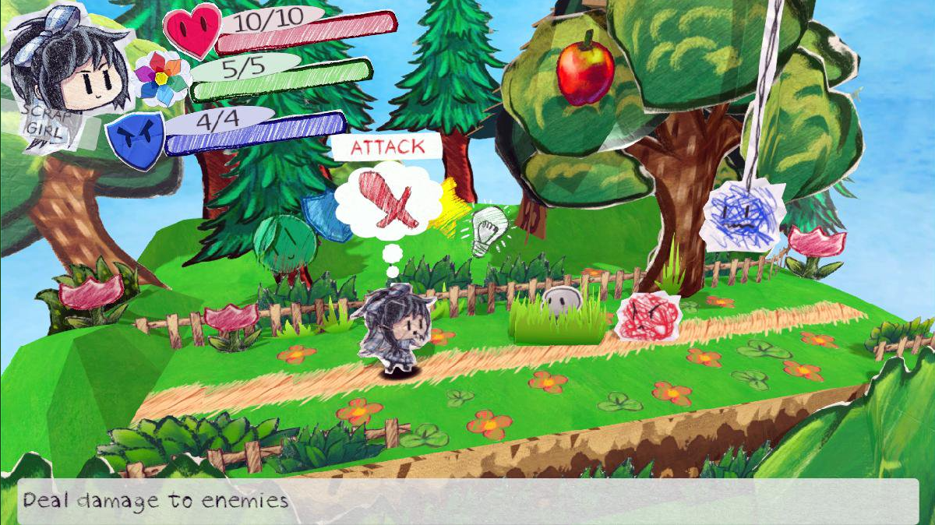
In development Example
https://twitter.com/ScrapPaperDev [6]
Notes:
inspiration from Paper Mario
Unity is democratized.

Slide 18
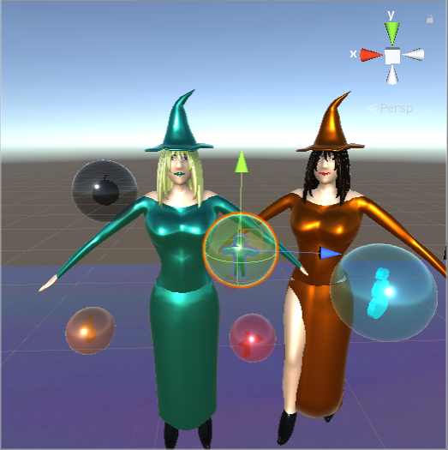
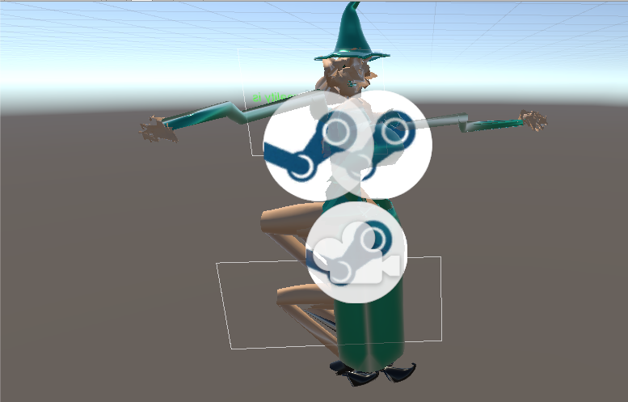
Issues: Weird .blend file issue after Blender 2.8
[2]
Notes:
Sometimes crashing
FBX as other option

Slide 19
Current Personal Ratings
Usability: 5/5
Functionality: 5/5
Efficiency: 4/5
Reliability: 3.8/5
Flexibility: 5/5
Affordability: 4/5
Notes:
Usable in my opinion,
Adds a lot of useful functionality. Working from scratch is too hard
Many platforms to choose from, switch, 3ds, ps4, mobile, pc, mac https://unity3d.com/unity/features/multiplatform
Efficiency: Aside from load times that can sometimes be long it is efficient
Reliability: Sometimes crashes, but okay
Flexibility, has a lot of options for platforms [8]
Affordability: Free is good, other options a little pricey for me

Slide 20
References
[1] A Hat in Time on Steam. (n.d.). Retrieved November 13, 2019, from https://store.steampowered.com/app/253230/A_Hat_in_Time/.
[2] D. Helgason, J. Ante, and N. Francis. Unity - Video Game Engine. Unity Technologies, Unity Technologies, San Francisco, 2019
[3] Get Unity - Download Archive. (n.d.). Retrieved November 13, 2019, from https://unity3d.com/get-unity/download/archive.
[4] Ori and the Blind Forest on Steam. (n.d.). Retrieved November 13, 2019, from https://store.steampowered.com/app/261570/Ori_and_the_Blind_Forest/.
[5] Microsoft. Visual studio, 2019
[6] Story, S. (2019, October 31). Scrap Story (@ScrapPaperDev). Retrieved November 13, 2019, from https://twitter.com/ScrapPaperDev.
[7] Technologies, U. (n.d.). Order of Execution for Event Functions. Retrieved November 13, 2019, from https://docs.unity3d.com/Manual/ExecutionOrder.html.
[8] Technologies, U. (n.d.). 2D, 3D, VR, & AR software for cross-platform development of games and mobile apps. Retrieved November 13, 2019, from https://store.unity.com/#plans-business.
[9] Unity Asset Store - The Best Assets for Game Making. (n.d.). Retrieved November 13, 2019, from https://assetstore.unity.com/.
[10] Unity ID. https://id.unity.com/ Accessed: 2019-11-13
[11] Unity Teams. (n.d.). Retrieved November 13, 2019, from https://unity3d.com/teams?_ga=2.190702827.1544450340.1573465794-106106230.1572853235.

