Slide 1
Project Management Tool
— Notion

Slide 2
Overview
Notion
Project management
Features
My experience
Disadvantage

Slide 3
Notion
Notion Labs Inc.
San Francisco, founded in 2016
All-in-one workspace
Note-taking, project management and task management.

Slide 4
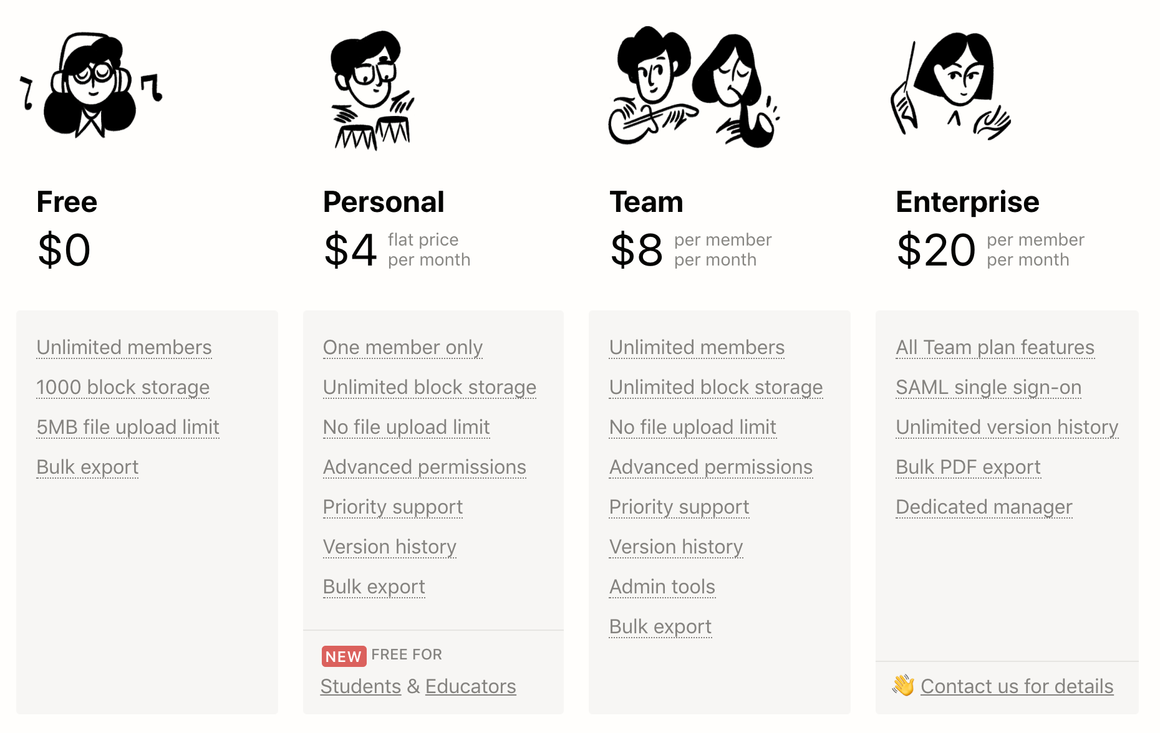
Notion - pricing

Slide 5
Project Management
Project Manager
“Finish this in one month within 10k!“
Engineering
“They don’t need this?”
Customer
“Did I say that!?”

Slide 6
Project Management
Notion
Schedule
Cost
Requirement

Slide 7
Features
Block
Markdown
Database
Template
Import
Notion/product Integration

Slide 8
Project YeeAH
My experience.

Slide 9
What can be done?
More edit options - font, pagination
Preview for export
Formal template - proposal, paper (Ex: Latex)

Slide 10
Thanks!
Any question ?

Slide 11
Links
Notion
Wikipedia — Notion

