Slide 1
Presentation on NetBeans IDE
Tawfiq Chowdhury

Slide 2
What is NetBeans
NetBeans is a Computer Aided Software Engineering tool (CASE). It falls under the category of Integrated Development Environment (IDE). Development in NetBeans is highly modularized, and NetBeans also has a very user-friendly interface. NetBeans is compatible with several operating systems including Windows, Linux, MacOS, Solaris, etc. It is primarily used for Java development and it is one of the most popular coding tools among Java developers. NetBeans also has extensions for C, C++, PHP and HTML5

Slide 3
Background of NetBeans
The NetBeans initially was a student project called Xelfi and the project was initiated by the Faculty of Mathematics and Physics at Charles University in Prague, Czech Republic. A company was formed in 1997 based on the project and developed commercial versions of the IDE till 1999 when the company was bought by Sun Microsystems in 1999. In June 2000, Sun Microsystems open sourced the IDE. In 2010, Oracle Corporations acquired Sun Microsystems. Since then, NetBeans project is managed by the Oracle Corporations.

Slide 4
Versions
NetBeans IDE 6.0 introduced support for developing IDE modules and rich client applications based on the NetBeans platform, a Java Swing GUI builder, improved CVS support
NetBeans IDE 6.5, released in November 2008, extended the existing Java EE features
NetBeans IDE 6.9, released in June 2010, added support for OSGi, Spring Framework 3.0, Java EE dependency injection (JSR-299), Zend Framework for PHP, and easier code navigation
Apache NetBeans 11.2 is the latest version of NetBeans

Slide 5
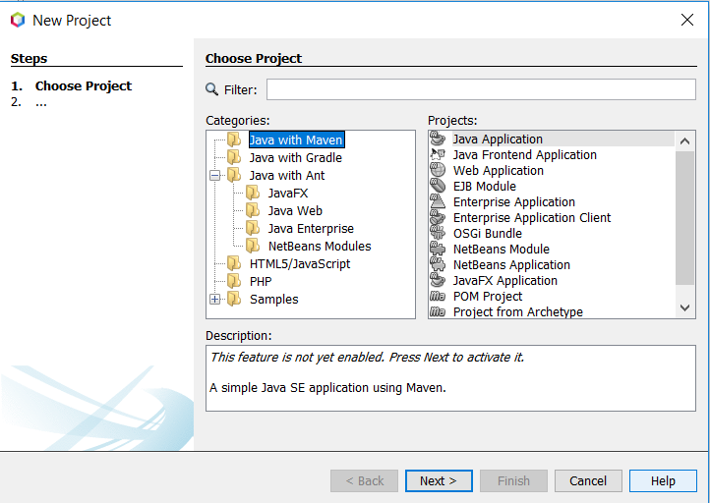
The Interface of NetBeans

Slide 6
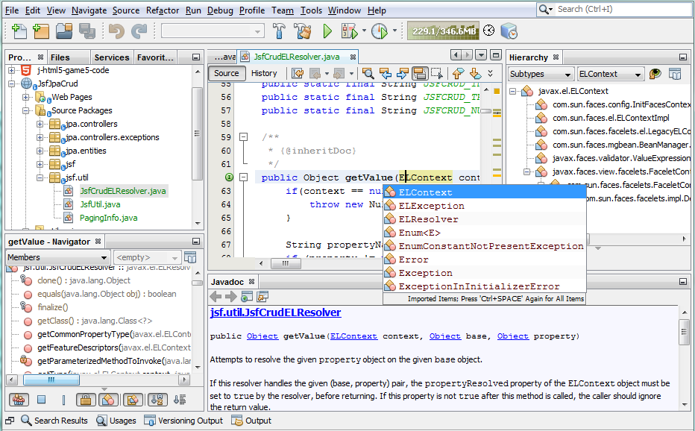
The Interface of NetBeans(Continued)

Slide 7
Key Features
Modularity
Standalone Package
Supports Java Enterprise Editions (EE)
Powerful Swing GUI
Compatible with Multiple Operating Systems

Slide 8
Advantages
Development in Multiple Languages
Free and Open Source
Friendly User Interface
Profiling and Debugging Tools
Extensible Platform
Version control system
Availability of dedicated support

Slide 9
Limitations
Need to separately configure compilers for C++
Takes up more memory than lighter IDEs
Advanced tools and features require some training
NetBeans IDE is a little bit slow to load

Slide 10
My Project using NetBeans GUI
https://www.youtube.com/watch?v=xN___Yp4_4A&feature=youtu.be

Slide 11
References
1. https://en.wikipedia.org/wiki/NetBeans
2. https://netbeans.apache.org/
3. https://netbeans.org/features
4. https://netbeans.org/kb/index.html

