Slide 1
JetBrains MPS
Presented by: Vineeth Rajamohan
Software Tool

Slide 2
Table Of Contents
Introduction
Main Functionality
Characteristics
Advantages
Disadvantages
Evaluations
Personal Suggestions

Slide 3
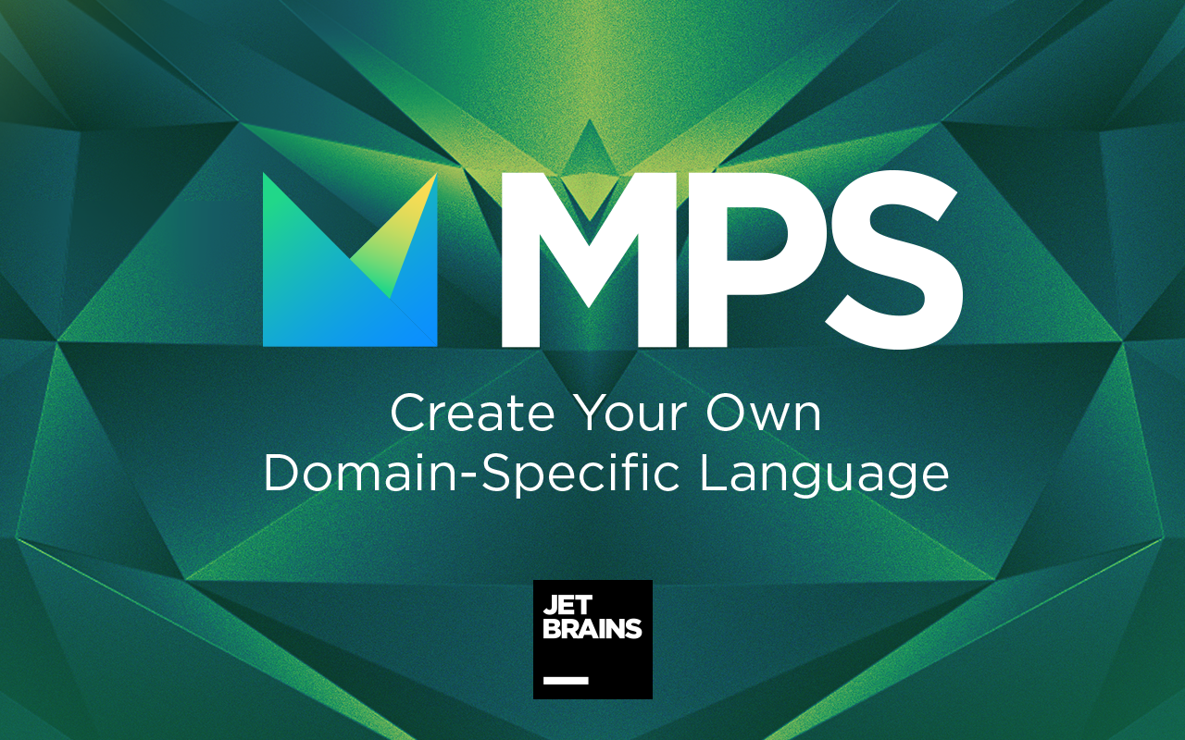
Introduction
JetBrains MPS is a language workbench based on a projectional editor.
Workbench: A software development tool designed to define, reuse and compose domain-specific languages together with their integrated development environment.
JetBrains MPS is used for :
Create one or more DSLs (Domain Specific Languages).
It can also be used to extend an existing language.
For example, Mbeddr is an extension for C that was created to improve embedded programming.
Practical use

Slide 4
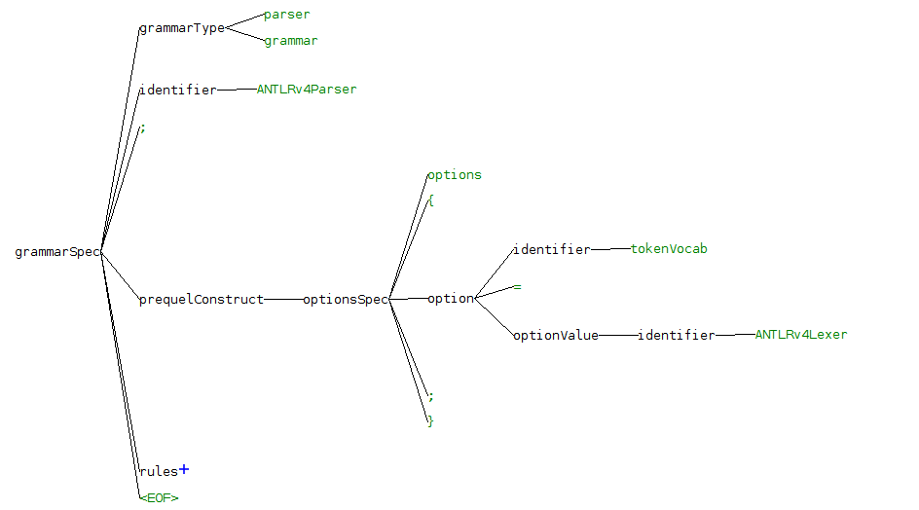
Main Functionality
Preserve the underlying structure of the data.
Traditional Method
compile source code -> transform code into a logical representation -> perform necessary actions
Whereas MPS allows directly work with the logical representation known as an abstract syntax tree (AST).
Advantage: Allows language modularization.
Display data in an easy editable form.
Allows users to visualize the AST in a user-friendly manner.
Advantage: Effective editing.

Slide 5
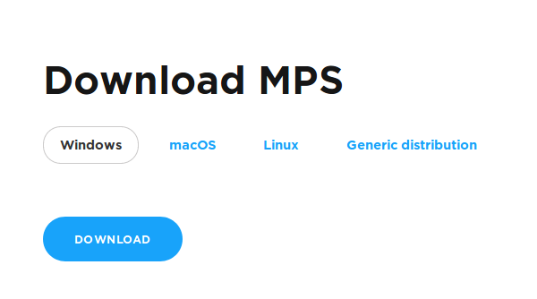
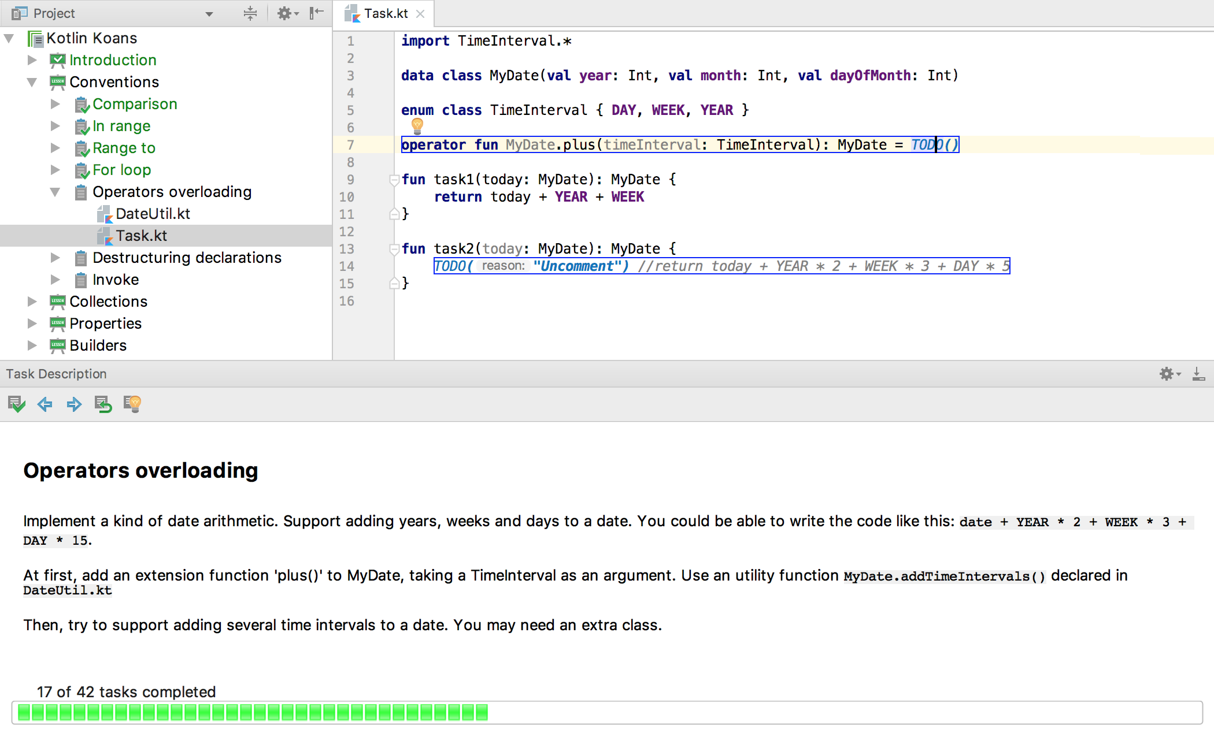
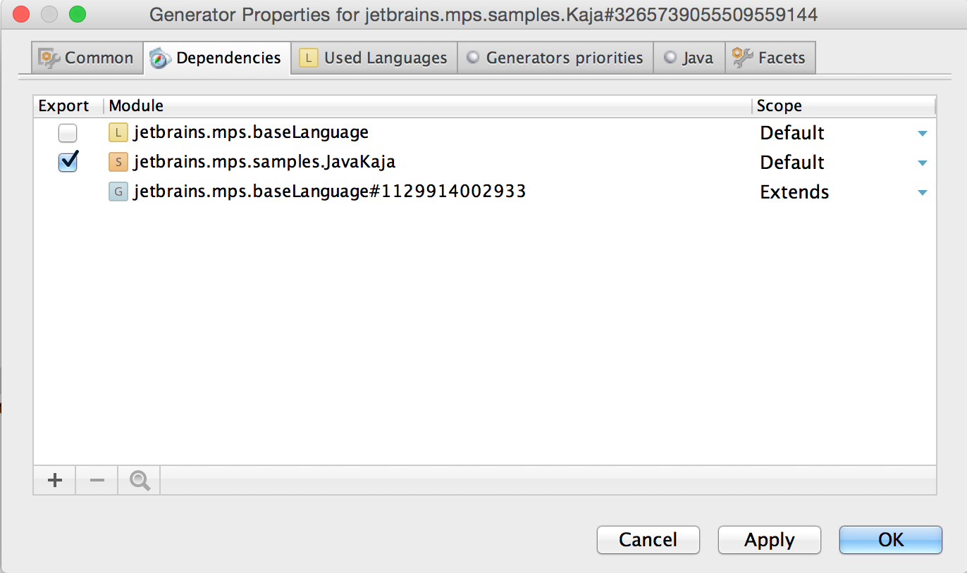
Characteristics
Tool is portable.
Available on MacOS, Windows, Linux, and Generic distribution.
Allows usage of advanced programming languages.
Example is Kotlin an advanced programming language for JVM and android
Tool is very efficient.
Offers powerful graphic facilities in order to describe and document.
Video

Slide 6
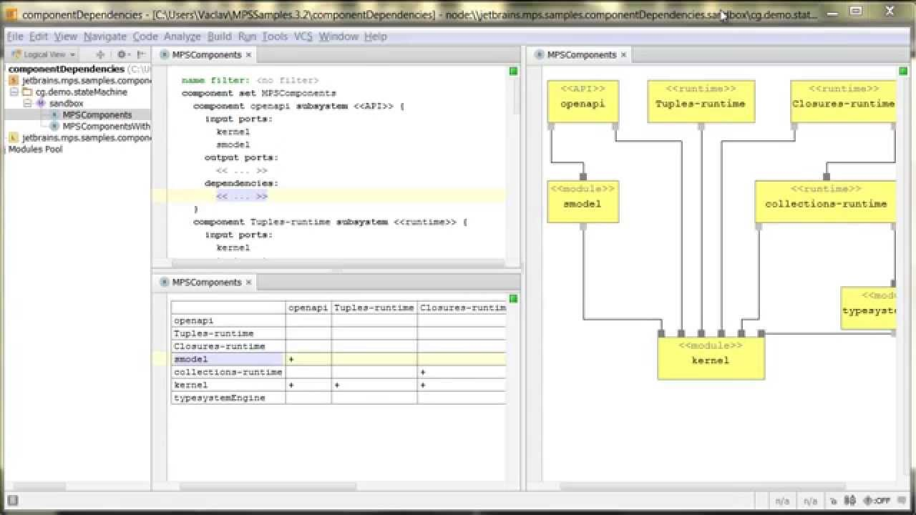
Advantages
Users can create a DSL that allows various forms of input.
Graphical editor, a tabular input or just a normal text.
Useful for non-programmers.
Usually developers are not very familiar with the business aspect.
Graphic facilities allow developers to better understand the business domain.

Slide 7
Disadvantages
Does not allow the users to modify the code in certain ways.
Actions such as copy and paste (one input form to another).
Lacks in providing systematic updates.
Software updates are not consistent.

Slide 8
Evaluation
Criteria proposed by Ramsey [1] An Overview on Current Free and Open Source Desktop GIS ... http://terragis.net/docs/presentations/sstein_foss_desktop_gis_overview.pdf. Accessed 4 Nov. 2019.
Criteria | Rating (out of 5)
Functionalities and features | 4
Documentation | 5
User community | 5
Maintainability | 5
Usability | 4
Licensing | 5

Slide 9
Personal Suggestions
Allow users were to mark a task/node as completed.
Show the list of completed and uncompleted tasks/nodes.
Allow tool to be integrated with other tools such as Overleaf.
Beneficial if the task/node is capable of supporting subtasks/subnodes to help better organize and structure.

Slide 10
Your Questions ?

Slide 11
Thank You !

