Slide 1
Making the Move to Microservice Architecture
Alex Yovev

Slide 2
What?

Slide 3
...the microservice architectural style is an approach to developing a single application as a suite of small services, each running in its own process and communicating with lightweight mechanisms, often an HTTP resource API. These services are built around business capabilities and independently deployable by fully automated deployment machinery. There is a bare minimum of centralized management of these services, which may be written in different programming languages and use different data storage technologies.
— Martin Fowler

Slide 4
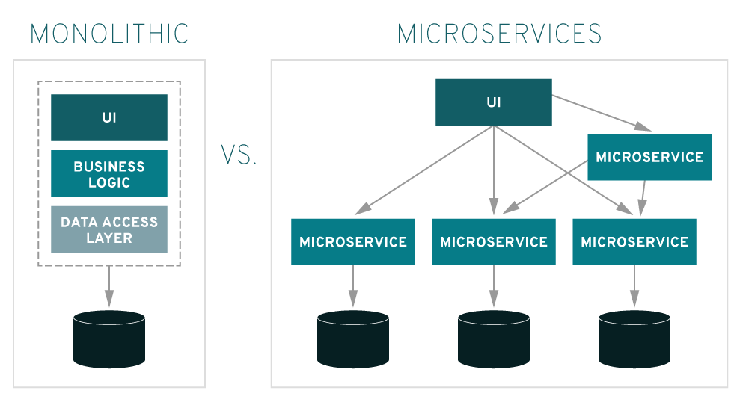
Monolith vs Microservices

Slide 5
Why?

Slide 6
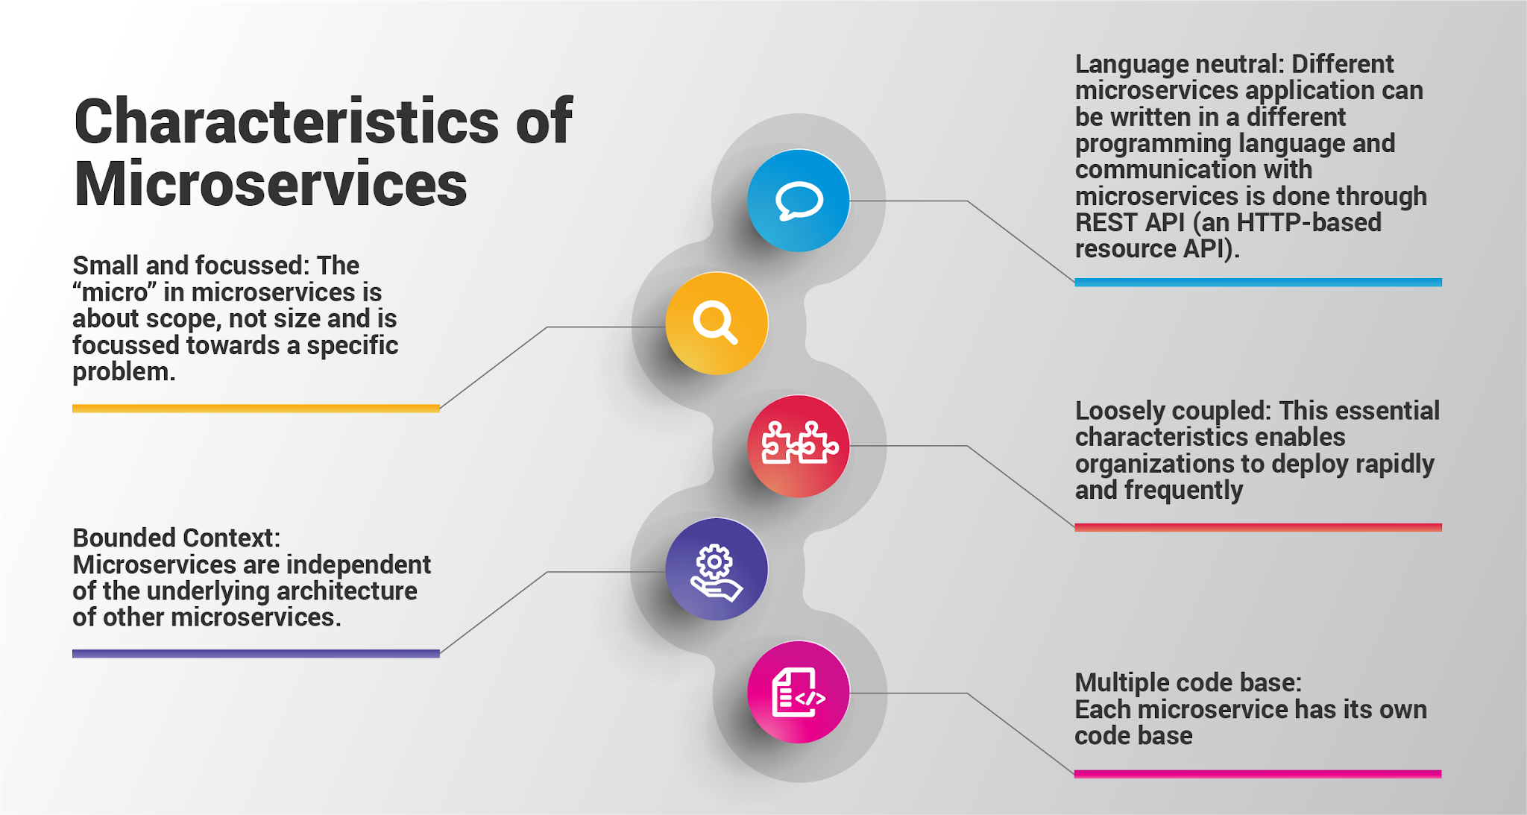
Characteristics of Microservices

Slide 7
How?

Slide 8
Monolith Development Lifecycle

Slide 9
Microservices Development Lifecycle

Slide 10
Result

Slide 11
Microservices @ Netflix

Slide 12
Thank You

