Slide 1
AMOGA: A Static-Dynamic Model Generation Strategy for Mobile Apps Testing
By Ibrahim-Anka Salihu, Rosziati Ibrahim, Bestoun S. Ahmed*, Kamal Z. Zamli, and Asmau Usman
Presented By Andrew Flangas

Slide 2
Outline
Why automated testing for mobile apps?
Model-based testing (MBT)
Dynamic vs. Static approach
Crawling algorithm
AMOGA
How AMOGA compares to other tools

Slide 3
What is mobile app testing
https://youtu.be/mTIdoDEuXrM?t=55

Slide 4
Automated Testing
Mobile devices have been replacing traditional computers
Mobile app developers are exploiting this observation
Testing can be tedious
Automation can alleviate laborious activities that go with testing
Android OS leading with 85.9%
Demand for software engineering techniques and tools to support the analysis and testing task for mobile apps

Slide 5
What is MBT?
Popular approach where model of application is built to derive input automatically
Improvement to conventional scripted testing (scripts and test coverage)
Modeling can be difficult with agile methods
Demand for techniques/tools to aid automated model generation

Slide 6
Dynamic VS. Static Approach…Hybrid?
Application is dynamically analyzed at run-time to gather information
Pure dynamic approach is incomplete (infeasible path exploration, user inputs)
Static is the analysis of bytecode/source code to extract information
The hybrid approach uses static to extract mobile app’s events, dynamic matches the event list of UI element associated with each event to see ordering at run-time.

Slide 7
Crawling Algorithm
Automated model exploration tools use a crawler that require info of the set of app’s UI widgets.
Crawlers typically use a Depth First Search (DFS) algorithm
Breadth First Search (BFS) can provide an improvement over DFS(redundancy)
Both are based on stack data structure
The algorithm that the AMOGA crawler uses is the Dijkstra’s algorithm which is an enhanced form of BFS.
Finds the shortest path to explore UI.

Slide 8
Functionality
Performs four main decisions repeatedly until all events are explored.
First step is selecting next event to explore and fire action on widget
Checks if the next UI is a new state
Checks whether the next event can be reached from current UI
Backtrack if no
Algorithm will fire action if the next event is reachable from current UI

Slide 9
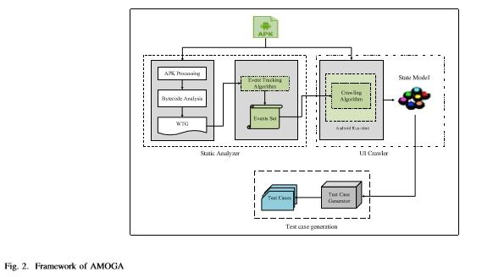
AMOGA
Automated Model Generator for Android Apps
Uses hybrid approach(static and dynamic)
Uses Dijkstra’s algorithm for crawler(BFS)
Tool for automated UI model generation for mobile applications

Slide 10
Other tools
Monkey
AndroidGuitar
SwiftHand
Orbit
MCrawlT
MobiGUITAR

Slide 11
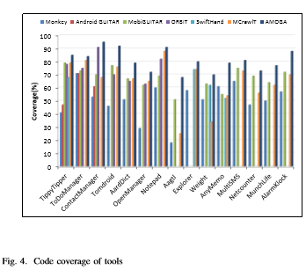
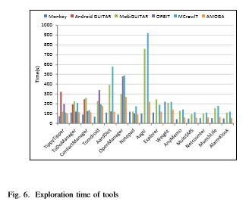
Test Results

Slide 12
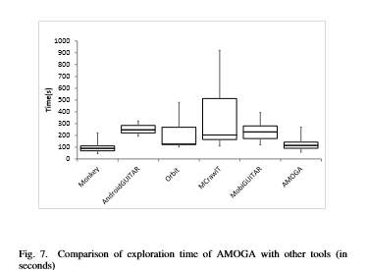
Box Plots

Slide 13
Conclusion
AMOGA is a tool based on hybrid approach for automated UI model generation
Consists of static analyzer and dynamic crawler
Can generate comprehensive model that improves code coverage of app compared to other tools
AMOGA achieved a high mutation score

Slide 14
Questions
Describe both the dynamic and static approach for testing mobile apps.
What is the purpose of a crawler in mobile application testing?
What data structure is the DFS and BFS algorithms based on?

Slide 15
Cited from
I. Salihu, R. Ibrahim, B. S. Ahmed, K. Z. Zamli, and A. Usman. Amoga: A static-dynamic model generation strategy for mobile apps testing. IEEE Access, 7:17158–17173, 2019.

