Slide 1
Big Picture of Big Data Software Engineering: With Example Research Challenges
Paper By: Ryan Hubbard, Aldis Sipolins, and Lin Zhou
Presented By: Andrew Muñoz

Slide 2
Overview
What is Big Data?
Introduction
Context Model of BDSE
Research Challenges
Conclusion
Questions

Slide 3
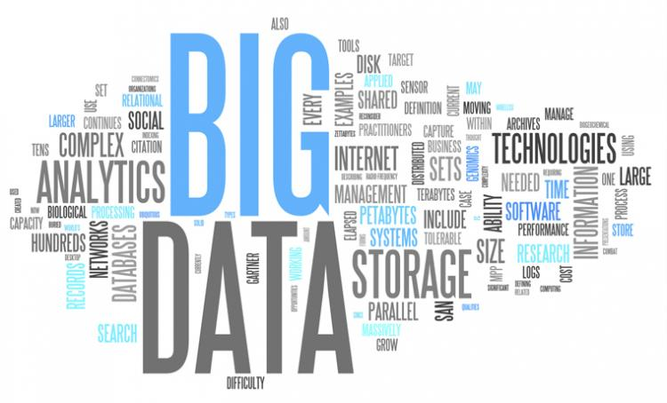
What is Big Data?
To put it simply, big data constitutes large and complex datasets
The term Big Data can refer to both the volume of data as well as the tools and processes used to handle the data
How is Big Data used?
Predictive analysis
Medical/Healthcare
Research
Personal Quantification

Slide 4
Characteristics of Big Data
The 4 V’s of Big Data:
Volume (Size)
Velocity (Speed)
Variety (Forms)
Veracity (Quality)
Notes:
Can also include value and variability

Slide 5
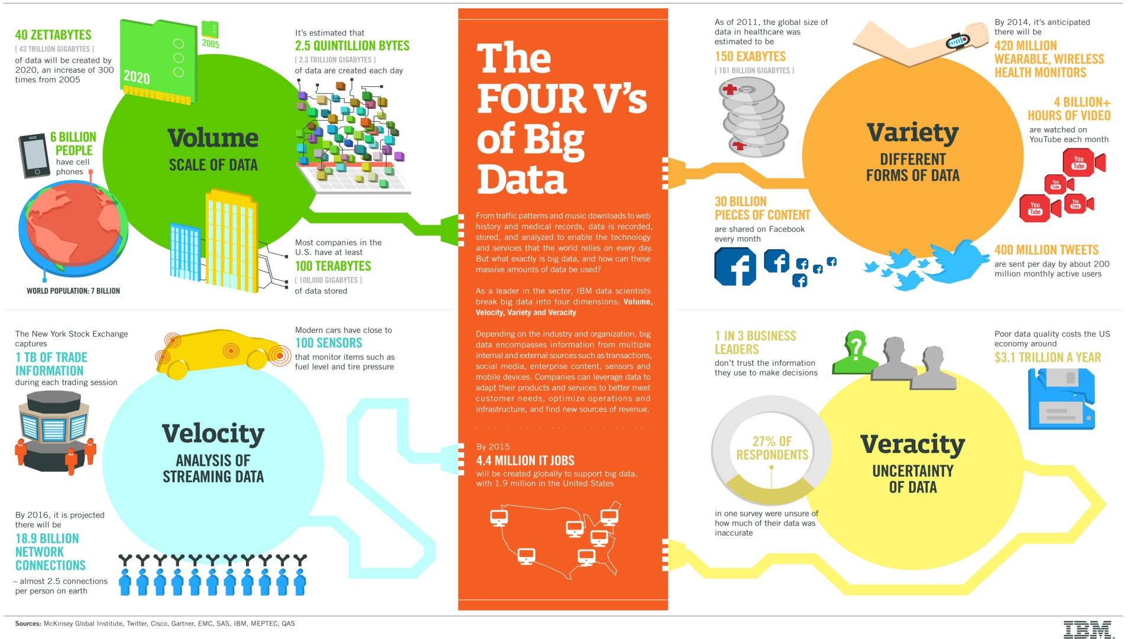
The Four V’s of Big Data

Slide 6
Introduction
Authors note that due to rapid growth of Big Data, many business communities are investing in infrastructure as opposed to applications software development
Approximate ratio 80:20
The main purpose of the paper is to create a context model Big Data Software Engineering (BDSE) to put in perspective where various types of stakeholders fit in

Slide 7
Introduction
BDSE model expected to help in two ways:
Organizational structuring with appropriate agent roles, processes, and relationships
In precipitating research in targeted areas of the Big Data environment
This paper focuses more on the latter due to it being a research study

Slide 8
Context Model of BDSE

Slide 9
Context Model of BDSE
The model shows that developed systems and services are deployed in the context of use (e.g., a financial sector)
Never-ending amount of data is processed to yield value to the stakeholders
However, requirements for building end-user applications must come, in large measure, from stakeholder input
Otherwise a system (a) may not have desirable usability qualities and (b) when used may not yield desirable business or stakeholder value
It is assumed that customer and end-users are part of the BDSE “blob”

Slide 10
Research Challenges
This purpose of the paper is to raise awareness and does not offer solutions to the challenges and problems
There are three research challenges included in the paper:
Requirements Engineering (RE)
Reference Architectures
Testing and Maintenance

Slide 11
Requirements Engineering (RE)
Big Data Characteristics:
RE for Big Data is still an emerging area
Clearer understanding is needed to separate requirements for infrastructures, tools, and end-user applications
Multi-Peak Processes:
Include technologies such as granular computing, cloud computing, etc. which have a lot of capabilities for processing information
Enables requirements engineers to elicit requirements more compatible with end-user applications
That allows for more abstract requirements which requires closer agile cooperation

Slide 12
Reference Architectures
Currently, there is limited work done on the investigation of reference architectures and patterns for Big Data analytics applications and on how these reference architectures can be reified into concrete architectures and deployments
Large organizations such as IBM and Microsoft have started some research on the issue but there is still work to be done
Another issue that needs further work is determining techniques to asses the impact of design decisions on functional and non functional requirements

Slide 13
Testing and Maintenance
Big Data Systems (BDS) are complex solutions with many components
To validate changes to system, the test system needs to be identical to the production system
Research Question: How to build a representative test system using hardware and software resources that account for a fraction of the BDS production system?

Slide 14
Testing and Maintenance
Scaling Down Resources (Volume and Velocity)
How to scale down the resources to produce realistic test BDS system?
Need to reduce the amount of storage and computational resources
Scaling Data Representatively (Variety)
How to scale data representatively?
Need to ensure that data representation in test maintains same meaning as in production
Workload Capture-Replay (Volume and Velocity)
How to capture workload on a production BDS and replay it on a test BDS?
Notes:
Scaling Data - Note: While there exist tools for generating subsets of structured data, there has been no work to generate subsets of unstructured data

Slide 15
Conclusion
Analysis shows a bias that favors infrastructure over applications development with an approximate ratio of 80:20
This bias created a gap in understanding how various elements in Big Data fit together, which lead to creation of BDSE model
Model is general observations made by authors
Discussed some research challenges in BDSE that still need to be addressed

Slide 16
Questions
What are two challenges in the field of Big Data?
What could considered Big Data SE practices as shown in the BDSE context model?
Is there any way that the BDSE model could be improved?

Slide 17
Thank you! Questions?

