Slide 1
What Do We (Really)
Know about Test-Driven
Development?
Paper by: Itir Karac and Burak Turhan
CS 791
James Schnebly
8/7/19

Slide 2
Test-Driven Development
Test-Driven Development (TDD) is one of the most controversial agile practices in terms of software quality and programmer productivity
When TDD first came out, it promised better quality, productivity, and cleaner design coming with a growing test suite
“TDD is a way of writing code in which you write tests before you write code.”

Slide 3
TDD Workflow
1. You start by identifying the increment of functionality that is required. This should normally be small and implementable in a few lines of code.
2. You write a test for this functionality and implement it as an automated test. This means that the test can be executed and will report whether or not it has passed or failed.
3. You then run the test, along with all other tests that have been implemented. Initially, you have not implemented the functionality so the new test will fail. This is deliberate as it shows that the test adds something to the test set.
4. You then implement the functionality and re-run the test. This may involve refactoring existing code to improve it and add new code to what’s already there.
5. Once all tests run successfully, you move on to implementing the next chunk of functionality

Slide 4
TDD Workflow (II)

Slide 5
15 Years of (Contradictory) Evidence
In 2003, Kent Beck posed a claim based on anecdotal evidence and paved the way for software engineering researchers:
“No studies have categorically demonstrated the difference between TDD and any of the many alternatives in quality, productivity, or fun. However, the anecdotal evidence is overwhelming, and the secondary effects are unmistakable.”
Since then many have attempted to conduct studies but not one contains conclusive results

Slide 6
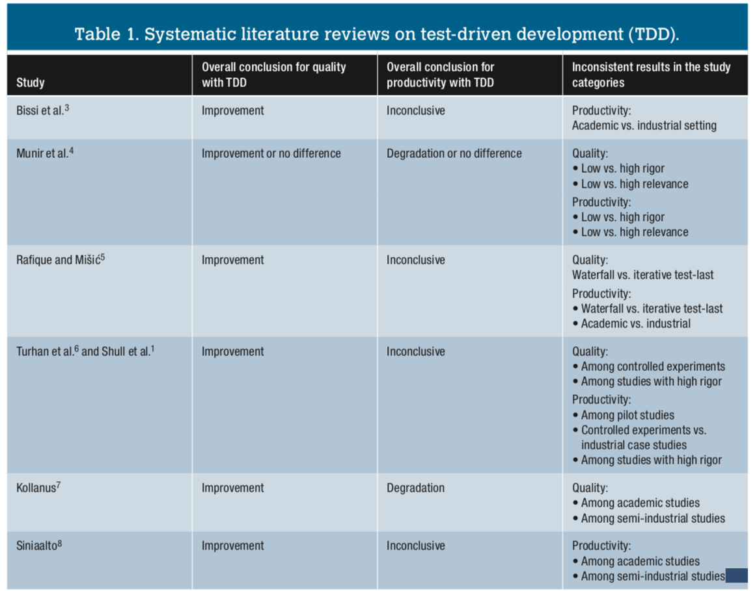

Slide 7
Why Inconsistent Results?
TDD has too many cogs
Its effectiveness is highly influenced by the context (for example, the tasks at hand or skills of individuals)
The cogs highly interact with each other
“...most of the experiments employed a coarse-grained test-last process closer to the waterfall approach as a control group”

Slide 8
Industry Adoption (or Lack Thereof)
In a study done on 416 developers’ code on github, only 12% of projects that claimed to use TDD actually adhered to the TDD protocol
The biggest reasons for this lack of adoption are a lack of TDD protocol knowledge in programers and insufficient testing skills
Similarly, a recent study analyzed a September 2015 snapshot of all the (Java) projects in GitHub. Using heuristics for identifying TDD-like repositories, the researchers found that only 0.8 percent of the projects adhered to TDD protocol

Slide 9
Why?
Adnan Causevic and his colleagues identified seven factors limiting TDD’s use in the industry:
increased development time (productivity hits)
insufficient knowledge
insufficient skills
insufficient protocol usage/TDD experience or design
Insufficient developer testing adherence to TDD
domain and tool-specific limitations
legacy code.

Slide 10
What Really Makes TDD Tick?
A recent study of 39 professionals reported that a steady rhythm of short development cycles was the primary reason for improved quality and productivity
The effect of test-first completely diminished when the effects of short and steady cycles were considered
Basically, working on small, well-defined tasks in short, steady development cycles has a more positive impact on quality and productivity than the order of test implementation

Slide 11
Conclusion
The author states, “There’s no convincing evidence that TDD consistently fares better than any other development method, at least those methods that are iterative.”
He says the key to using TDD is in the context of the problem
It makes sense to use TDD in specific situations (small/short tasks) rather than either always adhering to or never using TDD
He ends the paper saying if you think TDD allows you to prevent taking shortcuts and produces better code without sacrificing productivity, go for it
If you can write quality code without following TDD protocol, do that

Slide 12
Questions
According to the author,
What are two reasons for the lack of industrial adoption of TDD?
When should you use TDD?
What did TDD promise when it initially came out?

